Slide 1
Fundamentals of Infrastructure Security
SEC290 - Final Project
January 2025 Session
Nicholas J. Allen
BS in Computer Information Systems
DeVry University – Illinois
Professor Mansi Thakar
February 25, 2025

Slide 2
Table of Contents
Introduction
Module 1: Manual Vulnerability Analysis
Module 2: Intrusion Analysis Using Wireshark
Module 3: Open SSL
Module 4: Snort
Module 5: Live Memory Analysis
Module 6: Firewall
Challenges In The Project
Career Skills Obtained
Conclusion
References

Slide 3
Introduction
SEC-290, Fundamentals of Infrastructure Security, touched on several topics and tools surrounding threats, risks, and vulnerabilities.
Course Objectives
** Taken from the course Syllabus **
Describe risks to the CIA Triad and security controls for networks and endpoints.
Utilize threat intelligence to support organizational security.
Perform vulnerability scans and analyze the scan reports.
Explain threats and vulnerabilities associated with operating in the cloud.
Explore security solutions for infrastructure management.
Explain software and hardware assurance best practices.
Analyze security monitoring data.
Examine four phases of the incident response process.
Evaluate techniques used to identify, assess, and manage risks.
Define elements of the cybersecurity policy framework.
Explore the evolving job market in the digitized world.
Produce a secure network.
Module 7

Slide 4
Module 1: Manual Vulnerability Analysis
During Module 1, we learned about Nmap and Windows Vulnerabilities like MS08-067 and MS17-010.
Used nmap to scan the Virtual Machines to locate IP addresses and open ports.
Used metasploit to expoit MS08-067 and MS17-010 vulnerabilities in our Windows VM.
Module 1

Slide 5
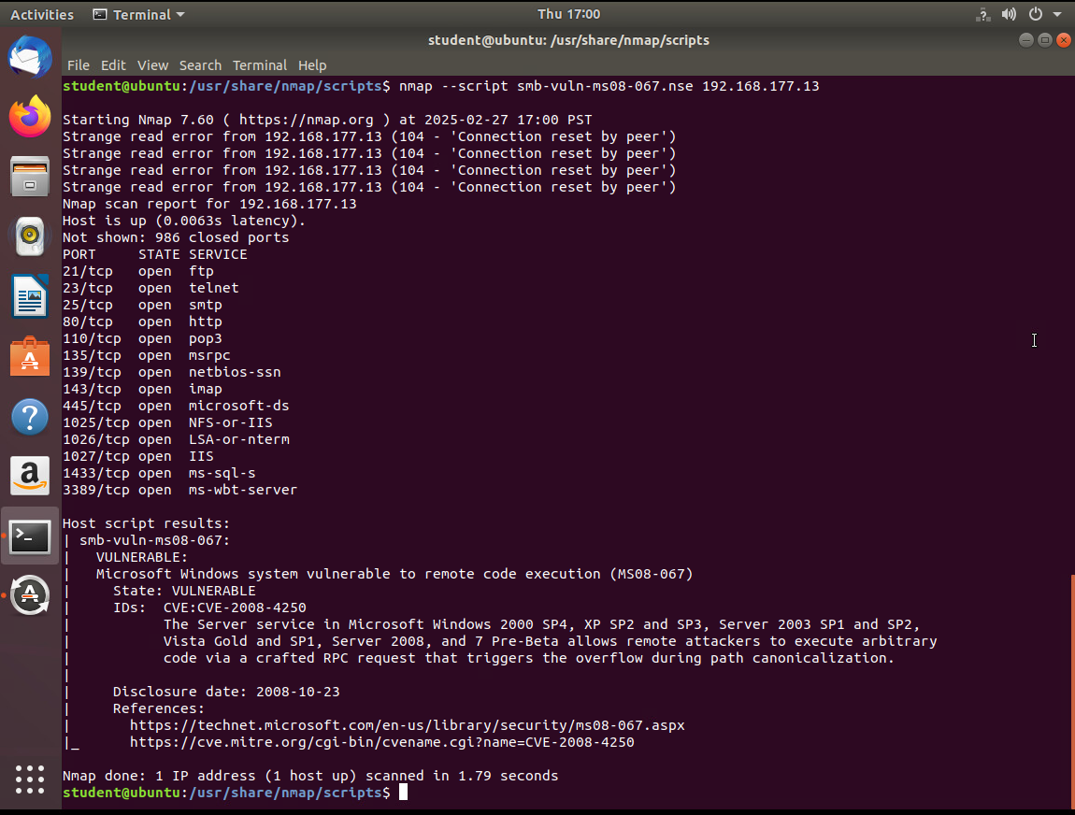
MS Windows Bulliten MS08-067 Vulnerability
Take a screenshot of the output of Part 3, Step 2. It should show that a vulnerability exists on the test VM.
Module 1

Slide 6
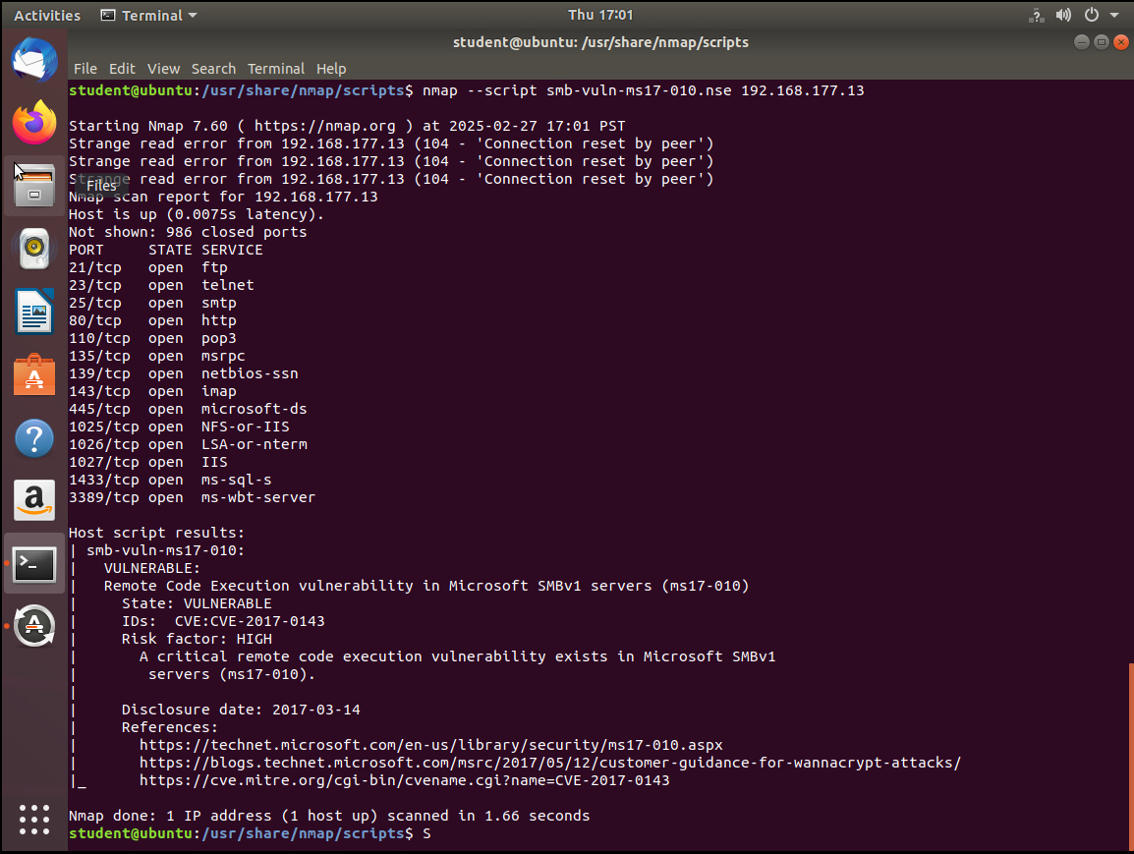
MS Windows Bulliten MS17-010 Vulnerability
Take a screenshot of the output of nmap command in Part 4. It should show that a vulnerability exists on the test VM.
Module 1

Slide 7
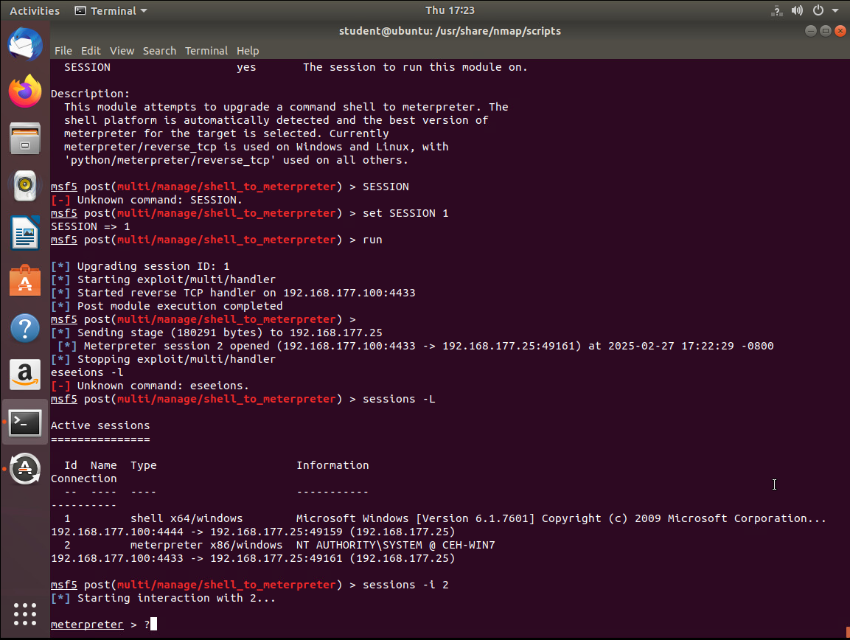
Meterpreter Session Command Output
Take a screenshot of the output of meterpreter session command in Part 5, Step 19 or 20.
Module 1

Slide 8
Module 2: Intrusion Analysis using Wireshark
In Module 2, we used Wireshark to analyze network traffic and packets.
Examined ICMP packets
Examined TCP and HTTP traffic
Examined 3-way handshake
Module 2

Slide 9
Basic Attack Analysis
Look at captures no. 20 and 22. (You can use the “Go” link at the top of the Wireshark screen to quickly go to a specific capture) Both packets are ICMP traffic but there are subtle differences between them. Compare the time-to-live and data field sizes in the two packets. What differences do you see?
Some differences I find between capture 20 and 22 are:
20 and 22 share an initial time to live of 64, meaning they are running a variation of Linux
20 is a Type 8 Ping request, 22 is a Type 0 Ping reply
These both have different Source and Destination IP addresses
20 has a Data length of 56 bytes while 22 has a Data length of 48 bytes.
20 requested a response from frame 21, 22 responded to a request from frame 21
22 contains a response time, timestamp, and total time to run
Do a little Internet research to discover which operating systems use the specific values in their ping commands. What operating system generated the echo request in capture 20?
According to Google’s AI search assistant and the article titled How To Identify Operating System Using TTL Value and Ping Command from OSTECHNIX.com, the operating system that is responding to the Ping request can be determined by looking at the initial Time To Live (TTL) value (Ostechnix, 2024). Linux has a lower initial TTL value of 64 while modern versions of Microsoft Windows operating system have an initial TTL value of 128 (Ostechnix, 2024). Knowing this, and seeing capture 20 has a TTL of 64, I can say that the echo request in 20 was made by a Linux system.
Module 2

Slide 10
Basic Attack Analysis (Cont.)
Review packet no. 37 and beyond, what do you think is taking place here?
After reviewing TCP flags and their meanings from an article on LinkedIn titled Understanding the Significance of TCP Flags in Network Communication to get the same lesson from a different perspective and take in any new information presented to me (Nalupurakkal, 2024). It appears to me that at capture 37 we start capturing packets during a nmap, or other network, scan. I determined this because each request/reply is coming or going from the same 2 IP addresses, the computer being scanned at 192.168.25.1 and the computer doing the scanning at 192.168.25.200. After realizing this was just 2 computers, I noticed that each port is being probed with a SYN command and being responded to with an acknowledgment (ACK) and rejection, or reset (RST).
Look at capture 22846. What is suspicious about the flag settings in this packet?
22846 seems to be closing a connection (FIN) from source port 34601 to destination port 1488.
What is the IP address of the host being targeted?
The target, or destination, IP address for capture 22846 is 192.168.25.1 and the attacker, or source, IP address is 192.168.25.200
Module 2

Slide 11
Module 3: OpenSSL
Module 3 seen OpenSSL self-signed certificate and server
Created SSL Certificate using OpenSSL
Used OpenSSL to create a SSL/TLS server
Used Wireshark to view traffic
Forced a lower version of TLS to the server to complete a 3-way handshake
Used Wireshark to decrypt the SSL stream
Module 3

Slide 12
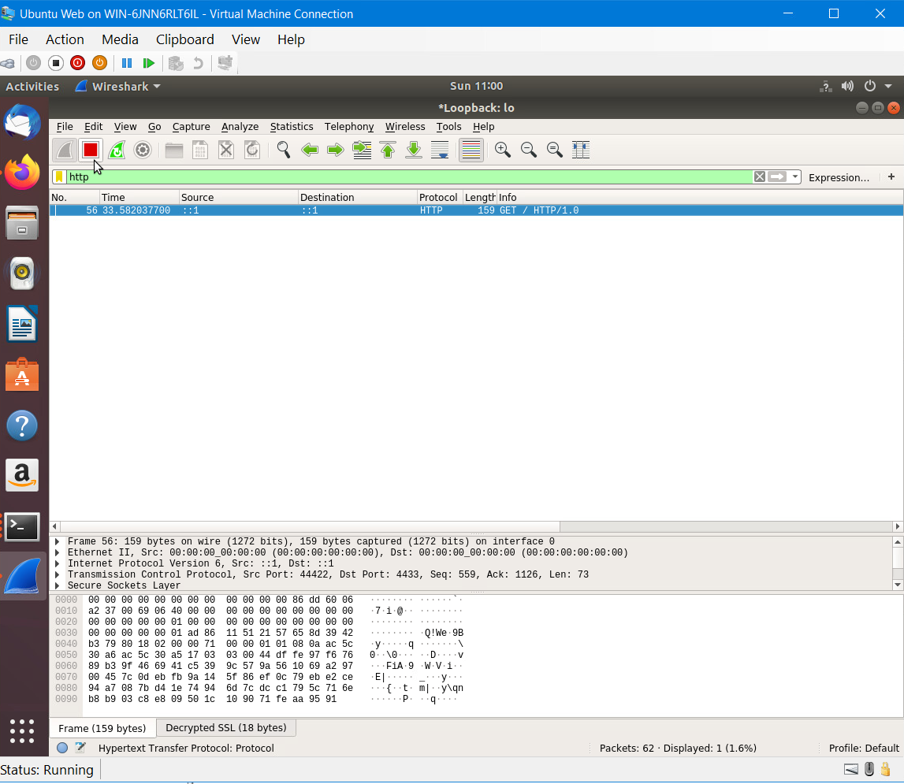
Creating and testing an SSL/TLS file
Take a screenshot of the output in Step 17. It should show the GET request in the Info column.
Module 3

Slide 13
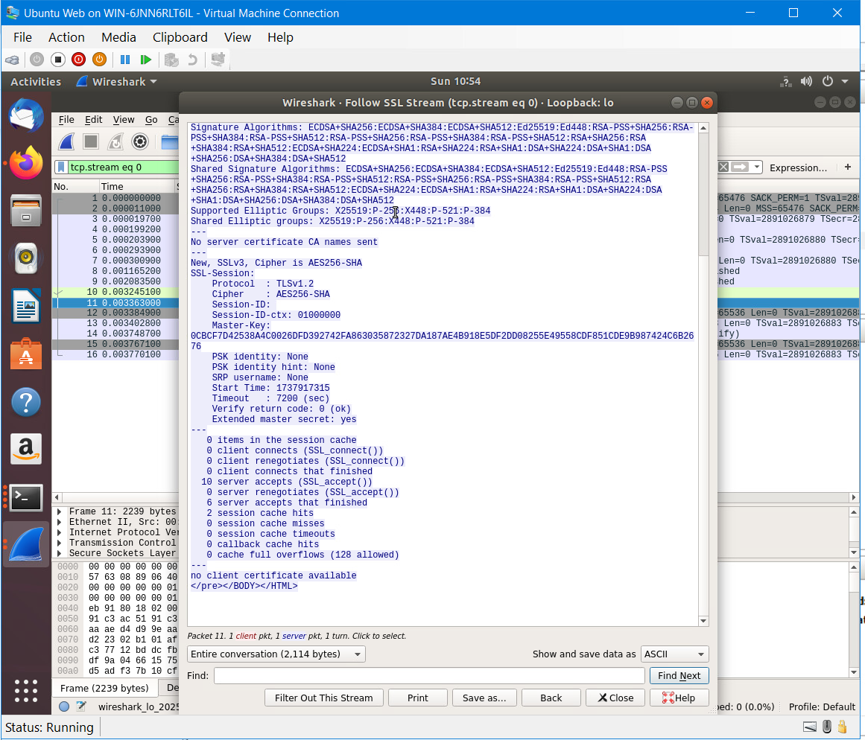
Creating and testing an SSL/TLS file (Cont.)
Take a screenshot of the output in Step 20. It should show the decrypted SSL stream.
Module 3

Slide 14
Module 4: Snort
In Module 4, we took a look into Squil and firewall rules
Scanned the virtual network with nmap
Used Sguil to view IPS alerts (XMAS Tree)
Used Wireshark to view TCP traffic and flags
Used nano to edit local firewall rules
Used ping to view alerts increasing in number
Module 4

Slide 15
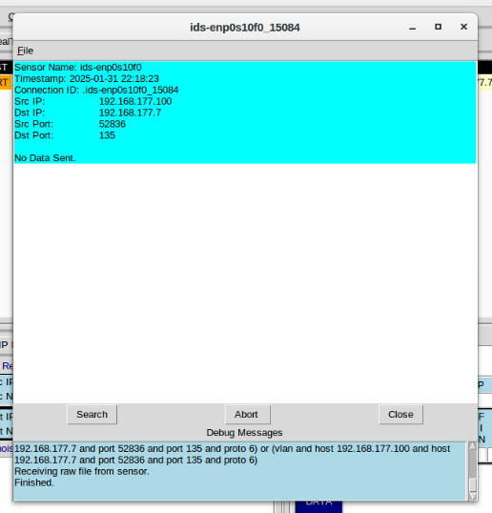
Testing Snort rules
Take a screenshot of the output in Part 1 Step 8. It should show the transcript of the XMAS scan alert.
Module 4

Slide 16
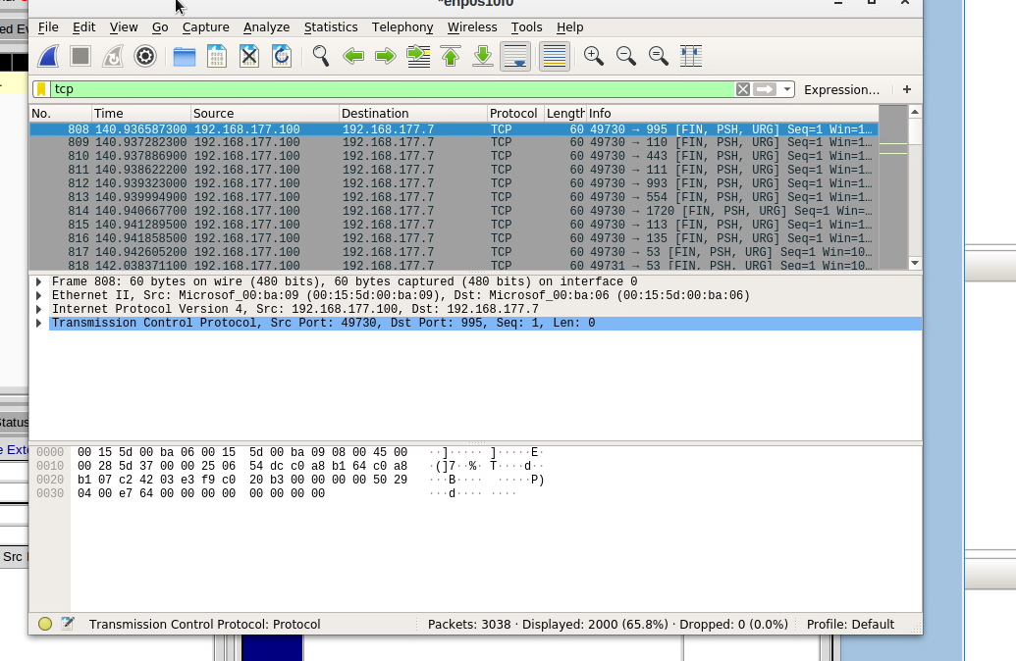
Testing Snort rules (Cont.)
Take a screenshot of the output in Part 1 Step 10. It should show the TCP packets generated by the XMAS scan.
Module 4

Slide 17
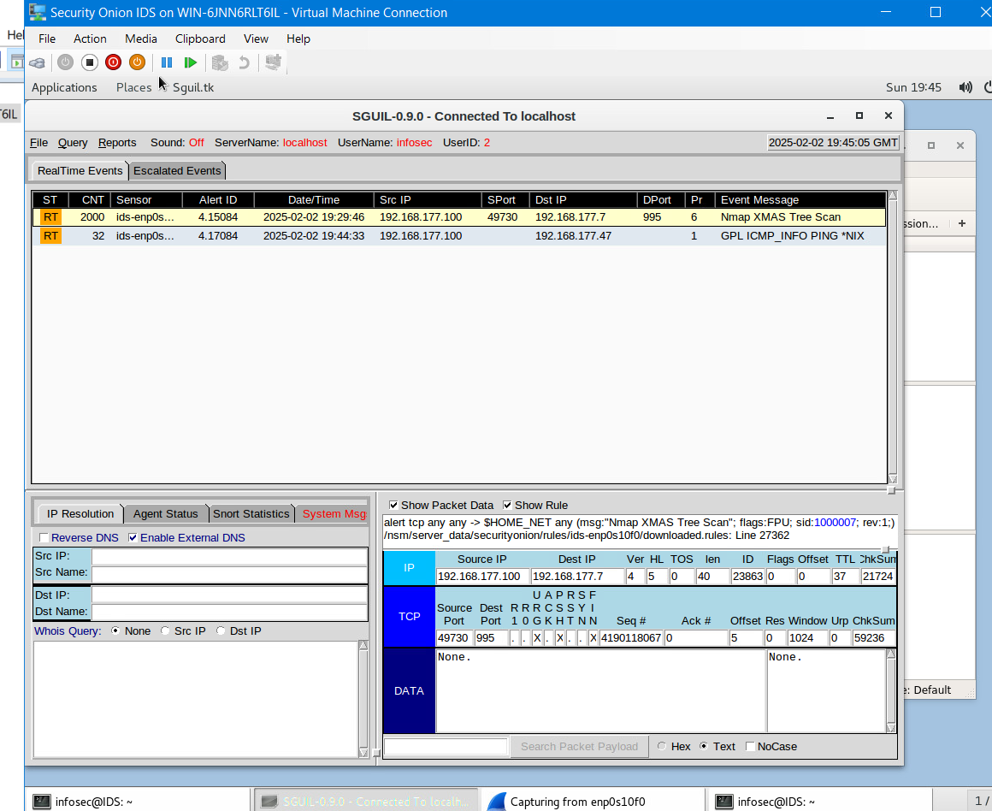
Creating Snort rules
Take a screenshot of the output in Part 2 Step 5. It should show the ping activity alert.
Module 4

Slide 18
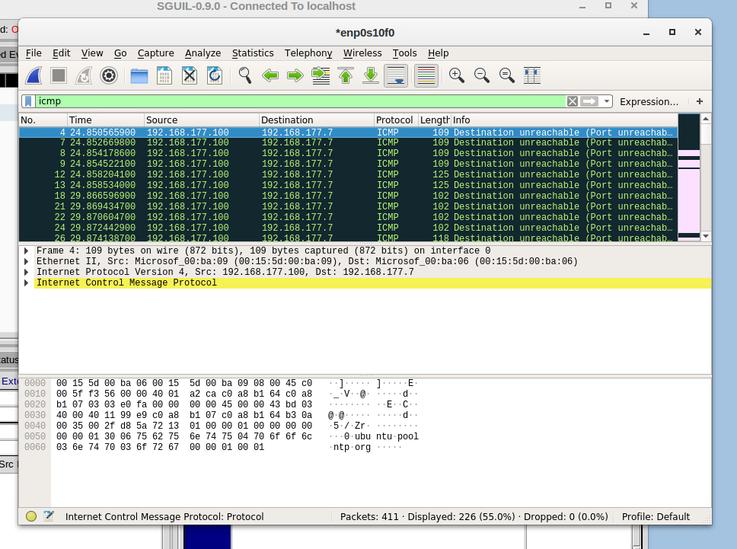
Creating Snort rules cont’d
Take a screenshot of the output in Part 2 Step 6. It should show the ICMP packets generated by the ping activity.
Module 4

Slide 19
Module 5: Live Memory Analysis
Module 5 involved many new tools to view active memory, processes and other information
Used ps command to view current process information
Used lsof command to view open files
Used dmesg command to view kernel messages
Used less command to view syslog “general” messages
Used netstat command to view network connections
Used lsmod command to view kernel modules
Used Process Hacker to view details of running processes
Module 5

Slide 20
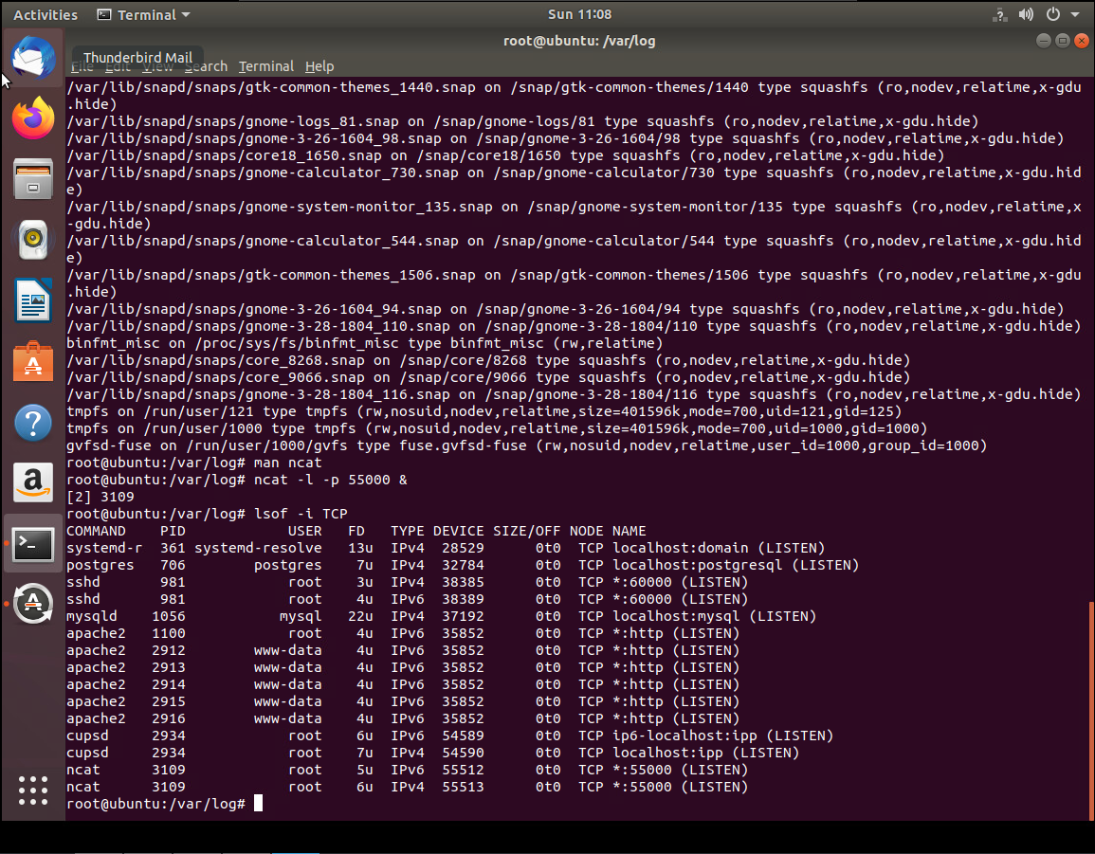
Linux Processes
Take a screenshot of the output in Part 1, Step 13. It should show port 55000 open for both IPv4 and IPv6.
Module 5

Slide 21
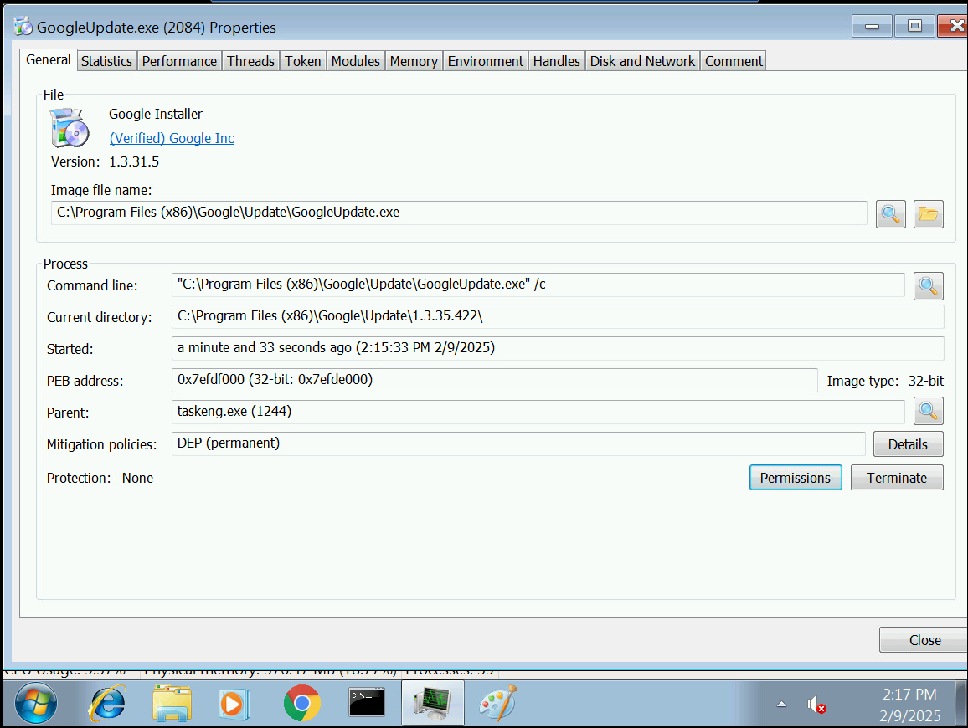
Process Hacker
Take a screenshot of the output in Part 2, Step 5. It should show properties of a chosen process.
Module 5

Slide 22
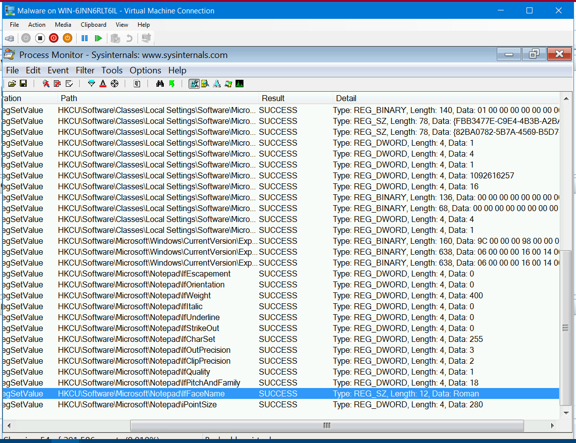
Process Monitor
Take a screenshot of the output in Part 3, Step 12. It should show ifFaceName in the Path column and Data: Roman in the Detail column.
Module 5

Slide 23
Module 6: Firewall
During Module 6, we created IP routing tables and firewall rules to allow limited connection to the DMZ machine.
Used ping to attempt to communicate with the DMZ VM.
Used netstat to view IP routing table
Used route to add routing rule to the routing table to both Ubuntu VM and DMZ VM
Used sysctl to set forwarding to active
Used iptables to set firewall rules to only allow connection via SSH during certain times of the day
Used timedatectl to set the time to test the rules
Module 6

Slide 24
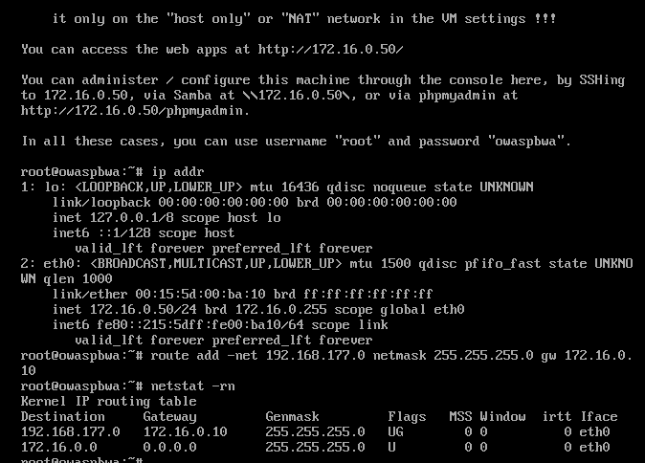
Time-based Access
Take a screenshot of the output in Part 1 Step 18. It should show the output of the DMZ Route Table.
Module 6

Slide 25
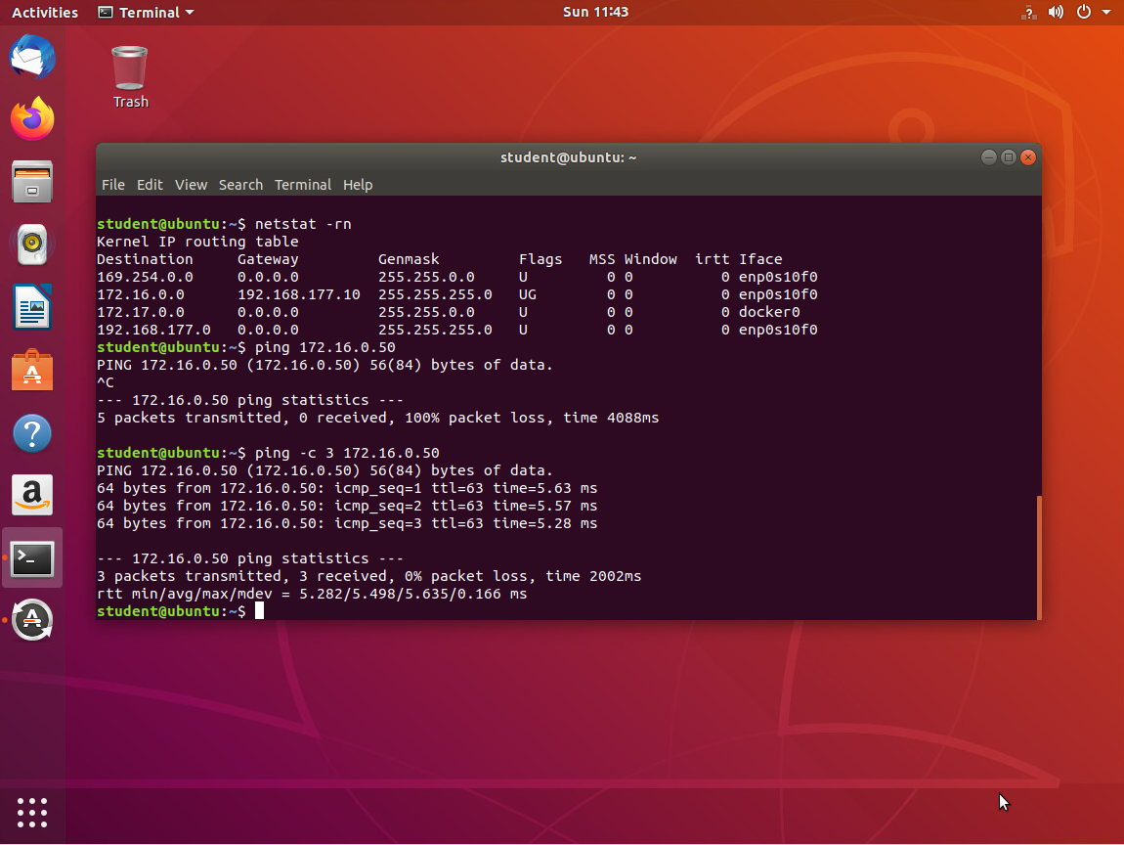
Time-based Access
Take a screenshot of the output in Part 1 Step 23. It should show a successful ping from the Ubuntu Web VM and the DMZ VM.
Module 6

Slide 26
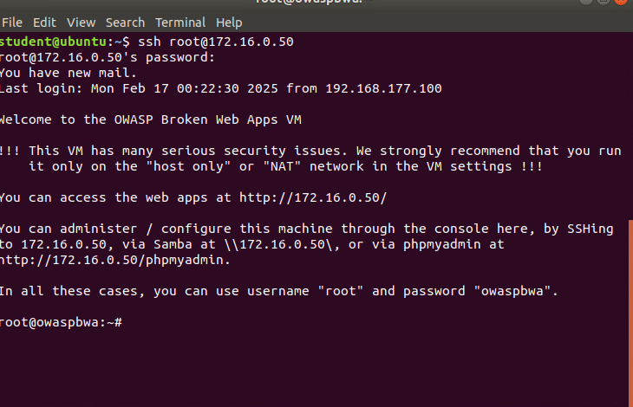
Time-based Access
Take a screenshot of the output in Part 1 Step 33. It should show two time-based access rules in the FORWARD chain
Module 6

Slide 27
Challenges In The Project
I have worked with virtual machines, Windows, and Linux for a number of years so most of this was familiar to me. If I had to pick one part of this project that was challenging, I would say it would be keeping connected to the virtual machines and which one I needed to be working in.
Module 7

Slide 28
Career Skills Obtained
Threat intelligence
Security Vulnerability Scanning
Security Data Analysis
Risk Management
Incidence Detection
Module 7

Slide 29
Conclusion
SEC-290, Fundamentals of Infrastructure Security, has given me a foundation of security detection and response. I feel learning to use Nmap and Wireshark to scan the network, will be the greatest help in the future. If I pursue a career in security.
Module 7

Slide 30
This template is licensed under a Creative Commons Attribution-ShareAlike 3.0 Unported License. It makes use of the works of Mateus Machado Luna.
References
WEEK 2
Nalupurakkal, N. (2024, March 11). Understanding the significance of TCP flags in network communication. LinkedIn. https://www.linkedin.com/pulse/understanding-significance-tcp-flags-network-naveen-nalupurakkal-j5usc
Ostechnix. (2024, March 27). Identify operating system using TTL value and Ping. OSTechNix. https://ostechnix.com/identify-operating-system-ttl-ping/
WEEK 5
lsof(8) — Linux manual page. LSOF(8) - linux manual page. (n.d.). https://man7.org/linux/man-pages/man8/lsof.8.html
syslog(2) — Linux manual page. Syslog(2) - linux manual page. (n.d.). https://man7.org/linux/man-pages/man2/syslog.2.html
WEEK 6
Chapple, M., & Seidl, D. (2020). CompTIA CySA+ Study Guide Exam CS0-002 (2nd ed.). Wiley Professional Development (P&T). https://devry.vitalsource.com/books/9781119684114
Iptables(8) - linux manual page. (n.d.). https://man7.org/linux/man-pages/man8/iptables.8.html

