Slide 1
Weather Data Analytics Project
Nicholas Allen
CEIS110 – Intro. To Programming
Professor Tevis Boulware
06/21/2022

Slide 2
Table of Contents
Introduction – Pg. 3
Getting Started – Pg. 4
Building the Database – Pg. 7
Data Query Using SQLite – Pg. 11
Extracting Data Into a CSV File – Pg. 17
Using PANDAS and matplotlib in Python – Pg. 22
Conclusion – Pg. 27

Slide 3
Introduction
The point of this project is to demonstrate how to connect and use various tools in Python code. We will install the noaa-sdk module and use it to download our local weather database for the last few weeks. We will then use SQLite to connect to the database and retrieve data. This data will be saved into a CSV file to allow us to use Microsoft Excel to manipulate the data and create charts and graphs from it.
I have attached comments to some slide with code that can be copied and pasted into Spyder or another Python IDE or console.

Slide 4
Getting Started
The first step to any successful, complete, and coherent project is planning. Software programming is no different. Using a flowchart to plan your project can help lead to success. Don’t forget to always create a project folder to help keep track of your files.
We also need to install the NOAA Software Development Kit to access the weather data they have collected.
The next few slides show a flowchart
of the steps and installation of the
NOAA Software Developer Kit, or SDK.
Previous: Introduction – Pg. 3
Project Flowchart – Pg. 5
NOAA-SDK – Pg. 6
Next: Building the Database – Pg. 7

Slide 5
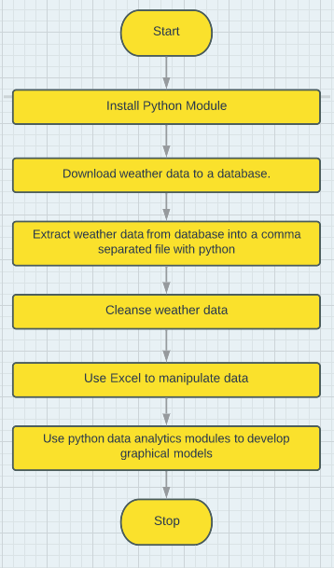
Project Flowchart
Showing the following processes:
Install NOAA_SDK Python module.
Download weather data to a database.
Extract weather data from database into a comma separated file with python
Cleanse weather data
Use Excel to manipulate data
Use python data analytics modules to develop graphical models

Slide 6
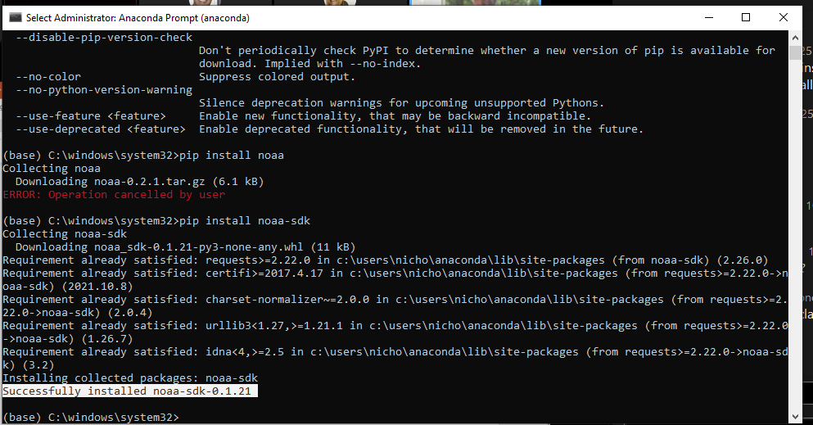
Software Inventory (Screenshots)
Showing the installation of the noaa-sdk into Python shell.

Slide 7
Building the Database
Here we create the program to download and create the database on the local hard drive. We are using SQLite through Python to create and manipulate the database. This code is named BuildWeatherDb.py and saved into the designated project folder for later use. Once the program is working, bug free, we allow it to download and create our weather database.
Previous: Getting Started – Pg. 3
BuildWeatherDb Python Code – Pg. 8
BuildWeatherDb Creating the Database – Pg. 9
Proof of Program Execution – Pg. 10
Next: Database Query – Pg. 11

Slide 8
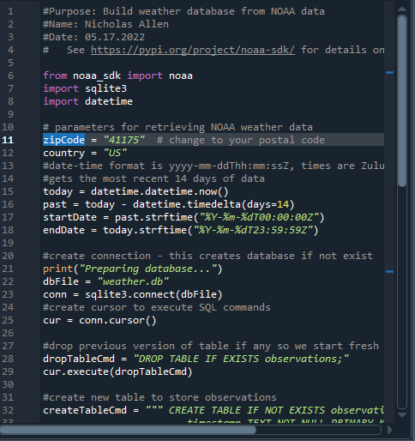
BuildWeatherDb Python Code (Screenshot)
Screenshot of code in Spyder including name, date, and zip code in comments.
Line 2 = Name
Line 3 = Date
Line 11 = Zip Code
Please see the comment attached to this slide for Copy / Paste code.

Slide 9
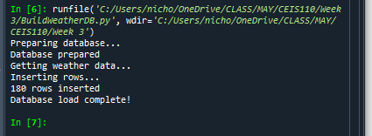
BuildWeatherDb Creating the Database (Screenshot)
Screenshot of program output in the Python shell console of Spyder showing that the program executed successfully.

Slide 10
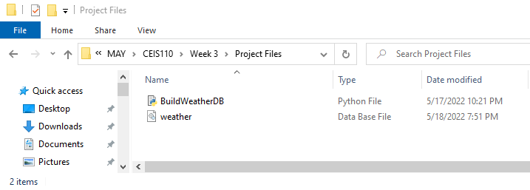
Weather.db: Proof of Program Execution (Screenshot)
Screenshot of Windows Explorer showing that the database file, Weather.db, was created when BuildWeatherDb was executed.

Slide 11
Data Query Using SQLite
In this section I will show how to use SQLite within Python to query the database and retrieve the desired data. We will go through a series of three queries; getting all the data, finding the highest and lowest temperatures, and we show all the data for only the clear days.
Previous: Building the Database – Pg. 7
Retrieve All Columns and All Rows – Pg. 12
You can find copy and paste code as a
comment for each slide with code.
Retrieve Highest and Lowest Temperatures – Pg. 14
Retrieve All Clear Days – Pg. 15
Next: Extracting Data into a CSV File – Pg. 17

Slide 12
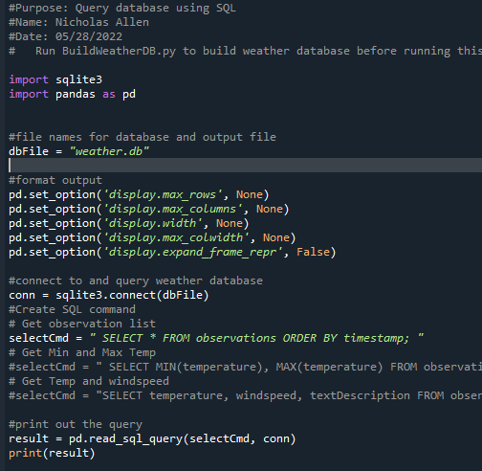
Query to Retrieve All Columns and All Rows
Screenshot of QueryWeatherDb code

Slide 13
QueryWeatherDb Running (Screenshot)
Screenshot of QueryWeatherDb running and displaying all the data from each column and row.

Slide 14
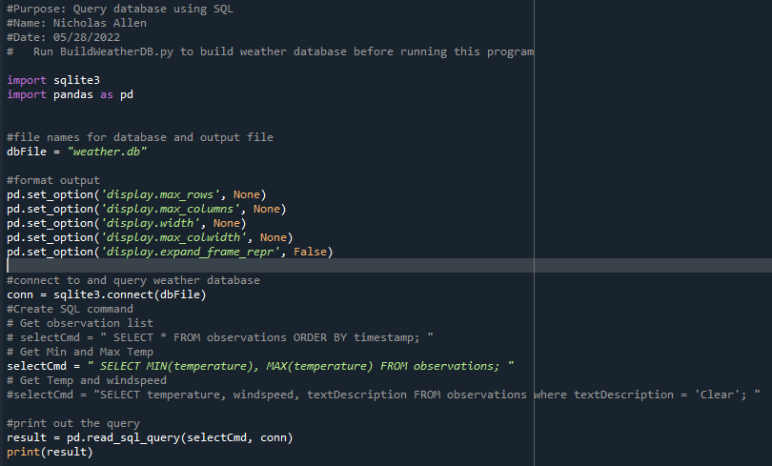
Query to retrieve lowest and highest temperatures
Screenshot of QueryWeatherDb altered to display only the minimum and maximum temperatures.
Screenshot of QueryWeatherDb running and displaying the minimum and maximum temperatures.

Slide 15
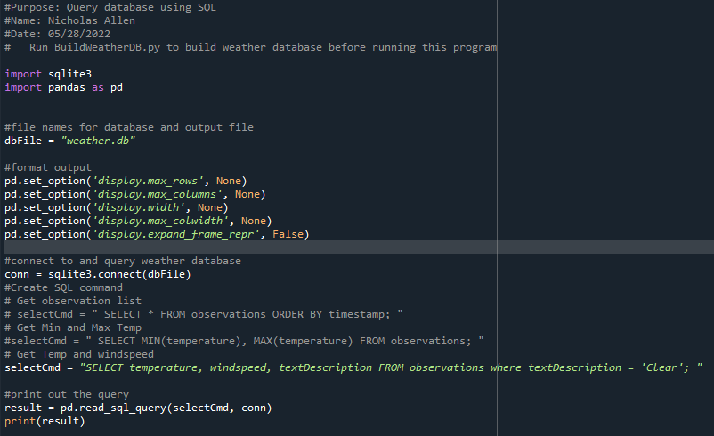
Code to Query to retrieve all clear days
Screenshot of QueryWeatherDb altered to display the data for only Clear days.

Slide 16
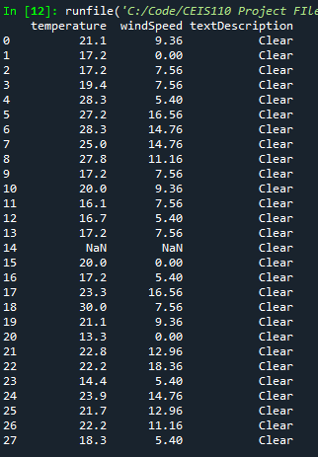
Query to retrieve all clear days
Screenshot of QueryWeatherDb running and displaying the data for only Clear days.

Slide 17
Extracting Data Into a CSV File
We have learned how to query the database and retrieve only the data specified. In this next section, we extract the temperature and humidity from the database and save it into a “Comma Separated Values” (.CSV) file
Previous: Query Data with SQLite – Pg. 11
Extract Temperature and Humidity to CSV – Pg. 18
Accessing CSV Data with Microsoft Excel – Pg. 19
You can find copy and paste code as a
comment for each slide with code.
Temperature and Humidity Chart Week 1 – Pg. 20
Temperature and Humidity Chart Week 2 – Pg. 21
Next: Using PANDAS and matplotlib – Pg. 22

Slide 18
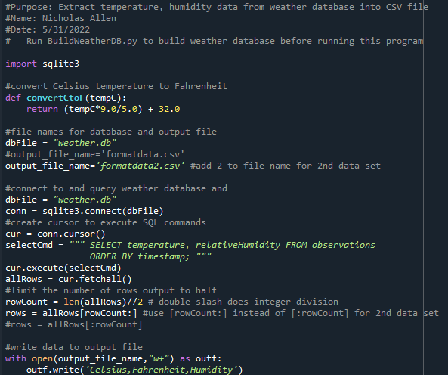
Extract Temperature and Humidity to CSV (Screenshot)
ExtractTempHumidity.py Python code. Edits were made that are not shown here. Please see comments.

Slide 19
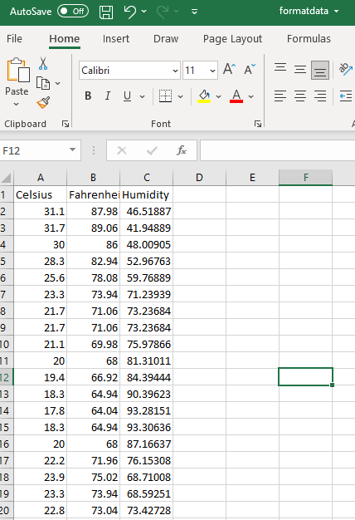
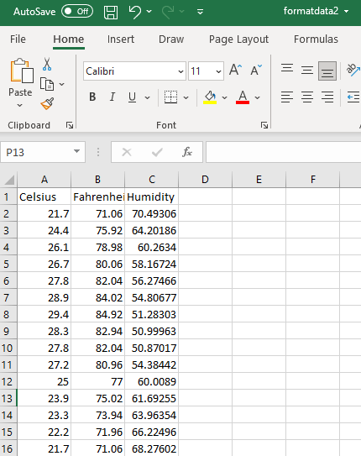
Accessing CSV Data with Microsoft Excel (Screenshot)
Week 1 (first half of data) as CSV
Week 2 (last half of data) as CSV

Slide 20
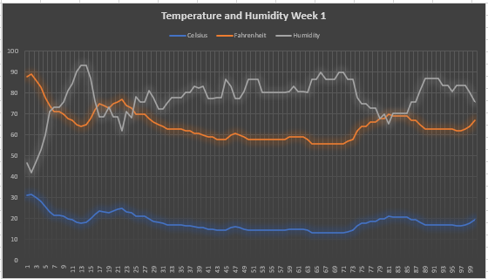
Temperature and Humidity Chart Week 1 (Graph)
Excel chart based on temperature and humidity data from database for week 1

Slide 21
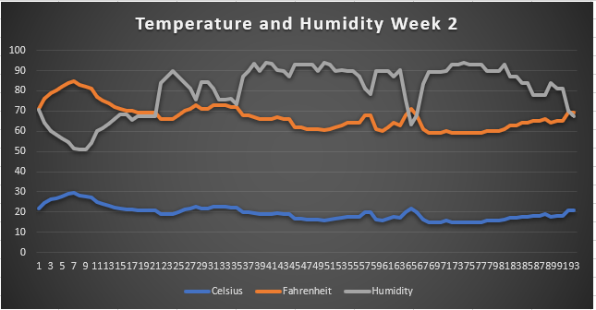
Temperature and Humidity Chart Week 2 (Graph)
Excel chart based on temperature and humidity data from database for week 2

Slide 22
Using PANDAS and matplotlib in Python
In this last section, we will use Python with PANDAS and matplotlib to create a program to make graphs and charts. I am attaching comments to this slide with the copy and paste code for these charts; Box Plot, Compare Periods, Histogram, and Scatter Plot. These are just a few as there are numerous possibilities.
PANDAS Website: https://pandas.pydata.org/
matplotlib Website: https://matplotlib.org/
Previous: Extracting Data to CVS – Pg. 17
Compare Periods Plot – Pg. 23
Histogram of Humidity – Pg. 24
You can find copy and paste code as a
comment for each slide with code.
Analysis: Netflix Vs Hulu – Pg. 25
Prediction: Looking Ahead – Pg. 26
Next: Conclusion – Pg. 27

Slide 23
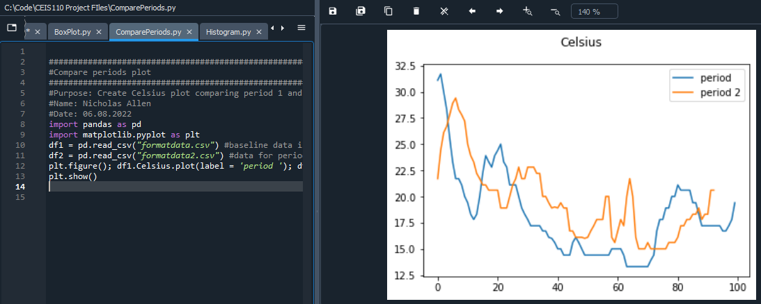
Compare Periods Plot
Screenshot of Spyder console showing a compare periods plot.
In the chart we compare the Celsius temperatures in week 1 and week 2.

Slide 24
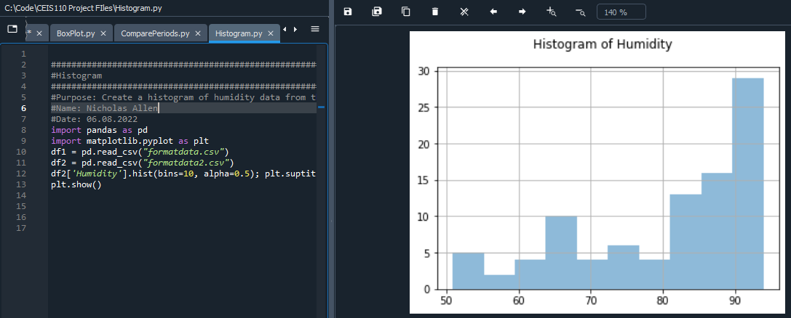
Histogram of Humidity
Screenshot of Spyder console showing a Histogram plot of the humidity.
In the chart we show the humidity of week 2.

Slide 25
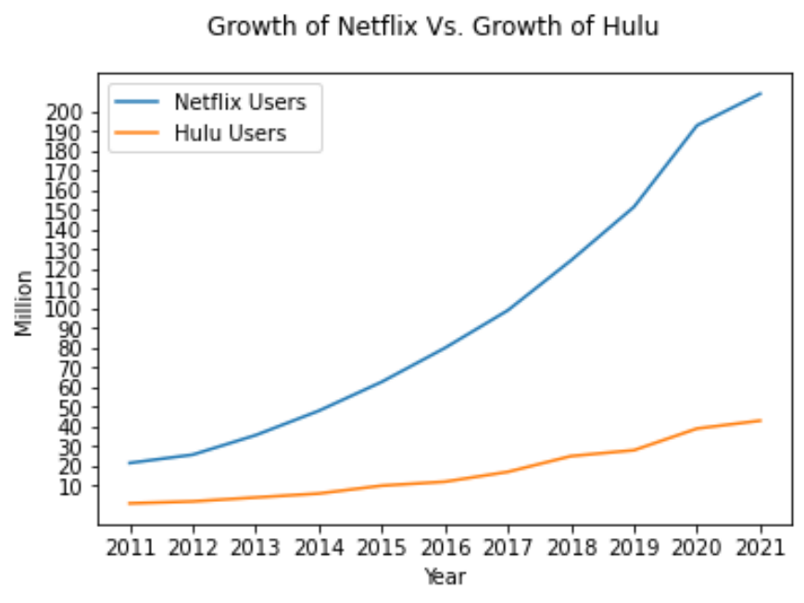
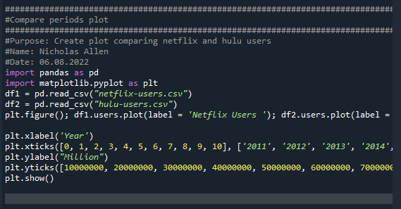
Analysis – Who grows faster, Hulu Vs. Netflix?
Results: Netflix has a much higher user base, and growth rate.
Comparison Chart of Netflix Vs Hulu
Program to create the Netflix Vs Hulu chart

Slide 26
Weather Prediction Based on Data
Develop a prediction based on the data. What variations in temperature and humidity do you expect over the next few hours or days?
Warmer days to come with cool nights. However, I live in northeast Kentucky and get Ohio weather… this means it could be 85 and sunny now and snowing this evening.
How would humidity change if temperature goes up or down?
The relative humidity will rise with a drop in temperature and drop with a rise in temperature.

Slide 27
Conclusion
In this presentation we discussed how to use Python in combination with SQLite, PANDAS, and matplotlib. We also touched on how to create graphs and charts with Microsoft Excel and CSV file data.
Included are copies of all code used to follow along with the data and make your own weather predictions.
Previous: Using PANDAS and matplotlib – Pg. 22
Career Skills – Pg. 28
Project Challenges – Pg. 29
Table of Contents – Pg. 2

Slide 28
Career Skills
The skills acquired in this class will help me in my career by giving me confidence in my coding abilities. Another skill I acquired while doing this project is critical thinking for problem solving. This will be used daily for all projects, in my career, college, and home life.

Slide 29
Project Challenges
Challenges during this project were negligible at best, as most of the code was pre-written and ready to use. I have always found database programming challenging and found this very helpful to use as an example.

