Slide 1
SEC285 Final Project
By Nicholas Allen
Professor Burton Piper
DeVry University
Session: May 2023
Course ID: SEC285

Slide 2
Table of Contents
Introduction
Week 1 – Getting Started
Week 2 – Asymmetric Key Encryption
Week 3 – Stateful Firewall
Week 4 – B.Y.O.D. Security Policy
Week 5 – Multi-factor Authentication
Week 6 – Vulnerability Assessment
Week 7 – Pre-Test Prep
Week 8 – Final Project
Project Challenges
Career Skills
References

Slide 3
Introduction
SEC285, Fundamentals of Information System Security has taught me about securing systems and networks. In this class we learned about security threats and bad actors. I learned that SHA256 is the best encryption to use.
This presentation will progress from week 1 through the final week, week 8. Each week demonstrates the application of each weeks schoolwork with the exception of weeks 1 and 7.

Slide 4
Week 1 – Getting Started
In week 1 we learned about Information System Security and some types of attacks.
Virus attack files on a system and wait for a human to transfer the file to infect another system.
Worms can infect a system with a virus and move to another system.
Malware is any software that has malicious intent.
Social Engineering is the #1 way hackers gain unauthorized access to a system or network.

Slide 5
Week 2 - Asymmetric Key Encryption
In week 2, we discussed cryptography in depth. We learned about public and private keys and how the Diffie-Hellman key exchange works.
In this week’s project we created a file, then encrypted it, which removed the original file.
We completed the project by decrypting the file, which recreated the original plaintext file, and displayed it.

Slide 6
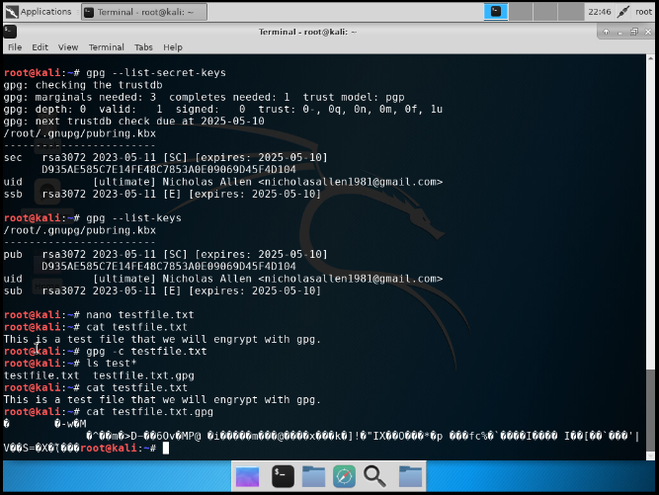
File Encryption
Content of the plain text file
Content of the encrypted file

Slide 7
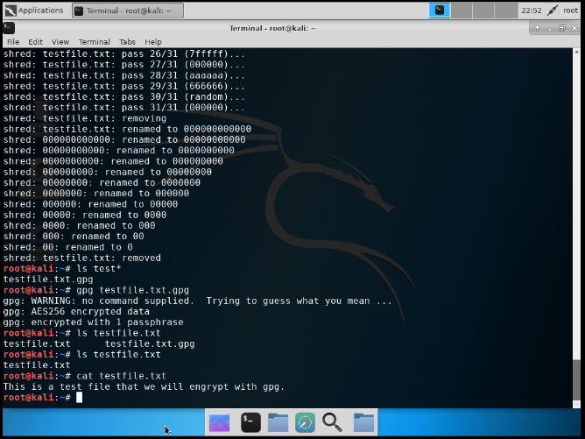
File Decryption
The encrypted file being listed by itself
The decrypting process
Both the encrypted file and the original plain text file being listed

Slide 8
Week 3 – Stateful Firewall
During week 3, we learned about firewalls and how to configure them.
In our project this week we used Nmap to scan for open ports and determined the command
‘sudo iptables –policy INPUT DROP’
Blocks all traffic not whitelisted in the iptables file.

Slide 9
Question
What effect does the sudo iptables --policy INPUT DROP command have on the access to computing resources?
Answer here:
By comparing the two outputs of nmap, the command ‘sudo iptables –policy INPUT DROP’ seems to close all open ports.
According to a beginner's guide to ip tables by Comparitech, specifying “-policy INPUT DROP” will set the default policy to refuse all incoming traffic that does not match anything specified in IPTables (Keary, 2022).
References: Keary, T. (2022, December 6). The beginners guide to iptables (includes essential commands!). Comparitech. https://www.comparitech.com/net-admin/beginners-guide-ip-tables/

Slide 10
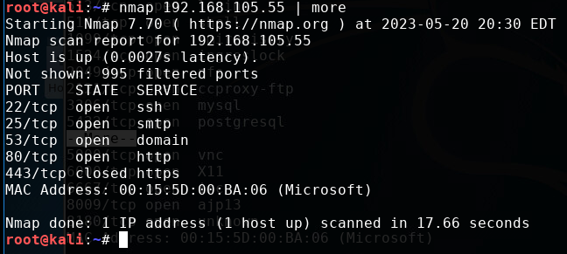
Nmap Scan
This screenshot should show the Nmap scan result of the Linux Server VM.

Slide 11
Week 4 – Bring Your Own Device Security Policy
In week 4, we learned about the different policies that companies may have.
Our project consisted of creating a Bring Your Own Device Policy for a fictional company.

Slide 12
B.Y.O.D. Security Policy
Please click the icon to view the Bring Your Own Device Security Policy

Slide 13
1. Overview:
Bring Your Own Device (BYOD) usage, such as personal smartphones, tablets, and laptops, are becoming increasingly more common tools in the workplace. Because personal devices connect to many different networks, it is possible to transmit malware and infect other devices across multiple networks. Our goal is to protect the confidentiality, integrity, and accessibility of data.
2. Purpose:
This policy will outline the acceptable use of personal devices at Xeonic Design LLC. through participation in the BYOD program. The BYOD program is used to manage device access, and to ensure all personal devices used at Xeonic Design LLC. are secure, company resources are protected, and CIA is maintained.

Slide 14
3. Scope:
This policy shall cover all employees who participate in Xeonic Design LLC.’s BYOD program. Only personal devices that have been registered and cleared through the IT department are allowed to participate in the program and will be granted access to Xeonic Design LLC.’s network and other resources to perform job-related functions while in the workplace. Activity on personal devices shall not be limited to job-related functions, however, Xeonic Design LLC. provides limited access to external networks, including the internet.
Allowed Devices
Smartphone
Tablet
Laptop
IT Approved accessory
Allowed Operating Systems include:
Android version 10 or higher
iOS version 13 or higher
Windows 7 or higher
4. Policy:
All employees wishing to participate in Xeonic Design LLC.’s BYOD program must be submitted to IT for review. For a device to be admitted into the BYOD program it must have all available operating system security patches, up-to-date antivirus, and firewall software. If the IT department cannot bring the device into compliance, acceptance into the BYOD program will be denied.

Slide 15
5. Policy Compliance:
Compliance with this policy will be verified at random, through the process of submitting the personal device to the IT department. If the IT department finds the device has not been kept up-to-date, or the device is not currently registered to be used with our BYOD program, all access to company resources via BYOD will be denied and may result in disciplinary actions up to and including termination of employment.
6. Related Standards, Policies, and Processes:
Ask a manager about Xeonic Design LLC.’s policy on BYOD data collection, and how it’s used.
Xeonic Design LLC.’s BYOD data collection policy will be included in the BYOD enrollment package and MUST contain the enrolling employee’s signature.

Slide 16
7. Definitions and Terms:
In this document:
Bring Your Own Device is referred to as BYOD.
The Information Technology Department is referred to as IT, or the IT department.
The Confidentiality, Integrity, and Accessibility of data is referred to as CIA.
Smartphones, tablets, and laptops, that are personally owned are referred to as personal devices.
8. Revision History:
Date of change | Responsible | Summary of change
August 2019 | SANS policy team | Updated and converted to new format
May 2023 | Xeonic Design IT Dept. | Created BYOD Security Policy

Slide 17
Week 5 – Multi-factor Authentication
Week 5 was about different types of authentication methods.
This week’s project was about multi-factor authentication and setting up a Linux account with google authenticator.

Slide 18
Common-auth Configuration File
This screenshot should show the entry that indicates the use of the Google Authenticator module.

Slide 19
MFA Logon Screen
This screenshot should show the logon screen where a verification code is required.

Slide 20
Week 6 – Vulnerability Assessment
In week 6, we discussed several vulnerabilities and how assessments can be made to determine if these vulnerabilities should be patched.
For our week 6 project we explored some tools that we can use to scan networks and systems to make a accurate vulnerability assessment.
Tools Used
Nmap
NetCat
Wireshark
Nessus

Slide 21
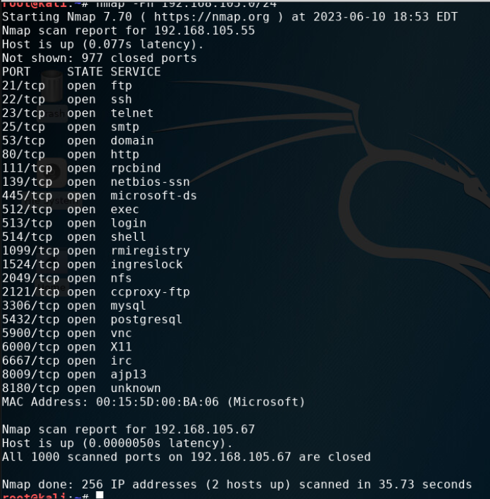
Nmap
This screenshot should include the scan result showing both the Kali and Linux Server VMs.

Slide 22
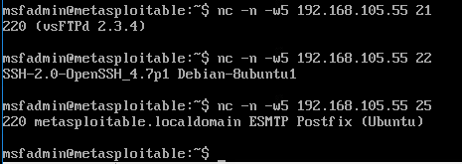
NetCat
This screenshot should include the results of the NetCat scan.

Slide 23
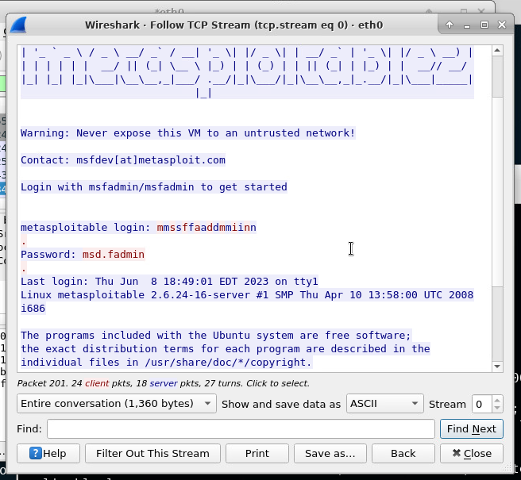
Wireshark
This screenshot should include the Wireshark—Follow TCP Steam window showing the Telnet username and password.

Slide 24
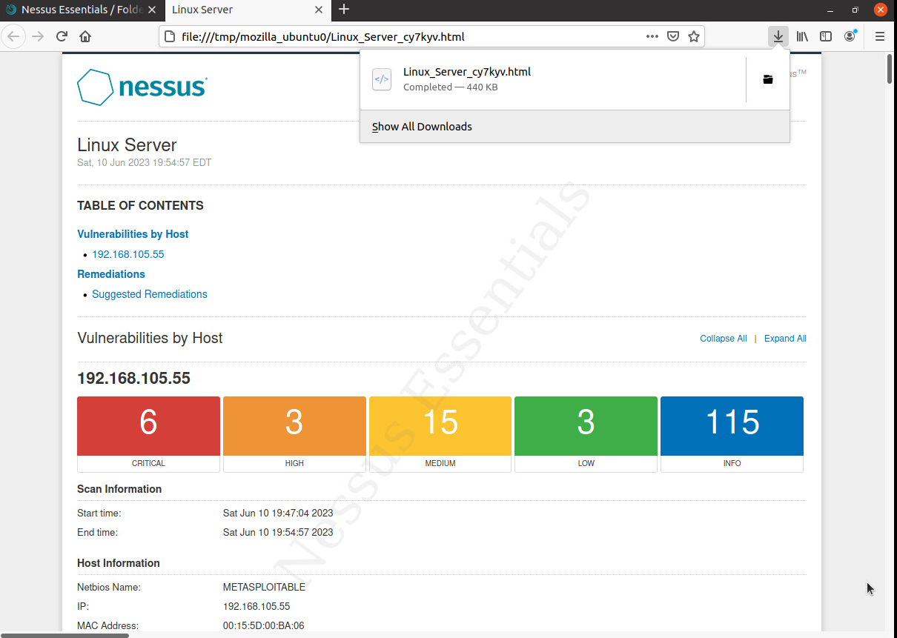
Nessus
This screenshot should include the high-level view of the Nessus vulnerability scan report (showing categories of vulnerability in different colors).

Slide 25
Challenges
To me, security is always a challenge. If it becomes easy, you haven’t been keeping up with the flow of technology.
My biggest struggle in this class has been managing my time and getting everything completed on time. The content was mostly new, but, other than the math associated with encryption, wasn’t anything unexpected.

Slide 26
Career Skills
The skills I have developed in this class can be applied directly to any tech related job as well as to all personal computers.
This class has taught me to think more about my personal computer and network security. It has opened my eyes to the fact that anyone can be hacked at anytime. Security, both passive and active, and trust in those with access is a must.
My grandmother used to tell me,
“A lock only keeps an honest man honest.”

Slide 27
References
References: Keary, T. (2022, December 6). The beginners guide to iptables (includes essential commands!). Comparitech. https://www.comparitech.com/net-admin/beginners-guide-ip-tables/

