Slide 1
The Projects of Applied Physics
By Nicholas Allen
Professor Saeed Jellouli
DeVry University
Session: March 2023
Course ID: PHYS204

Slide 2
Table of Contents
Please Click Section Title for Quick Navigation.
Section Title | Page Number
Title | 1
Main Introduction | 3
Inventory of Parts and Software | 4
Precision of the Ultrasonic Sensor | 11
Gravitational Acceleration of a Free-Falling Object | 18
Conservation of Energy of a Free-Falling Object | 27
Relationship Between Linear and Rotational Motion | 34
Observing the Hall Effect | 41
Project Challenges | 48
Career Skills | 49
Conclusion | 50

Slide 3
Main Introduction
In Applied Physics with Lab (PHYS204) we learned about the basic laws of physics. Throughout the course we took a hands-on approach to learning different aspects of physics.
Within this class we created different projects using the Arduino Mega 2560 and the ESP32 microcontrollers to demonstrate the application of the laws of physics.
The first project is a simple project inventory, with written and visual lists of items and required software. Project two is the first section to use the Arduino 2560 and the next three projects use data collected during this project. The fifth project also used the Arduino 2560 and the rotary encoder. The final project, project six, uses the ESP32 microcontrollers built in hall effect sensor.
At first this class was intimidating and very confusing to me. These projects helped me understand how to apply what we was learning.
Back to Table of Contents

Slide 4
Inventory of Parts and Software
Week 2 - Project 1
Back to Table of Contents

Slide 5
Project Introduction
In this section, I have included the inventory of parts and software. For easy identification I have included a photograph of the inventory with corresponding text labels.
Projects 1, 2, and 3 use the same project inventory, software, and project setup.
Project 4 has a few different parts, but the software is the same
Project 5 uses an entirely different microprocessor than the previous projects
Course Inventory
Arduino Mega 2560 | ESP32
Male-to-Male Wires | Male-To-Female Wires
USB-A to USB-B Cable | USB-A to USB-Mini-A Cable
Ultrasonic Sensor (HC-SR04) | Rotary Encoder (KY-040)
Breadboard | Ruler / Tape Measurer
Object to Experience Free-Fall | Object for Rotary Encoder
Magnet
Course Software
Arduino IDE V. 1.18 | Microsoft Excel

Slide 6
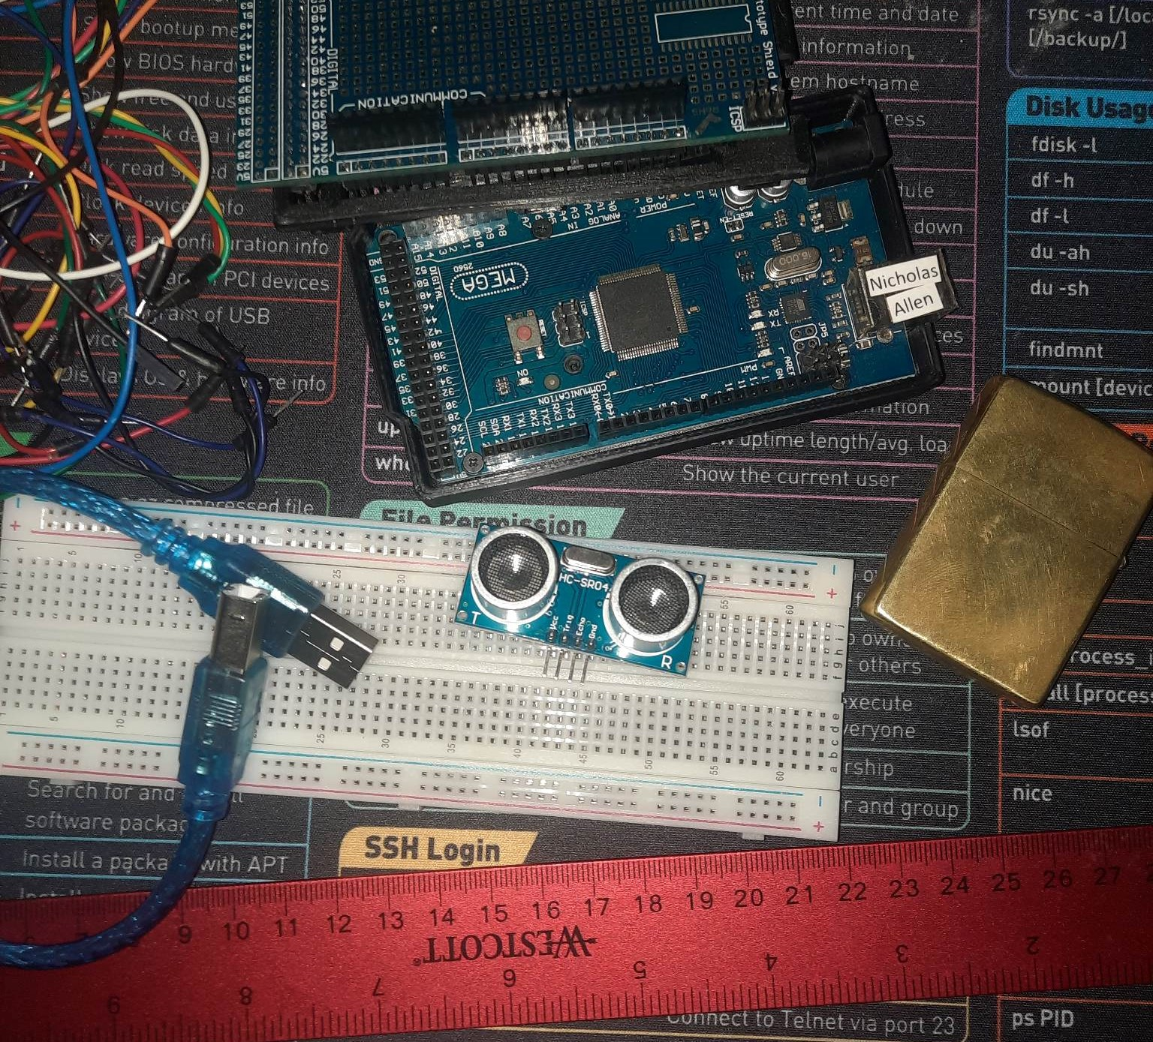
Projects 1, 2, & 3 - Materials List
Arduino Mega 2560
Male to Male Wires
Ultrasonic sensor HC-SR04
USB cable to connect Arduino
Breadboard
Object to act as obstacle and/or undergo free-fall
Ruler or tape measurer

Slide 7
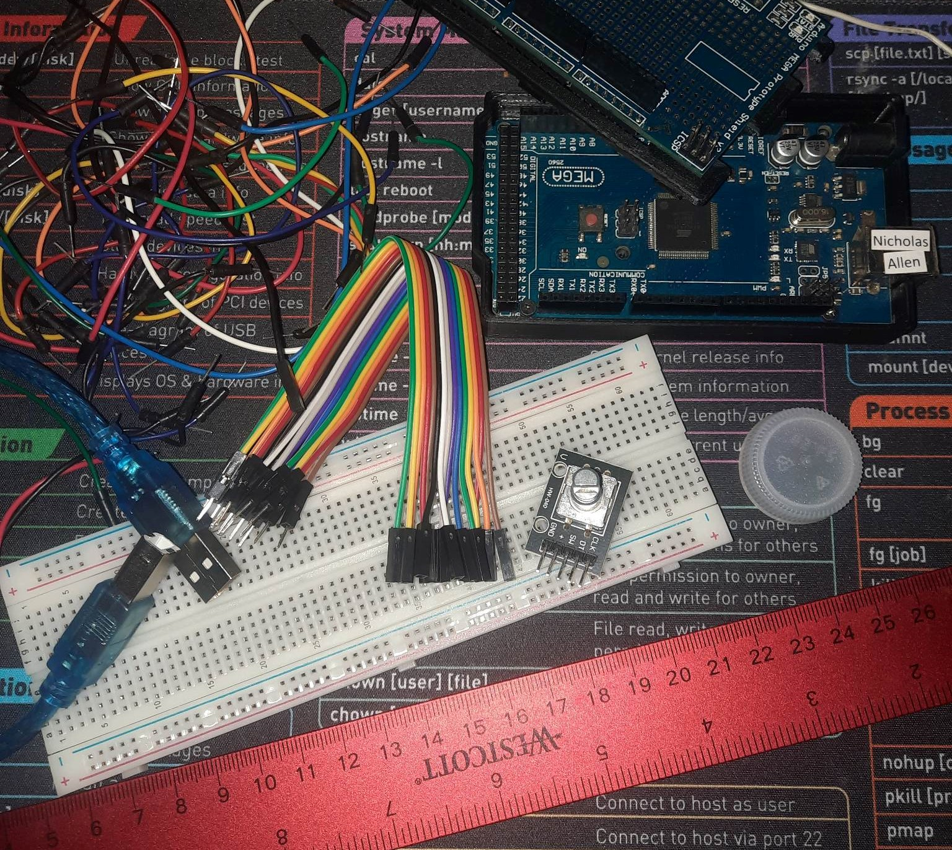
Project 4 - Materials List
Arduino Mega 2560
USB cable to connect Arduino
Male to Female Wires
Rotary Encoder Part KY-040
Object to attach onto rotary encoder
Ruler or tape measurer

Slide 8
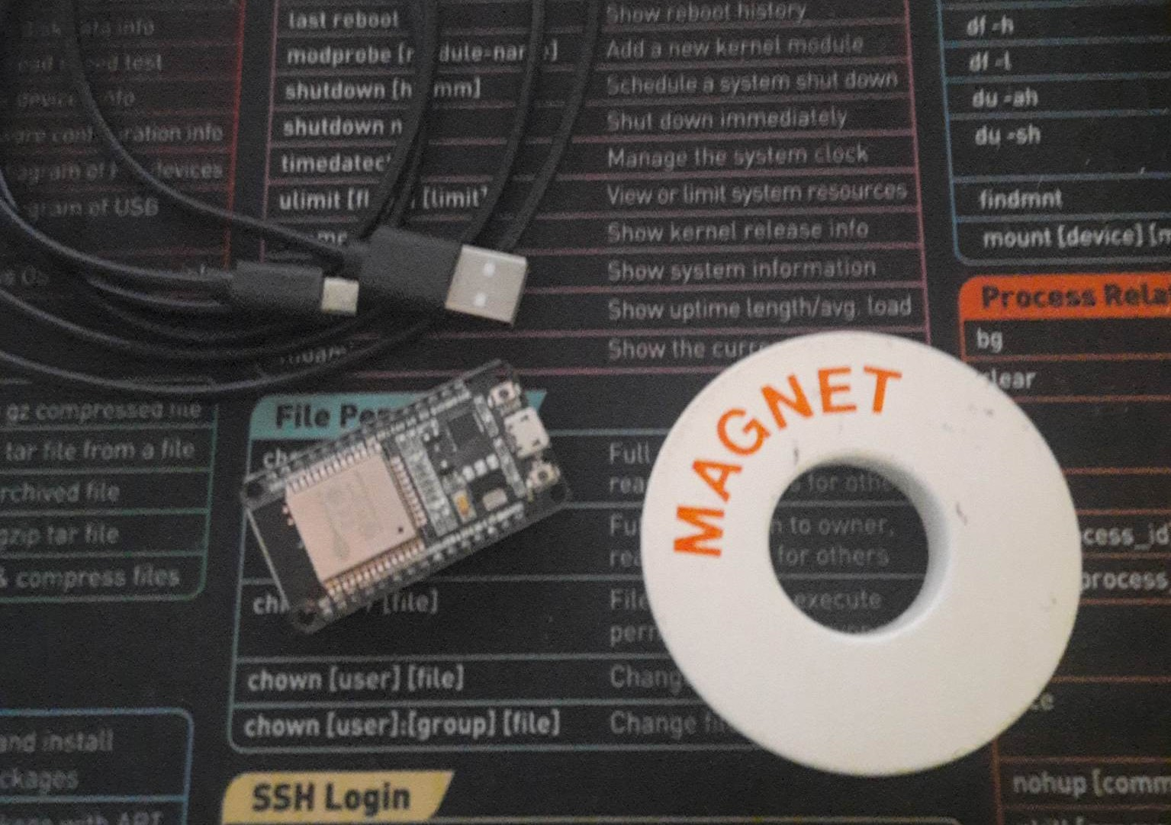
Project 5 - Materials List
Micro-USB cable
ESP32 microprocessor
Magnet

Slide 9
Microsoft Excel Screen Shotc
Microsoft Excel installed and running on your computer

Slide 10
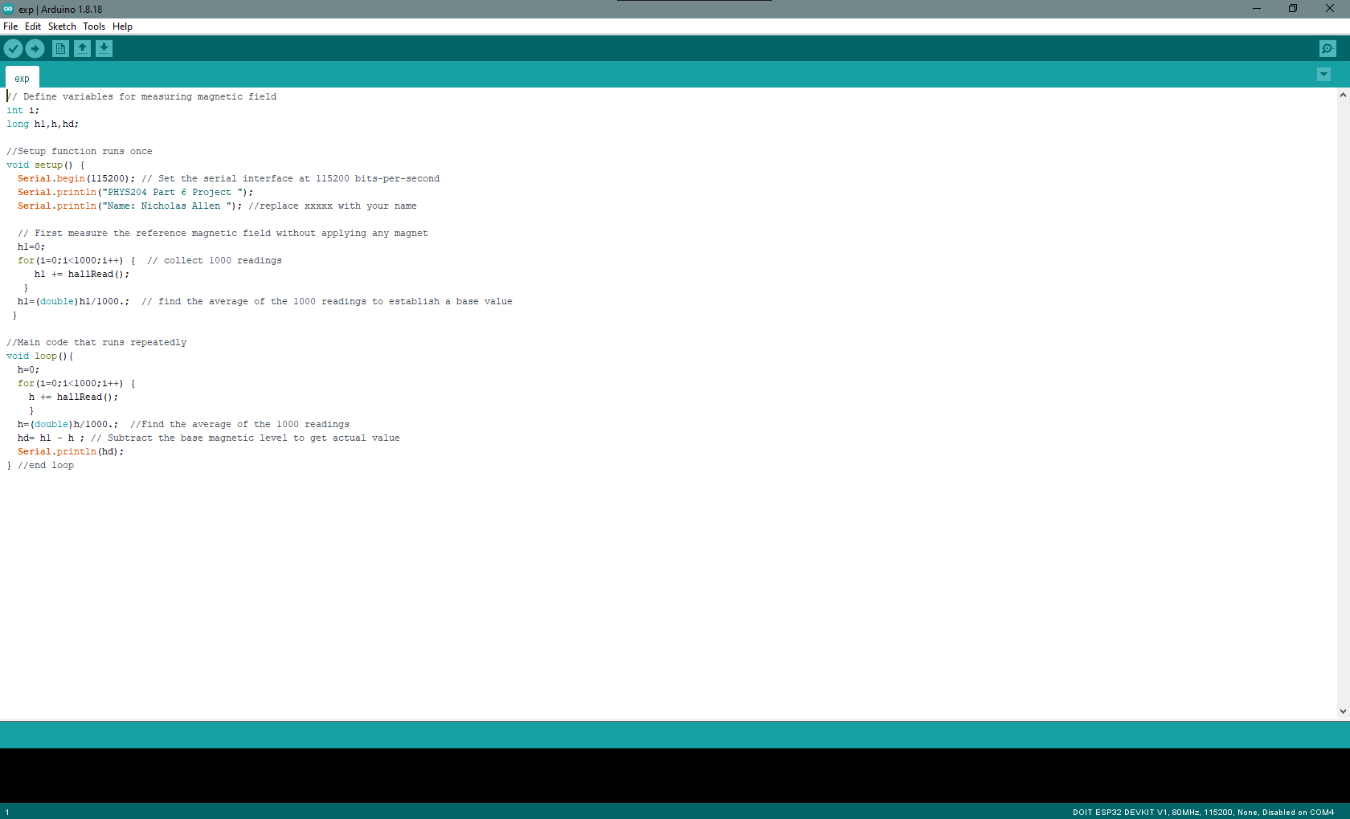
Arduino IDE Screen Shot
Arduino IDE installed and running on your computer

Slide 11
Precision of the Ultrasonic Sensor
Week 3 - Project 2
Back to Table of Contents

Slide 12
Project Introduction
Project 2 was used to determine the precision of the ultrasonic sensor we received in our kit because each sensor has its own actual precision. I completed the experiment several times to collect the best possible data. Things like wobbling and spinning or contact with an obstacle caused many redrops of my book.
When I finished this experiment, I had calculated an average of 4.4% difference in velocity during the 5 drops used.

Slide 13
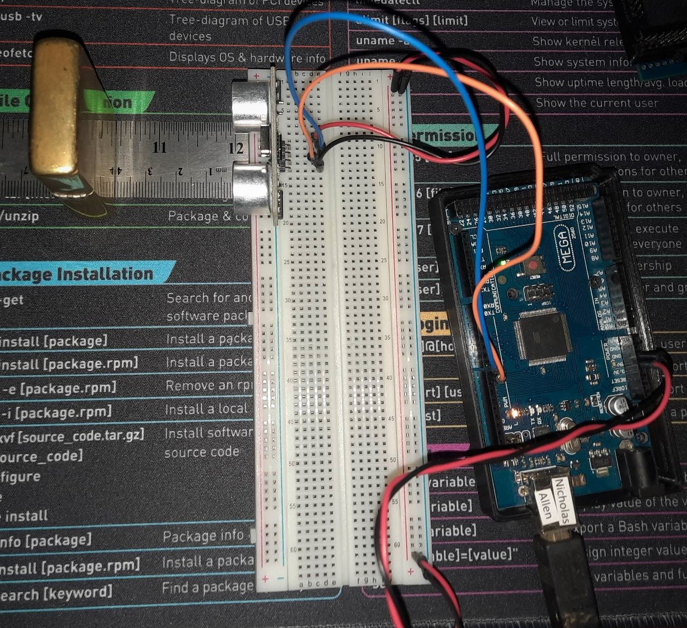
Experimental Set-up (Picture)
Materials List:
Mega 2560 Board
Ultrasonic sensor HC-SR04
Male to Male Wires
Breadboard
Ruler or tape measurer
Large and flat object to act as obstacle

Slide 14
Raw Data
Screenshot of Serial Monitor from Arduino IDE showing raw data.

Slide 15
Data Collection
Trial | Ruler Distance (cm) | Total Roundtrip Distance (m) | Time from Serial Monitor (microseconds) | Roundtrip time (s) | Velocity = distance/time (m/s)
1 | 4 | 0.08 | 226 | 0.000226 | 354
2 | 8 | 0.16 | 528 | 0.000528 | 303
3 | 12 | 0.24 | 732 | 0.000732 | 328
4 | 16 | 0.32 | 985 | 0.000985 | 325
5 | 20 | 0.40 | 1211 | 0.001211 | 330

Slide 16
Data Analysis
Average velocity from table
Percent difference where $v_{sound}=343 m/s$
$$v_{avg}= \frac{v_{1}+v_{2}+v_{3}+v_{4}+v_{5}}{5}$$
Answer: 328
m/s
$$Percent difference = \frac{\left|v_{avg}−v_{sound}\right|}{v_{sound}}×100$$
Answer: 4.4
%

Slide 17
Conclusions
Discuss the results and comment on the source of errors.
Answer: I completed this project several times and always came out with about the same answer, between 4% and 6% difference. This tells me I should account for a 5% error rate.
What is the dependence of temperature, humidity, and atmospheric pressure on the speed of sound? How does it affect the results?
Answer: Because sound is energy it is affected by other forms of mass and energy and depending on the conditions, can speed up or slow down.

Slide 18
Gravitational Acceleration of a Free-Falling Object
Week 4 - Project 3
Back to Table of Contents

Slide 19
Project Introduction
Project 3 uses the same setup as project 2. The only difference is the sensor needs to point down off the side of a table. This will allow space below the sensor for the object to experience free-fall.

Slide 20
Experiment Set-up (Picture)
Materials List:
Arduino Mega 2560
Ultrasonic Sensor HC-SR04
Male-to-Male Wires
Breadboard
Large, flat object
I had issues with the Ultrasonic sensor connecting through the breadboard. I connected it directly.

Slide 21
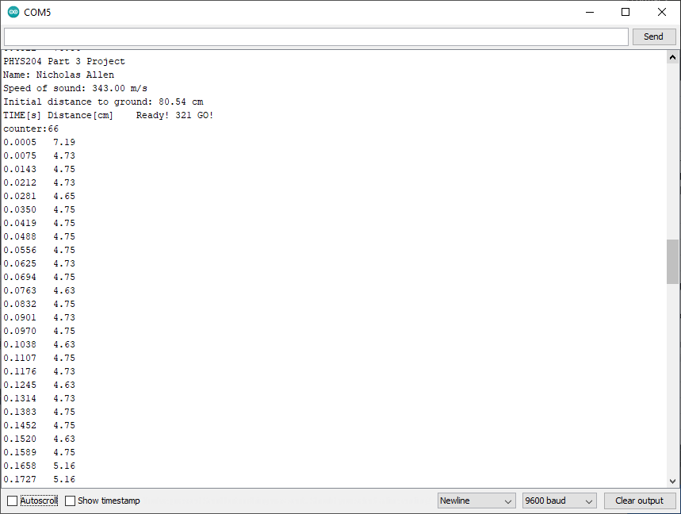
Serial Monitor (Screenshot)

Slide 22
Excel Table (Screenshot)

Slide 23
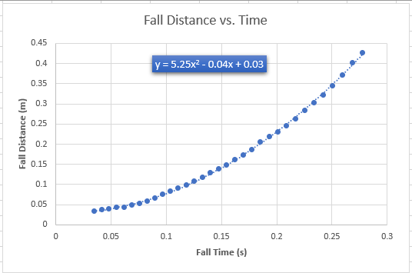
Excel Graph (Screenshot)

Slide 24
Data Collection
Trial | x² coefficient value from curve fitting | Acceleration (m/s²) = 2* (x² coefficient)
1 | 5.25 | 10.5
2 | 6.45 | 12.9
3 | 4.73 | 9.46
4 | 4.82 | 9.64
5 | 5.17 | 10.34

Slide 25
Data Analysis
Average acceleration from table
Percent difference with $g=9.8 m/s^{2}$
$$a_{avg}= \frac{a_{1}+a_{2}+a_{3}+a_{4}+a_{5}}{5}$$
= 10.568 m/s
$$Percent difference =\frac{\left|a_{avg}−g\right|}{g}×100$$
= 7.84 %

Slide 26
Conclusions
Discuss the results and comment on the source of errors.
Answer: I had issues with the sensor and the breadboard and would not fully read the data. Sometimes I wouldn’t get any data at all and other times the data was very inconsistent.
How much variation is there from trial to trial? What does this indicate about the uncertainty of the result?
Answer: I came out with a difference of 7.84%, the data from a couple drops seemed a little different than the others but met the criteria to be used.

Slide 27
Conservation of Energy of a Free-Falling Object
Week 5 - Project 4
Back to Table of Contents

Slide 28
Project Introduction
Project 4 uses data collected in project 3 and used to produce calculations for the potential energy and the kinetic energy.
The equilibrium is the point where the potential energy remaining and the kinetic energy spent have become equal.

Slide 29
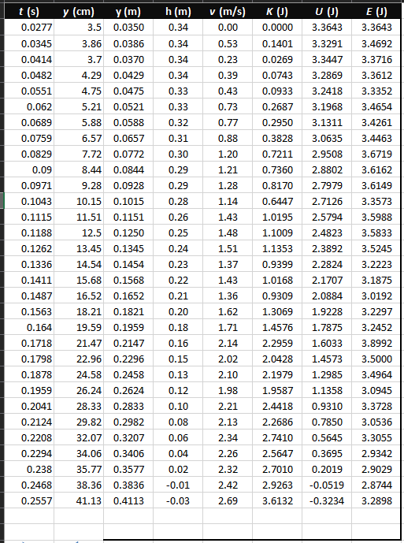
Excel Table (Screenshot)

Slide 30
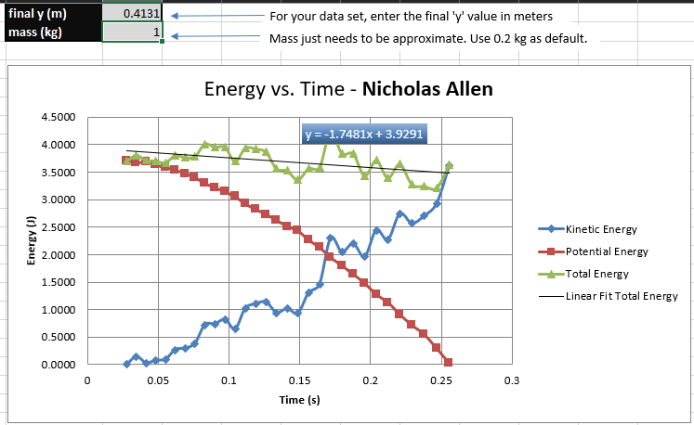
Excel Graph (Screenshot)

Slide 31
Data Analysis
Theoretical value of final velocity
Final velocity from experimental data (or largest velocity)
Percent difference
$h=y_{final}−y_{initial}=$
.3781 m/s²
$v_{f}=\sqrt{2gh}=$
2.50 m/s²
$v_{experimental}$ =
2.69 m/s
$$Percent difference =\frac{\left|v_{f}−v_{experimental}\right|}{v_{f}}×100$$
= 7.6 %

Slide 32
Conclusions
Discuss the key characteristics of the plot. Consider the points when potential energy U is maximum, U is minimum, kinetic energy K is maximum, K is minimum and when U and K are the same value. What is the significance of these points?
Answer: The potential energy is maximum, and the kinetic energy is the minimum at the start of the experiment and change positions steadily until the end. This is due to the potential energy being converted into kinetic energy. The points where the two are the same is called equilibrium and refers to the point where the same amount of energy exists as potential energy and kinetic energy.
U is Max at highest position (start position)
When we are raising the book, we are putting potential energy into it with the force of gravity acting on the mass of the book.
K is Min at highest position (start position)
When the book has been raised, but not yet dropped, the book has no kinetic energy.
U is Min at lowest position (ending position)
When the book comes to rest at the lowest position, all potential energy has been converted into kinetic energy. Gravity is still acting on the mass of the book, but because it has come to rest, all potential energy has been spent.
K is Max at lowest Position (ending position)
The kinetic energy of the book is the highest just as the book comes to rest at the floor. This is because all the potential energy that we put into the book has been converted into kinetic energy.
U and K are the same (Equilibrium)
We can see in the data that there is a point at which the potential energy and the kinetic energy are the same. This is called equilibrium and don’t have to happen in the middle of the data. This occurs when the potential energy used is the same as the kinetic energy created.

Slide 33
Conclusions
What is the trend of the best fit line for the total energy E in your data? If the data is accurate, the total mechanical energy should decrease slightly. Why is that?
Answer: The trend is for my Total Energy line to be wavy around the best fit line, however my total energy does decrease as predicted. This decrease in total mechanical energy is due to several factors. Air resistance, spinning, and deflection of the signal away from the sensor could all play a role.
I tried all the data I saved, and the trend seemed to be the same for them all. The Total energy line jumped above and below the best fit line.

Slide 34
Relationship Between Linear and Rotational Motion
Week 6 - Project 5
Back to Table of Contents

Slide 35
Project Introduction
In this project we used a ruler, the Arduino Mega 2560, a rotary encoder, and an object to attach to the rotary encoder.
I had problems with the bottle cap slipping on my desk pad. To fix this and add more traction I added a small rubber band.

Slide 36
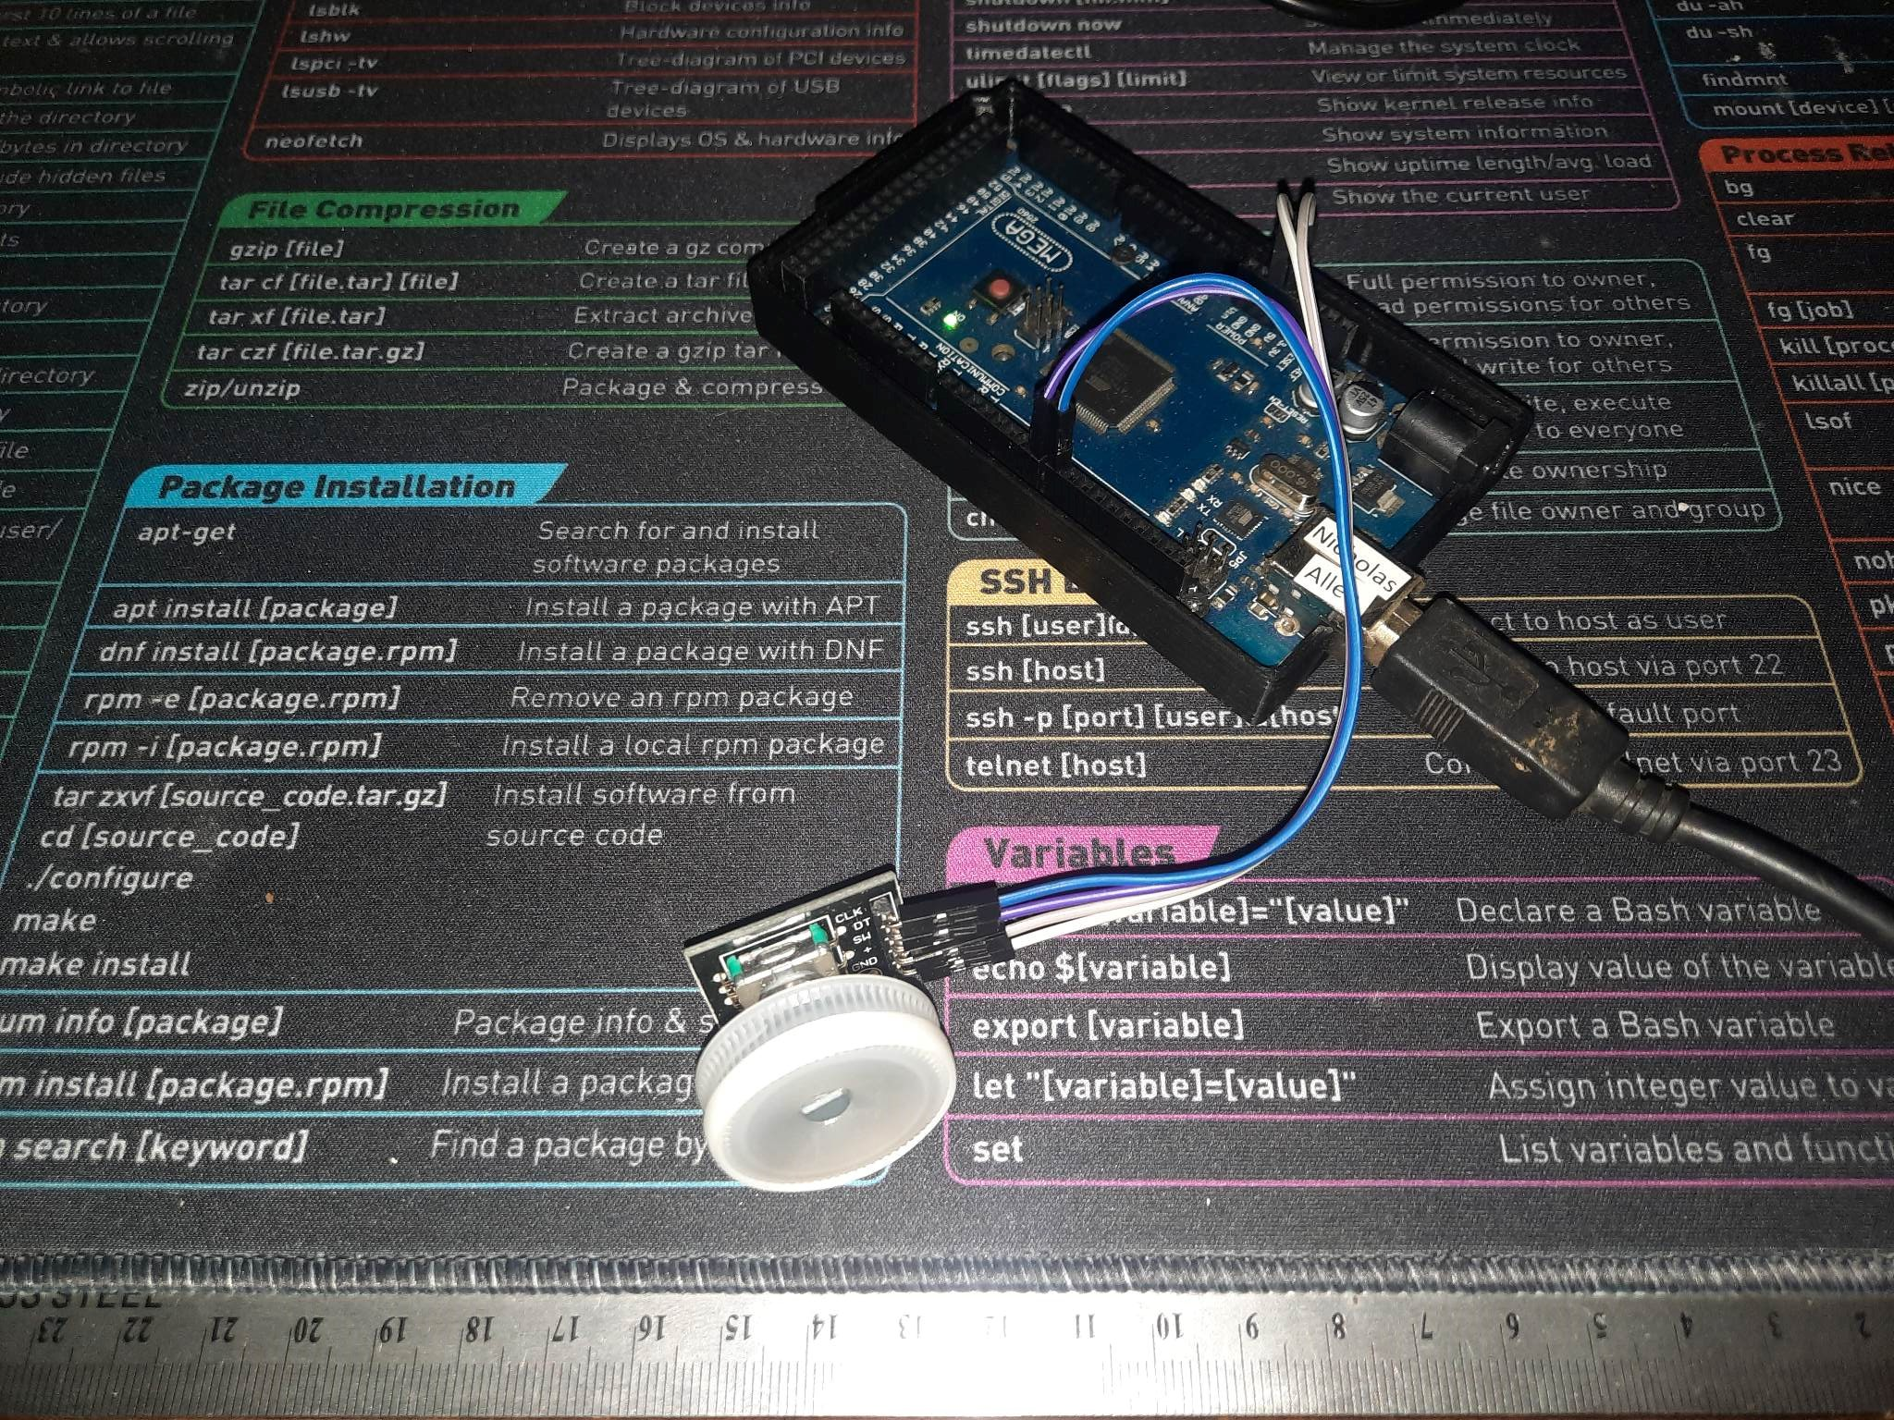
Experiment Set-up (Picture)
Materials List:
Mega 2560 Board
Rotary Encoder Part KY-040
Male to Female Wires
Object to attach onto rotary encoder (e.g. cork, bottle cap, ball)
Ruler or tape measurer

Slide 37
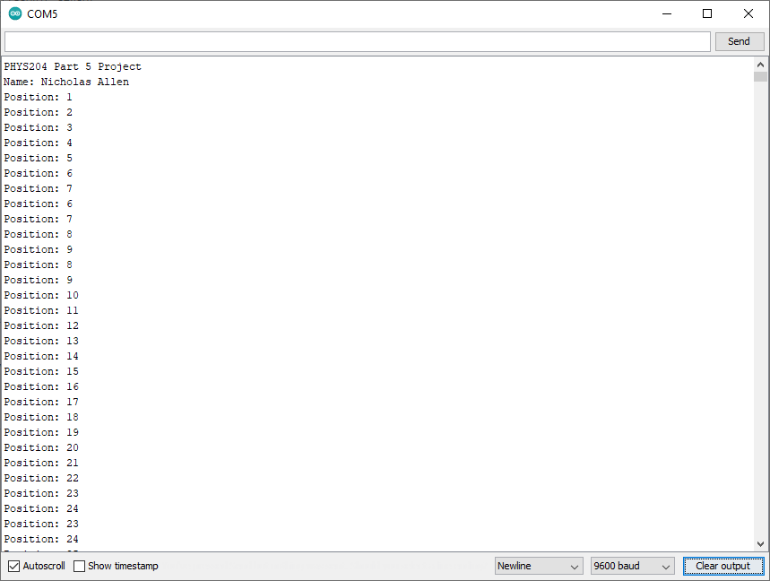
Raw Data (Screenshot)

Slide 38
Data Collection
Object diameter: d = 29mm
Object radius: r = 14.5 mm
Number of pulses for one revolution: x = 30
Resolution = $\left(\frac{1 }{30 } \frac{Revolution}{pulses}\right)∙\left(\frac{2∙π radians}{1 Revolution}\right)=$ 0.209 radians / pulse

Slide 39
Data Analysis
Trial | Number of pulses N | Encoder distance r$∙Resolution∙$ N | Measured distance with ruler | Percent difference
1 | 92 | 27.9 cm | 30 cm | 7 %
2 | 93 | 28.2 cm | 30 cm | 6 %
3 | 94 | 28.5 cm | 30 cm | 5 %
4 | 93 | 28.2 cm | 30 cm | 6 %
5 | 94 | 28.5 cm | 30 cm | 5 %
Average Resolution |  | 28.3 cm | Average % Difference |  | 5.8 %

Slide 40
Conclusions
Discuss the results and comment on the sources of error.
Answer:
The results kind of surprised me. I expected to be a lot closer to the originally measured 30 cm. During my first try rolling the encoder I felt it slipping a little and decided to wrap a rubber band around it to increase the traction.
I recorded this botched first data anyway, 78 pulses on the encoder, and out of curiosity I calculated the results. Without the rubber band my object is 2.6 cm in diameter, 1.3 cm in radius. Still using the 30 cm measured with the ruler, I calculated a rolling distance of 21.2 cm and a 29.3 % difference.
This shows me that traction is important when measuring in this method. Other factors that could cause a problem could be attempting to roll the encoder too fast or even in a curved line may interrupt the rolling and cause anomalies.
What are some applications of this measuring technique? Could this measuring system be used to measure surfaces that are not flat?
Answer:
One application is measuring linear feet in machinery. Rollers of specific diameters are used to calculate size for many automated cutting machines. I have personally used a rolling measurer to measure and mark for visualizing new buildings before they are placed. I have used them to measure for different types of installation of wires and pipes. Some police officers use this system to measure at scenes of accidents.
The question asks about measuring surfaces that are not flat and most of the ground around here isn’t flat so I would say yes. This measuring system can be used to measure anything that will cause the measuring roller to rotate. I have used this system on very uneven ground, over gravel and grass, and in hallways and driveways.

Slide 41
Observing the Hall Effect
Week 7 - Project 6
Back to Table of Contents

Slide 42
Project Introduction
Using the hall effect sensor that is built into the ESP32 microcontroller and a magnet we can see an interaction in Arduino IDEs serial monitor.
Hall effect sensors are used in a multitude of devices, like speed sensors in some electric vehicles.

Slide 43
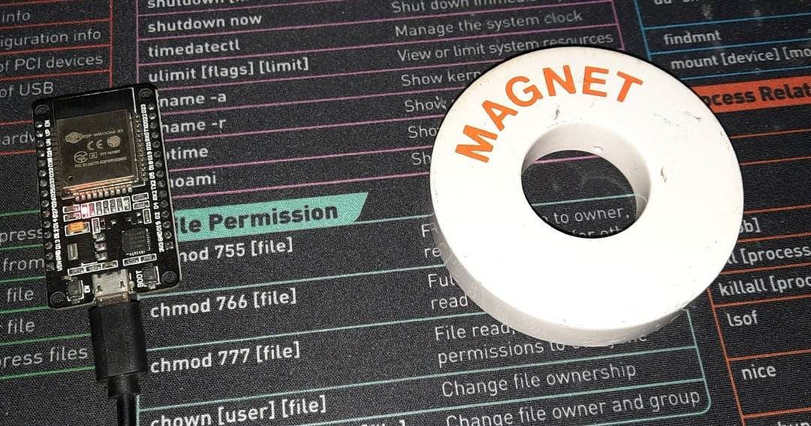
Experimental Set-up (Picture)
Materials List: ESP32 microprocessor, Micro-USB cable, Magnet

Slide 44
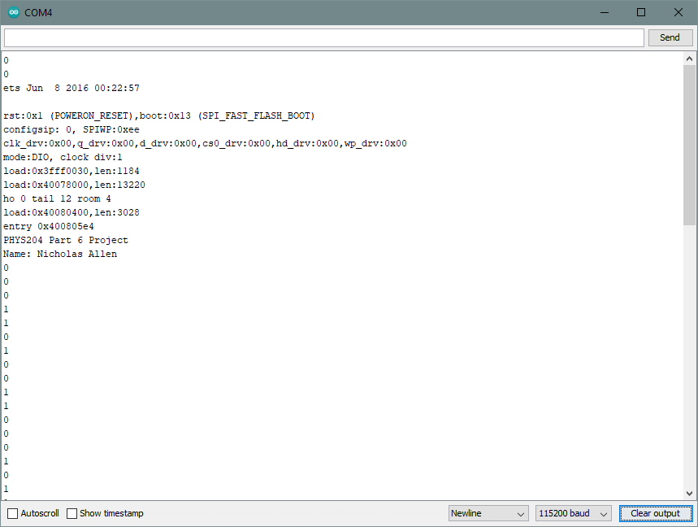
Raw Data (Screenshot)
Screenshot of Serial Monitor from Arduino IDE showing raw data.

Slide 45
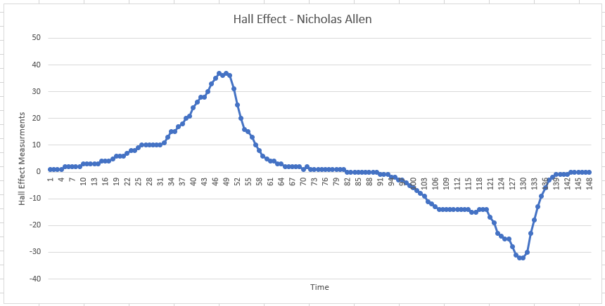
Excel Graph (Screenshot)
Include Excel graph for a single trial of data plotted as a function of time.

Slide 46
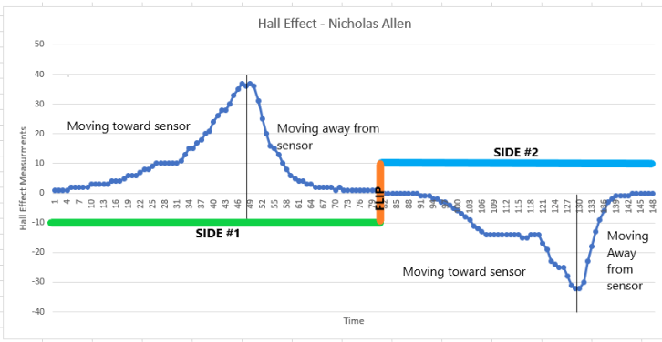
Enhanced Excel Graph (Screenshot)
Enhanced graphic showing the areas of motion of the magnet toward and away from the Hall effect sensor and the point of flipping the magnet.

Slide 47
Conclusions
Discuss the results and comment on the sources of error.
Answer: As seen in the Raw Data screenshot, I was having some jitter even with the magnet moved far away. I believe the source of this error was my wireless optical mouse which was only a few inches away from the ESP32. Once I removed the mouse from the area the jitter stopped.
Describe how the Hall sensor works. What are some applications for the Hall effect sensor?
Answer: Hall effect sensors work by detecting a magnetic field and calculating the strength and the direction of the field. Hall effect sensors are used in some vehicles and other machinery to detect speed. They can be used for current sensors to detect and regulate voltages.

Slide 48
Project Challenges
I had difficulty getting the ultrasonic sensor to connect to the Arduino Mega 2560 through the breadboard. I fixed this by connecting the sensor directly to the microcontroller.
I also had to add a rubber band to the bottle cap I was using on the rotary encoder. I did not have enough traction to cause the encoder to properly rotate.
Back to Table of Contents

Slide 49
Career Skills
I learned a lot about how the world works with the help of math.
I have learned patience and perseverance through this class. Some of the material in this class seemed to be way over my head, but with enough patience and practice I was able to get it.
I can apply these to my everyday life as well as any career I should choose.
Back to Table of Contents

Slide 50
Conclusions
I enjoyed learning how physics is all around us, everyday, all the time. Before this class, just setting at my desk, I never thought about how physics was actively participating. From the energy powering my personal computer, to gravity keeping everything on my desk and the lightbulb in the lamp, physics is everywhere!
Nick Allen
Back to Table of Contents

