Slide 1
Netw211 – Final Project Fundamentals of Cloud Computing
By Nicholas Allen
Professor Toni McGee
DeVry University
Session: May 2023
Course ID: NETW211

Slide 2
Table of Contents
Introduction
Week 1 – Getting Started
Week 2 – Virtual Machine (VM) Instances
Week 3 – Microsoft Azure Vnet & Subnet
Week 4 – Microsoft Azure VM security
Week 5 – Cloud Storage
Week 6 – Cloud Monitoring
Project Challenges
Career Skills
Conclusion
References

Slide 3
Introduction
The main goal of Networking 211 class is to teach about the fundamentals of cloud computing and prepare us for taking the CompTIA Cloud+ Certification exam. I believe the class has taught me a lot about computing in the cloud, but I do not feel ready to take this test.
A few things this class has taught me:
What Cloud Computing is.
What a Virtual Network is and how it is configured.
Techniques for storage on the cloud.
Procedures for migrating to the cloud.

Slide 4
Week 1 Getting Started
In week 1, we were introduced to cloud computing and learned about planning and executing a migration to the cloud. We touched on the software development life cycle and DevOps.
Week 1’s project was ungraded and simply signing up for our Microsoft Azure Student Accounts and successfully logging in.

Slide 5
Week 2 Virtual Machine (VM) Instances
Week 2 was all about Virtual Machines, or VMs.
We learned about a few different types of connections available to a VM, like SSH, VNC, and RDP. We also learned about network virtualization and began our lessons in Cloud Computing.
This weeks project showed us how to create, connect to, and delete a virtual machine on Microsoft Azure.

Slide 6
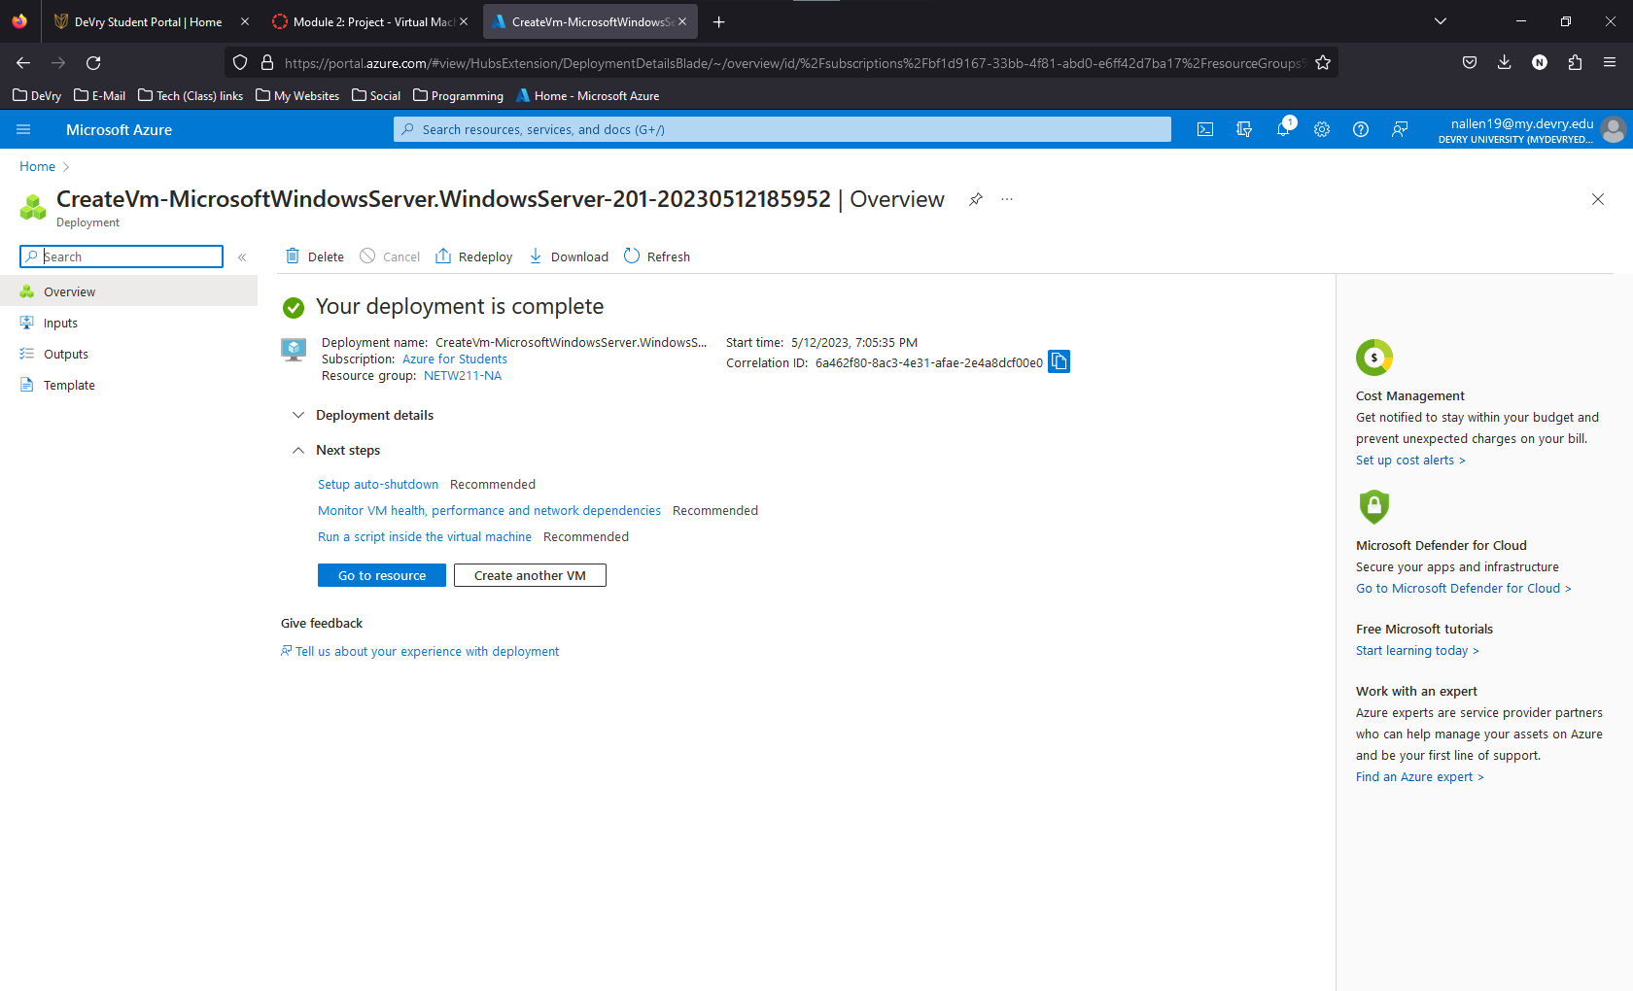
Deploying a VM in Azure
This screenshot should show the NETW211VM page with information such as the resource group name, subscription, public IP address, etc.

Slide 7
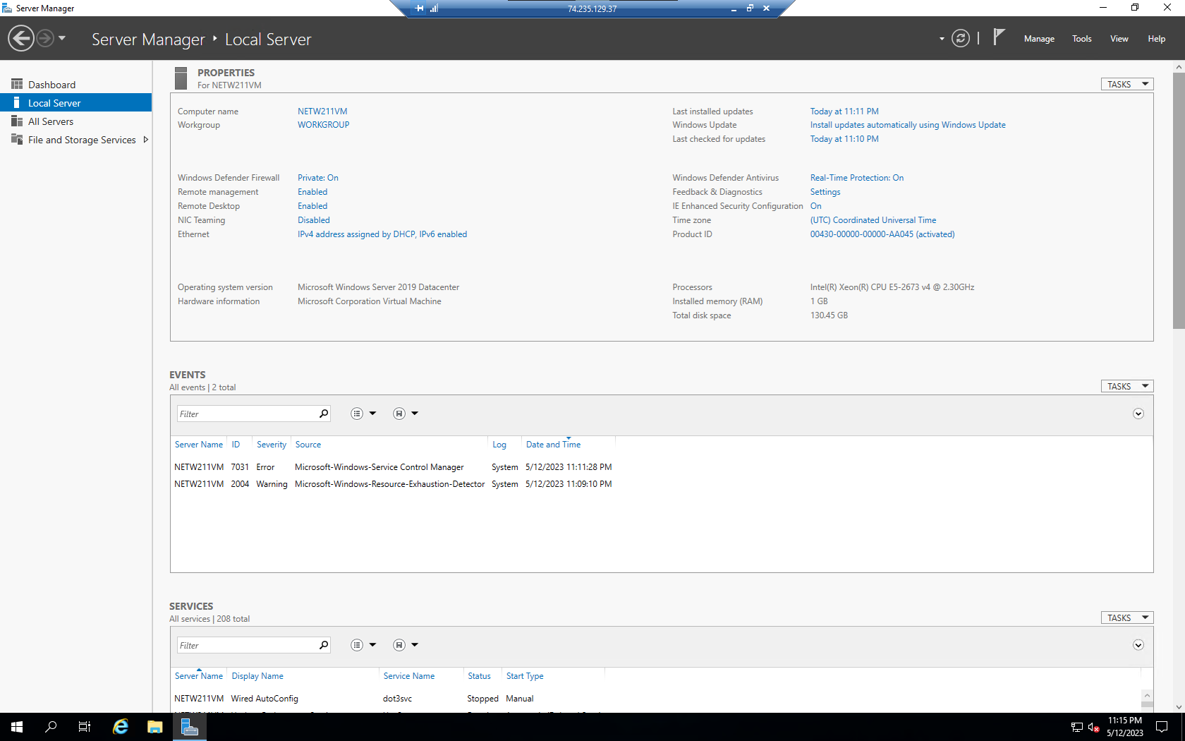
Connecting to the VM
This screenshot should show the PROPERTIES for NETW211VM page, with the computer name, operating system version, hardware information, etc.

Slide 8
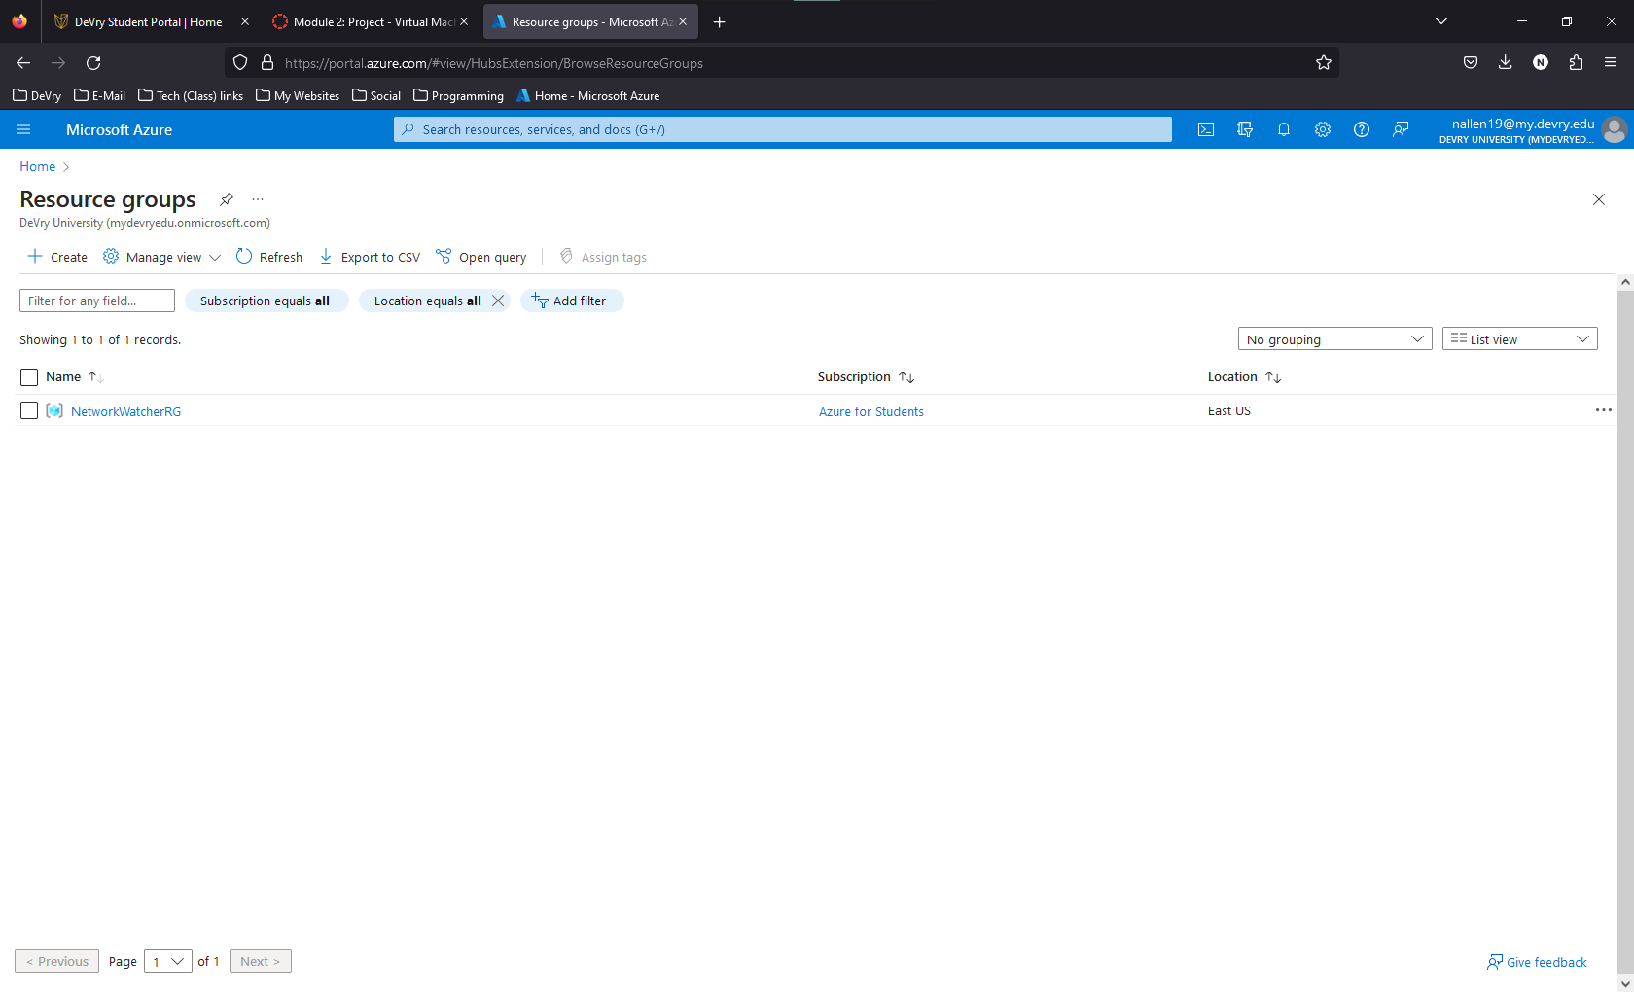
Deleting the VM
This screenshot should show the Resource groups page, with the Subscription == all selection, but without the NETW211-XX (Your Initials) resource group listed.

Slide 9
Week 3 Microsoft AZURE VNET & Subnets
In week 3 we discussed Hybrid (on-prem and cloud based) and Multi cloud (cloud based services from 2 or more providers) networking. We also discussed load balancing and access management.
Our week 3 project encompassed creating a subnet on Microsoft Azure, creating and deploying VMs to the newly created subnets and show connectivity between the two virtual networks.

Slide 10
Creating a VNet with Two Subnets
Question 1
With a /24 network prefix, how many usable IPv4 host addresses are there? [hint: you learned this in NETW191]
Answer here:
There should be 256 IP addresses with a CIDR of /24, however, only 251 available IP addresses are reported on the “Subnets” page on Microsoft Azure.

Slide 11
Creating a VNet with Two Subnets
Question 2
Given the answer from before, why is the number of available IP addresses for Subnet0 (10.0.0.0/24) or Subnet1 (10.0.1.0/24) shown as 251? [hint: where did the missing addresses go?]
Answer here:
Researching through the Azure FAQ, I learned that Azure reserves the first four and last IP address of the range.
The first IP address is reserved for the Network address
The second is reserved for the default gateway.
The third and fourth IP addresses in the range are used for DNS and other services.
The last IP in the range is reserved for the Network Broadcast Address.
References:
1. Azure Virtual Network frequently asked questions, https://docs.microsoft.com/en-us/azure/virtual-network/virtual-networks-faq

Slide 12
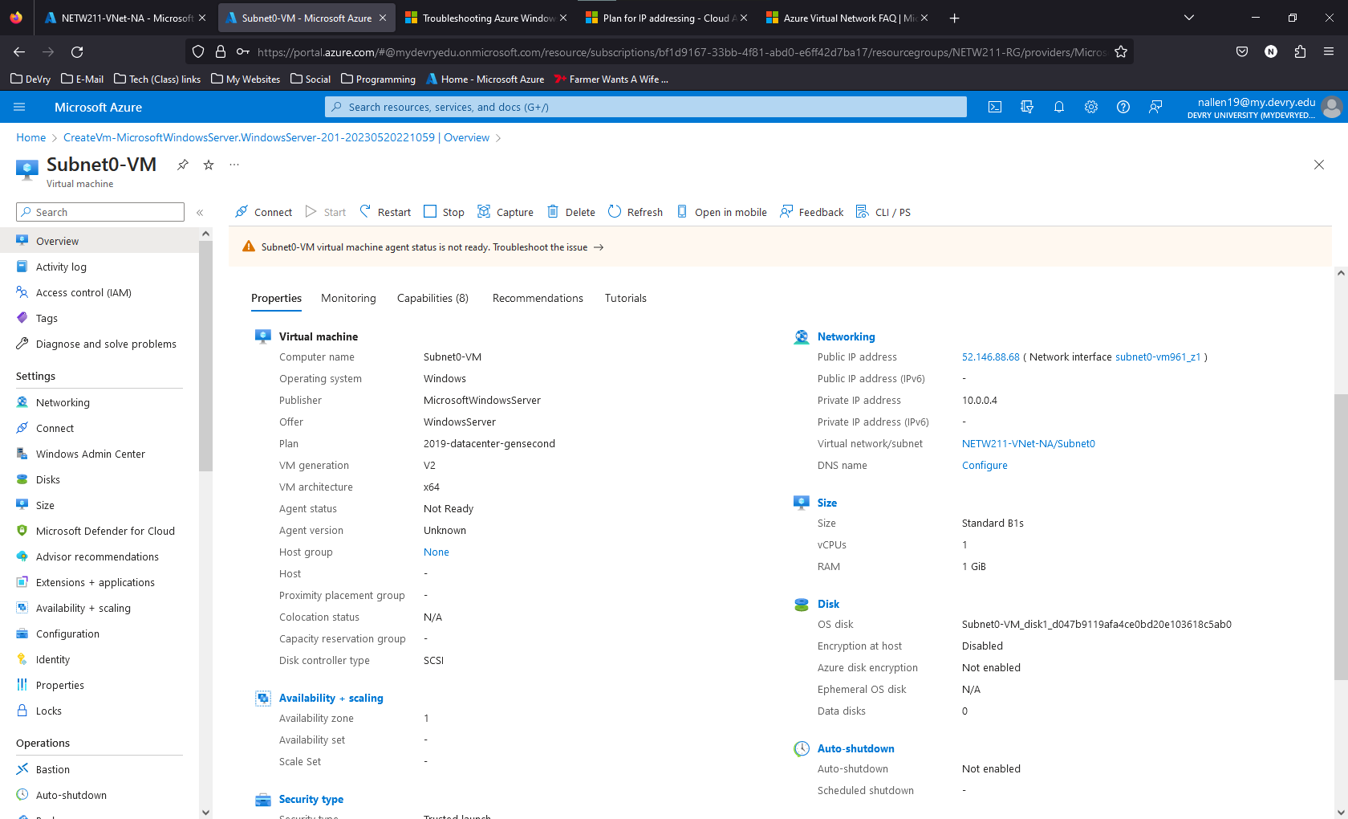
Deploying VMs into Subnets
This screenshot should show the Properties section of the Subnet0-VM page, showing the networking and size information of the VM.

Slide 13
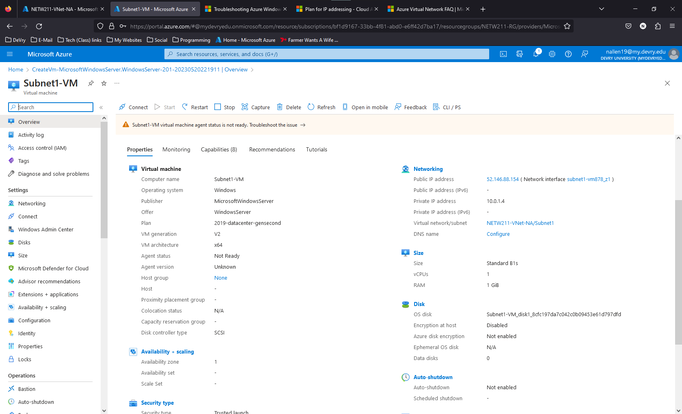
Deploying VMs into Subnets Cont’d
This screenshot should show the Properties section of the Subnet1-VM page, showing the networking and size information of the VM.

Slide 14
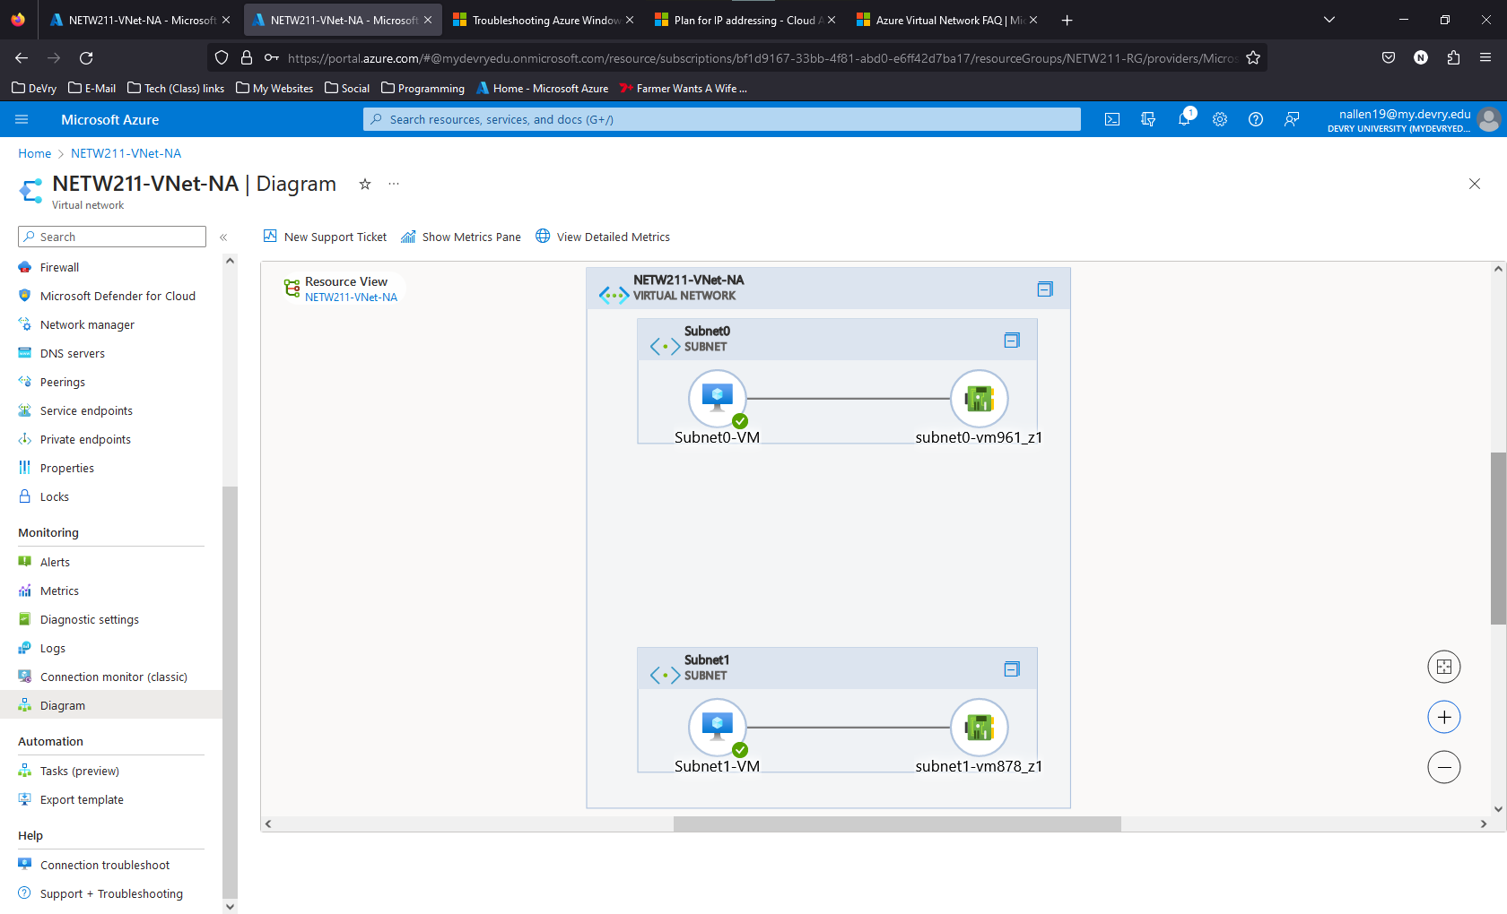
Deploying VMs into Subnets Cont’d
This screenshot should show the topology diagram of your VNet (NETW211-VNet-Your Initials) with two subnets (Subnet0 and Subnet1) and one VM in each subnet (Subnet0-VM and Subnet1-VM).

Slide 15
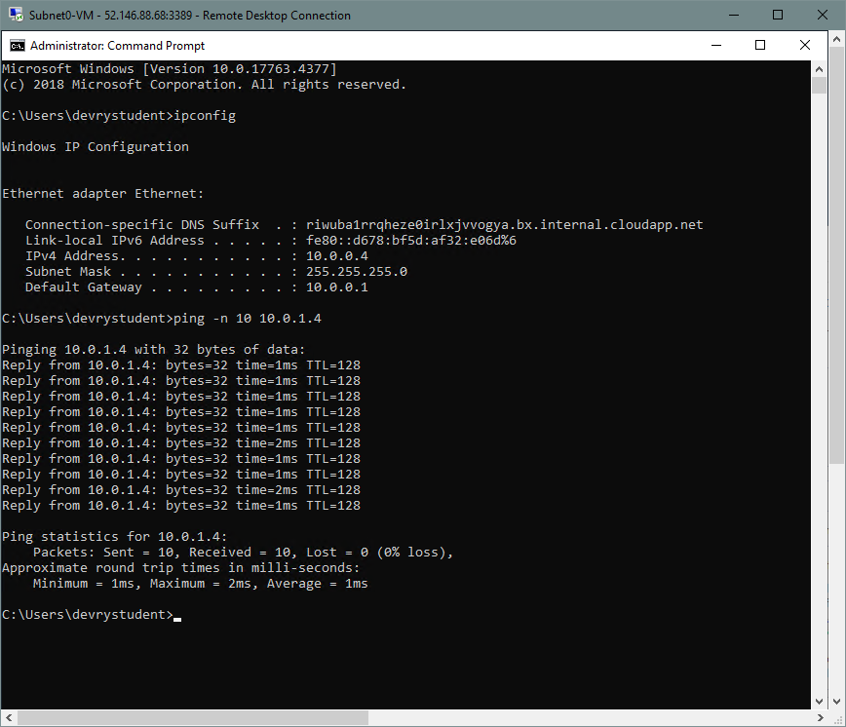
Verifying Connectivity between VMs
This screenshot should show the ipconfig and ping x.x.x.x results in the command prompt window, including the Subnet0-VM – x.x.x.x – Remote Desktop Connection window title.

Slide 16
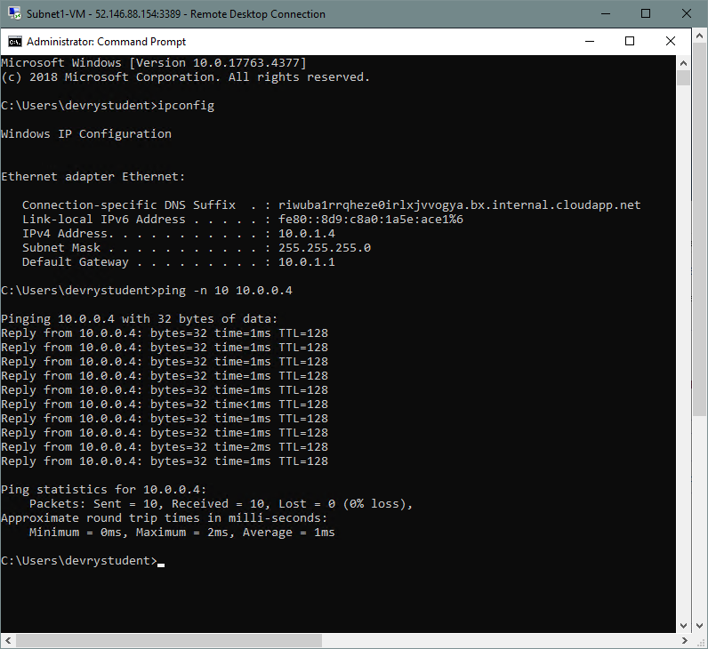
Verifying Connectivity in VMs Cont’d
This screenshot should show the ipconfig and ping x.x.x.x results in the command prompt window, including the Subnet1-VM – x.x.x.x – Remote Desktop Connection window title.

Slide 17
Week 4 Microsoft AZURE VM Security
Week 4 was about cloud security and the techniques that can be applied. We talked about DevSecOps and Micro-segmentation We learned about how allow and deny rules control traffic on a virtual network.
In the week 4 project, we created a VM inside Microsoft Azure and then connected to it via SSH. We then tested and configured allow and deny rules to control the traffic.

Slide 18
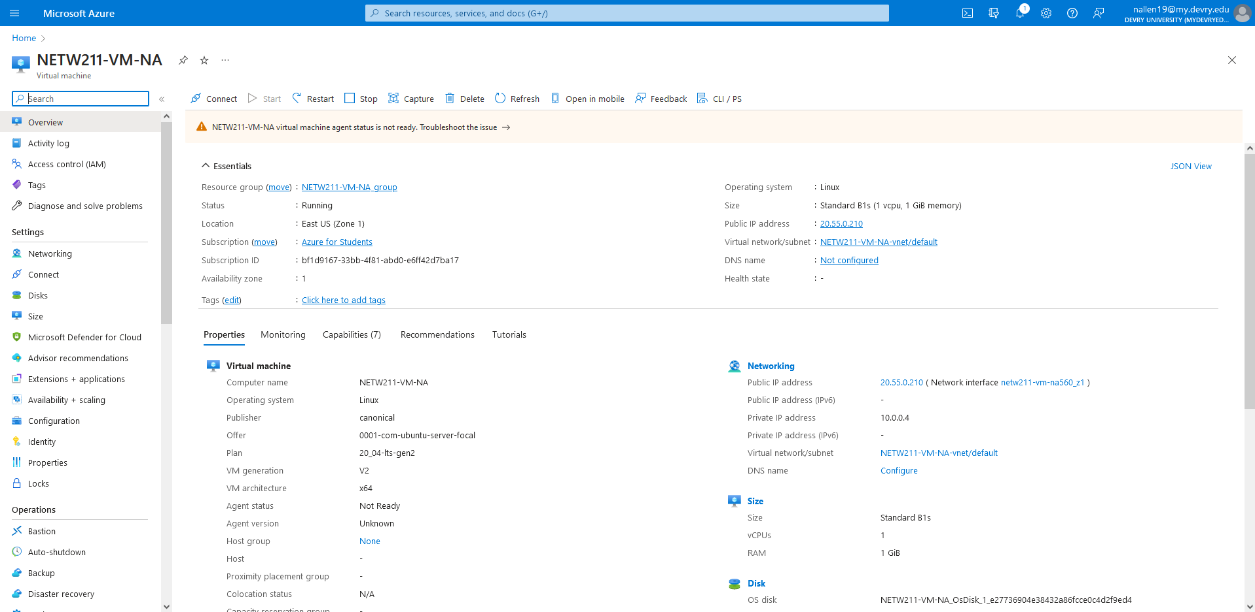
Launching a VM
This screenshot should show the NETW211-VM-Your Initials page, with information such as the resource group name, subscription, public IP address, etc.

Slide 19
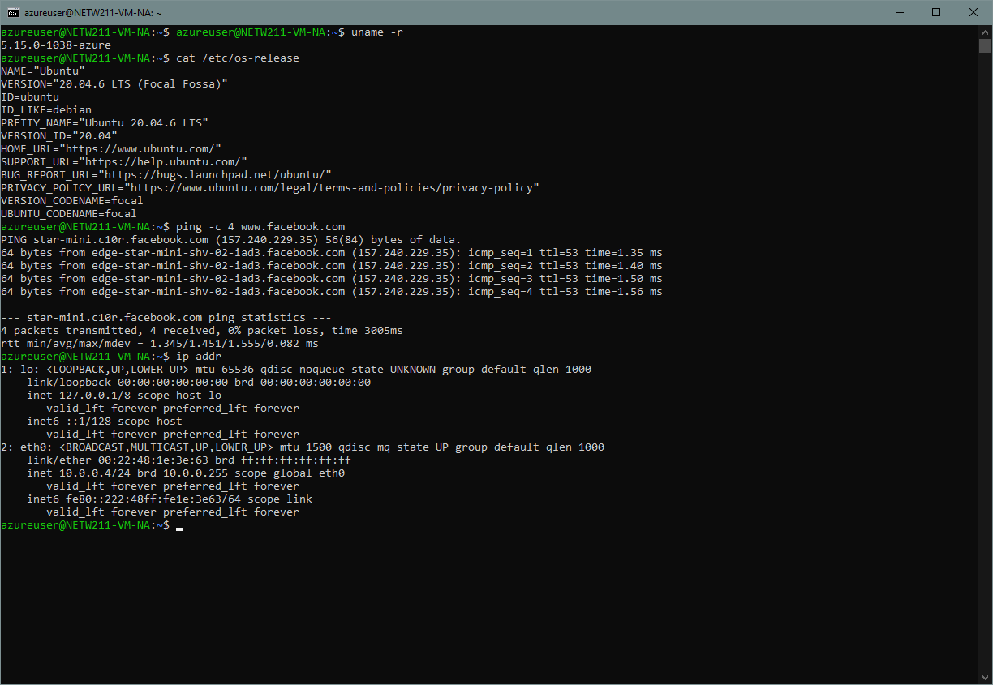
Connecting to the VM via SSH
This screenshot should show the azureuser@NETW211-VM-Your Initials window showing the IPv4 address of the VM in the Azure cloud.

Slide 20
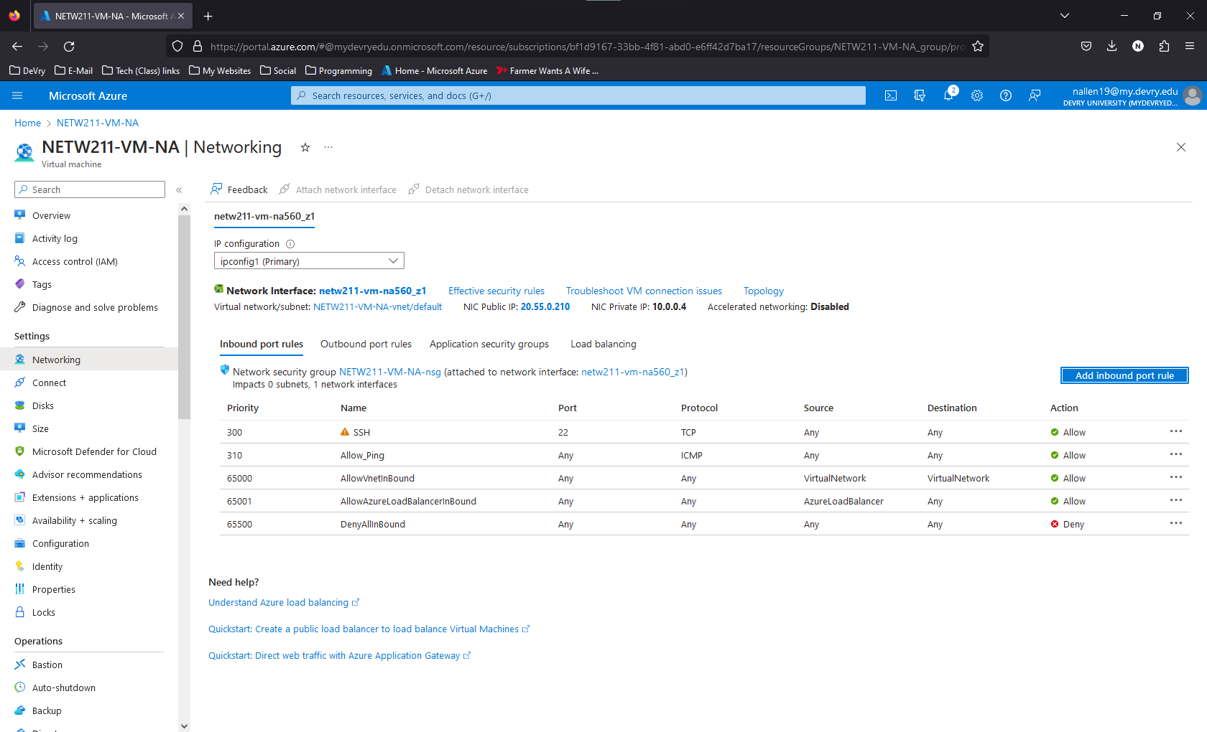
Configuring and NSG
This screenshot should show the Inbound port rules section with the newly added Allow_Ping rule.

Slide 21
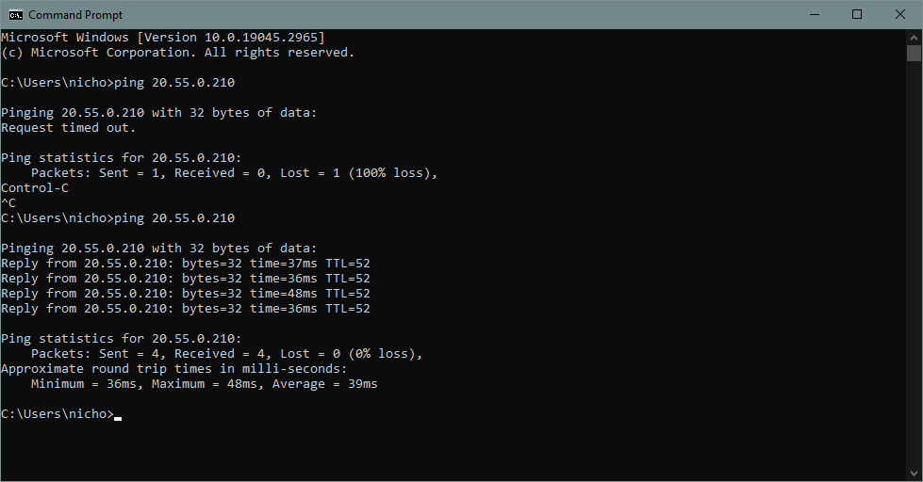
Configuring an NSG cont’d
This screenshot should show the successful ping result from your local computer to the VM in the Azure cloud.

Slide 22
Week 5 Cloud Storage
Week 5 was about storage on the cloud. The different types of storage are Object, File, and Block storage, and each has its pros and cons. This week we also learned about backup redundancy, or multiple backups on multiple medias, in multiple locations.
3-2-1 rule – 3 copies of backup, 2 medias, 1 media in a different location
This weeks project consisted of uploading a file to Microsoft Azure and accessing this file from the web. It also included creating Blob storage on Microsoft Azure, uploading a file, and removing the Blob Storage.

Slide 23
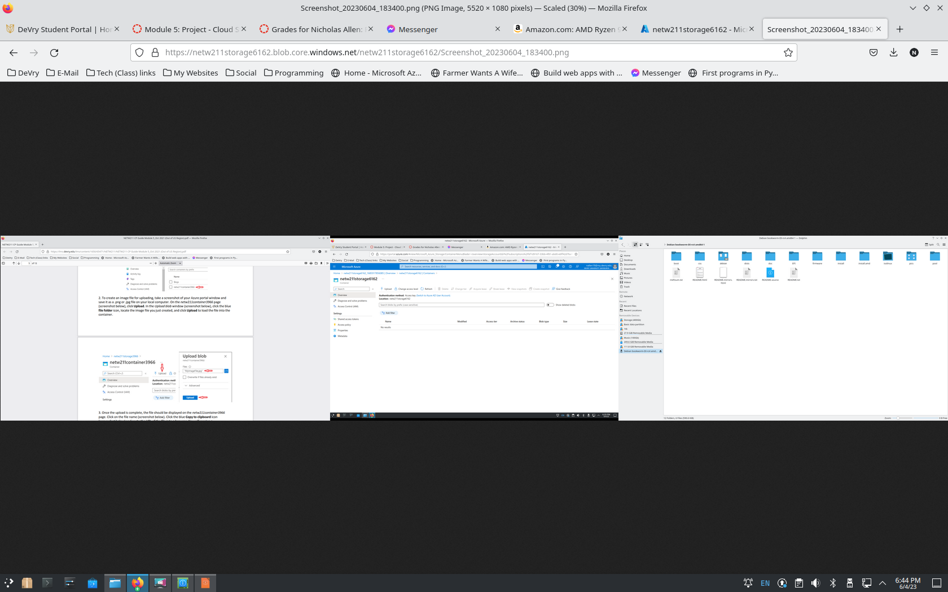
Uploading and Accessing a File
This screenshot should show the browser window with the image uploaded from your local computer and the URL on top of the window.

Slide 24
Question
What does the access tier setting do? What are the Azure blob storage access tiers?
Access tiers for Azure blob storage are available to provide cost effective storage solutions.
Tiers include – HOT, COOL, COLD, and ARCHIVE.
HOT – Data needing highest accessibility, highest cost of storage with lowest access cost
COOL – Data needing medium accessibility, stored for 30 days minimum
COLD – Data needing low accessibility, stored for 90 days minimum
ARCHIVE – Data needing rare accessibility, lowest cost of storage with highest access cost
References:
Hot, Cool, and Archive access tiers for blob data, https://docs.microsoft.com/en-us/azure/storage/blobs/access-tiers-overview

Slide 25
Creating Blob Snapshots
This screenshot should show the browser window with the “This is the original version. –Your Initials” message and the URL on top of the window

Slide 26
Enabling blob versioning
This screenshot should show the browser window with the “This is the first revised version. –Your Initials” message and the URL on top of the window.

Slide 27
Week 6 Cloud Monitoring
In week 6, we learned about Cloud Monitoring and how to create a dynamic dashboard with the tools and information most commonly needed.
In the week 6 project we learned about setting up alert rules in Microsoft Azure. These alerts will send a email if a certain set of events happens.

Slide 28
Setting up an Action Group and Notifications
This screenshot should show the “VM-Status-Change” action group on the Manage actions page.

Slide 29
Setting up Alert Rules
This screenshot should show the Alert rules window showing the VM-Deallocate and VM-Restart rules.

Slide 30
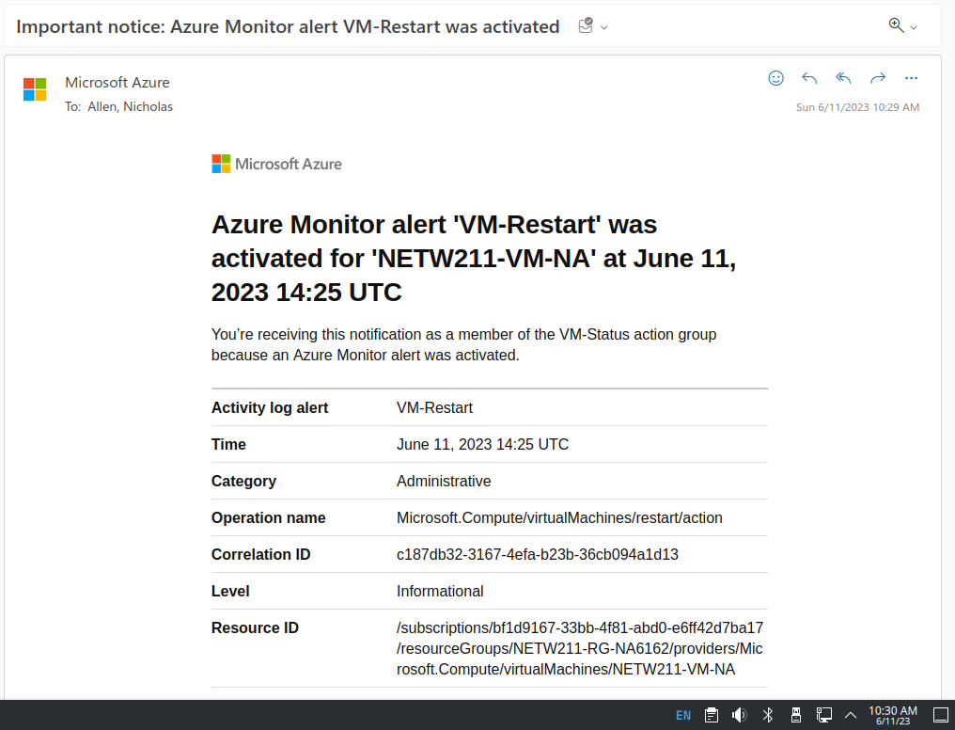
Testing Alerts
This screenshot should show the ‘VM-Restart’ was activated email message with the date and time of the alert.

Slide 31
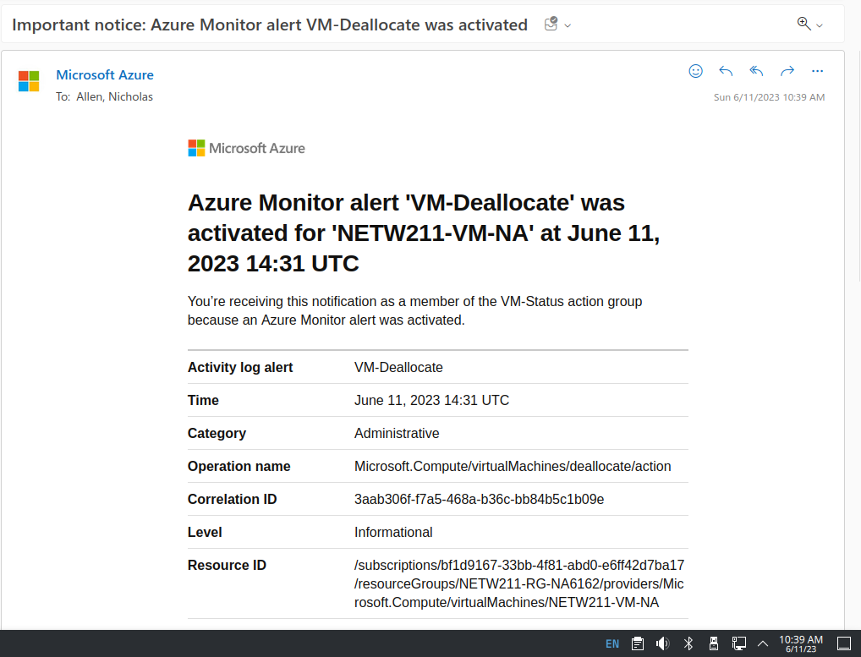
Testing Alerts cont’d
This screenshot should show the ‘VM-Deallocate’ was activated email message with the date and time of the alert.

Slide 32
Project challenges
I did not have much challenge in this class as I have toyed around with my Microsoft Azure Student Account since I started at DeVry in Jan, 2022. Cloud computing and virtual machines have always fascinated me, so I just purchased a new PC to take advantage of some of the things I have learned in this class.

Slide 33
Career Skills
The skills I learned in this class will definitely help me in most tech fields as a lot of the technology is going into the cloud for ease of use and accessibility
Knowing a little about Microsoft Azure gives me confidence that I can continue to learn and eventually be able to take the CompTIA Cloud+ Certification exam.

Slide 34
Conclusion
In conclusion, this class has taught me about cloud computing and networking.
I learned about cloud maintenance tools and techniques, how to choose cloud service providers, and basic creation of virtual machines.
I thought this class was a good class, I learned quite a bit about things I didn’t understand yet. I feel like I had an advantage by playing with Microsoft Azure a bit and getting to know the software.

Slide 35
References
Week 3, Slide 11
Azure Virtual Network frequently asked questions, https://docs.microsoft.com/en-us/azure/virtual-network/virtual-networks-faq
Week 5, Slide 24
Hot, Cool, and Archive access tiers for blob data, https://docs.microsoft.com/en-us/azure/storage/blobs/access-tiers-overview

