Slide 1
Fundamentals of Information Technology and Networking
By Nicholas Allen
Professor Gary Giomi
DeVry University
Session: March 2023
Course ID: NETW191

Slide 2
Table of Contents
Please Click Section Title for Quick Navigation.
Section Title | Page Number
Main Introduction | 3
IP Addressing | 4
Connectivity Test | 8
IP Subnetting and Loopback Interface | 14
SOHO Wireless Networking Security | 20
Microsoft Visio Network Diagram | 24
Project Challenges | 27
Career Skills | 28
Conclusion | 29
References | 30

Slide 3
Main Introduction
In this course we learned about networking and focused in on IPv4 addresses. In this presentation I show some key points of IPv4 and subnetting in a virtual environment.
In the first section, we setup a connection and discuss the default gateway.
The second section shows both virtual computers connecting to the virtual SOHO router.
The next section shows how we created a subnet to contain different virtual “departments” and only allow access to what is needed.
Section four talks about network security in wireless networks and available options in TP Link wireless routers.
The next section is simply a graphic, created with Microsoft Visio, showing a network diagram with related information.
Back to Table of Contents

Slide 4
IPv4 Addressing
Week 2 – Project Part 1
Back to Table of Contents

Slide 5
Project Introduction
This section begins the weekly projects. Here we access the virtual labs, check that a default gateway is assigned, and experience the OpenWRT interface.

Slide 6
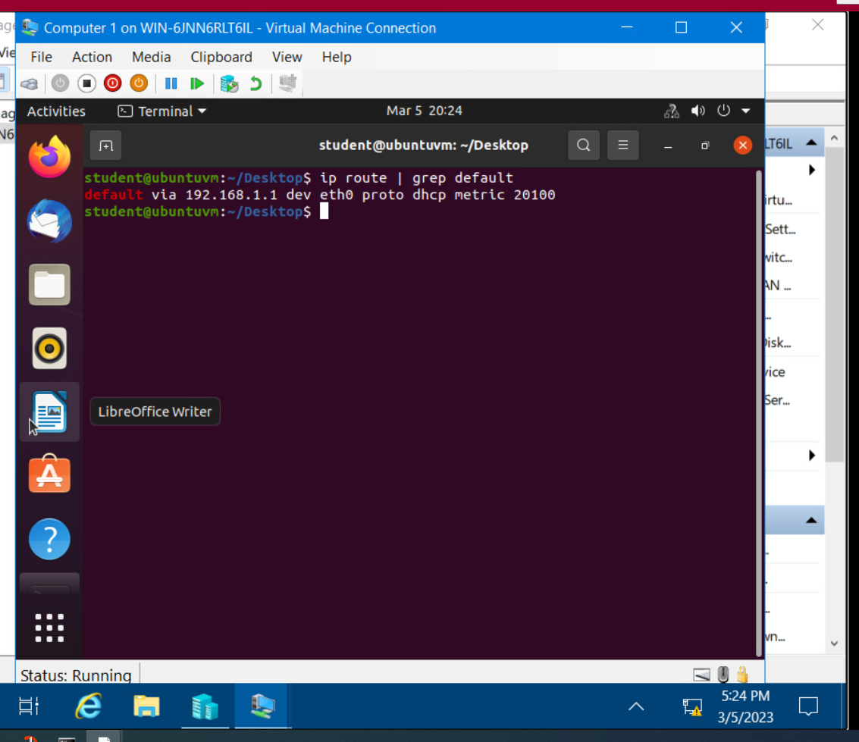
Preparation
This screenshot should include the terminal window that shows the default gateway IP address.

Slide 7
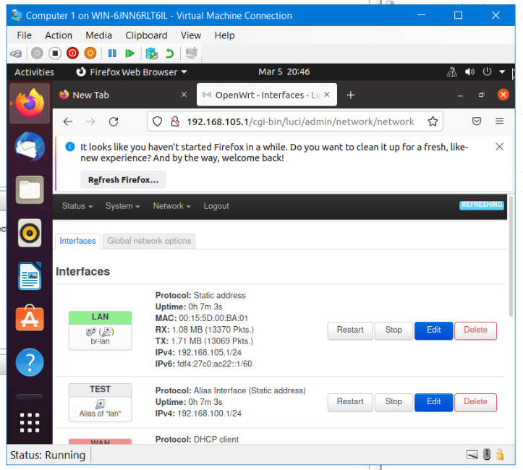
IPv4 Address Assignment
This screenshot should include the Interfaces page that shows the new IPv4 address on the LAN interface.

Slide 8
Connectivity Test
Week 3 – Project Part 2
Back to Table of Contents

Slide 9
Project Introduction
This section shows the connectivity between virtual computer 1 and virtual computer 2.
We show the connection by using the command “ping” to send and receive packets from one device to another.

Slide 10
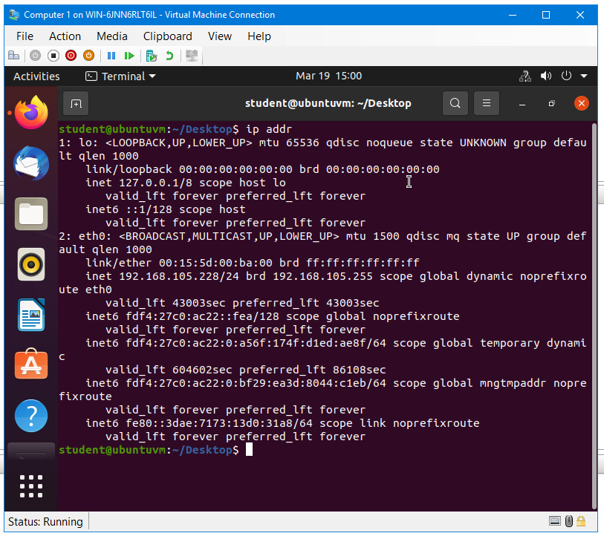
Dynamic IP Address Assignment
This screenshot should show the IPv4 address of the Computer 1 VM.

Slide 11
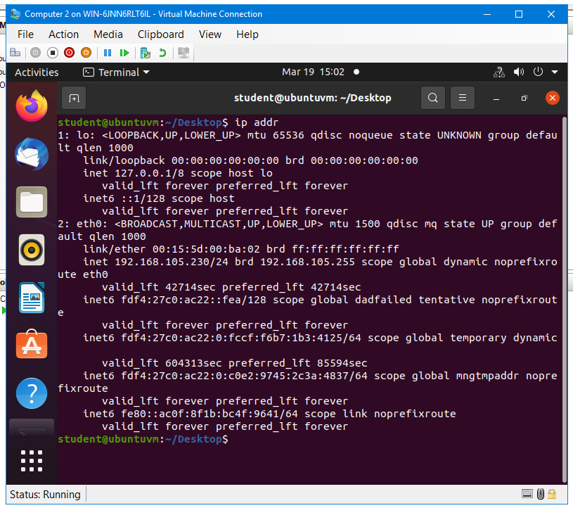
Dynamic IP Address Assignment
This screenshot should show the IPv4 address of the Computer 2 VM.

Slide 12
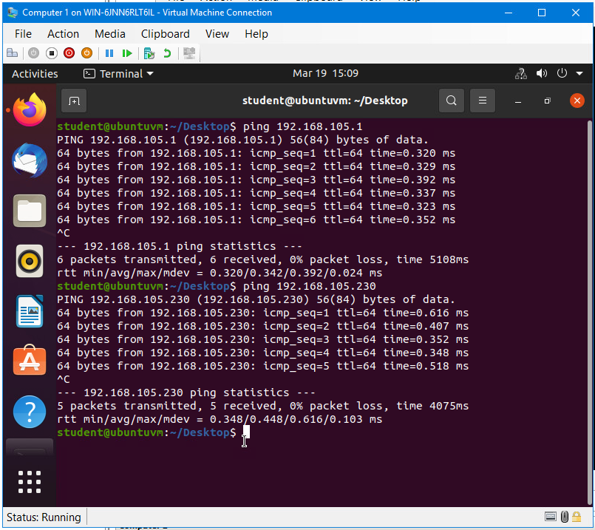
Connectivity Test
This screenshot should show the connectivity tests between the Computer 1 VM and the other two devices (i.e., the SOHO Router VM and Computer 2 VM).

Slide 13
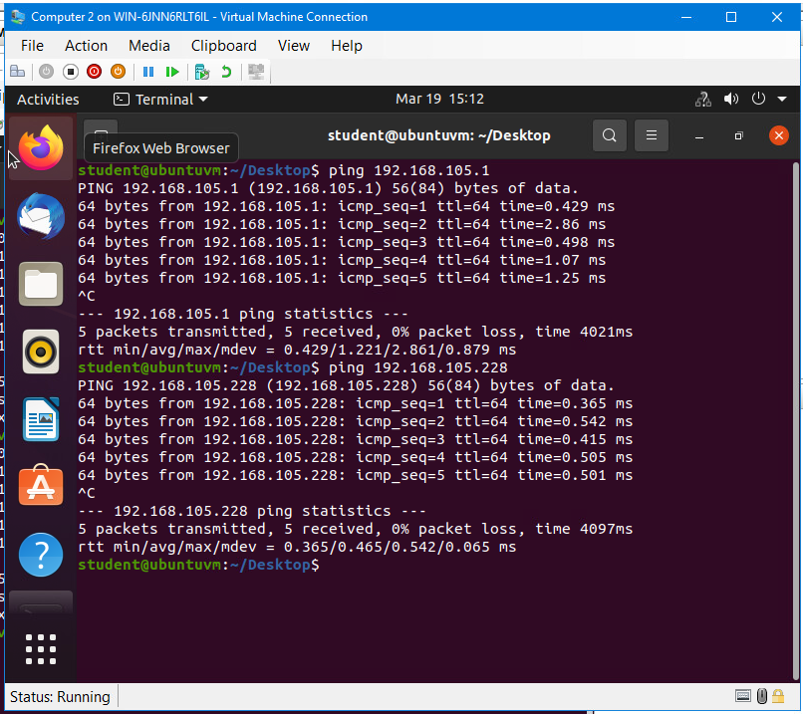
Connectivity Test
This screenshot should show the connectivity tests between the Computer 2 VM and the other two devices (i.e., the SOHO Router VM and Computer 1 VM).

Slide 14
IP Subnetting and Loopback Interface
Week 4 – Project Part 3
Back to Table of Contents

Slide 15
Project Introduction
Here we show the IP subnetting information used to create two subnets. I also show that I was able to ping both subnets and receive a response.

Slide 16
Subnetting Table
Two /25 subnets, subnet notation, network address, first usable host address, last usable host address, and broadcast address of each subnet.
 | Subnet ID | Network Mask (/prefix) | Network Mask (Dotted Decimal) | First Usable Host Address | Last Usable Host Address | Broadcast Address
1st Subnet | 0 | /25 | 255.255.255.128 | 192.168.5.1 | 192.168.5.126 | 192.168.5.127
2nd Subnet | 1 | /25 | 255.255.255.128 | 192.168.5.129 | 192.168.5.254 | 192.168.5.255

Slide 17
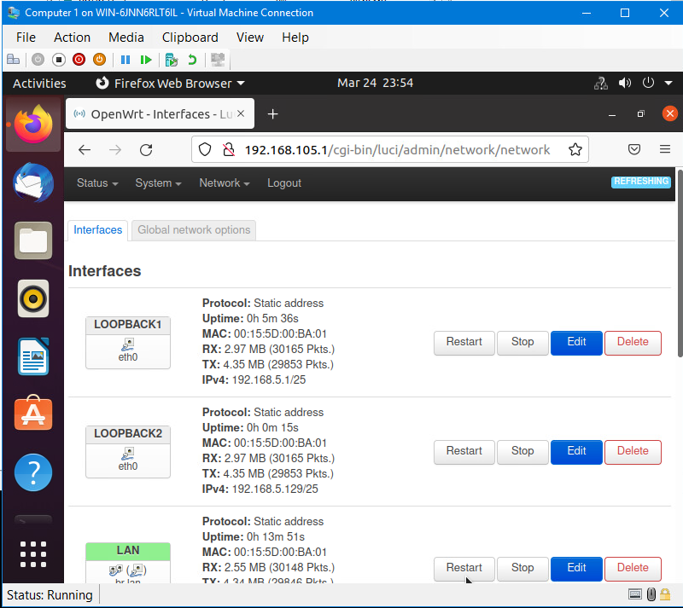
Loopback Interfaces
Loopback1 and Loopback2 interfaces and their correct IPv4 addresses.

Slide 18
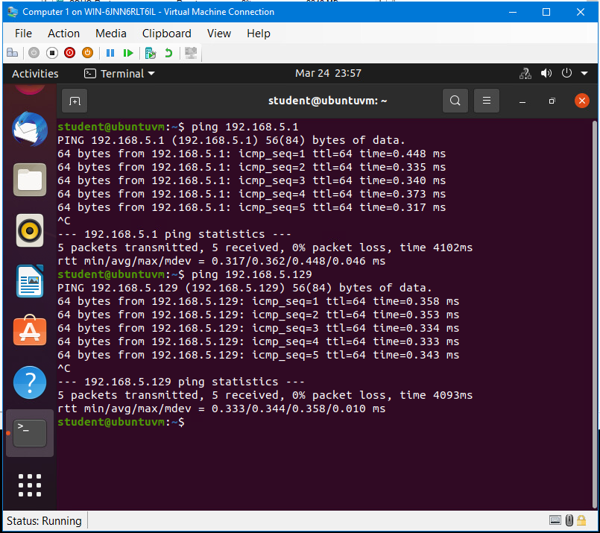
Connectivity Tests
Two successful ping tests from the Computer 1 VM to the Loopback 1 and Loopback 2 interfaces.

Slide 19
SOHO Router Verification (ip addr)
The output from the command “ip addr” when ran on the virtual SOHO router

Slide 20
SOHO Wireless Network Security
Week 5 – Project Part 4
Back to Table of Contents

Slide 21
Project Introduction
This section is about wireless network security. The questions are mainly in reference to TP Link wireless routers and the functions available with it’s software.

Slide 22
SOHO Wireless Network Security
1. What are the factory default username and password of a TP-Link router? Why is it important to change the default username and password of a SOHO router?
Answer: The default username and password for TP-Link routers are admin for both. This is the case for many SOHO routers, either admin for username and password, or admin for username and password for the password. These defaults are easily found online and should always be changed.
2. To protect a SOHO wireless network with a small number of devices, which address management method provides more control, configuring the device IP addresses manually (static IP) or using a DHCP server (dynamic IP)? Why?
Answer: Configuring your small network to use static IP can provide more control over what IP address is assigned to what device. Static IP by MAC address can allow only known and configured devices to gain access to parts of, or the entire network.
3. What does MAC filtering do? If needed, when would you use deny filtering rules and when would you use allow filtering rules? What happens to devices that want to connect, if the “Allow the stations specified by any enabled entries in the list to access” function is enabled but there are no entries in the list?
Answer: MAC filtering either allows or denies access to the network based on configuration (WIFI). The deny rules could be applied if you have noticed a rogue device on your network, whereas the allow rules could allow only certain devices to access sensitive data (WIFI). If the allow rules are applied, but no devices are in the list, no devices will be able to access the network (WIFI).

Slide 23
SOHO Wireless Network Security
1. What wireless security settings are displayed on the Wireless Security page? Which one is recommended by the vendor? Why?
Answer: WPA2-PSK AES encryption is the vendor recommended wireless security option to use (WIFI). WPA2-PSK AES stands for Wi-Fi Protected Access Version 2 - Pre-Shared Key with Advanced Encryption Standard and is the latest in Wi-Fi security (Sahu, 2022). WPA2 is the second version of the wifi protected access protocol and addresses vulnerabilities known in previous versions (Sahu, 2022). And when used in combination with a Pre-Shared Key using the Advanced Encryption Standard you create a hard to penetrate setup.
2. Among the configurations you explored in this module, which one is a true security function? Why?
Answer: If I think of a true security function, WPA2-PSK comes to mind. It only allows access to those who have the password and can be used in combination with other encryption methods like AES and TKIP.
3. What would you do to protect your wireless network at home? Why?
Answer: Honestly, I still use the default router password as it’s just a jumble of letters and numbers. I monitor my network for rogue actors and remove any that I might think need removed.

Slide 24
Microsoft Visio Network Diagram
Week 6 – Project Part 5
Back to Table of Contents

Slide 25
Project Introduction
This section shows a network diagram displaying the virtual LAN.
Computer 1, Computer 2, and the SOHO router are all virtual devices, all related information is contained in the graphic.

Slide 26
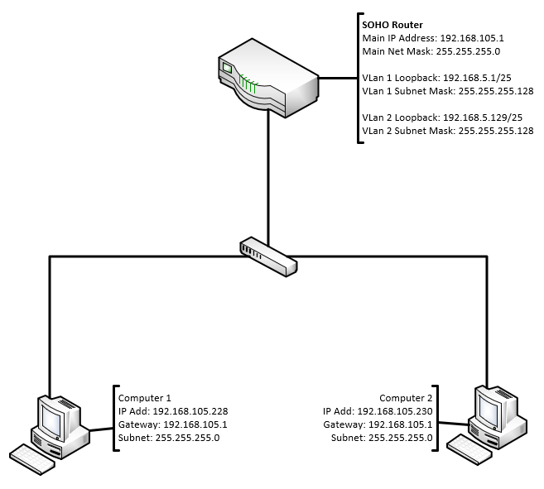
This diagram should illustrate the interconnection of the Computer 1 VM, the Computer 2 VM, and the SOHO Router VM along with proper addressing and labeling.
Microsoft Visio Network Diagram

Slide 27
Project Challenges
I think the most challenging part of this course has been trying to retain all of the information presented.
I enjoy the hands-on projects to learn by experience and allow the opportunity to fail and try again.
Back to Table of Contents

Slide 28
Career Skills
I believe everyone in any tech field should understand the basics of networking and how to set up a secure environment. I think understanding subnetting and how to break the network down into smaller chunks will increase the opportunities in all tech jobs.
Back to Table of Contents

Slide 29
Conclusions
I never knew there was so many different pieces that all needed to work together seamlessly in order to connect to another device on a different network.
Understanding the OSI model, converting from decimal octets to binary, IPv4 and Subnetting seem to be the most important parts of this course.
Nick Allen
Back to Table of Contents

Slide 30
References
Sahu, V. (2022, December 14). What is WPA2-PSK? Scaler Topics. Retrieved April 8, 2023, from https://www.scaler.com/topics/wpa2-psk/
WIFI networking equipment for Home & Business. (n.d.). Retrieved April 8, 2023, from https://emulator.tp-link.com/902AC_US_Emulator/Emulator_Hotspot/index.htm
Back to Table of Contents

