Slide 1
CIS355a
Business Application Programming - Final Project
Nicholas Allen
8.30.2024
DeVry University
July/Aug 2024 Session
Professor Rick Bird

Slide 2
AGENDA
Project Overview
Week 1 - UML & Wireframe
Week 2 - Customer Class / Information Panel
Week 3 - Welcome Panel
Week 4 - Customer List Panel / Combining
Week 5 - DataIO class
Week 6 - Database connectivity
What I Learned
Challenges
Peer Review
Conclusion

Slide 3
Project Overview
An overview of the entire project
Back to Agenda

Slide 4
Whole Project Overview
This project demonstrates how to use Java to go from designing the UML and Wireframe Diagrams to a finished product ready for the client. We use many different GUI controls, save and retrieve data with CSV files and connect to and use MySQL Databases.

Slide 5
Week 1
Using Visio to create UML and Wireframe Diagrams
Back to Agenda

Slide 6
Week 1 – Part 1
Create a UML Class diagram following the information below
Class name: Customer
Attributes:
customerID - int - private
name - String - private
address - String - private
yardType - String - private
length - double - private
width - double - private
totalCost - double - private
Behaviors
toString() - String - public
getDetails() - String - public
Class name: DataIO
Attributes:
DATABASE_NAME - String - private
CONNECTION_STRING - String - private
USER_NAME - String - private
PASSWORD - String - private
Behaviors
add(cust: Customer) - void - public
delete(customerID: int) - void – public
getList() – ArrayList<customer>

Slide 7
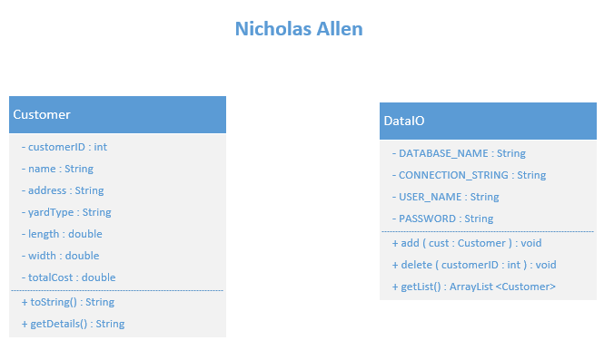
UML Class Diagram
Step 1 was creating the “Customer” and “DataIO” UML Class Diagrams.
We used Microsoft Visio to complete the tasks in week 1

Slide 8
Week 1 – Part 2
Create a Wireframe Diagram to visualize the project once complete.
Creating the Wireframe Diagram
The provided instructions told us to create an application with a landscape design. Place a Menu bar, with items File and Order onto the design. Next add 3 panels with names “Welcome”, “Information”, and “Customer List” titles. Then we were instructed to build the application out by adding several components to each panel. These components include labels, buttons, textBoxes, textAreas, and radioButtons.

Slide 9
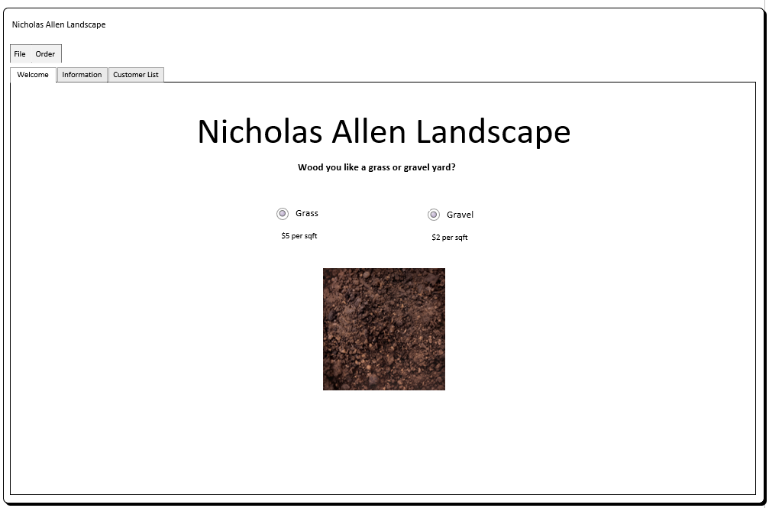
Wireframe – Welcome Panel
The first panel to build out is the “Welcome” panel.
This panel consists of labels and radio buttons inside of a button group.
Notice I didn’t say anything about an image? This is because the image is inside of a label! Crazy right?
Here we need to ask the customer what kind of yard they want and show a visual representation of the material.

Slide 10
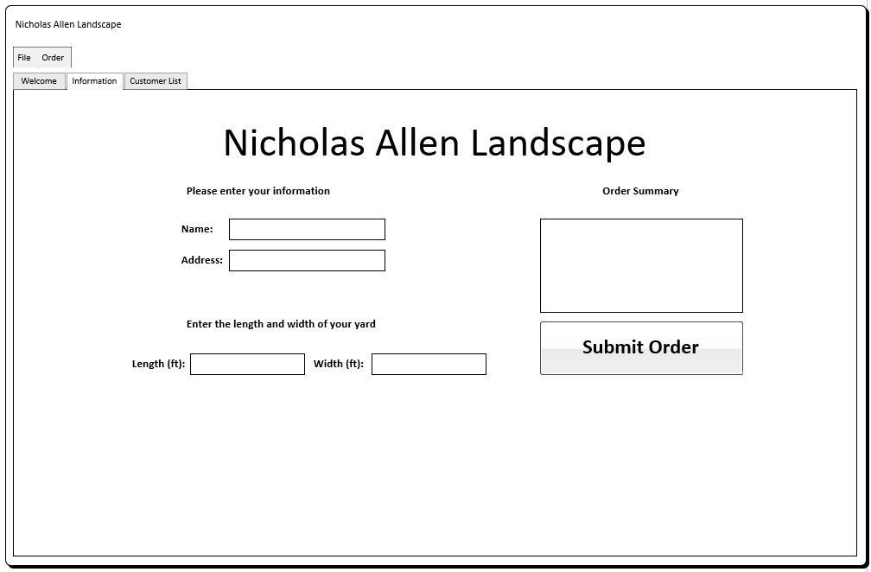
Wireframe – Information Panel
The next panel to build out is the “Information” panel.
This panel has labels like the “Welcome” panel but also contains a few different components. Here we have text boxes, a text area, and a button.
We need to collect the customers information and submit the order.

Slide 11
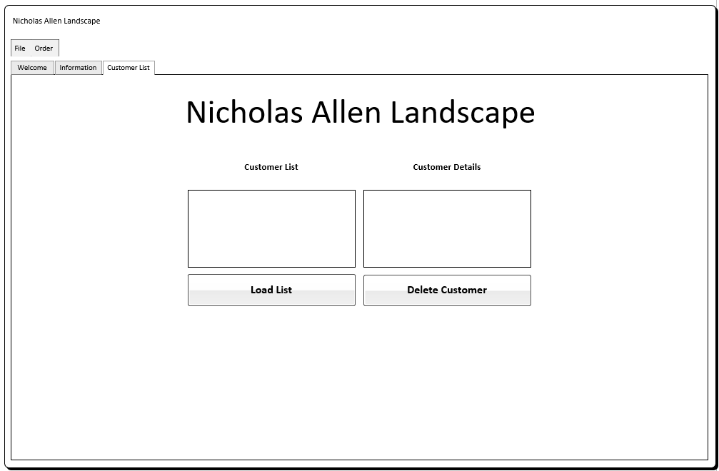
Wireframe – Customer List Panel
The final panel to build out is the “Customer List” panel.
As labels are need to identify what information is requested or displayed in what area, we see they are also used here. Now, this panel looks like it’s just two more text areas but the one on the left (Customer List) is going to be a list box when we program it.
Here we can view customer information, load the customer list, and remove customers from the list.

Slide 12
Week 2
Using NetBeans to create the Customer class and the “Information” panel GUI
Back to Agenda

Slide 13
Week 2
Creating the Customer class
Starting off, we created a new GUI project in NetBeans. After adding a new Java class to the project, we began creating the customer class. Creating the constructors, adding the attributes, behaviors, and finally the getters and setters. We use the UML Class diagram that we created in week 1 to gather what the Customer Class code will look like. We need public methods for each of the behaviors, while the attributes need to stay private, and use public getter and setter methods for access.
Creating the GUI for the “Information” panel
We need to add a new JFrame Form this time. This gives us the ability to use NetBeans built in GUI editor. Following the Wireframe Diagram that we created in week 1, we begin to flesh out the “Information” panel. We do not have a tabbed panel in out project yet, as we are building each panel in a different JFrame Form and then combining them in a later week. We add several lables, text boxes, buttons, and a text area.
Once finished with the GUI design we started in code. We learned how to validate the users input and respond accordingly. If all input was valid, we create a Customer object and store the customers information: customerID, name, address, yardType, length, width, and totalCost. We left the Submit button unfinished but display a message stating the method is not complete.

Slide 14
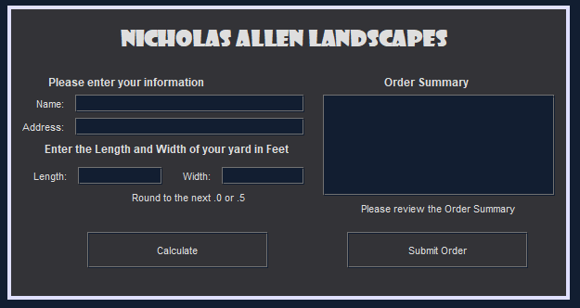
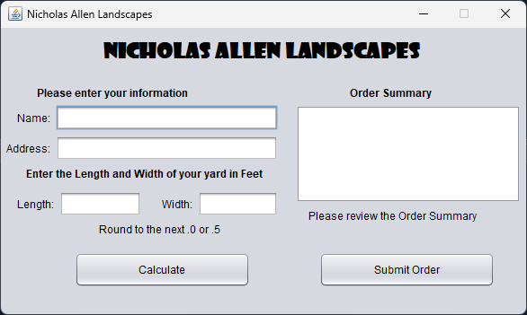
NetBeans GUI– INFORMATION Panel
The first GUI we make in this project is the “Information” panel. We build each panel as an individual JFrame form and combine them in a later week.
Here we use the Wireframe from week 1 to design the panel.
(Dark = design, Light = running)

Slide 15
Week 3
Using NetBeans to create the “Welcome” panel GUI
Back to Agenda

Slide 16
Week 3
Gathering resources
For the week 3 project, we will be creating the GUI for the “Welcome” panel. This panel has a label that contains an image, that we change depending on what radio button is selected, or not selected. This first step is to gather the resources and copy them into the project. Locating images on Google for academic use is allowed, so most any image you like will due.
Creating the GUI for the “Welcome” panel
Create a new JFrame Form, adding the appropriate labels, buttons, and menu items. We are going to add a couple buttons to act as a “reset” and to progress to the “Next” panel.
Coding consists of making the reset menu item call the same method and the button press, connecting the radio buttons to the button group and code to change the image upon selection, or back to “dirt” when the reset button/menu is clicked. While the Order > Submit Order menu item displays a message saying it is still incomplete, the “Next” button loads and displays the “Information” JFrame that we created in week 2.

Slide 17
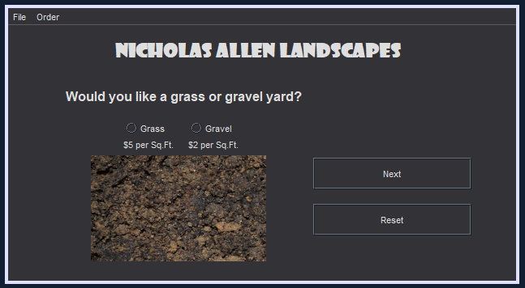
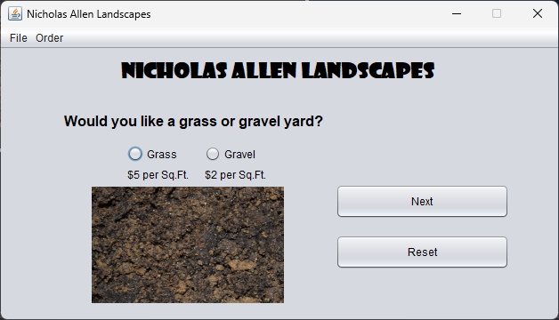
NetBeans GUI– Welcome Panel
The next GUI we make is the “Welcome” panel. This panel contains mainly labels, but also radio buttons, regular buttons, and menu items.
We use the Wireframe from week 1 to design the panel.
(Dark = design, Light = running)

Slide 18
Week 4
Using NetBeans to create the “Customer List” panel GUI and combine panels into a tab panel
Back to Agenda

Slide 19
Week 4
Combining the panels into a Tabbed Pane
We made a copy of the “Welcome” panel GUI and removed all of the components except the menu. We then added a Tabbed Pane and populated it with 3 panels. We named the panel tabs accordingly and moved all the components from the “Welcome” and “Information” JFrame Forms over to the respective tab panels.
Creating the GUI for the “Customer List” panel
This time instead of creating a JFrame Form, we put the required components directly into the panel associated with the requested tab. We add more labels, a text area, and a list, along with few buttons.
NetBeans will copy the code that is associated with the component you are copying, so most of the code is already there, only moved to the correct file. We need to finish coding the “Customer List” tab, so we will start with modifying the existing code to function like we want. Re-coding the Next button on the “Welcome” screen to now flip to the “Information” tab, instead of opening the JFrame, and updating the Reset button to include resetting the text areas on the “Information” tab while placing you back at the “welcome” tab. We then needed to code the methods to make the “Customer List” tab usable. Like adding code to submit the order, adding the customer to the list, and displaying the details depending on what customer was selected in the list.

Slide 20
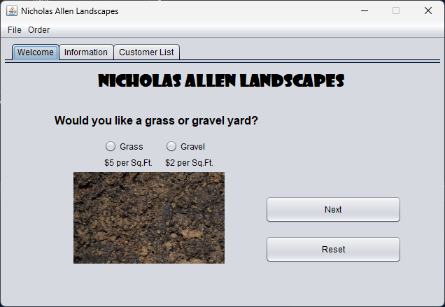
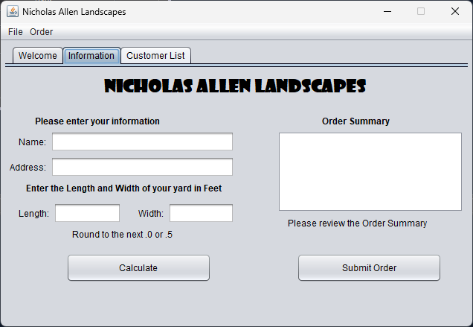
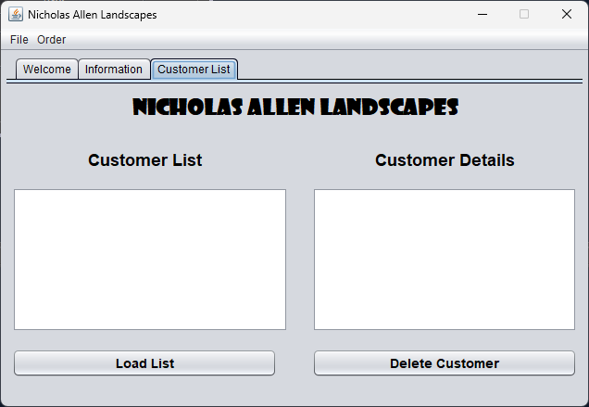
NetBeans GUI–Complete
Now we have a complete GUI. It is usable but it still does not save any data. Great for a test but not practical for the real world. We need to save and retrieve the data, and that’s next weeks project.
We use the Wireframe from week 1 to design the panel.

Slide 21
Week 5
Creating the DataIO Calss to Read and Write Files
Back to Agenda

Slide 22
Week 5
Creating the DataIO Class
Following the UML diagram for the DataIO class, but omitting the private attributes, we create the DataIO class with the behaviors of add(), delete(), and getList(). We then updated the submitOrder() method in the GUI to use the DataIO functions we just created to save the order details. We chose to use comma separated value files (.CSV) to store the data in a convenient way. CSV files are like databases because they are structured in a predictable order, and separated by a delimiter, typically a comma, and most database management systems can export and import CSV files.
We then added the code to open and read the information from the file to an ArrayList, and on into the DefaultListModel used for the Customer List component. We connected this to the Load List button on the “Customer List” tab. We connected the Remove customer button to the code to delete the customer. I completed the optional challenge of making the customer list load when the program runs.

Slide 23
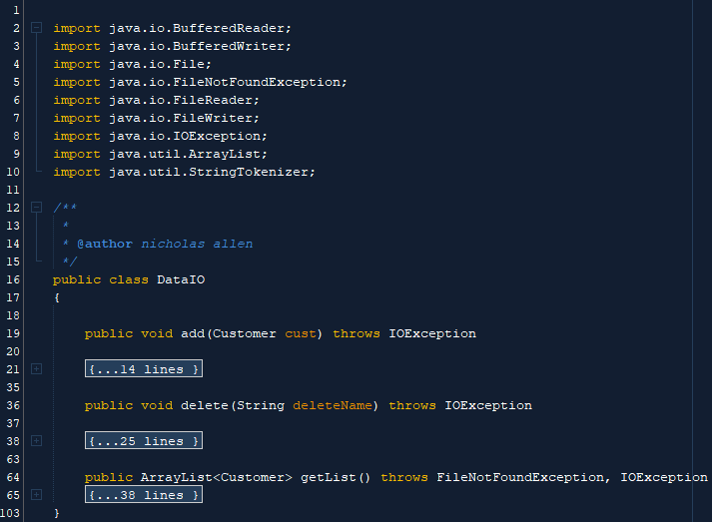
DataIO Class
Now that the GUI is complete, we can focus on saving and retrieving data from files.
Here we create the DataIO class using the UML class diagram from week 1, apart from the private attributes (used next week).

Slide 24
Week 6
Creating a database schema in MySQL Workbench, and connecting our program to store and retrieve data using this database
Back to Agenda

Slide 25
Week 6
Creating the Database Schema
Using MySQL Workbench we created a database named cis355a, a table within named landscape, and columns inside the table. These columns are named CustomerID, CustomerName, CustomerAddress, LandscapeType, YardLength, YardWidth, and LandscapeCost.
Next, we must update the DataIO code to include the private attributes we left out last week. We need to add DATABASE_NAME, CONNECTION_STRING, USER_NAME, and PASSWORD attributes to the class level scope of the DataIO class.
Because we have outgrown the CSV file storage and need a more dynamic approach to saving data, we need to remove all the code from the add(), delete() and getList() methods. Replacing these with appropriate code to add, delete and load the list from the database.
Over in the GUI, we need to update the submitOrder(), deleteCustomer(), and loadCustomers() functions to throw an exception if the database driver isn’t found or other SQL exceptions occur.

Slide 26
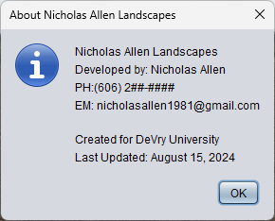
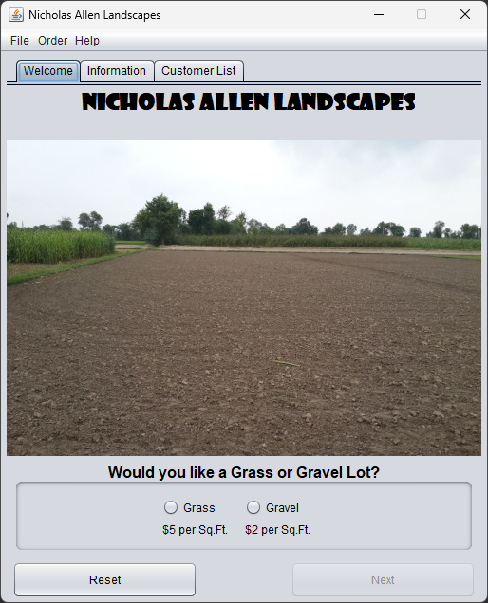
Final Product
After connecting the database I took some creative liberties to make the program look better to me. I added a Help > About menu, changed the layout of components, and changed the welcome screen images to larger representations.

Slide 27
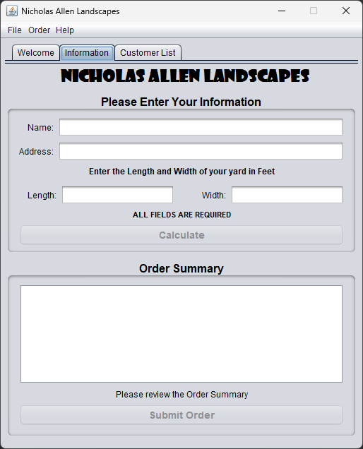
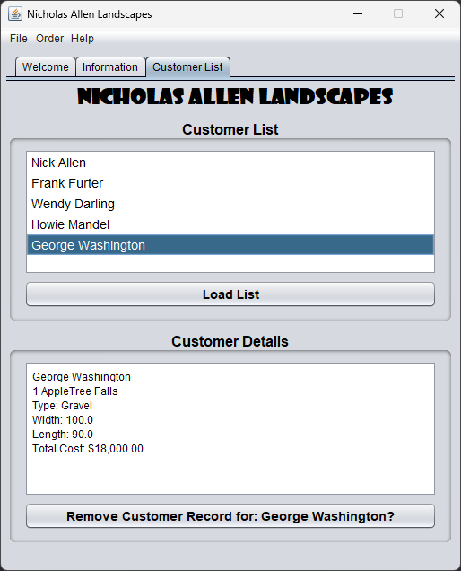

Slide 28
Conclusion
Back to Agenda

Slide 29
What I learned (Career Skills)
Java – GUI programming using NetBeans
This course taught me how to use NetBeans and Java to create spectacular looking GUI applications with ease. Some of the core concepts I learned are/:
Data Validation
File IO & Database connectivity
Using advanced controls in GUI development
Reinforced learning of Object-Oriented Programming
Back to Agenda

Slide 30
Challenges
Areas I felt challenging:
Connecting to the MySQL Database took me a few tries, but once I successful, I understand where I was going wrong.
Loading the customer details after connecting to the database was a task that I couldn’t seem to get, until it clicked.
Back to Agenda

Slide 31
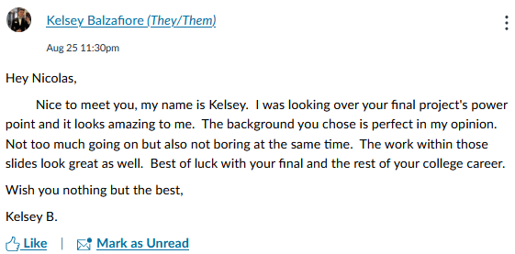
Peer Reviews
Back to Agenda

Slide 32
THANK YOU
In conclusion, I believe this course has set me on a path that I will never find an end to. Knowing what little I do about Java only fuels the fire to learn. I seem to find Java easy to understand, so looking at the future, I am glad to have Java in my toolbelt.
Back to Agenda

