Slide 1
CEIS295
Data Structures and Algorithms
Final Presentation
By Nicholas Allen
Professor Gustavo Cira
DeVry University
Session: November 2023
Course ID: CEIS-295

Slide 2
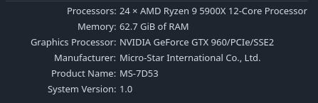
Table of Contents
Introduction to CEIS-295
Module 1 – Speed Test for ArrayList Data Structure
Module 2 – Speed Test for LinkedList Data Structure
Module 3 – Simulate Automatic Call Distributor
Module 4 – Speed Test for Sorting Algorithms
Module 5 – Speed Test for Searching Algorithms
Module 6 – Speed Test for Binary Search Tree Data Structure
Final Analsys
Challenges
Career Skills Obtained
Conclusion
Hardware used for all tests

Slide 3
Introduction to CEIS-295
In this course, CEIS-295 Data Structures and Algorithms, we learned about several types of Abstract Data Structures and how these work.
Knowing these algorithms exist, how they function, and when they function best allows me to choose the best way of completing a task within my program and ensuring greatest functionality and speed balance.

Slide 4
CEIS295
~ Module 1 ~
Speed Test for ArrayList Data Structure

Slide 5
Introduction (Module 1)
We learned how to time a process using Python.
We created a Client.py class to be used to create Client objects to hold our testing data
We created ArrayListActualSpeed.py and tested 3 scenarios:
Scenario 1: Print Queue / Call Queue / Service Queue
1a: Add many records to end of data structure
1b: Pull all records off front of data structure
Scenario 2: Customer Service Center
2a: Display 1000 random records
Scenario 3: Call Center
3a: Add 1000 records, display 1000 random records, remove 1000 random records

Slide 6
TimeProcess.py
Python code for TimeProcess.py file.
Include the following processes:
Display ‘‘Hello Everyone’‘ 1000 times.
Code:
#Name: Nicholas Allen
#Date: 10/23/23
#Purpose: Check speed of function
import time # use time library to time the code executions
# get current time before the process
start_time = time.time()
# run the process
for i in range(1000):
print( "Hello Everyone!" )
# get current time after the process
end_time = time.time()
# subtract start time from end time to get time used by process
total_time = end_time - start_time
# Show the result. Note: .6f means “show six decimal places”
print("\nSeconds run 1000 times: {:.6f}".format(total_time))

Slide 7
Client.py
Python code for Client.py file.
Include the following attributes and behaviors:
Attributes
__client_id
__first_name
__last_name
__phone
__email
Behaviors
__eq__
__str__
Getters and Setters
Code:
#Name: Nicholas Allen
#Date: 10/23/2023
#Course: CEIS295 - Data Structures and Algorithms
## Define Class
class Client:
## __init__() Runs automatically
def __init__(self, client_id=0, first_name="Unknown", last_name="Unknown", phone="Unknown", email="Unknown"):
self.__client_id = client_id
self.__first_name= first_name
self.__last_name = last_name
self.__phone = phone
self.__email = email
# Functions
def __lt__(self, other):
return self.__client_id < other.__client_id
def __eq__(self, other):
return self.__client_id == other.__client_id
# __str__() Automatically called when you print object
def __str__(self):
return str(self.__client_id) + ", " + self.__last_name + ", " + self.__first_name
##
# Getters and Setters
##
# Client ID
def get_client_id(self):
return self.__client_id
def set_cilent_id(self, client_id):
self.__client_id = client_id
# First Name
def get_first_name(self):
return self.__first_name
def set_first_name(self, first_name):
self.__first_name = first_name
# Last Name
def get_last_name(self):
return self.__last_name
def set_last_name(self, last_name):
self.__last_name = last_name
# Phone
def get_phone(self):
return self.__phone
def set_phone(self, phone):
self.__phone = phone
# Email
def get_email(self):
return self.__email
def set_email(self, email):
self.__email = email

Slide 8
ArrayListActualSpeed.py
Python code for ArrayListActualSpeed.py file.
Include the following processes:
Read records into application
Test the following process speeds:
Add records to beginning of data structure
Add records to end of data structure
Add records to middle of data structure
Retrieve records from beginning of data structure
Retrieve records from end of data structure
Retrieve records from middle of data structure
Code:
# Name: Nicholas Allen
# Date: 10.23.2023
from ArrayList import ArrayList
from Client import Client
from Quicksort import Quicksort
import time
import random
import sys
from datetime import date
## Header
print ("Name:", "Nicholas Allen")
print ("Date:", date.today())
print ()
## Create list
clients = []
input_file = 'ClientData.csv'
## Open file
with open(input_file) as infile:
for line in infile:
## Split each line on comma
#print(line)
s = line.split(',')
client_id = int( s[0] )
f_name = s[1]
l_name = s[2]
phone = s[3]
email = s[4]
## Create client object
clt = Client(client_id, f_name, l_name, phone, email)
## Add to list
clients.append(clt)
# sort Client List
Quicksort.sort(clients)
## Count the records
num_records = len(clients)
## Create Array
my_array_list = ArrayList()
## Scenario 1 - Printer Queue or Call Queue
#### TIMER - Adding records to the Array
section_title = "Scenario 1: Printer Queue or Call Queue"
print(section_title)
print("-" * len(section_title))
start_time = time.time()
for i in range(num_records):
my_array_list.append(clients[i])
end_time = time.time()
total_time = end_time - start_time
first_test_time = "Seconds to add 10000 records: {:.6f}".format(total_time)
print(first_test_time)
#### TIMER - Removing Records from the front of the Array
start_time = time.time()
for i in range(num_records):
my_array_list.remove_at(0)
end_time = time.time()
total_time = end_time - start_time
second_test_time = "Seconds to remove all records from the front: {:.6f}".format(total_time)
print(second_test_time)
## Senario 2 - Customer Service Center
answer = input("Continue (y/n) ")
if answer.lower() != "y":
sys.exit()
section_title = "Scenario 2: Customer Service Center"
print(section_title)
print("-" * len(section_title))
## Add clients to the Array
for i in range(num_records):
my_array_list.append(clients[i])
#### TIMER - Randomly display 1000 records
start_time = time.time()
for i in range(1000):
smallest_id = 100001
largest_id = smallest_id + num_records
random_num = random.randint(smallest_id, largest_id)
#print(my_array_list.search(Client(random_num)))
print(my_array_list.search_sorted(Client(random_num)))
end_time = time.time()
total_time = end_time - start_time
third_test_time = "Seconds to display 1000 random records: {:.6f}".format(total_time)
print(third_test_time)
## Senario 3 - Call Center
answer = input("Continue (y/n) ")
if answer.lower() != "y":
sys.exit()
section_title = "Scenario 3: Call Center"
print(section_title)
print("-" * len(section_title))
#### TIMER - Random Add, Display, and Remove 100 Records
start_time = time.time()
#add
current_id = 100001 + num_records + 1
for i in range(1000):
my_array_list.append(Client(current_id))
current_id += 1
#display
for i in range(1000):
smallest_id = 100001
largest_id = smallest_id + num_records
random_num = random.randint(smallest_id, largest_id)
#print(my_array_list.search(Client(random_num)))
print(my_array_list.search_sorted(Client(random_num)))
#remove
for i in range(1000):
sallest_id = 100001
largest_id = smallest_id + num_records
random_num = random.randint(smallest_id, largest_id)
print(my_array_list.search(Client(random_num)))
end_time = time.time()
total_time = end_time - start_time
fourth_test_time = "Seconds to randomly add, display, and remove 1000 random records: {:.6f}".format(total_time)
print(fourth_test_time)
##CONSOLIDATED OUTPUT
print("-" * 15)
print("Nicholas Allen")
print(date.today())
print("=" * 15)
print("Scenario 1: Printer Queue or Call Queue")
print(first_test_time)
print(second_test_time)
print("Scenario 2: Customer Service Center")
print(third_test_time)
print("Scenario 3: Call Center")
print(fourth_test_time)

Slide 9
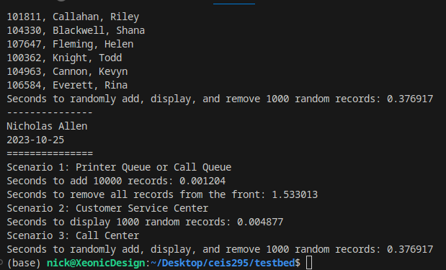
Running Code Screenshot
Run your ArrayListActualSpeed.py code and take a screenshot of the output. The output screenshot must show your name and the date to be accepted.
Please note. We are looking to avoid plagiarism. As a result, if the running code does not show your name and the current date, then this Course Project will be given a zero until you submit a PowerPoint that shows your name and the current date in the output screenshot.

Slide 10
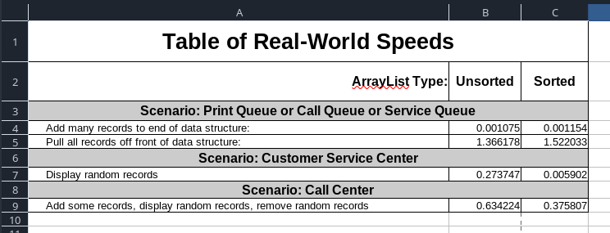
Table of Real-World Speeds
Create a table showing the time that it takes for the following scenarios:
Printer Queue or Call Queue or Service Queue
Add many records to end of data structure
Pull all records off front of data structure
Customer Service Center
Display random records
Call Center
Add some records
Display random records
Remove some records

Slide 11
CEIS295
~ Module 2 ~
Speed Test for LinkedList Data Structure

Slide 12
Introduction (Module 2)
We used the Client.py class that we created in Module 1.
We created LinkedListActualSpeed.py and tested the same 3 scenarios:
Scenario 1: Print Queue / Call Queue / Service Queue
1a: Add many records to end of data structure
1b: Pull all records off front of data structure
Scenario 2: Customer Service Center
2a: Display 1000 random records
Scenario 3: Call Center
3a: Add 1000 records, display 1000 random records, remove 1000 random records

Slide 13
LinkedListActualSpeed.py
Python code for LinkedListActualSpeed.py file.
Include the following processes:
Read records into application
Test the following process speeds:
Add records to beginning of data structure
Add records to end of data structure
Add records to middle of data structure
Retrieve records from beginning of data structure
Retrieve records from end of data structure
Retrieve records from middle of data structure
Code:
# Name: Nicholas Allen
# Date: 10.31.2023
from LinkedList import LinkedList
from Client import Client
import time
import random
import sys
from datetime import date
## Header
print ("Name:", "Nicholas Allen")
print ("Date:", date.today())
print ()
## Create list
clients = []
input_file = 'ClientData.csv'
## Open file
with open(input_file) as infile:
for line in infile:
## Split each line on comma
#print(line)
s = line.split(',')
client_id = int( s[0] )
f_name = s[1]
l_name = s[2]
phone = s[3]
email = s[4]
## Create client object
clt = Client(client_id, f_name, l_name, phone, email)
## Add to list
clients.append(clt)
## Count the records
num_records = len(clients)
## Create Array
my_linked_list = LinkedList()
## Scenario 1 - Printer Queue or Call Queue
#### TIMER - Adding records to the Array
section_title = "Scenario 1: Printer Queue or Call Queue"
print(section_title)
print("-" * len(section_title))
start_time = time.time()
for i in range(num_records):
my_linked_list.add_last(clients[i])
end_time = time.time()
total_time = end_time - start_time
first_test_time = "Seconds to add 10000 records: {:.6f}".format(total_time)
print(first_test_time)
#### TIMER - Removing Records from the front of the Array
start_time = time.time()
for i in range(num_records):
my_linked_list.remove_first()
end_time = time.time()
total_time = end_time - start_time
second_test_time = "Seconds to remove all records from the front: {:.6f}".format(total_time)
print(second_test_time)
## Senario 2 - Customer Service Center
answer = input("Continue (y/n) ")
if answer.lower() != "y":
sys.exit()
section_title = "Scenario 2: Customer Service Center"
print(section_title)
print("-" * len(section_title))
## Add clients to the Array
for i in range(num_records):
my_linked_list.add_last(clients[i])
#### TIMER - Randomly display 1000 records
start_time = time.time()
for i in range(1000):
smallest_id = 100001
largest_id = smallest_id + num_records
random_num = random.randint(smallest_id, largest_id)
print(my_linked_list.search(Client(random_num)))
end_time = time.time()
total_time = end_time - start_time
third_test_time = "Seconds to display 1000 random records: {:.6f}".format(total_time)
print(third_test_time)
## Senario 3 - Call Center
answer = input("Continue (y/n) ")
if answer.lower() != "y":
sys.exit()
section_title = "Scenario 3: Call Center"
print(section_title)
print("-" * len(section_title))
#### TIMER - Random Add, Display, and Remove 100 Records
start_time = time.time()
#add
current_id = 100001 + num_records + 1
for i in range(1000):
my_linked_list.add_last(Client(current_id))
current_id += 1
#display
for i in range(1000):
smallest_id = 100001
largest_id = smallest_id + num_records
random_num = random.randint(smallest_id, largest_id)
print(my_linked_list.search(Client(random_num)))
#remove
for i in range(1000):
sallest_id = 100001
largest_id = smallest_id + num_records
random_num = random.randint(smallest_id, largest_id)
my_linked_list.remove(Client(random_num))
end_time = time.time()
total_time = end_time - start_time
fourth_test_time = "Seconds to randomly add, display, and remove 1000 random records: {:.6f}".format(total_time)
print(fourth_test_time)
##CONSOLIDATED OUTPUT
print("-" * 15)
print("Nicholas Allen")
print(date.today())
print("Week 2")
print("=" * 15)
print("Scenario 1: Printer Queue or Call Queue")
print(first_test_time)
print(second_test_time)
print("Scenario 2: Customer Service Center")
print(third_test_time)
print("Scenario 3: Call Center")
print(fourth_test_time)

Slide 14
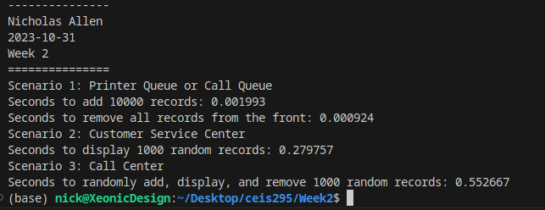
Running Code Screenshot
Run your LinkedListActualSpeed.py code and take a screenshot of the output. The output screenshot must show your name and the date to be accepted.
Please note. We are looking to avoid plagiarism. As a result, if the running code does not show your name and the current date, then this Course Project will be given a zero until you submit a PowerPoint that shows your name and the current date in the output screenshot.

Slide 15
Table of Real-World Speeds
Update the table from last week that shows the times for the ArrayList. Add a new column and show the times for the LinkedList for comparison.
Printer Queue or Call Queue or Service Queue
Add many records to end of data structure
Pull all records off front of data structure
Customer Service Center
Display random records
Call Center
Add some records
Display random records
Remove some records

Slide 16
CEIS295
~ Module 3 ~
Simulate Automatic Call Distributor

Slide 17
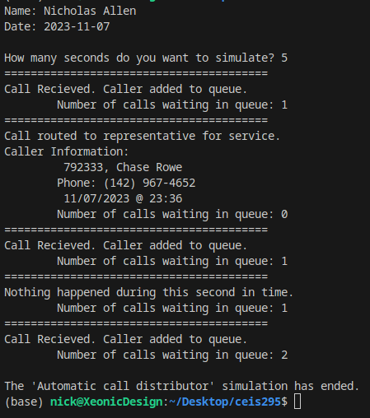
Introduction (Module 3)
We created a Call.py class to hold our call center information.
We created a AutomaticCallDistributor.py to simulate a call center. This application uses random numbers to simulate receiving incoming calls, call resolution (removal from queue), as well as no incoming, no removal periods.

Slide 18
Call.py
Paste your Call.py Python code in the box on the right side.
Include the following attributes and behaviors:
Attributes
call_id
customer_name
customer_phone
call_date
call_time
Behaviors
__str__
Code:
# Name: Nicholas Allen
# Date: 11/7/2023
# Week 3
from time import strftime
class Call:
def __init__(self, client_id=0, customer_name="Unknown", customer_phone="Unknown"):
self.client_id = client_id
self.customer_name = customer_name
self.customer_phone = customer_phone
self.call_date = strftime("%m/%d/%Y")
self.call_time = strftime("%H:%M")
def __str__(self):
return str(self.client_id) + ", " + self.customer_name + "\n\tPhone: " + self.customer_phone + "\t " + self.call_date + " @ " + self.call_time

Slide 19
AutomaticCallDistributor.py
Paste your Python code. Include the following processes:
Simulation of ADT
Ask user how many times to repeat
On each loop:
Randomly generate a number from 1 to 3
If 1, add call to queue
If 2, remove call from queue
If 3, do nothing
Code:
# Name: Nicholas Allen
# Date: 11/7/2023
from Queue import Queue
from Call import Call
from datetime import date
import time
import random
print("Name: Nicholas Allen")
print("Date:", date.today())
print()
calls = []
input_file_name = "/home/nick/Desktop/ceis295/Week3/ClientData.csv"
with open(input_file_name) as infile:
for line in infile:
s = line.split(",")
client_id = int(s[0])
client_name = s[1]
client_phone = s[2]
a_call = Call(client_id, client_name, client_phone)
calls.append(a_call)
calls_waiting = Queue()
call_number = 0
seconds = int(input("How many seconds do you want to simulate? "))
for i in range(seconds): # For Loop (known number of loops)
print("=" * 40)
time.sleep(1) # Pause
random_event = random.randint(1,4) # random number from 1 to 3
if random_event == 1 or random_event == 4:
print("Call Recieved. Caller added to queue.")
calls_waiting.enqueue(calls[call_number])
call_number += 1 #increment call_number
print("\tNumber of calls waiting in queue:", calls_waiting.get_length())
elif random_event == 2:
print("Call routed to representative for service.")
if calls_waiting.get_length() > 0:
print("Caller Information:")
print("\t", calls_waiting.dequeue())
else:
print("The call waiting queue is empty.")
print("\tNumber of calls waiting in queue:", calls_waiting.get_length())
else:
print("Nothing happened during this second in time.")
print("\tNumber of calls waiting in queue:", calls_waiting.get_length())
print("\nThe 'Automatic call distributor' simulation has ended.")

Slide 20
Running Code Screenshot
Run your AutomaticCallDistributor.py code and take a screenshot of the output. The output screenshot must show your name and the date to be accepted.
Please note. We are looking to avoid plagiarism. As a result, if the running code does not show your name and the current date, then this Course Project will be given a zero until you submit a PowerPoint that shows your name and the current date in the output screenshot.

Slide 21
CEIS295
~ Module 4 ~
Speed Test for Sorting Algorithms

Slide 22
Introduction (Module 4)
We modified the Client.py class that we created in Module 1.
We created SortingActualSpeed.py and tested the speeds for sorting algorithms:
Bubble Sort
Selection Sort
Insertion Sort
Shell Sort
Quicksort
Merge Sort
We modified the Client.py class that we created in Module 1.
We created SortingActualSpeed.py and tested the speeds for sorting algorithms:
Bubble Sort
Selection Sort
Insertion Sort
Shell Sort
Quicksort
Merge Sort

Slide 23
Client.py
Paste your Client.py Python code in the box on the right side.
Include the following attributes and behaviors:
Attributes
__client_id
__first_name
__last_name
__phone
__email
Behaviors
__lt__
__le__
__eq__
__str__
Getters and Setters
Code:
#Name: Nicholas Allen
#Date: 11/17/2023
#Course: CEIS295 - Data Structures and Algorithms
## Define Class
class Client:
## __init__() Runs automatically
def __init__(self, client_id=0, first_name="Unknown", last_name="Unknown", phone="Unknown", email="Unknown"):
self.__client_id = client_id
self.__first_name= first_name
self.__last_name = last_name
self.__phone = phone
self.__email = email
# Functions
def __lt__(self, other):
this_full_name = self.__last_name + " " + self.__first_name
other_full_name = other.__last_name + " " + other.__first_name
return this_full_name < other_full_name
def __eq__(self, other):
return self.__last_name == other.__last_name
def __le__(self, other):
return self.__last_name <= other.__last_name
# __str__() Automatically called when you print object
def __str__(self):
return self.__last_name + ", " + self.__first_name
##
# Getters and Setters
##
# Client ID
def get_client_id(self):
return self.__client_id
def set_cilent_id(self, client_id):
self.__client_id = client_id
# First Name
def get_first_name(self):
return self.__first_name
def set_first_name(self, first_name):
self.__first_name = first_name
# Last Name
def get_last_name(self):
return self.__last_name
def set_last_name(self, last_name):
self.__last_name = last_name
# Phone
def get_phone(self):
return self.__phone
def set_phone(self, phone):
self.__phone = phone
# Email
def get_email(self):
return self.__email
def set_email(self, email):
self.__email = email

Slide 24
SortingActualSpeed.py
Paste your Python code. Include the following processes:
Read records into application
Test the following sorting algorithm speeds:
Bubble Sort
Selection Sort
Insertion Sort
Shell Sort
Quicksort
Merge Sort
Code:
# Name: Nicholas Allen
# Date: 11.17.23
from MergeSort import MergeSort
from Client import Client
import time
from datetime import date
## Header
print ("Name:", "Nicholas Allen")
print ("Date:", date.today())
print ()
input_file_name = 'ClientData100.csv'
#input_file_name = 'ClientData1000.csv'
#input_file_name = 'ClientData10000.csv'
#input_file_name = 'ClientData100000.csv'
## Create list
clients = []
## Open file
with open(input_file_name) as infile:
for line in infile:
## Split each line on comma
#print(line)
s = line.split(',')
client_id = int( s[0] )
f_name = s[1]
l_name = s[2]
phone = s[3]
email = s[4]
## Create client object
clt = Client(client_id, f_name, l_name, phone, email)
## Add to list
clients.append(clt)
## Count the records
num_records = len(clients)
## Scenario - sorting records
#### TIMER - Adding records to the Array
section_title = "Scenario: Sorting " + str(num_records) + " Records"
print(section_title)
print("-" * len(section_title))
start_time = time.time()
MergeSort.sort(clients)
end_time = time.time()
print(end_time)
total_time = end_time - start_time
first_test_time = "Seconds to Sort {0} records: {1:.6f}".format(num_records, total_time)
print(first_test_time)
for clnt in clients:
print(clnt)
##CONSOLIDATED OUTPUT
print("-" * 15)
print("Nicholas Allen")
print(date.today())
print("Week 4")
print("=" * 15)
print("Scenario: Sorting", num_records, "records.")
print(first_test_time)

Slide 25
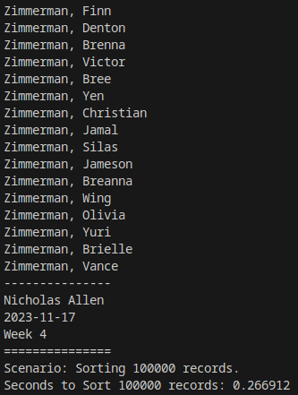
Running Code Screenshot
Run your SortingSpeed.py code and take a screenshot of the output. The output screenshot must show your name and the date to be accepted.
Please note. We are looking to avoid plagiarism. As a result, if the running code does not show your name and the current date, then this Course Project will be given a zero until you submit a PowerPoint that shows your name and the current date in the output screenshot.

Slide 26
Table of Real-World Speeds
Create a table showing the time that it takes for the following sorting algorithms using different data sizes:
Bubble Sort
Selection Sort
Insertion Sort
Shell Sort
Quicksort
Merge Sort

Slide 27
CEIS295
~ Module 5 ~
Speed Test for Searching Algorithms

Slide 28
Introduction (Module 5)
We modified the Client.py class that we created in Module 1.
We created SearchingActualSpeed.py and tested the search algorithms with various sized datasets.
Linear Search for 1000 random records
Binary Search for 1000 random records
100 Records
1,000 Records
10,000 Records
100,000 Records

Slide 29
Client.py
Paste your Client.py Python code in the box on the right side.
Include the following attributes and behaviors:
Attributes
__client_id
__first_name
__last_name
__phone
__email
Behaviors
__lt__
__eq__
__str__
Getters and Setters
Code:
#Name: Nicholas Allen
#Date: 11/23/2023
#Course: CEIS295 - Data Structures and Algorithms
## Define Class
class Client:
## __init__() Runs automatically
def __init__(self, client_id=0, first_name="Unknown", last_name="Unknown", phone="Unknown", email="Unknown"):
self.__client_id = client_id
self.__first_name= first_name
self.__last_name = last_name
self.__phone = phone
self.__email = email
# Functions
def __lt__(self, other):
return self.__client_id < other.__client_id
def __eq__(self, other):
return self.__client_id == other.__client_id
def __le__(self, other):
return self.__client_id <= other.__client_id
# __str__() Automatically called when you print object
def __str__(self):
return str(self.__client_id) + ", " + self.__last_name + ", " + self.__first_name
##
# Getters and Setters
##
# Client ID
def get_client_id(self):
return self.__client_id
def set_cilent_id(self, client_id):
self.__client_id = client_id
# First Name
def get_first_name(self):
return self.__first_name
def set_first_name(self, first_name):
self.__first_name = first_name
# Last Name
def get_last_name(self):
return self.__last_name
def set_last_name(self, last_name):
self.__last_name = last_name
# Phone
def get_phone(self):
return self.__phone
def set_phone(self, phone):
self.__phone = phone
# Email
def get_email(self):
return self.__email
def set_email(self, email):
self.__email = email

Slide 30
SearchingActualSpeed.py
Paste your Python code. Include the following processes:
Read records into application
Test the following searching algorithm speeds:
Linear Search
Binary Search
Test these two algorithms against different size datasets
100 records
1,000 records
10,000 records
100,000 records
Code:
# Name: Nicholas Allen
# Date: 11.23.23
from LinearSearch import LinearSearch
from BinarySearch import BinarySearch
from Quicksort import Quicksort
from Client import Client
import time
import random
from datetime import date
import sys
## Header
print ("Name:", "Nicholas Allen")
print ("Date:", date.today())
print ()
#input_file_name = 'ClientData100.csv'
#input_file_name = 'ClientData1000.csv'
#input_file_name = 'ClientData10000.csv'
input_file_name = 'ClientData100000.csv'
## Create list
clients = []
## Open file
with open(input_file_name) as infile:
for line in infile:
## Split each line on comma
#print(line)
s = line.split(',')
client_id = int( s[0] )
f_name = s[1]
l_name = s[2]
phone = s[3]
email = s[4]
## Create client object
clt = Client(client_id, f_name, l_name, phone, email)
## Add to list
clients.append(clt)
## Count the records
num_records = len(clients)
## Scenario - Searching records
section_title = "Scenario: Searching " + str(num_records) + " Records"
print(section_title)
print("-" * len(section_title))
# MUST SORT DATA TO DO BINARY SEARCH
Quicksort.sort(clients)
# Start and end record number
start_record = 100001 # First ID in Client_id
end_record = start_record + num_records # Last record
# Timer
start_time = time.time()
##### CHANGE
for i in range(1000):
client_id = random.randint(start_record, end_record)
clt = Client(client_id)
result = BinarySearch.search(clients, clt)
if result is None:
print(clt, "was not found")
else:
print(result)
end_time = time.time()
print(end_time)
total_time = end_time - start_time
first_test_time = "Seconds to Search {0} records: {1:.6f}".format(num_records, total_time)
print(first_test_time)
for clnt in clients:
print(clnt)
##CONSOLIDATED OUTPUT
print("-" * 15)
print("Nicholas Allen")
print(date.today())
print("Week 5")
print("=" * 15)
print("Scenario: Searching", num_records, "records.")
print(first_test_time)

Slide 31
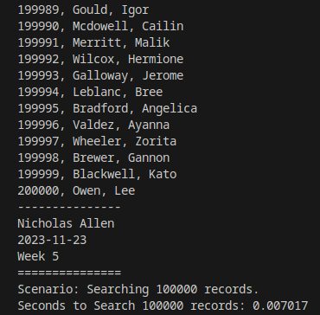
Running Code Screenshot
Run your SearchingSpeed.py code and take a screenshot of the output. The output screenshot must show your name and the date to be accepted.
Please note. We are looking to avoid plagiarism. As a result, if the running code does not show your name and the current date, then this Course Project will be given a zero until you submit a PowerPoint that shows your name and the current date in the output screenshot.

Slide 32
Table of Real-World Speeds
Create a table showing the time that it takes for the following searching algorithms using different data sizes:
Linear Search
Binary Search

Slide 33
CEIS295
~ Module 6 ~
Speed Test for Binary Search Tree Data Structure

Slide 34
Introduction (Module 6)
We modified the Client.py class that we created in Module 1.
We created BinarySearchTreeActualSpeed.py and tested the following scenarios
Add records to beginning of data structure
Add records to the end of data structure
Add records to the middle of data structure
Retrieve records from the beginning of data structure
Retrieve records from the end of data structure
Retrieve records from the end of data structure

Slide 35
BinarySearchTreeActualSpeed.py
Paste your Python code. Include the following processes:
Read records into application
Test the following process speeds:
Add records to beginning of data structure
Add records to end of data structure
Add records to middle of data structure
Retrieve records from beginning of data structure
Retrieve records from end of data structure
Retrieve records from middle of data structure
Code:
# Name: Nicholas Allen
# Date: 12/2/2023
from BinarySearchTree import BinarySearchTree
from Client import Client
from datetime import date
import time
import random
import sys
# Display Name and Date as output
print("Name:", "Nicholas Allen")
print("Date:", date.today())
print()
#create a list
clients = []
# Read records in
input_file_name = "ClientData.csv"
with open(input_file_name) as infile:
for line in infile:
# Split based on commas
s = line.split(',')
client_id = int(s[0])
f_name = s[1]
l_name = s[2]
phone = s[3]
email = s[4]
# create client object
clt = Client(client_id, f_name, l_name, phone, email)
# add client object to list
clients.append(clt)
# count of client objects in the list
num_records = len(clients)
# Create binary search tree to test real world speeds
my_bst = BinarySearchTree()
# Scenario 1: Printer Queue / call queue / service queue
section_title = "Scenerio: Printer Queue / call queue / service queue"
print(section_title)
print("-" * len(section_title))
# How long does it talke to add the client records to the BST?
start_time = time.time()
for i in range(num_records):
my_bst.insert(clients[i])
# End time
end_time = time.time()
total_time = end_time - start_time
scen1a = "Seconds to add records: {:.6f}".format(total_time)
print(scen1a)
# Remove records from teh front
start_time = time.time()
for i in range(num_records):
my_bst.remove_minimum()
end_time = time.time()
total_time = end_time - start_time
scen1b = "Seconds to remove records: {:.6f}".format(total_time)
print(scen1b)
# Scenerio 2 customer service number
answer = input("Continue (y/n)? ")
if answer.lower() != "y":
sys.exit
section_title = "Scenerio: Customer Service Center"
print(section_title)
print("-" * len(section_title))
# Add clients to BinarySearchTree
for i in range(num_records):
my_bst.insert(clients[i])
start_time = time.time()
for i in range(1000):
smallest_id = 100001
largest_id = smallest_id + num_records
randon_num = random.randint(smallest_id, largest_id)
print(my_bst.search(Client(randon_num)))
# End time
end_time = time.time()
total_time = end_time - start_time
scen2 = "Seconds to display 1000 random records: {:.6f}".format(total_time)
print(scen2)
# Scenerio 3 customer service number
answer = input("Continue (y/n)? ")
if answer.lower() != "y":
sys.exit
section_title = "Scenerio: Call Center"
print(section_title)
print("-" * len(section_title))
# Add clients to BinarySearchTree
for i in range(num_records):
my_bst.insert(clients[i])
# How long does it take to add more client records to the BST
#start Timer
start_time = time.time()
# Add Records
current_id = 100001 + num_records + 1
for i in range (1000):
my_bst.insert(Client(current_id))
current_id += 1
# How long does it take to search for 1000 cleent records
for i in range(num_records):
smallest_id = 100001
largest_id = smallest_id + num_records
randon_num = random.randint(smallest_id, largest_id)
print(my_bst.search(Client(randon_num)))
# Remove 1000 random records
for i in range(num_records):
smallest_id = 100001
largest_id = smallest_id + num_records
randon_num = random.randint(smallest_id, largest_id)
my_bst.remove(Client(randon_num))
# End time
end_time = time.time()
total_time = end_time - start_time
scen3 = "Seconds to add, display, and remove 1000 random records: {:.6f}".format(total_time)
print(scen3)
#FINAL RESULTS
print("--------------------------------------")
print("Name:", "Nicholas Allen")
print("Date:", date.today())
print("Week 6 - BinarySearchTree")
print("--------------------------------------")
print("Scenerio 1a:", scen1a)
print("Scenerio 1b:", scen1b)
print("Scenerio 2:", scen2)
print("Scenerio 3:", scen3)

Slide 36
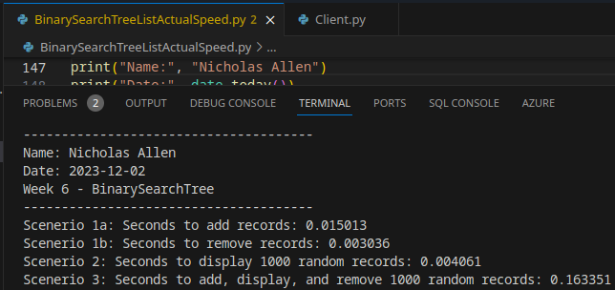
Running Code Screenshot
Run your BinarySearchTreeActualSpeed.py code and take a screenshot of the output. The output screenshot must show your name and the date to be accepted.
Please note. We are looking to avoid plagiarism. As a result, if the running code does not show your name and the current date, then this Course Project will be given a zero until you submit a PowerPoint that shows your name and the current date in the output screenshot.

Slide 37
Table of Real-World Speeds
Update the table from last week that shows the times for the ArrayList and LinkedList. Add a new column and show the times for the BinarySearchTree for comparison.
Printer Queue or Call Queue or Service Queue
Add many records to end of data structure
Pull all records off front of data structure
Customer Service Center
Display random records
Call Center
Add some records
Display random records
Remove some records

Slide 38
Final Analysis
CEIS-295 Data Structures and Algorithms has shown more ways to search, store and retrieve data other than the standard List and Array structures. Learning about the Binary Search Tree and how it can be used to make searching and retrieving data extremely fast.
Each data structure exists for our use without needing to know how it has been implemented into the language you are using.
The program you are creating may not need the speed that comes with a Binary Search Tree, so a Double Linked List may be a better option. Each method has it’s own pro’s and con’s and each has it’s use case.

Slide 39
Challenges
I found the most challenging part of this course was the Binary Search Tree zyBooks module. I don’t think the book did a fantastic job of explaining everything and therefore was a bit more complicated than it needed to be.

Slide 40
Career Skills Obtained
In this course, CEIS-295, I gained knowledge of abstract data structures and algorithms.
I learned about the different speeds associated with algorithms and how to calculate the speed of algorithms I create.
I learned “when to use what” when it comes to the assortment of list structures.

Slide 41
Conclusion
I found this class very informative. I didn’t realize there was so many ways to implement lists of data. Depending on what is being done with the data, one method will be better than the others.

