Slide 1
CEIS150 – Prog. W/ Objects Stock Analyzing Machine
Nicholas Allen
12.12.2022
DeVry University
Nov. 2022 Session
Professor David Lieberman

Slide 2
Table of Contents
Introduction
Week 1 – Software Setup
Week 2 – Class Diagrams, Class Coding, and Unit Testing
Week 3 – TUI – Text-Based User Interface
Week 4 – Interface Summary
Week 5 – Creating A Chart
Week 6 – Loading Data
Week 7 – GUI – Graphical User Interface
Week 8 – Wrap-Up and share
Career Skills Developed
Conclusion

Slide 3
Introduction
This project was completed in Nov. and Dec. of 2022 for DeVry University course CEIS150 – Programming with Objects with Professor David Lieberman.
In this project we learn the concepts and practice of Object-Oriented Programming in Python.
Each week we look at different parts of programming with objects in Python.

Slide 4
CEIS150 Module 1 Software Environment Setup

Slide 5
Week 1 Objectives
Install Anaconda or Python and another IDE
Create a simple Python program
Provide a screen shot of the program code
Provide a screen shot of the program running

Slide 6
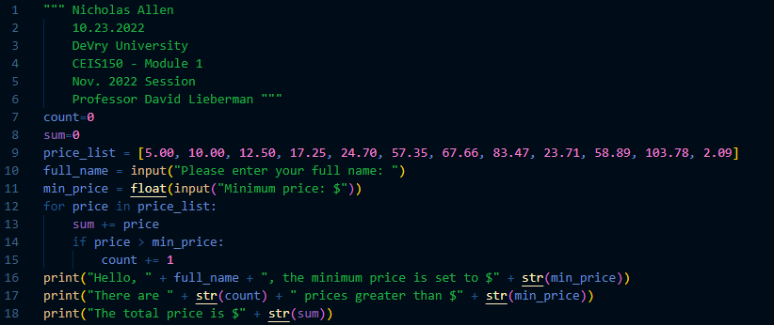
Program Code (Screenshot)

Slide 7
Program Code
""" Nicholas Allen DeVry University - CEIS150 – Nov. 2022 Session - Module 1 Professor David Lieberman """
count=0 sum=0 price_list = [5.00, 10.00, 12.50, 17.25, 24.70, 57.35, 67.66, 83.47, 23.71, 58.89, 103.78, 2.09] full_name = input("Please enter your full name: ") min_price = float(input("Minimum price: $")) for price in price_list: sum += price if price > min_price: count += 1 print("Hello, " + full_name + ", the minimum price is set to $" + str(min_price)) print("There are " + str(count) + " prices greater than $" + str(min_price)) print("The total price is $" + str(sum))

Slide 8
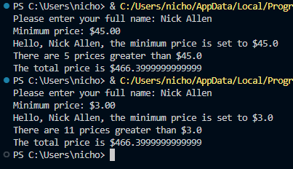
Program Running (Screenshot)

Slide 9
Week 1 – What I Learned
This week was pretty simple because I already had Anaconda and Visual Studio Code installed.
The coding project helped reinforce what I learned in the last programming class.

Slide 10
CEIS150 Module 2 Class Diagrams, Class Coding, & Unit Testing

Slide 11
Week 2 Objectives
Create a Class diagram for Stock and DailyData Classes
Create Stock Class with attributes of symbol, name, and shares as well as a DataList[]
Add Functionality: Add Stock; add_stock(stock_list)
Create DailyData Class as a child of Stock Class with attributes of date, close, and volume
Run the provided Unit Test to test that the Classes work

Slide 12
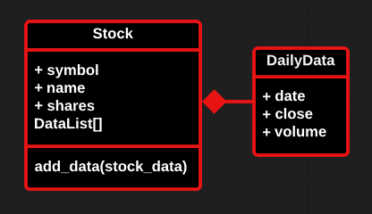
Class Diagram (Screenshot)

Slide 13
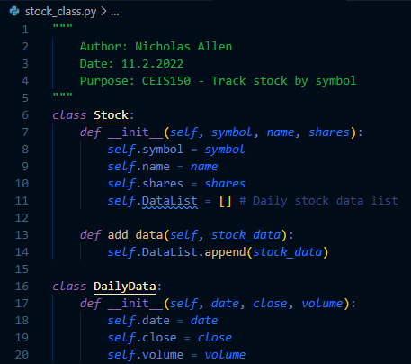
Class Code (Screenshot)

Slide 14
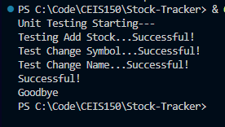
Unit Test Output (Screenshot)

Slide 15
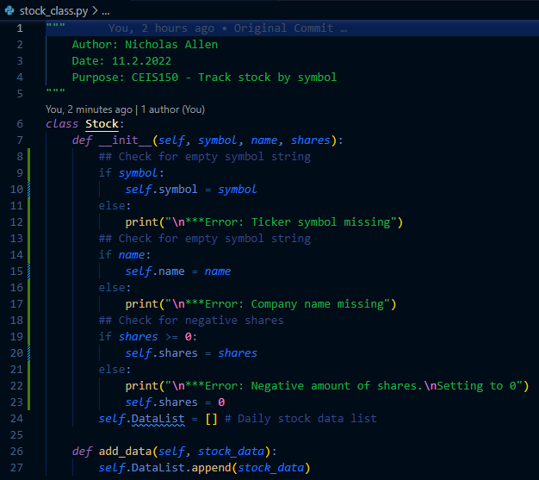
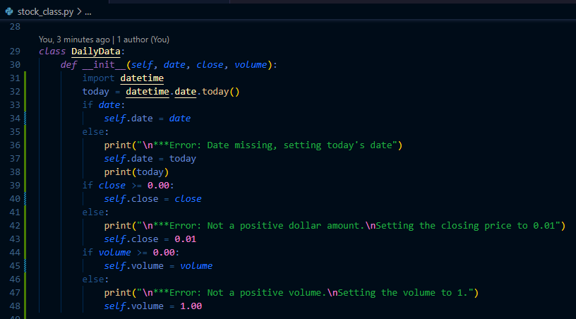
Optional Class Code (Screenshot)

Slide 16
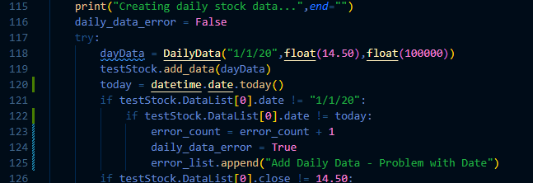
Optional Unit Test Code (Screenshot)
Edited lines 59, 120 and 122 inside the Unit Test code to accept today’s date for a successful test.

Slide 17
Week 2 – What I Learned
This week I learned to create Class diagrams, and how to structure them for everyone to understand.
I also learned how to create child classes and how inheritance works with parent and child classes in Python.

Slide 18
CEIS150 Module 3 Text-Based User Interface - Summary Report

Slide 19
Week 3 Objectives
Create A TUI – Text-Based User Interface
Add Functionality: Add Stock; add_stock(stock_list)
Add Functionality: List Stock; list_stock(stock_list)
Add Functionality: Delete Stock; delete_stock(stock_list)
Add Functionality: Add Daily Data; add_stock_data(stock_list)

Slide 20
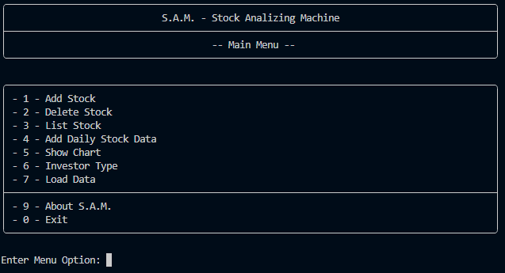
Main Screen (Screenshot)
Program Main Menu

Slide 21
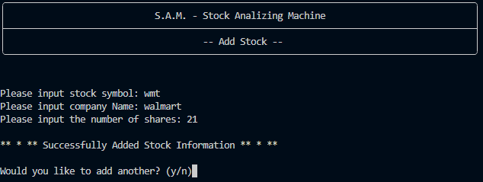
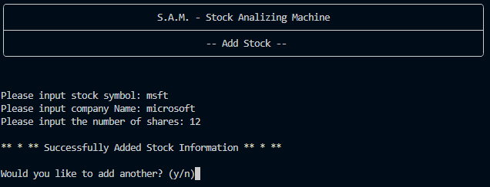
Adding Stocks (Screenshot)
Adding Stock #1
Adding Stock #2

Slide 22
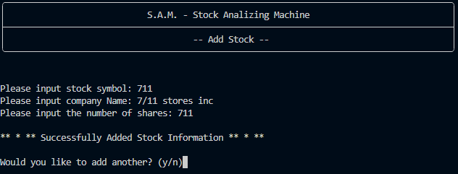
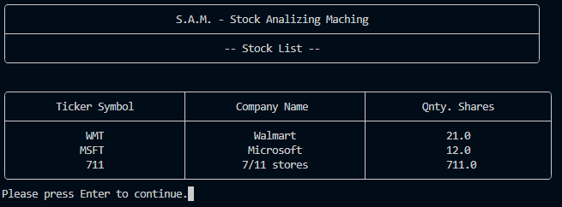
Adding & Listing Stocks (Screenshot)
Adding Stock #3
List of 3 Stocks

Slide 23
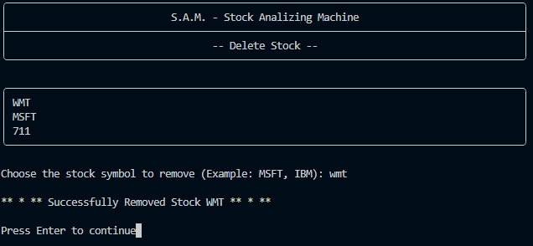
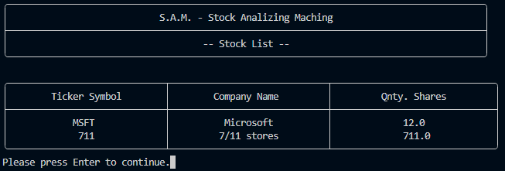
Delete Stocks (Screenshot)
List & Remove Stock
List of Stocks After Delete

Slide 24
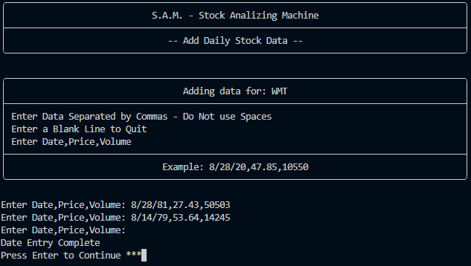
Add Daily Data (Screenshot)
Add Daily Stock Data – Select Stock
Add Daily Stock Data

Slide 25
Week 3 – What I Learned
In week 3 we learned to create a text-based user interface.
We connected the menu items to add, delete, and list stocks
We also connected the menu item to add daily stock data.

Slide 26
CEIS150 Module 4 Interface - Summary Report

Slide 27
Week 4 Objectives
Create Retirement Account class with attributes of balance and number
Create Traditional Account class as a child that inherits from the Retirement Account class
Add Functionality: Add Stock as a Traditional Account; add_stock(stock_list)
Create Robo class as a child that inherits from the Retirement Account class and adds the attribute years
Add Functionality: Investment Return; investment_return()

Slide 28
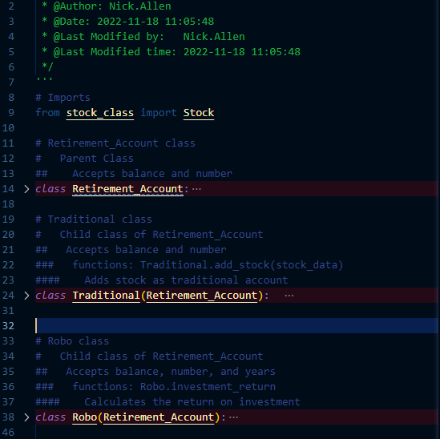
Inherited Classes (Screen Shot)
account_class.py

Slide 29
Unit Tests (Screen Shot)
Unit Test for stock_class.py
Unit Test for account_class.py

Slide 30
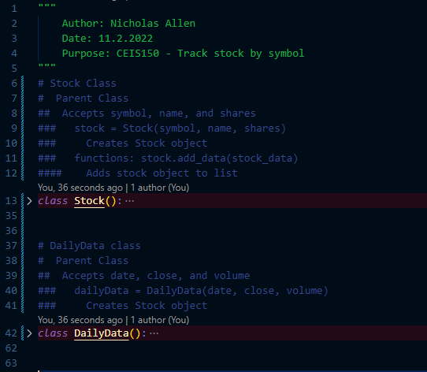
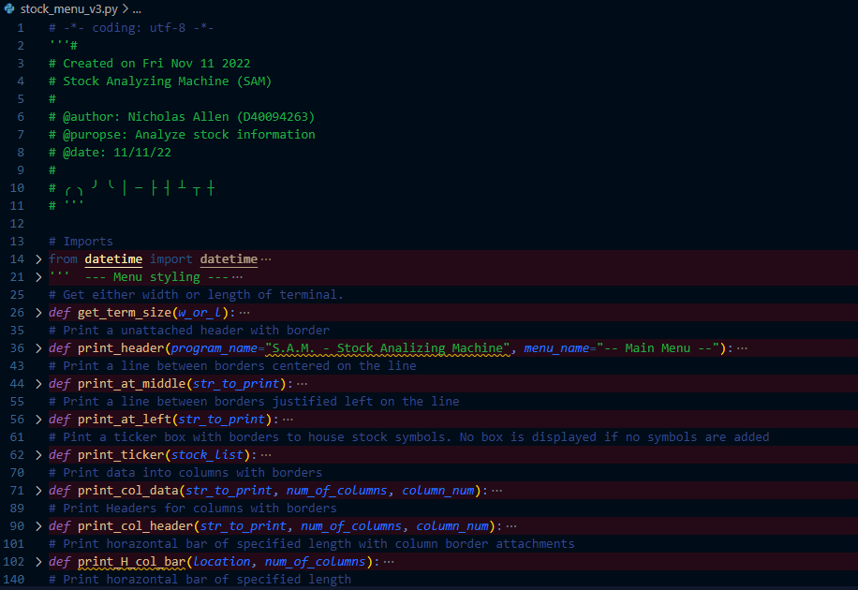
Sock Menu Program (Screen Shot)
stock_class.py
stock_menu_v3.py

Slide 31
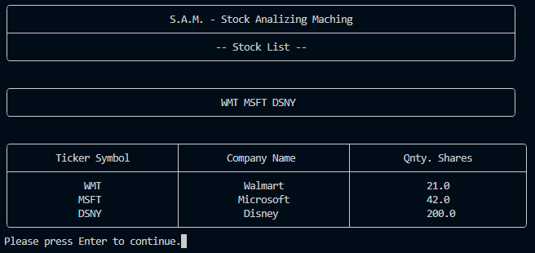
Program Demonstration
Traditional Investment Account
Stock List BEFORE Adding Investment Account

Slide 32
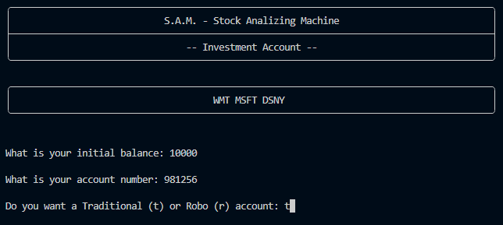
Program Demonstration
Traditional Investment Account
Adding a Traditional Investment Account

Slide 33
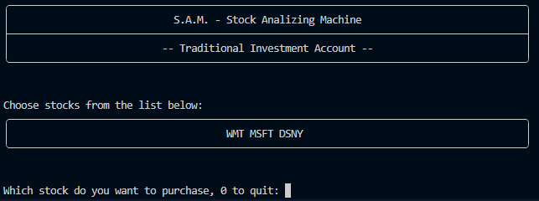
Program Demonstration
Traditional Investment Account
Choosing Stock to Invest in

Slide 34
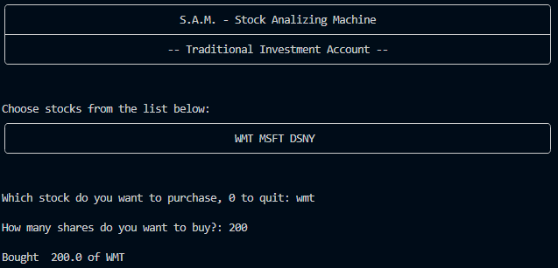
Program Demonstration
Traditional Investment Account
Investment Complete

Slide 35
Program Demonstration
Traditional Investment Account
Stock List AFTER Adding Investment Account

Slide 36
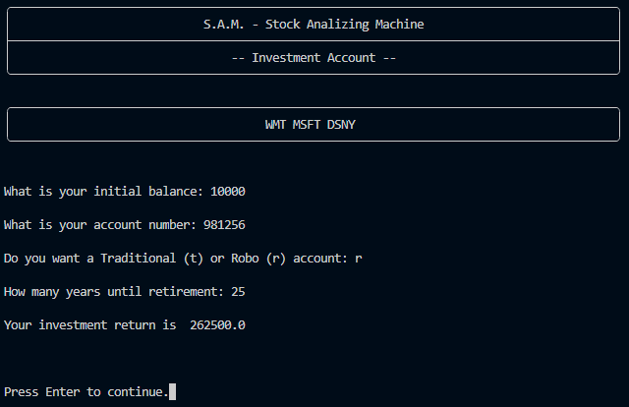
Program Demonstration
Robo Investment Account
Robo Investing Calculations

Slide 37
Week 4 – What I Learned
Week 4 was about parent and child classes and inheritance.
I learned how inheritance works using the __init__() of the parent.

Slide 38
CEIS150 Module 5 Interface – Creating A Chart

Slide 39
Week 5 Objectives
Create a chart using data added with the DailyData class.
Display chart using matplotlib

Slide 40
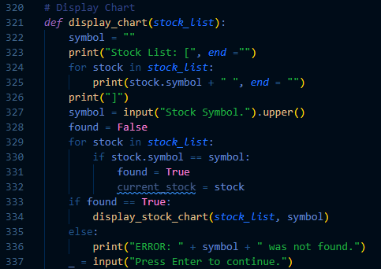
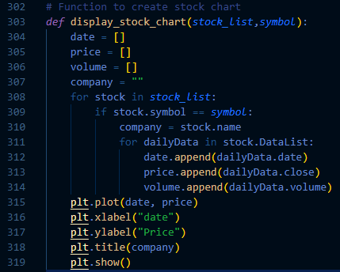
Code (Screen Shot)
display_chart
display_stock_chart

Slide 41
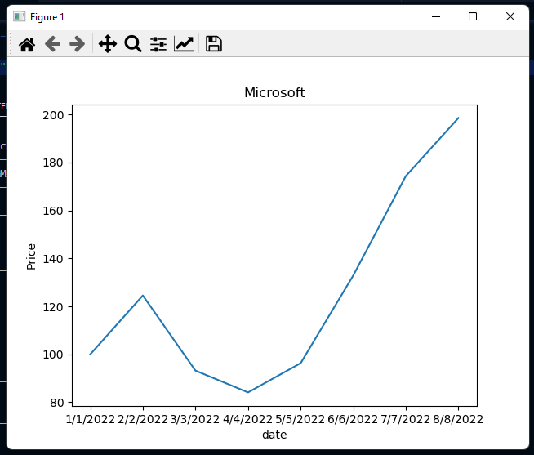
Chart (Screen Shot)
Matplotlib Chart with Test Data

Slide 42
Week 5 – What I Learned
In week 5 we learned how to create and display a chart using matplotlib

Slide 43
CEIS150 Module 6 Loading Data

Slide 44
Week 6 Objectives
Download a .CSV file from Yahoo Finance
Open and process .CSV file to display data
Display a summary report of the loaded stocks
Display a graph of .CSV file

Slide 45
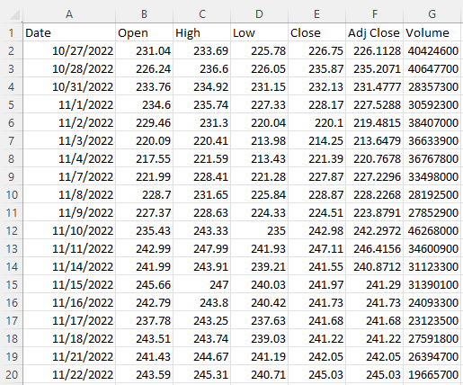
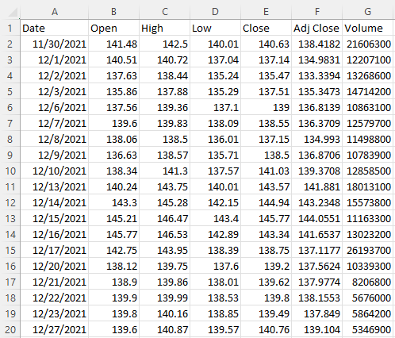
Files and Data
Data Files in Explorer
WMT.cvs file data
WMT.cvs file data

Slide 46
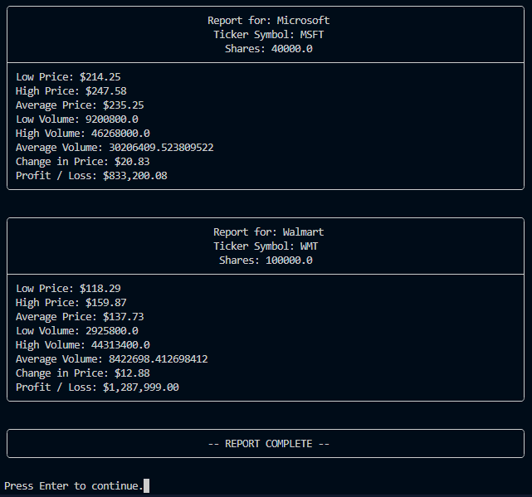
Importing data
WMT.cvs file data
Picking Stock to Load

Slide 47
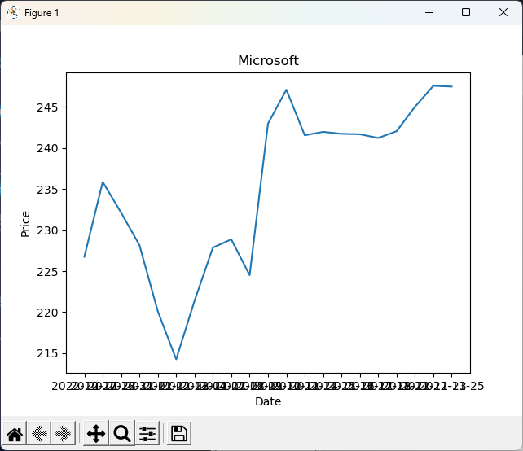
Matplotlib Chart
Microsoft Stock Data Chart

Slide 48
Week 6 – What I Learned
In week 6 we learned how to open and read from a comma separated values file.
We learned how to process the data to create a report and a graph

Slide 49
CEIS150 Module 7 GUI

Slide 50
Week 7 Objectives
Make the supplied GUI function correctly.

Slide 51
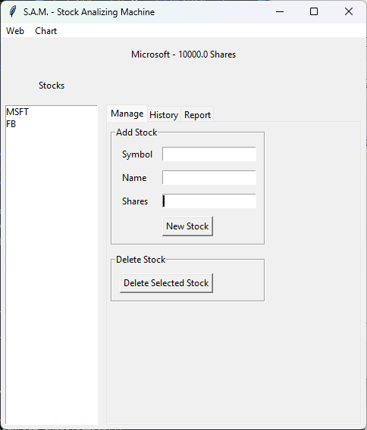
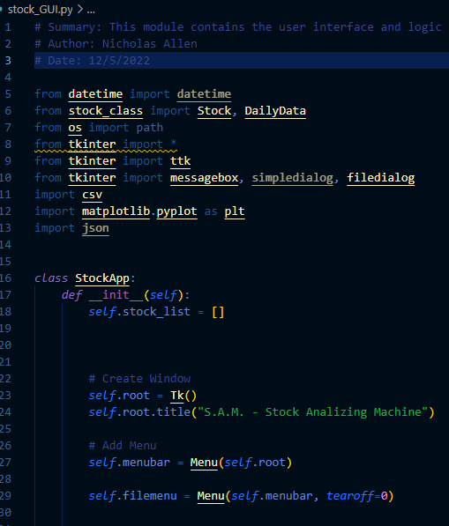
Basic GUI and Code Snippet
GUI with 2 stocks added
Code Snippet

Slide 52
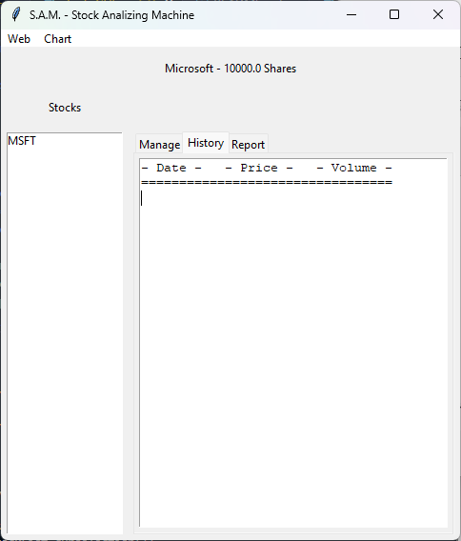
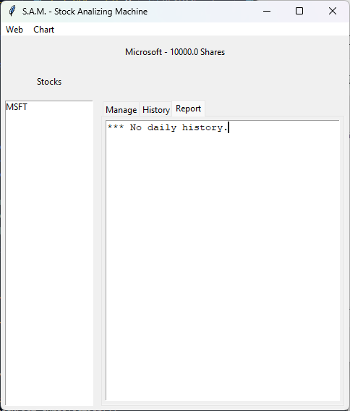
History & Report Tabs Before CSV Import
History Tab Before CSV Import
Report Tab Before CSV Import

Slide 53
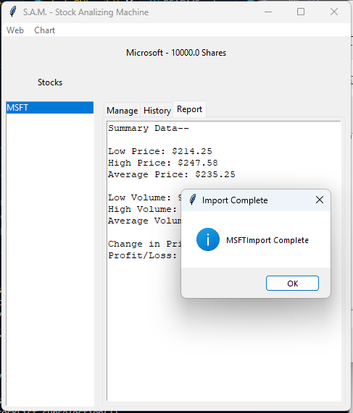
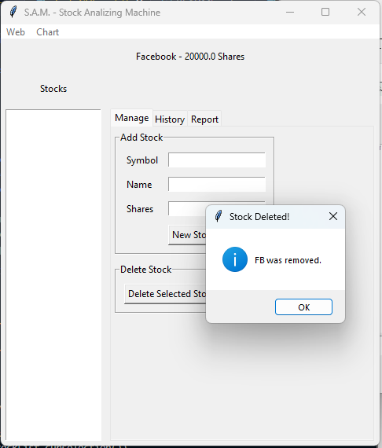
Stocks in GUI
Successfully Imported CSV
Successfully Deleted Stock

Slide 54
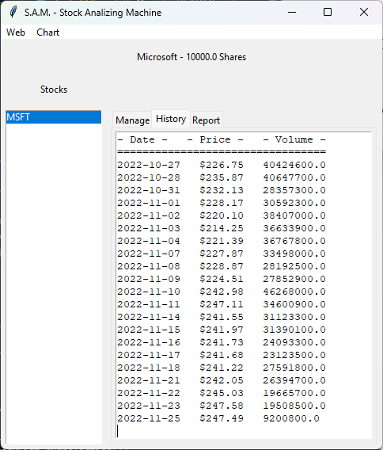
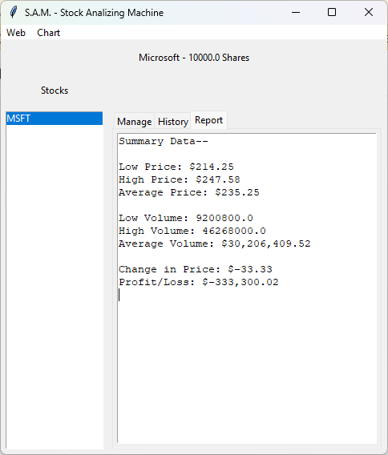
Stocks in GUI
Successfully Imported CSV
Successfully Deleted Stock
Chart Showing MSFT Stock

Slide 55
Week 7 – What I Learned
We learned, in week 7, about connecting the supplied GUI to the classes we created throughout the course.

Slide 56
CEIS150 Module 8 Wrap-Up and Share

Slide 57
Week 8 Objectives
Create a PowerPoint presentation containing all previous course project presentations, in addition to Title, Introduction, Career Skills, and Conclusion slides.
Upload the presentation to WiX or another web portfolio.
Upload the project files to GitHub

Slide 58
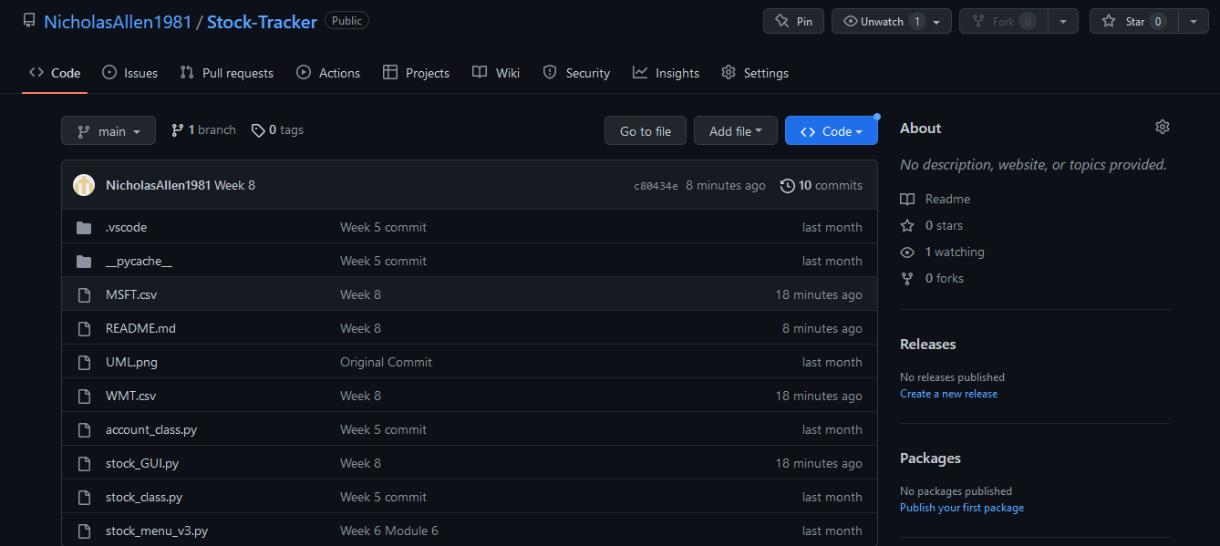
Upload Program
Uploaded Program Files to GitHub

Slide 59
Week 8 – What I Learned
Week 8 was about finishing up the course project, creating a PowerPoint presentation about the course project and uploading to a web portfolio.

Slide 60
Career Skills
I think this class and course project has increased my programming skills a lot. I now understand the importance of object-oriented programming.
Being able to create and use classes will enhance my opportunities.

Slide 61
Conclusion
This class has given me a solid understanding of Python. Object oriented programming is going to take some time to get used to.
This was also my first introduction to tkinter to create a GUI.

