Slide 1
CEIS114 Final Project
Multiple Traffic Signals with Crosswalk button and Web Controlled Emergency Button
Nicholas Allen
Sept 2022 session
10/19/2022

Slide 2
Table of Contents
Project Plan for IoT Traffic Controller
Creating a Single Traffic Controller
Adding a Second Traffic Controller
Adding a Cross-Walk Button
Adding an Emergency Display and a Buzzer
Adding Web Control of the Emergency System
Peer Feedback and Reflection
Challenges With the Project
Career Skills I Developed During the Project
Introduction
Conclusion

Slide 3
Introduction
In this presentation I will demonstrate the steps required to build a traffic controller
1 Planning and Inventory
2 Create a traffic light
3 Add a second traffic light
4 Add a crosswalk button and LED display
5 Add an emergency buzzer to the crosswalk system
6 Add blue emergency LED and web control of emergency mode
This project gives us an example on how to use libraries and how to connect a project to the IoT with web-based control.

Slide 4
Project Plan for IoT Traffic Controller
Project Completed During Module 2

Slide 5
Table of Contents
ESP32 (Image)
Installation of Arduino IDE (Screenshot)
ESP32 Wi-Fi Scan (Screenshot)
Introduction
Inventory (Image)
Conclusion

Slide 6
Module 2: Collecting Inventory
In this section we will see what components it will take to complete the project, collecting them and installing the Arduino IDE software.
Components we need are
ESP32 Board x1
Colored LEDs: RED x2, YELLOW x2, GREEN x2, and BLUE x1
220 Ohm Resistors x7 (to be used with LEDs to prevent premature burn out)
Wires (Lots)
Breadboard(s) x2 (The ESP32 board I have is too wide for a single breadboard)
LCD Unit with I2C Adapter x1
Active Buzzer x1
Mini Router x1 (Not needed if you have Wi-Fi from another router)
Push Button x1

Slide 7
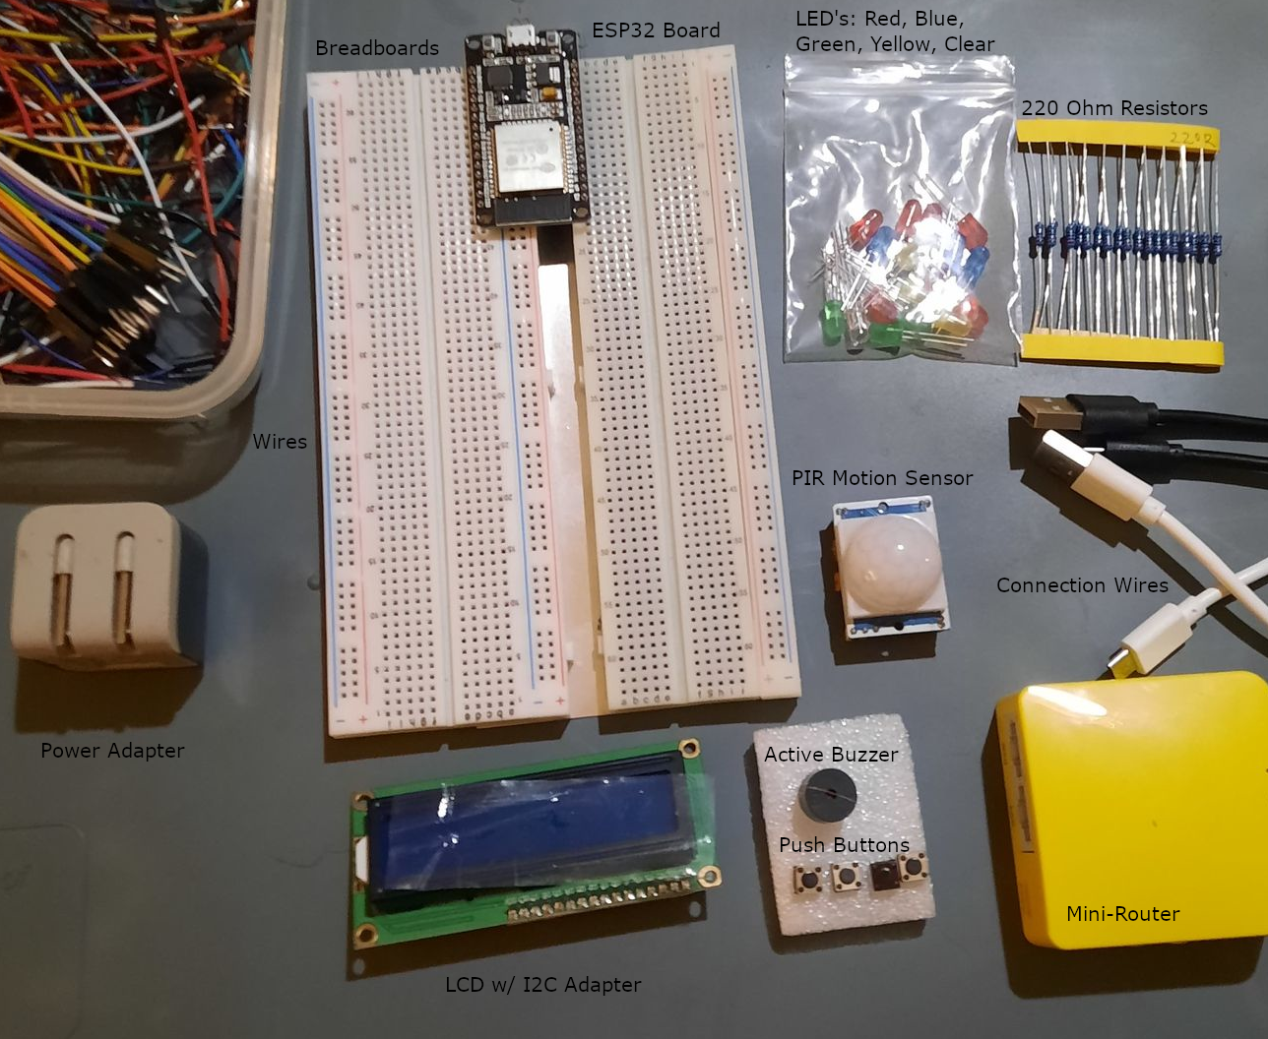
Inventory (Picture)
Image of all project components
ESP 32 Board
Colored LEDs: Red, Yellow, Green, and Blue
220 Ohm Resistors
Wires
Breadboard(s)
LCD Unit with I2C Adapter
Active Buzzer
Mini Router
Push Button
PIR Motion Sensor

Slide 8
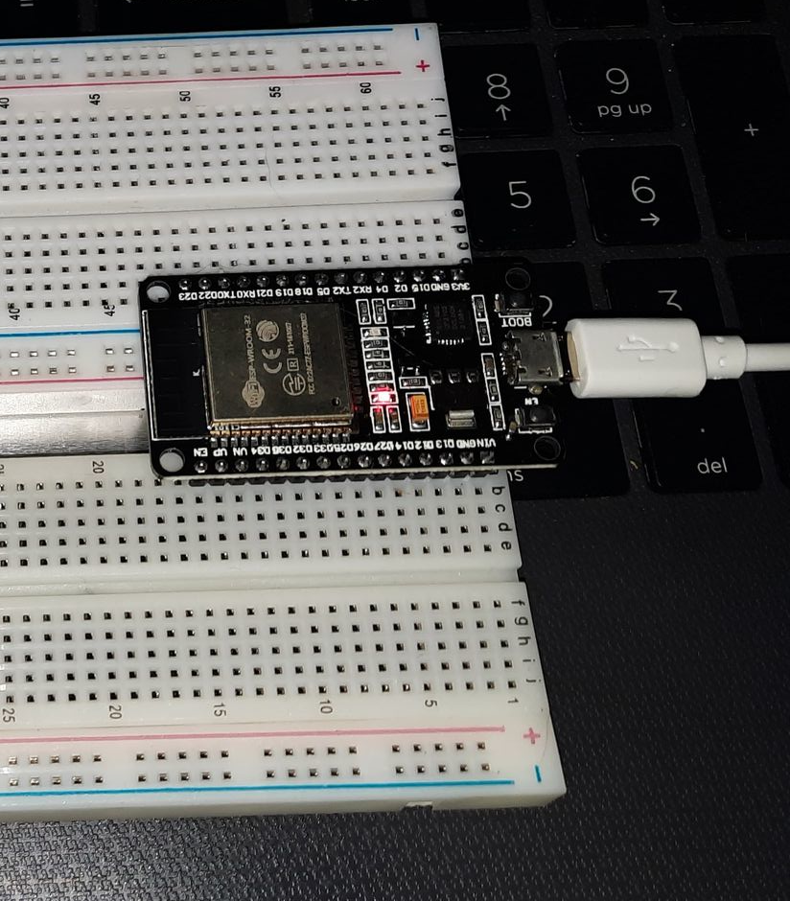
ESP32 (Picture)
Microcontroller mounted and powered ON

Slide 9
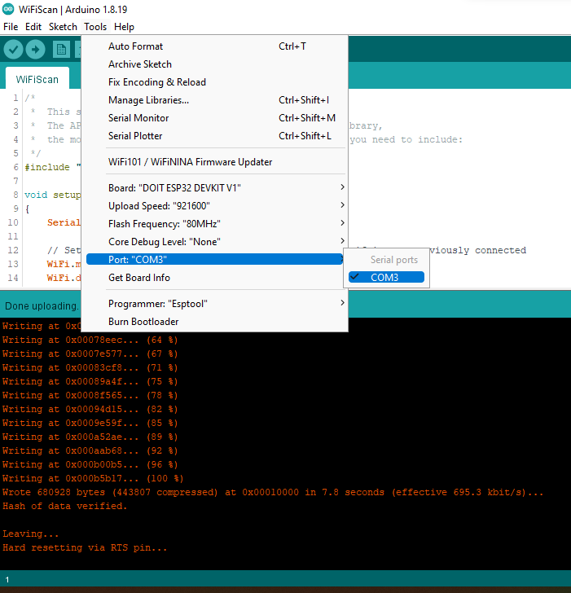
Installation of Arduino IDE
Screenshot of Arduino IDE with Port selected from Tools menu.

Slide 10
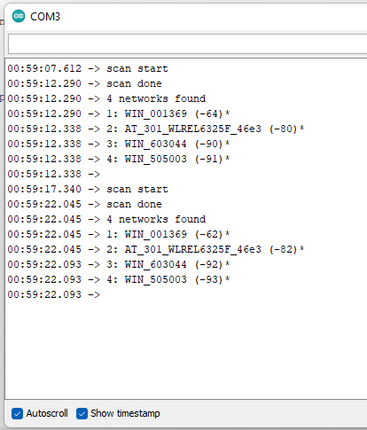
ESP32 Wi-Fi Scan
Screenshot of Serial Monitor in Arduino IDE showing the available networks

Slide 11
Module 2: Conclusion
One point I take from this module is to collect all items you will need and create a “kit” of sorts with all the components you will need. If you don’t have to search for the parts you need your much more likely to continue the project until it is complete.
Another point I take is to install the IDE and get to know how to use it. Make sure you have the correct USB drivers installed and you can access the COM port through the Arduino IDE.

Slide 12
Creating a Single Traffic Controller
Project Completed During Module 3

Slide 13
Table of Contents
Arduino IDE With Code (Screenshot)
Description
Circuit With Working LEDs (Image)
Conclusion

Slide 14
Description
In this part of the project, we will create our first traffic controller in the form of a single stop light. I add 3 LEDs, 3 resistors, and 3 wires. As noted, we will be using RED, YELLOW, and GREEN LED’s and 220-ohm resistors.
Red LED
Red Male-to-Male wire
Yellow LED
Yellow Male-to-Male wire
Green LED
Green Male-to-Male wire
220-ohm resistor (x3)

Slide 15
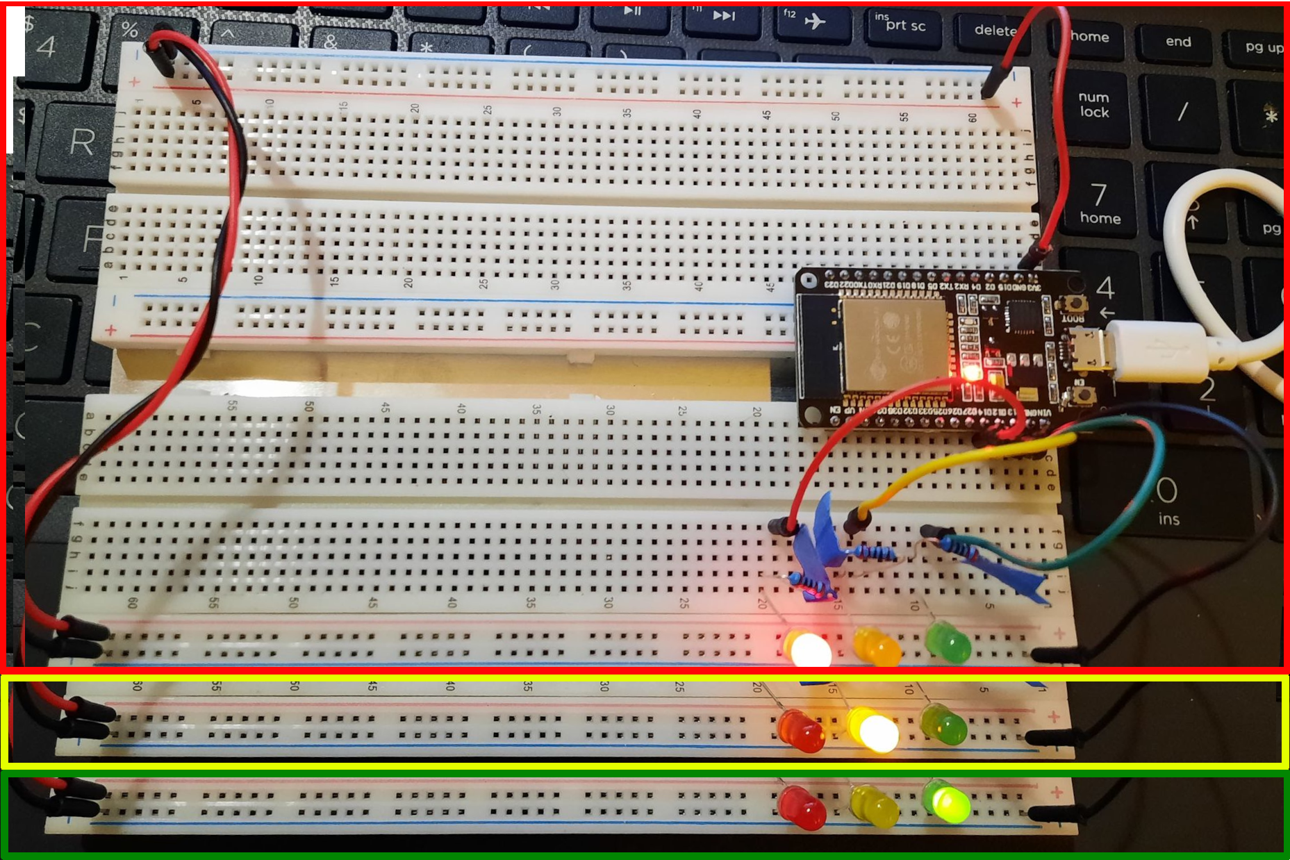
Circuit With Working LEDs
ESP 32 Board
Colored LEDs: Red, Yellow, Green
220 Ohm Resistors
Wires
Breadboard

Slide 16
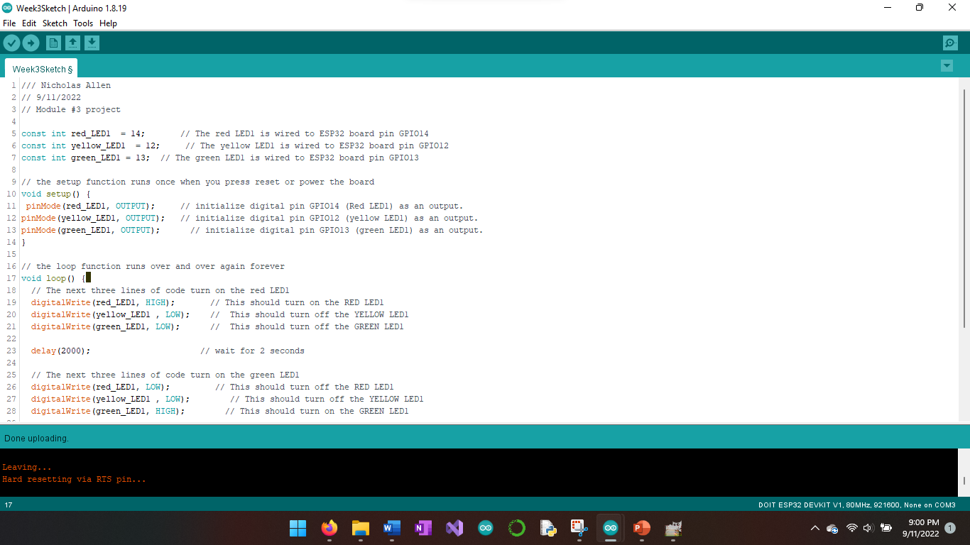
Arduino IDE with Code
Screenshot of code in Arduino IDE showing your name in the comment

Slide 17
Module 3: Conclusion
Connecting the ESP32 to the boards and hooking up the power rails gets us ready to build our circuit. Make sure to connect the long pin of the LED to positive power and ensure all wires are connected correctly. Upload the provided code into the device and watch the lights change.

Slide 18
Adding a Second Traffic Controller
Project Completed During Module 4

Slide 19
Table of Contents
Description
Circuit With Working LEDs (Image)
Conclusion
Arduino IDE With Code (Screenshot)

Slide 20
Description
Here we will add a second set of LEDs, resistors, and wires. We also need to update the code in the ESP32 device to reflect the changes and tell it how to work.
Red LED
Red Male-to-Male wire
Yellow LED
Yellow Male-to-Male wire
Green LED
Green Male-to-Male wire
220-ohm resistor (x3)

Slide 21
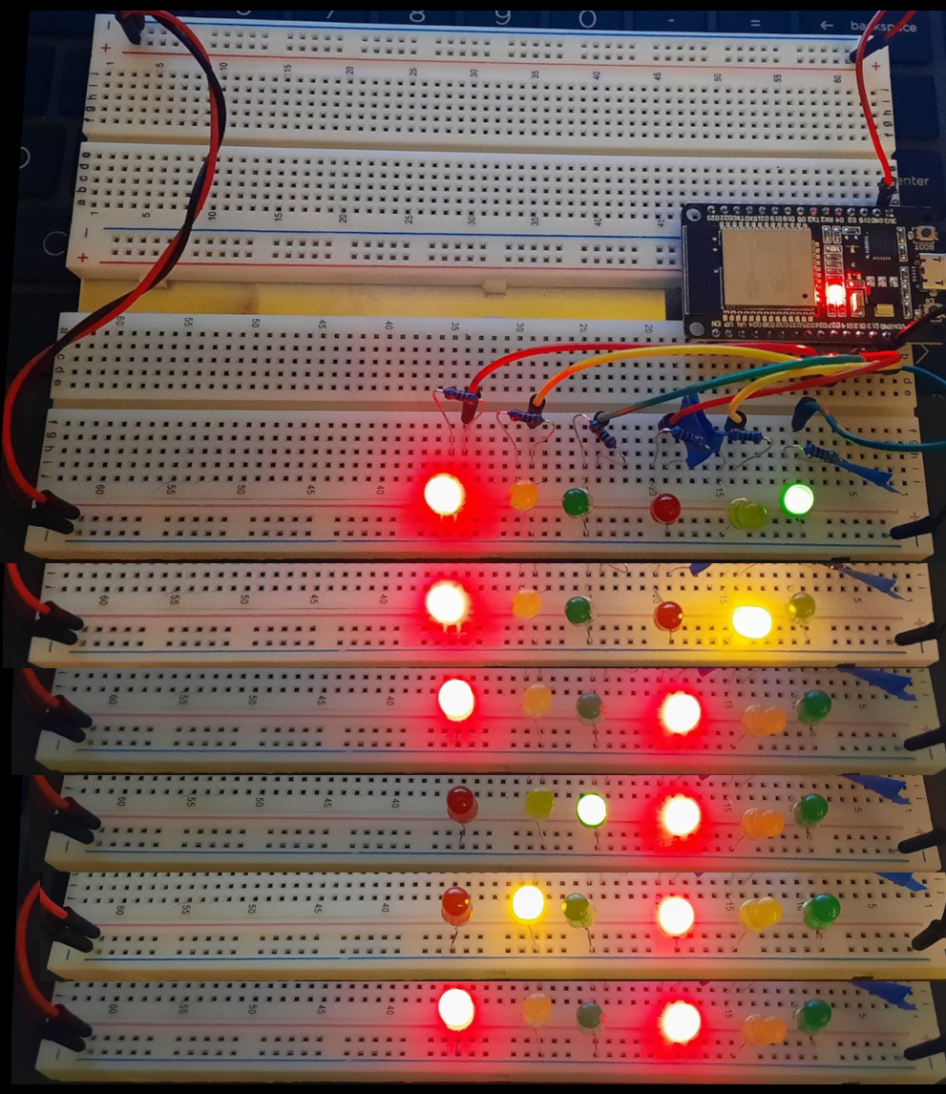
Circuit With Working LEDs
ESP 32 Board
Colored LEDs: Red, Yellow, Green (2 sets)
220 Ohm Resistors
Wires
Breadboard

Slide 22
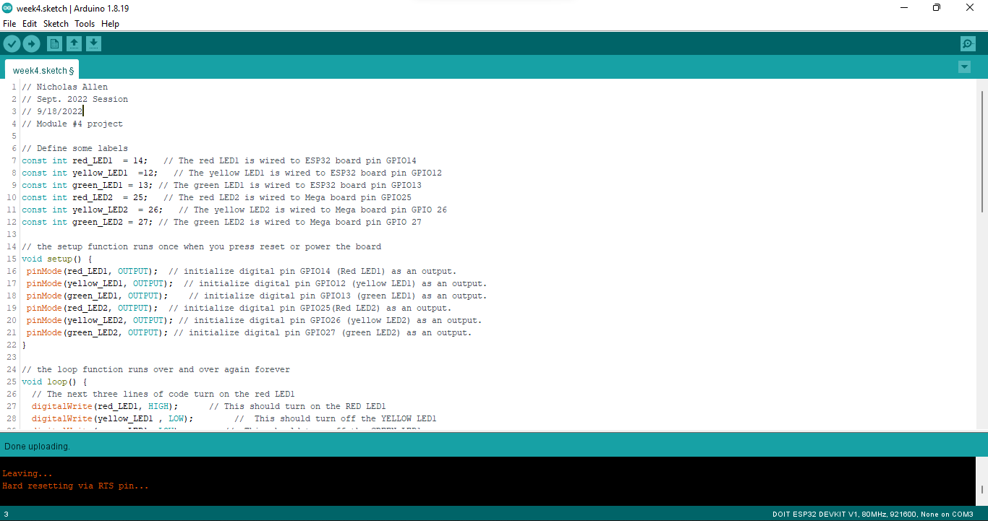
Arduino IDE with Code
Screenshot of code in Arduino IDE showing your name in the comment

Slide 23
Module 4: Conclusion
Connect another set of LEDs and resistors.
Red (x1)
Yellow (x1)
Green (x1)
220-ohm Resistor (x3)
Uploads provided code to the ESP32 device to control the traffic controller.

Slide 24
Adding a Cross-Walk Button
Project Completed During Module 5

Slide 25
Table of Contents
Description
Circuit With Working LEDs (Image)
Conclusion
Arduino IDE With Code (Screenshot)
Serial Monitor from Arduino IDE (Screenshot)

Slide 26
Description
In this section I add a push button and some wires and uploaded the code. The magic is in the code and tells the traffic controllers to flash red.
Push Button
Male-to-Male wire
Male-to-Male wire

Slide 27
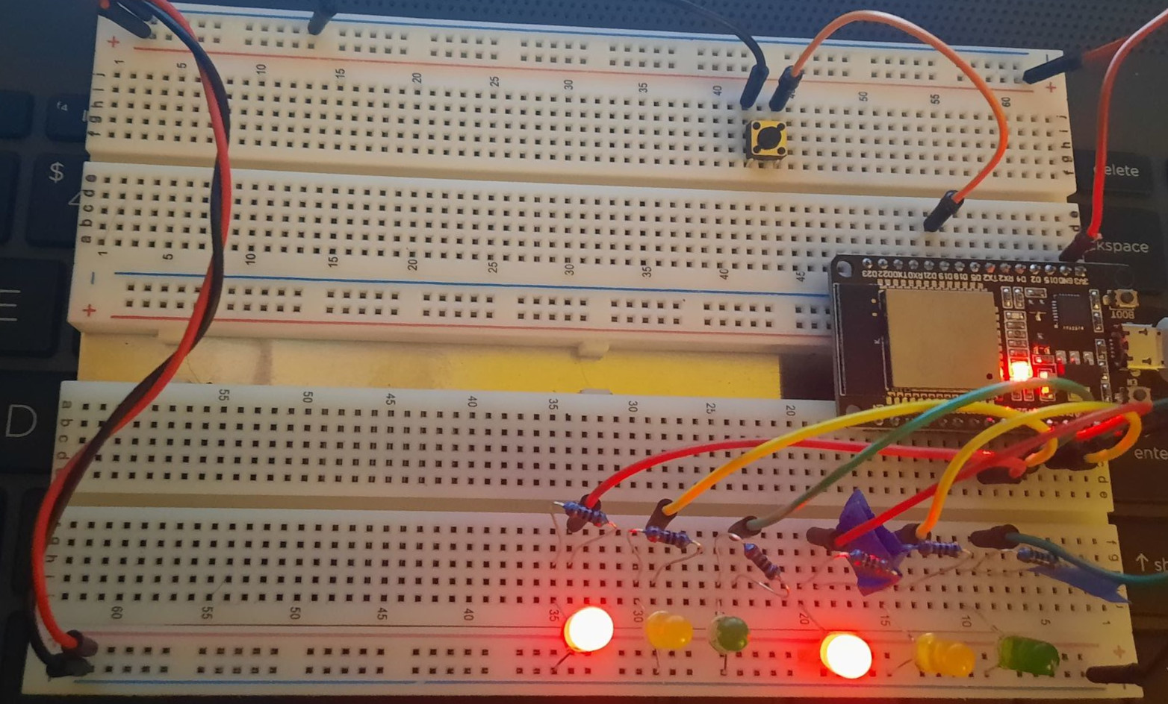
Circuit With Working LEDs
ESP 32 Board
Colored LEDs: Red, Yellow, Green (2 sets)
220 Ohm Resistors
Pushbutton
Wires
Breadboard

Slide 28
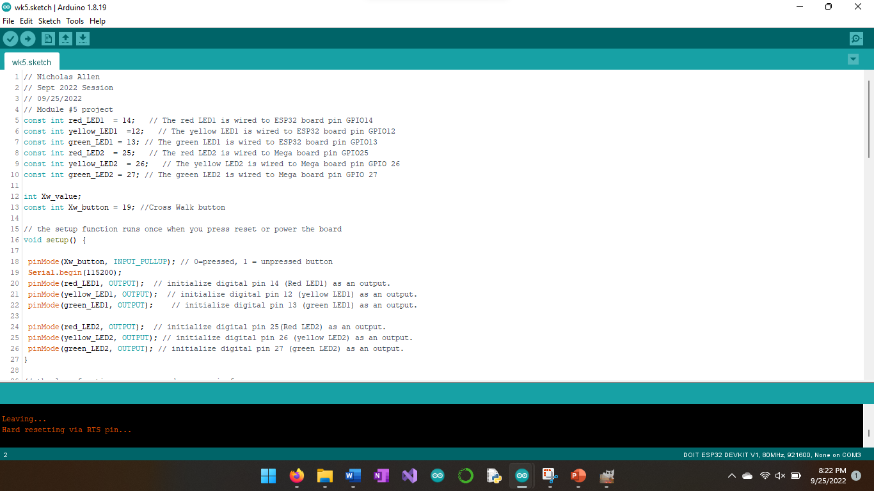
Arduino IDE with Code
Screenshot of code in Arduino IDE showing your name in the comment

Slide 29
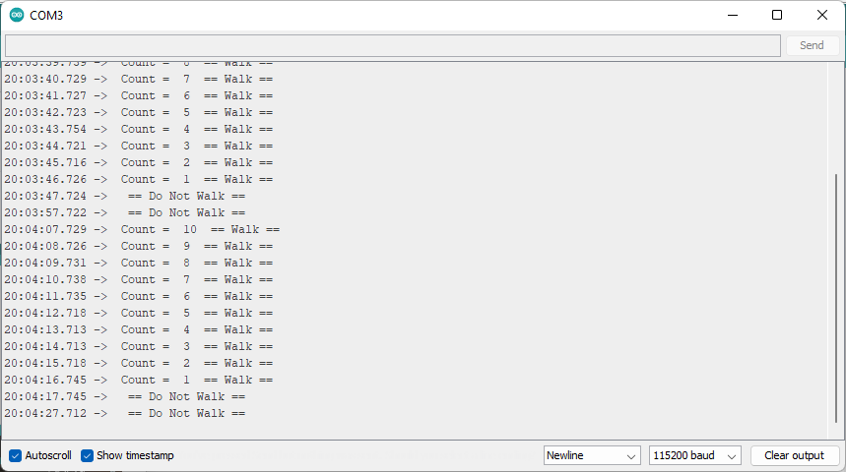
Serial Monitor from Arduino IDE
Screenshot of Serial Monitor from Arduino IDE with output

Slide 30
Module 5: Conclusion
Connect a push button and wires and upload the code to the ESP32.
Push Button
Male to Male Wires

Slide 31
Adding an Emergency Buzzer
Project Completed During Module 6

Slide 32
Table of Contents
Description
Circuit With Working LCD and LEDs (Image)
Conclusion
Arduino IDE With Code (Screenshot)
Serial Monitor from Arduino IDE (Screenshot)

Slide 33
Description
Here we add the LCD unit and Active Buzzer.
Active Buzzer
LCD Unit with I2C adapter
Male-to-Male wire

Slide 34
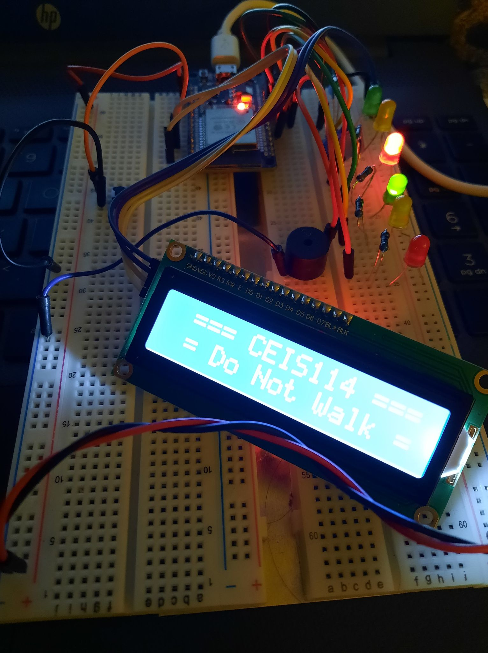
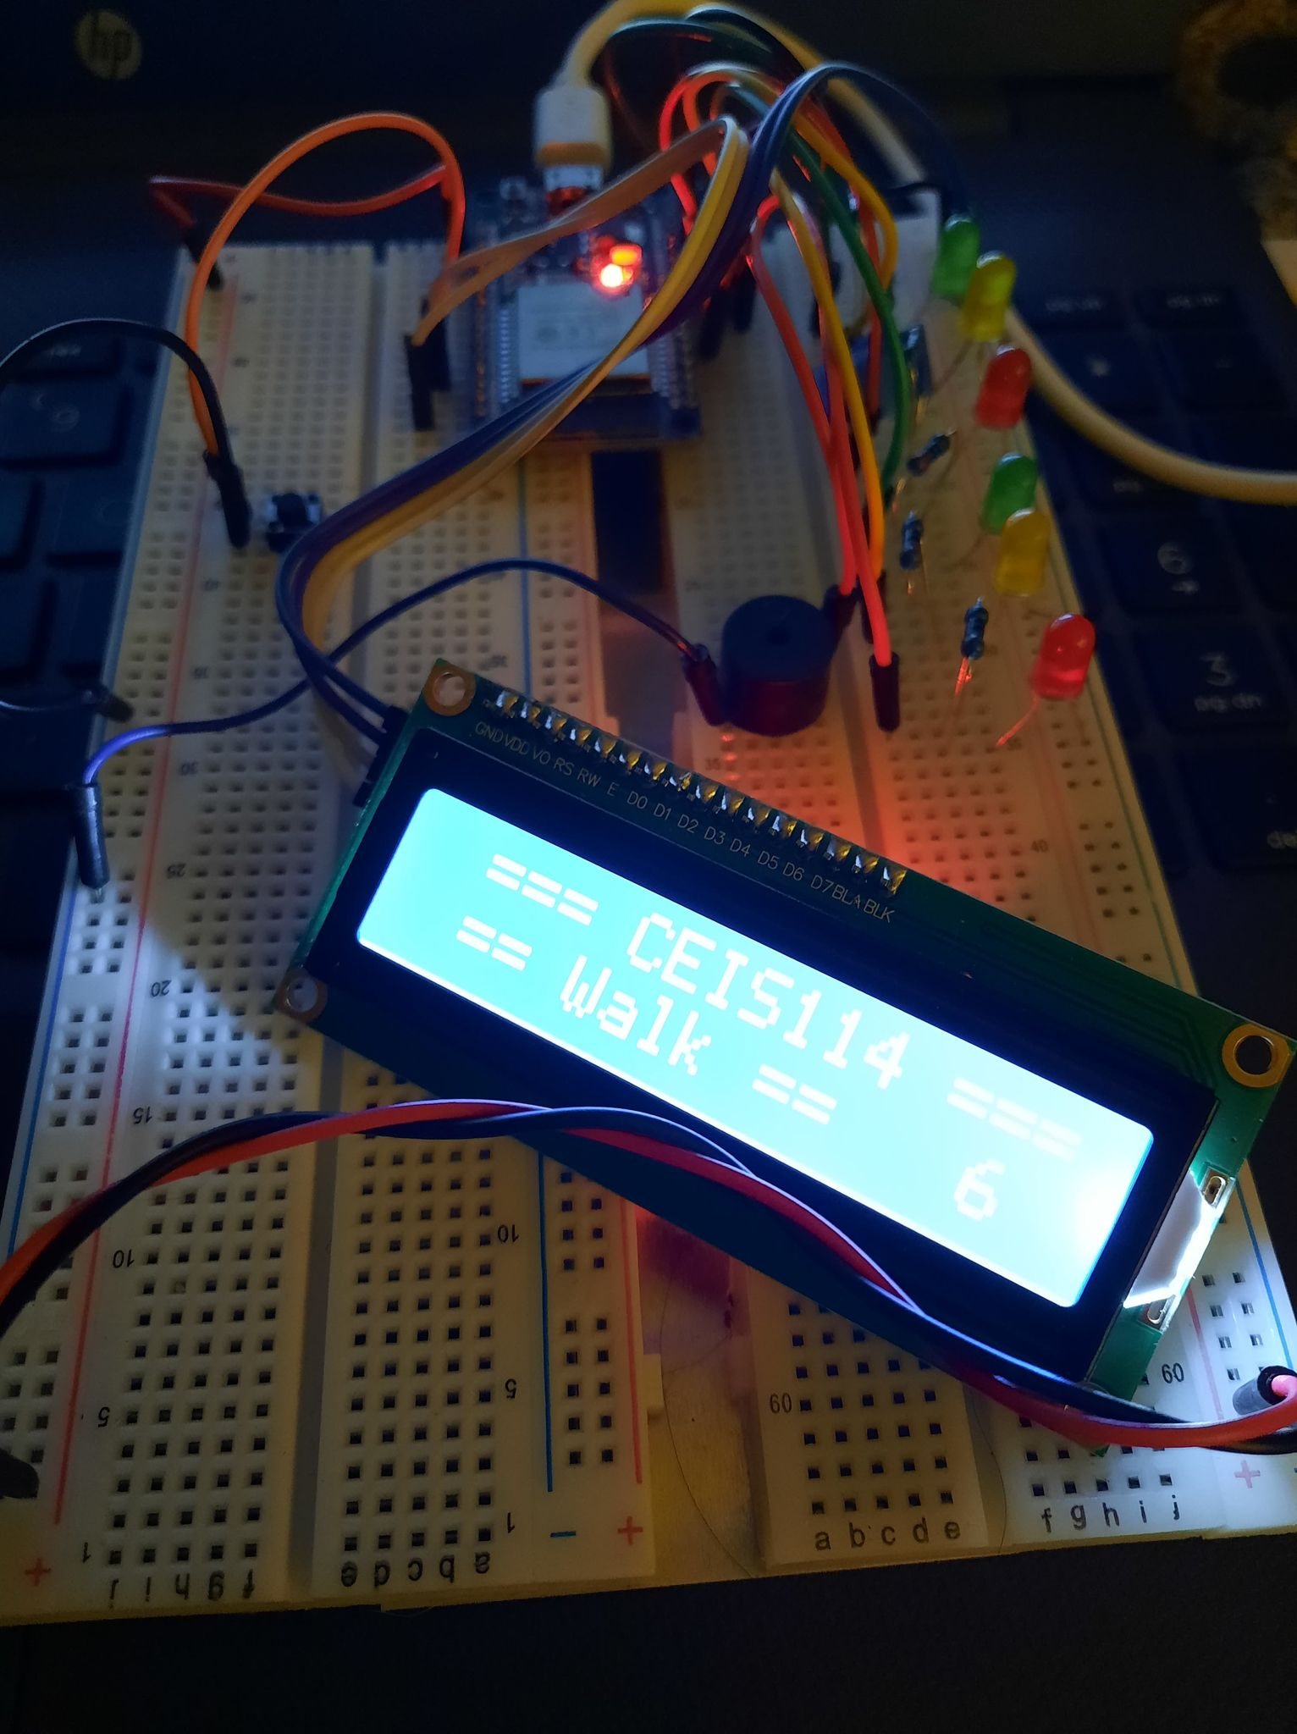
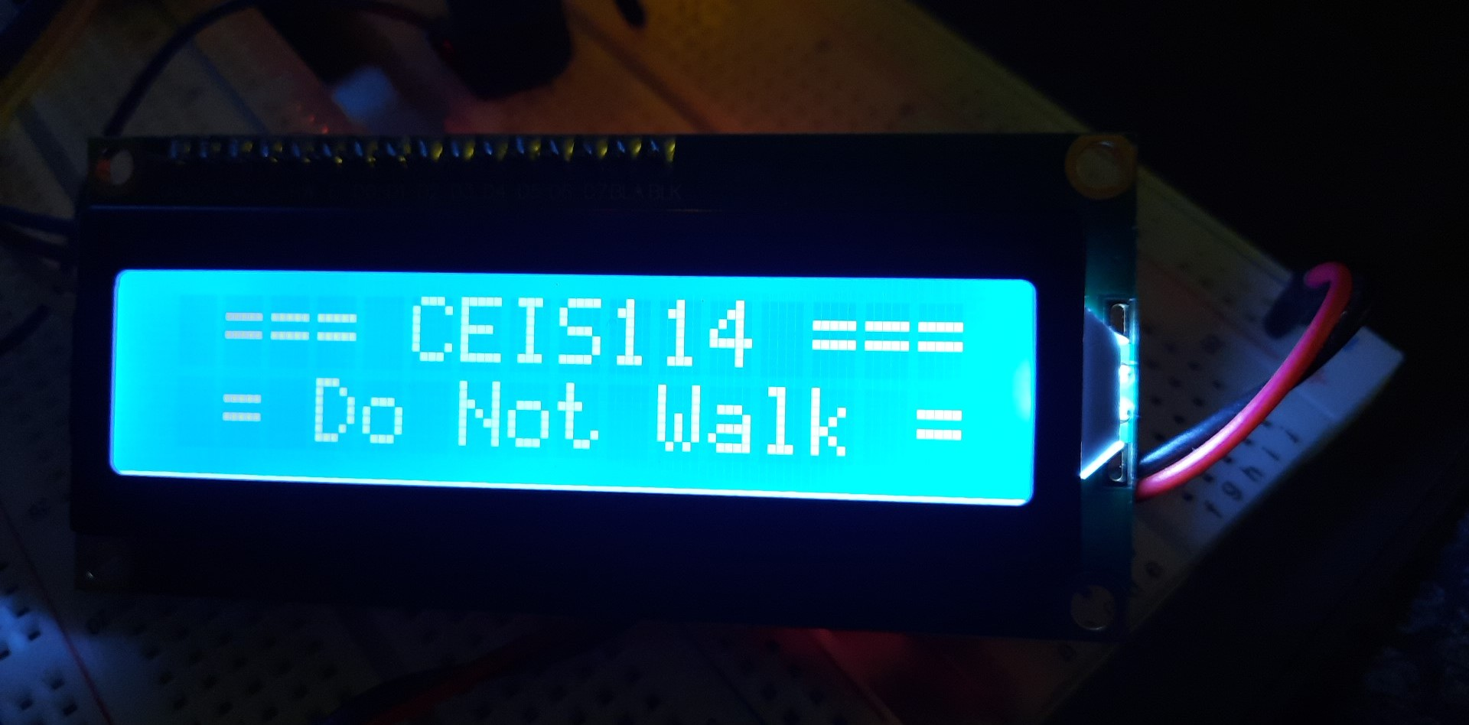
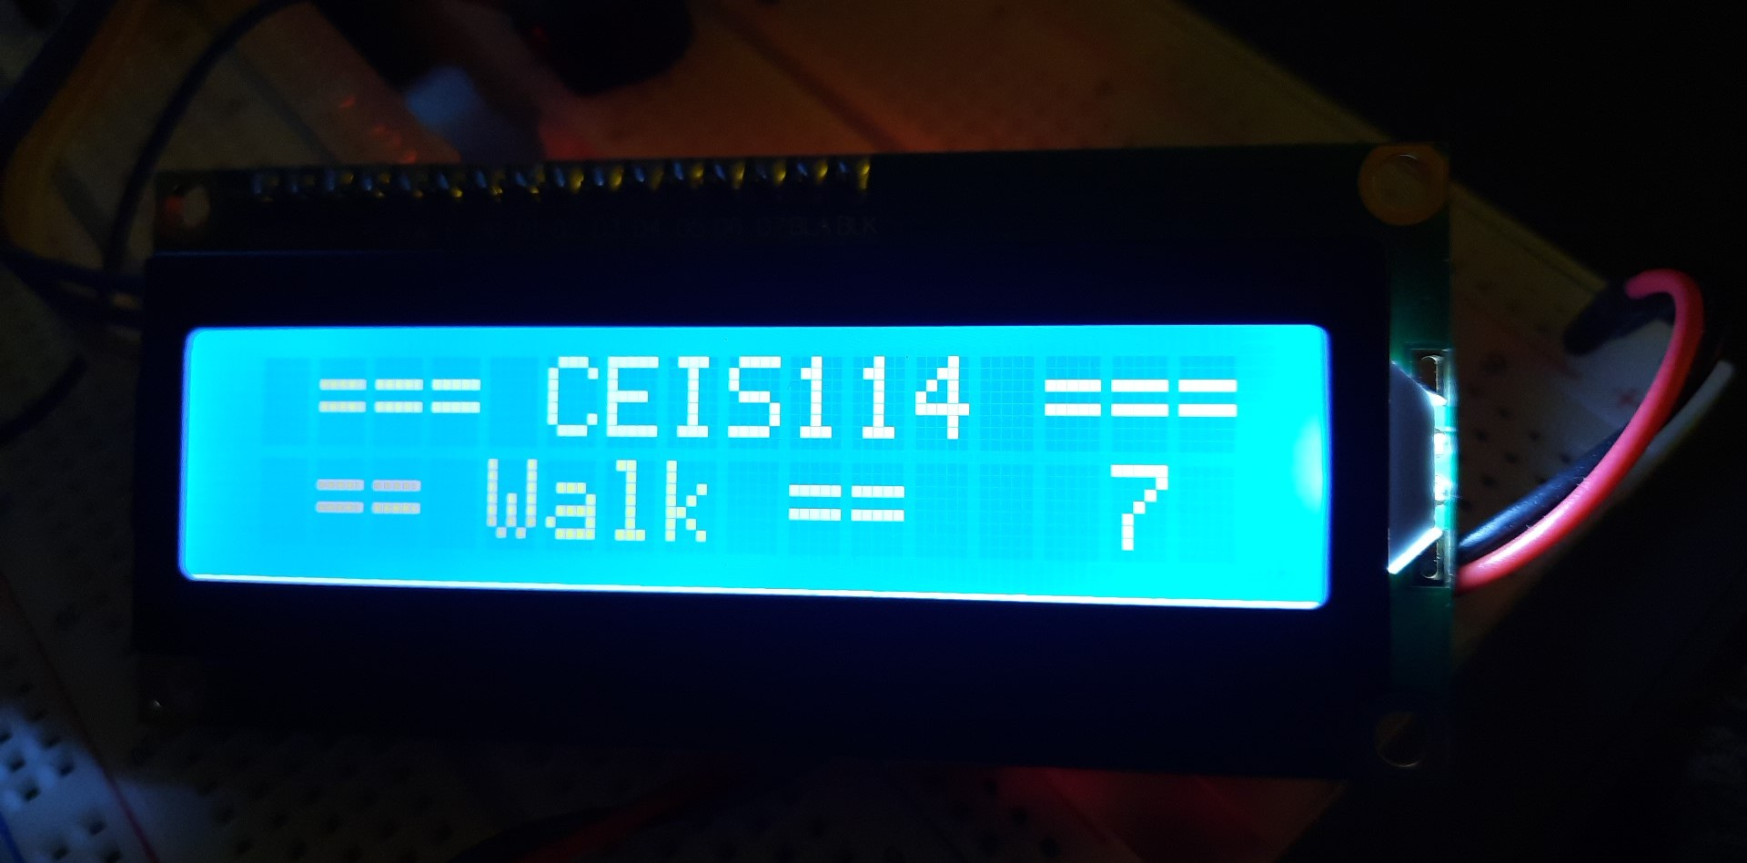
Circuit With Working LCD and LEDs
ESP 32 Board
Colored LEDs: Red, Yellow, Green (2 sets)
220 Ohm Resistors
Pushbutton
Wires
LCD Unit
Active Buzzer
Breadboard

Slide 35
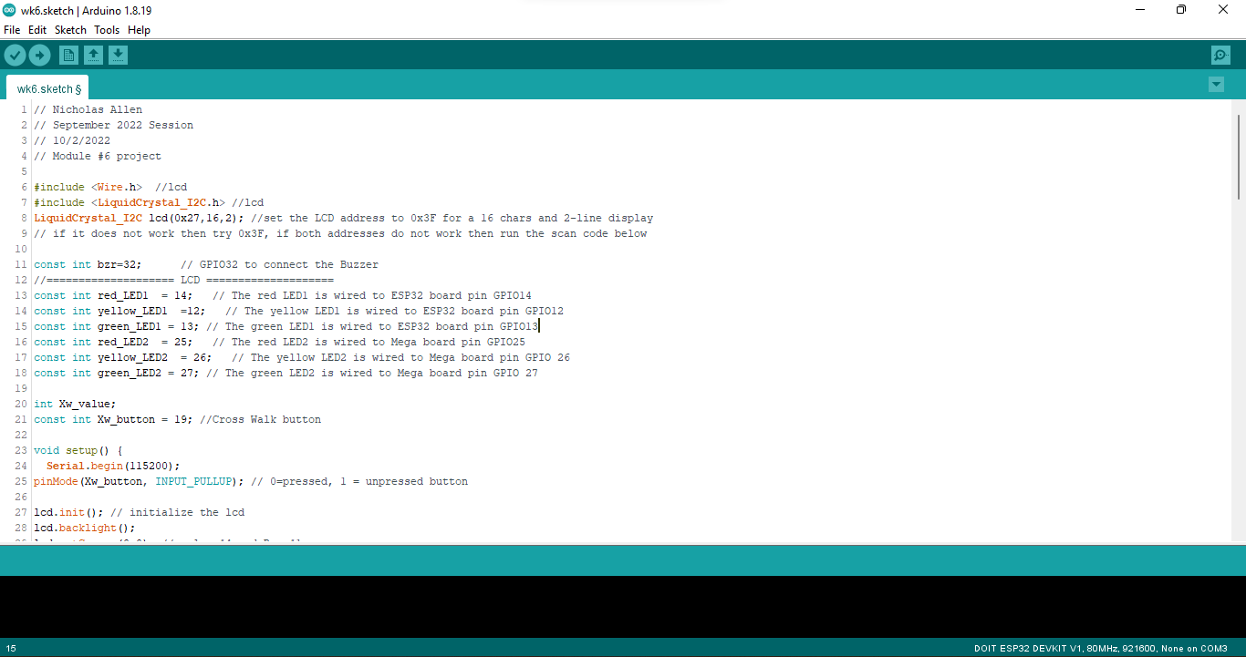
Arduino IDE with Code
Screenshot of code in Arduino IDE showing your name in the comment

Slide 36
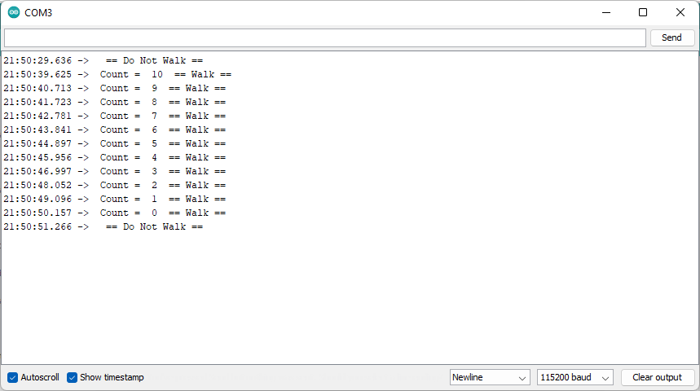
Serial Monitor from Arduino IDE
Screenshot of Serial Monitor from Arduino IDE with output

Slide 37
Module 6: Conclusion
Connect the LCD and Active Buzzer to the breadboard and upload the code
LCD Unit with I2C Adapter
Active Buzzer
Male to Male Wires
Male to Female Wires (to connect the LCD unit)

Slide 38
Adding Web Control of the Emergency System
Project Completed During Module 7

Slide 39
Table of Contents
Description
Circuit With Working LCD and LEDs (Image)
Conclusion
Arduino IDE With Code (Screenshot)
Serial Monitor from Arduino IDE (Screenshot)

Slide 40
Description
In the last module of the course, I chose Option 1. This was to connect the traffic controller to the IoT by connecting with Cayenne and creating a web-based push button that puts all signals at red, turns on the blue LED and displays EMERGENCY on the LCD. We edit the sketch and add our Wi-Fi SSID and password and the Cayenne connection information and upload the new code to the ESP32
Blue LED
Male-to-Male wires
https://cayenne.mydevices.com account and connection information

Slide 41
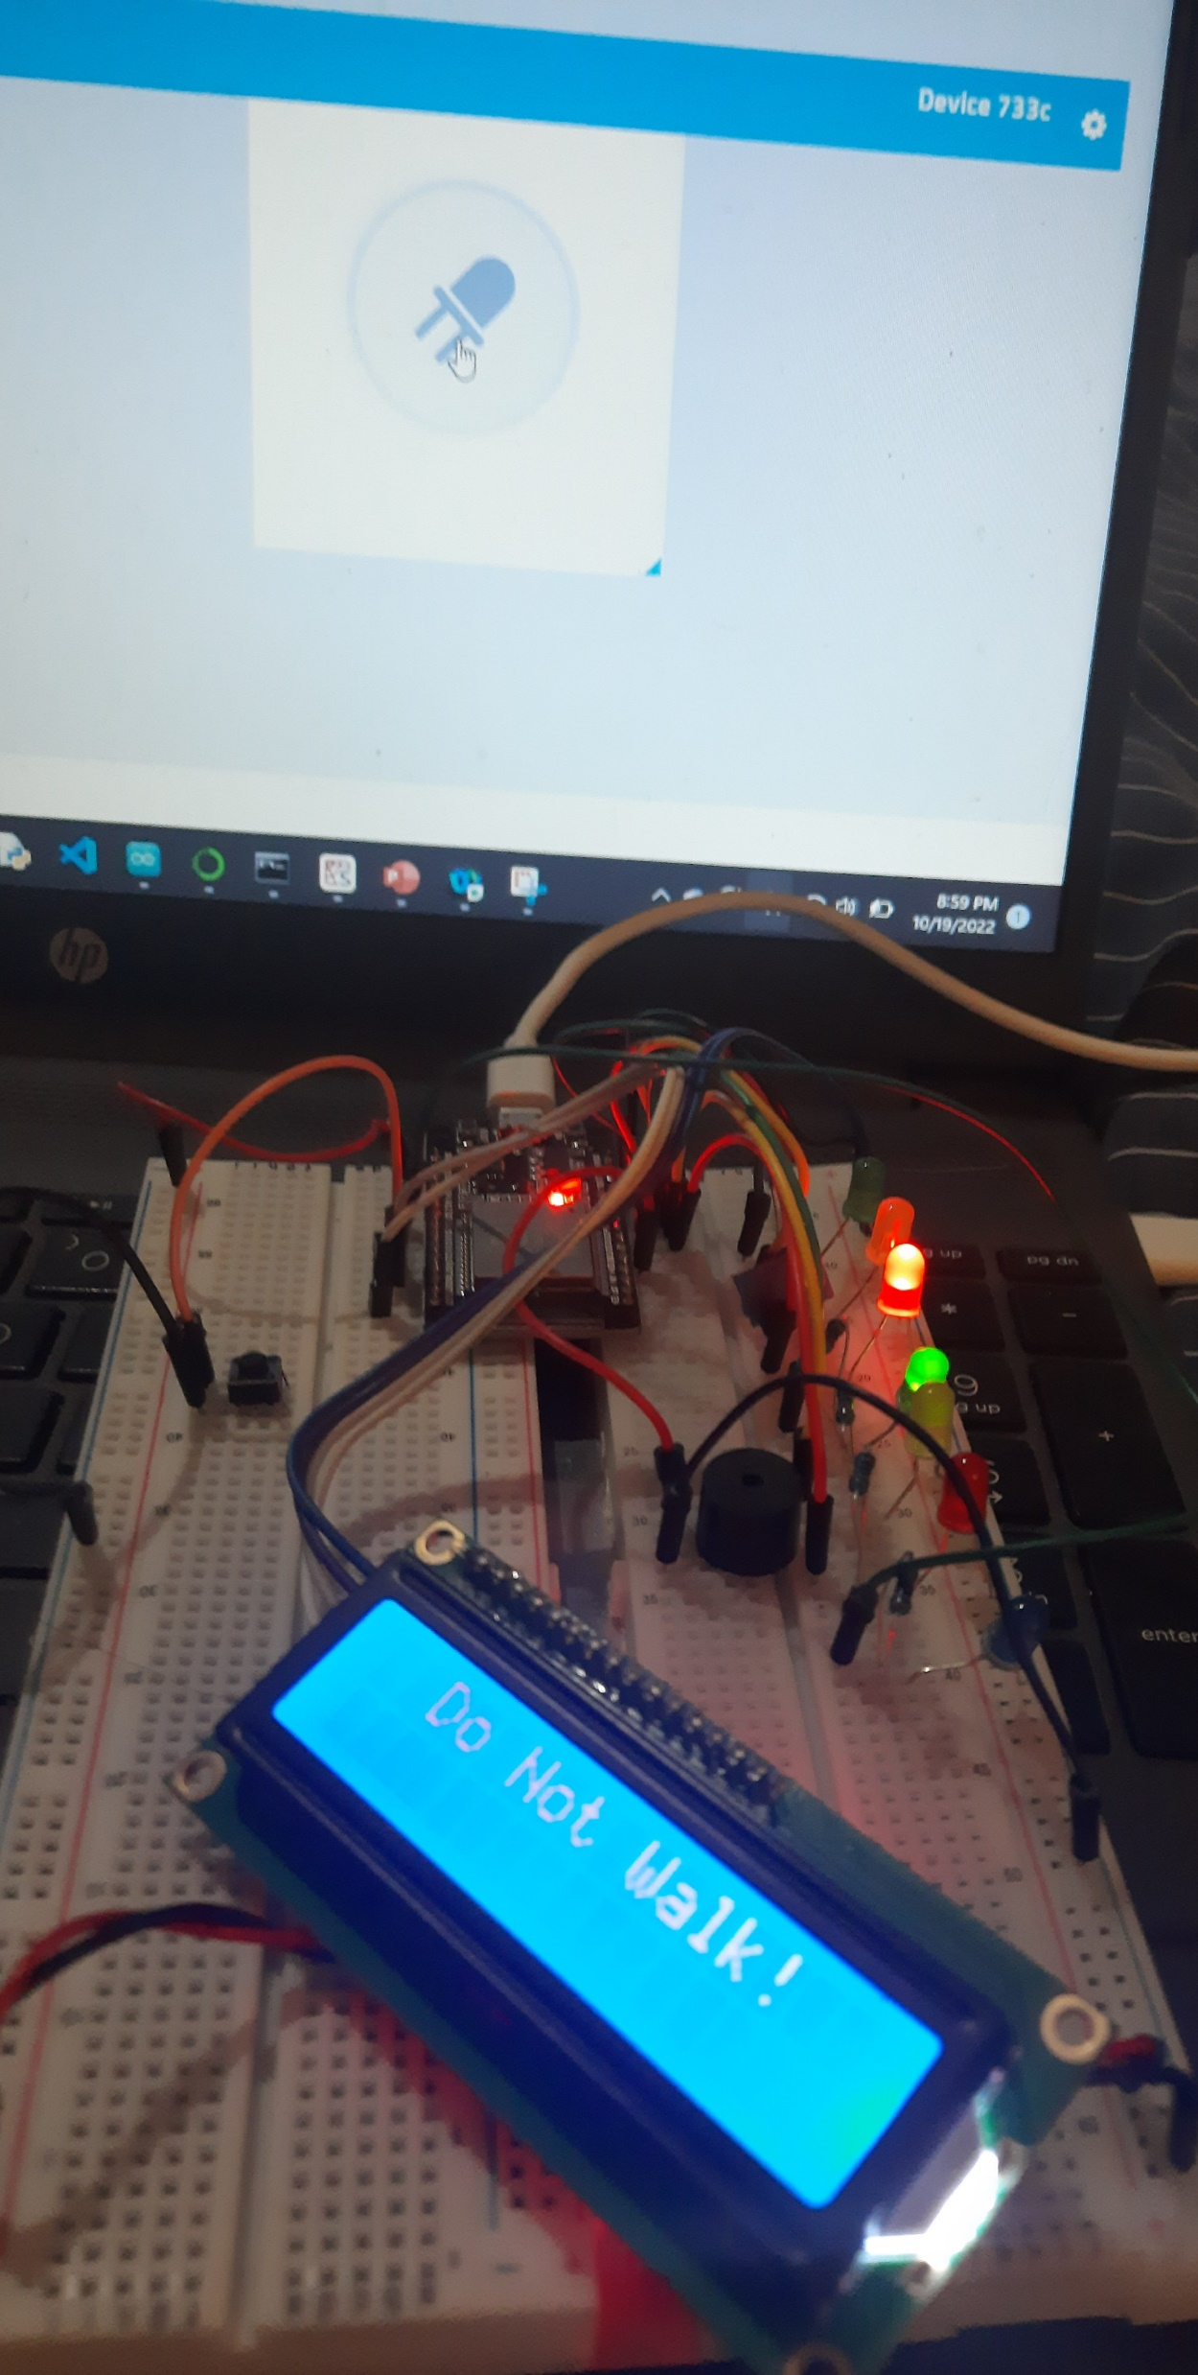
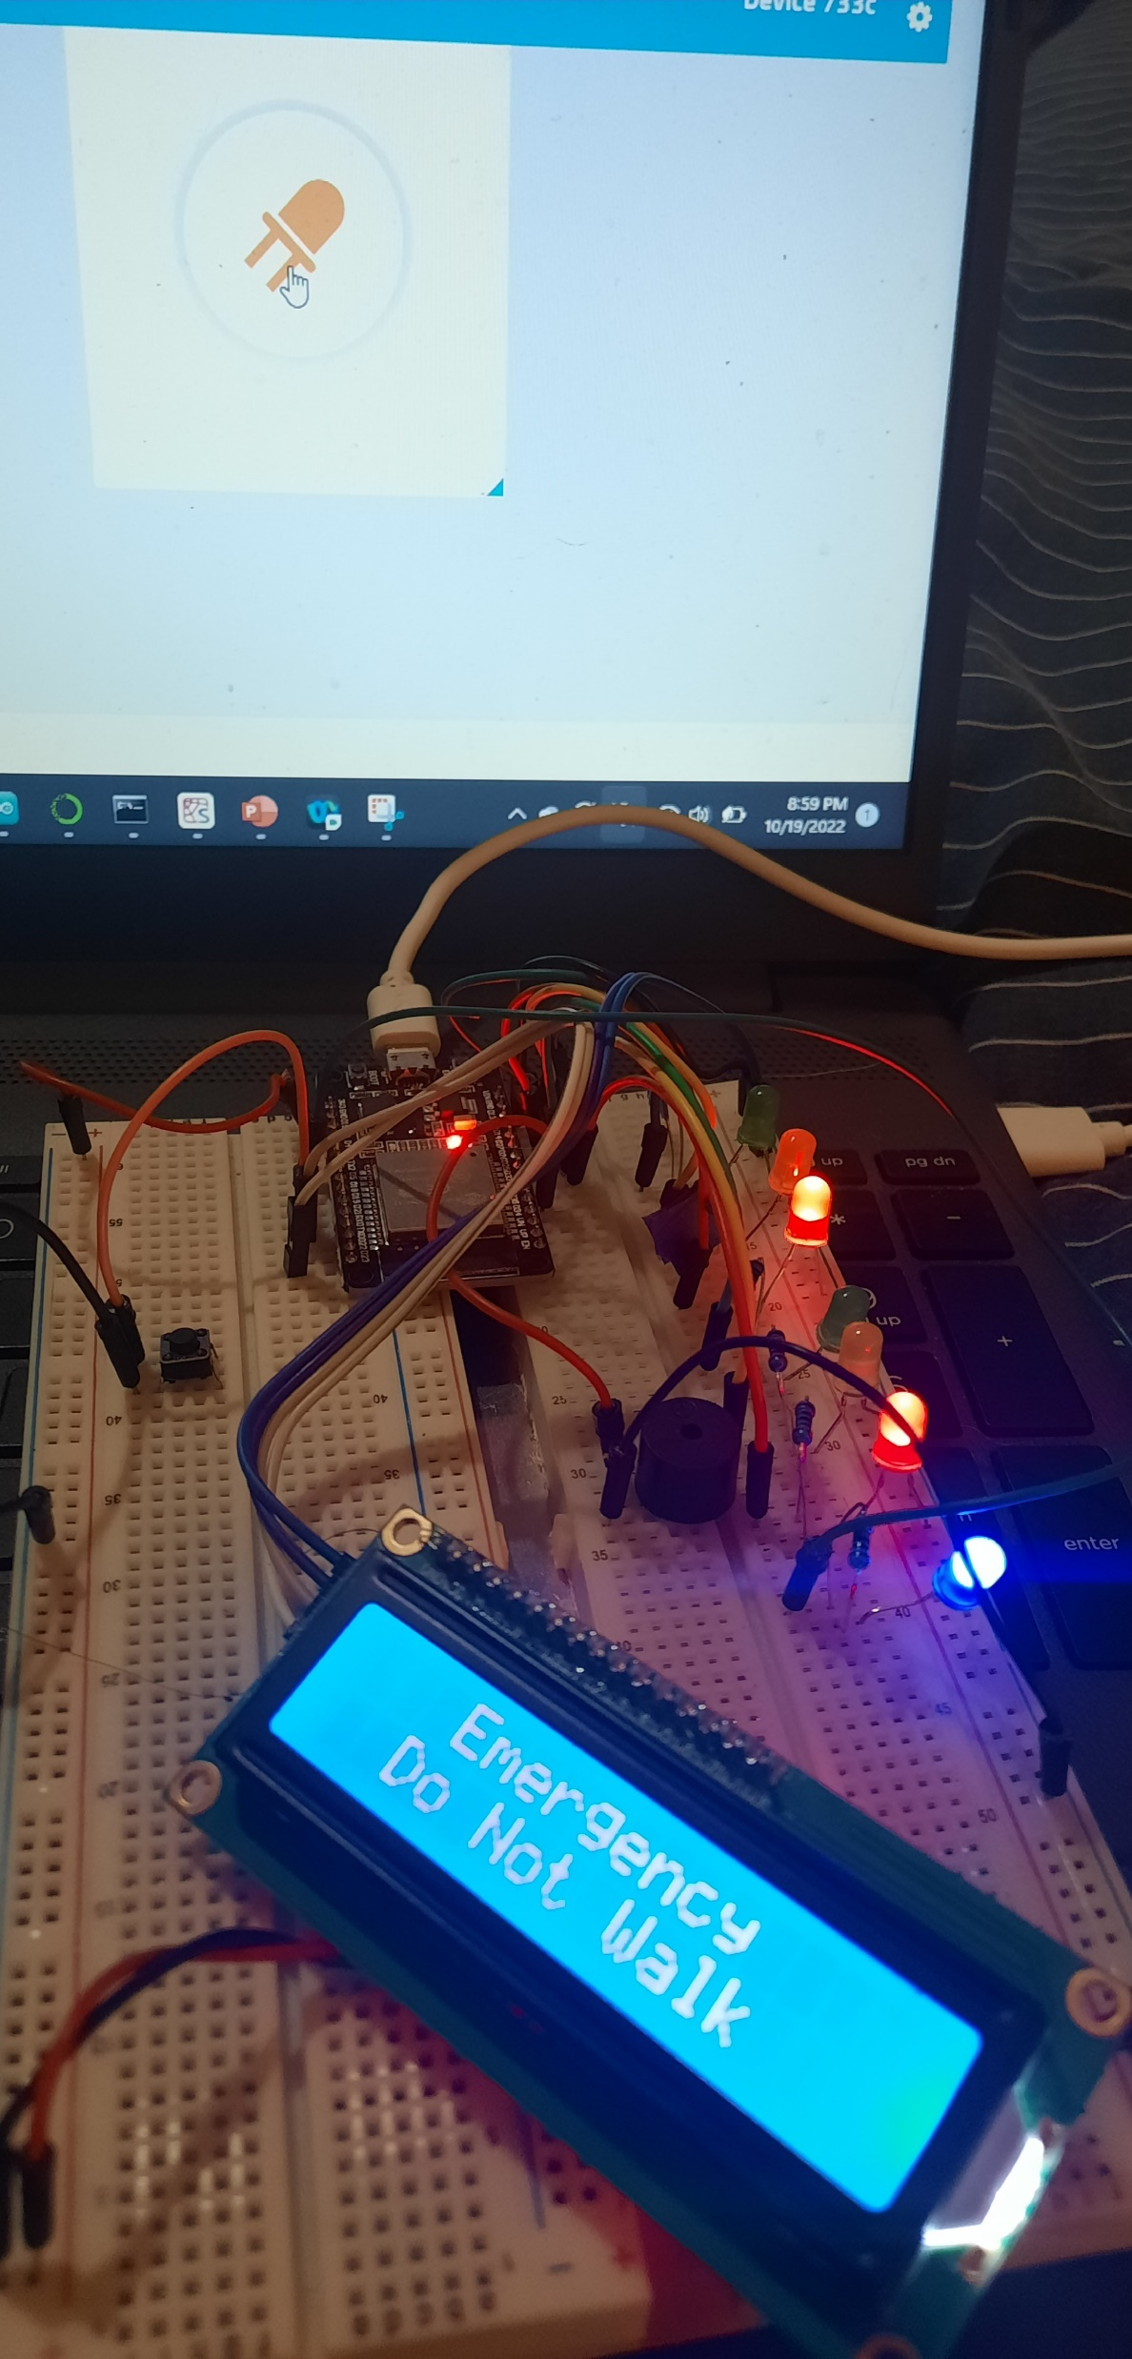
Circuit With Working LCD and LEDs
ESP 32 Board
Colored LEDs: Blue
220 Ohm Resistor
Wires
Breadboard

Slide 42
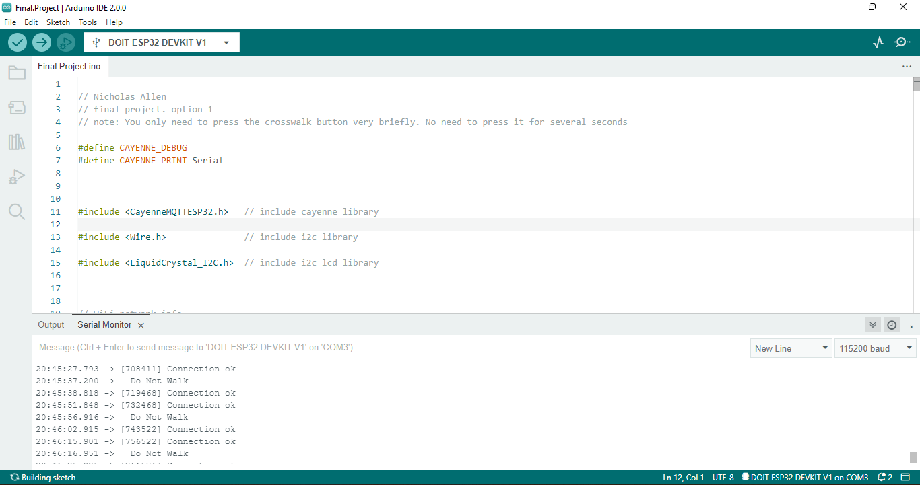
Arduino IDE with Code
Screenshot of code in Arduino IDE showing your name in the comment

Slide 43
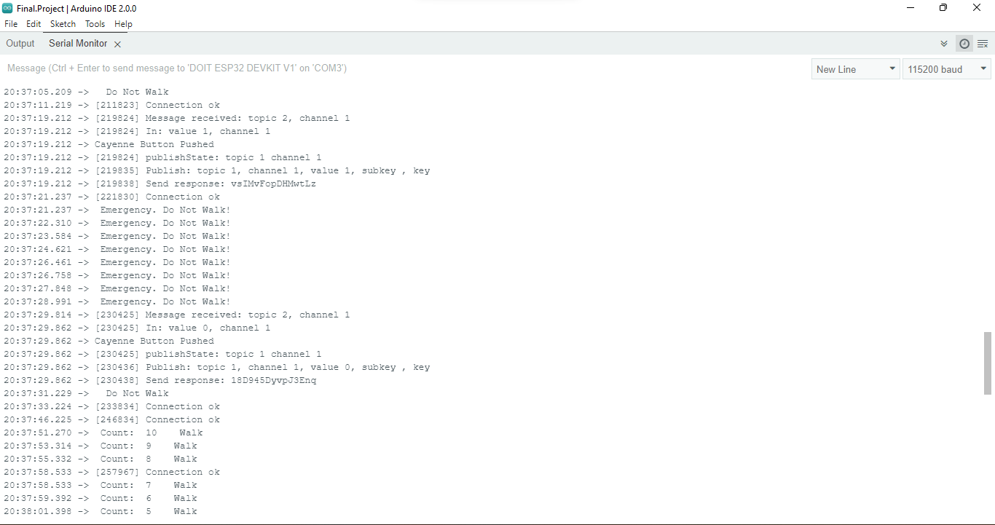
Serial Monitor from Arduino IDE
Screenshot of Serial Monitor from Arduino IDE with output

Slide 44
Module 6: Conclusion
Connecting the traffic controller to the network was easier than I expected. I had a little trouble with the first code we were given but was able to make it work, the second code worked as slick as I expected.
Blue LED
Male to Male Wires
Cayenne account and connection information

Slide 45
Feedback and Reflection
In this section of the presentation, I display the feedback I gave and received from my fellow peers on my ideas on how to complete this project. I reflect on this feedback and discuss with my team.

Slide 46
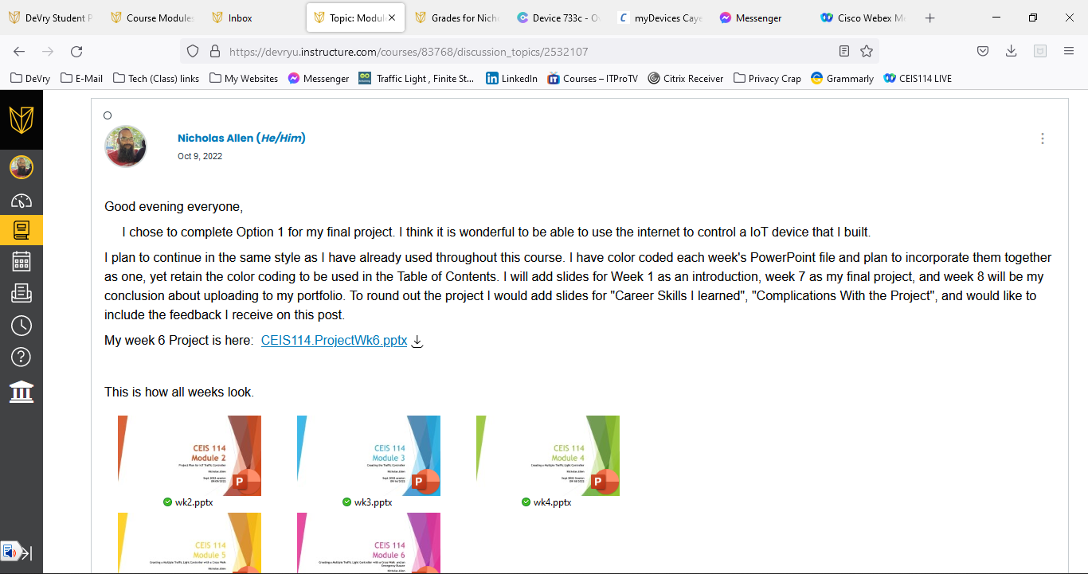
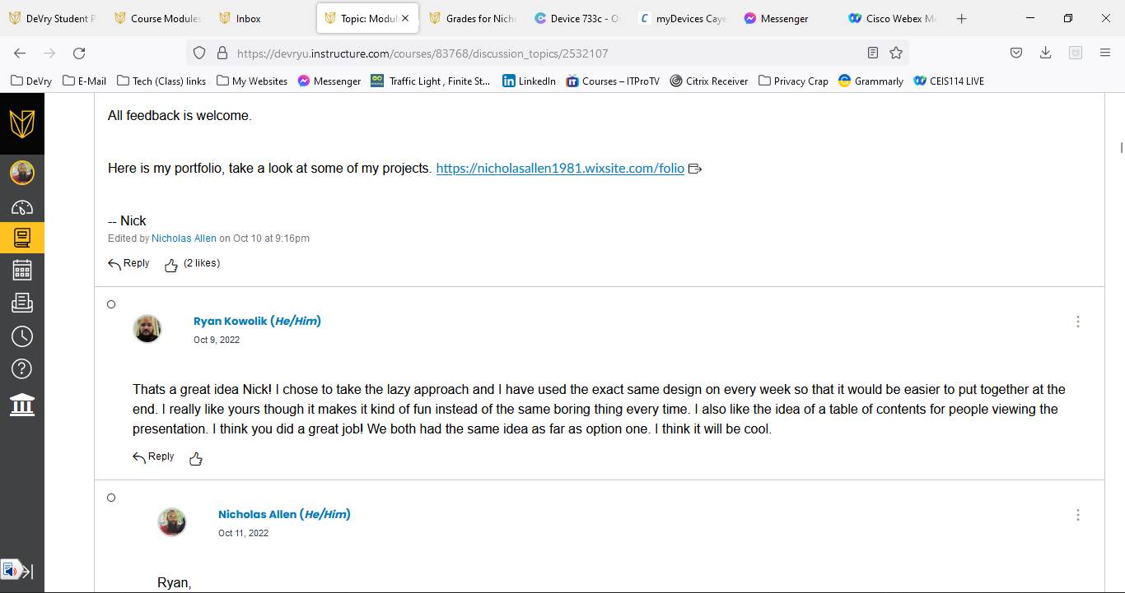
Feedback and Reflection

Slide 47
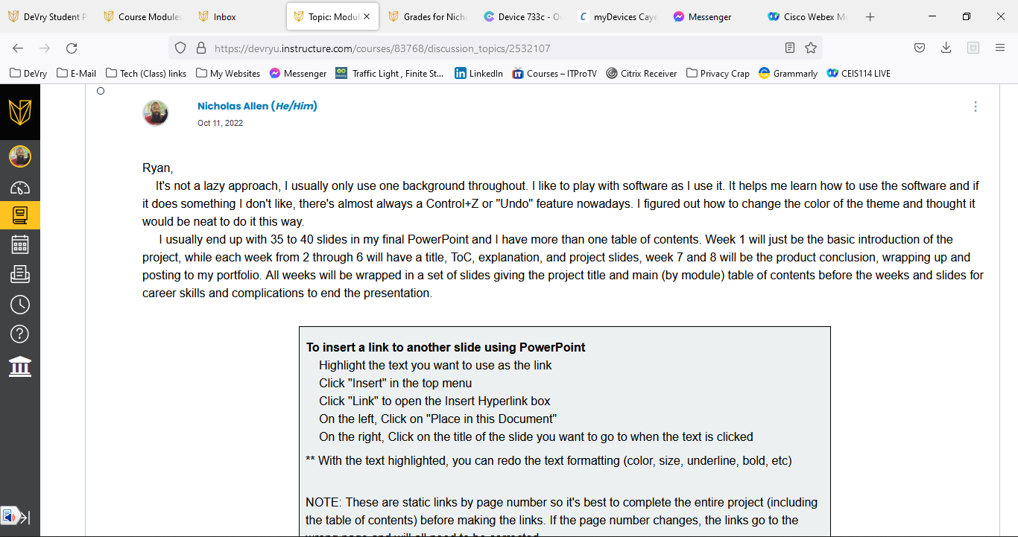
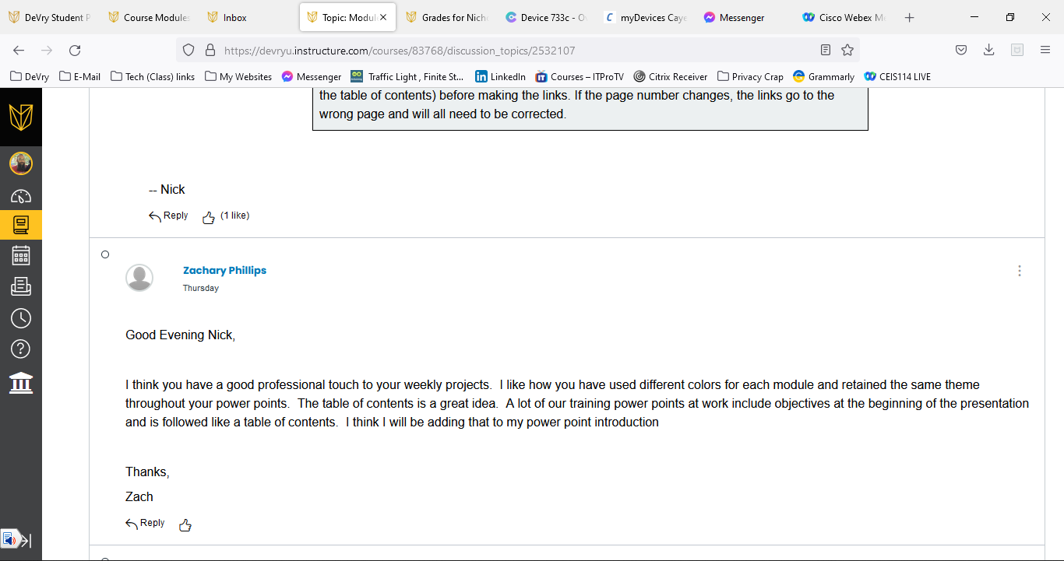
Feedback and Reflection

Slide 48
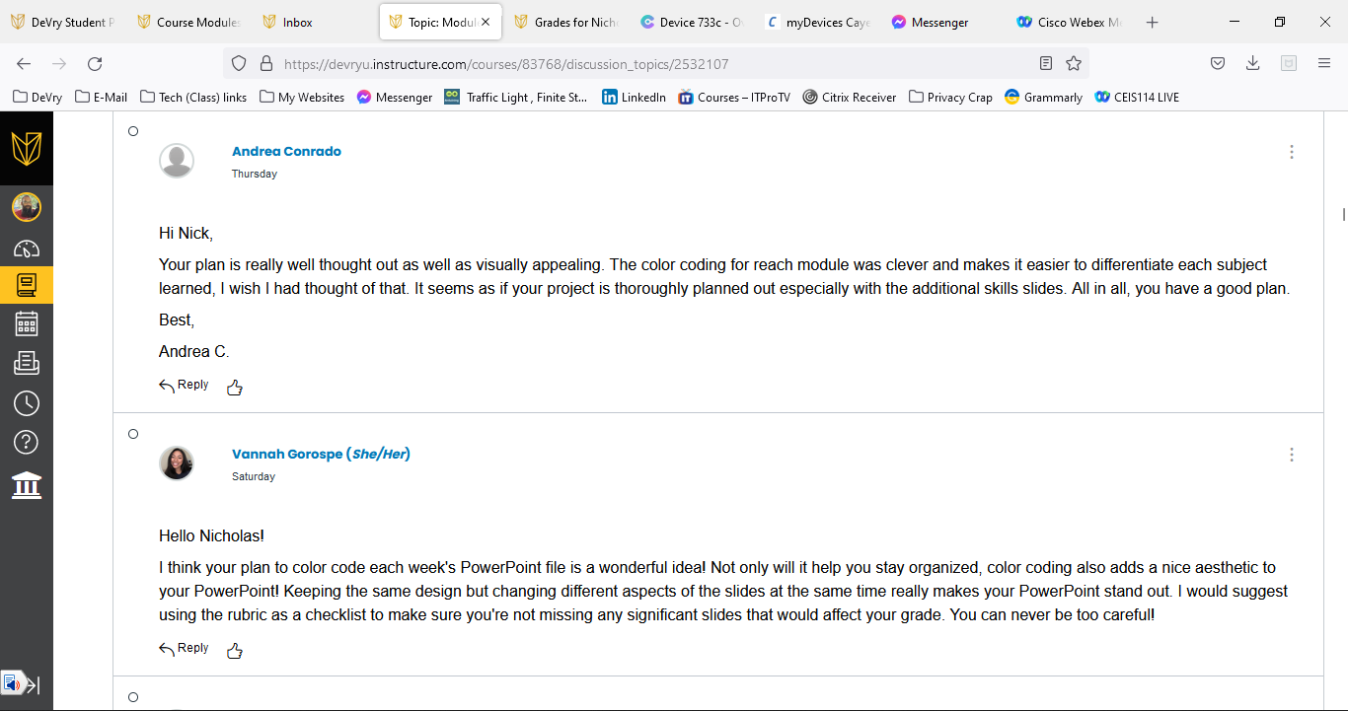
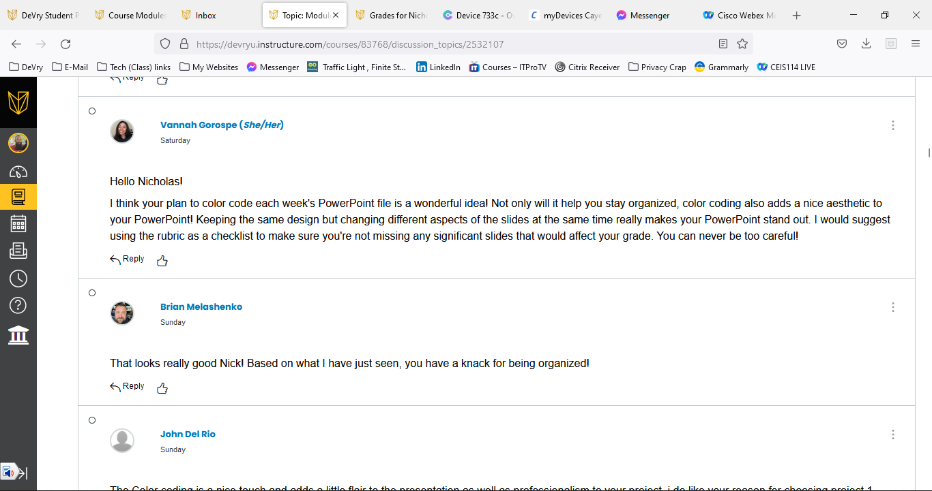
Feedback and Reflection

Slide 49
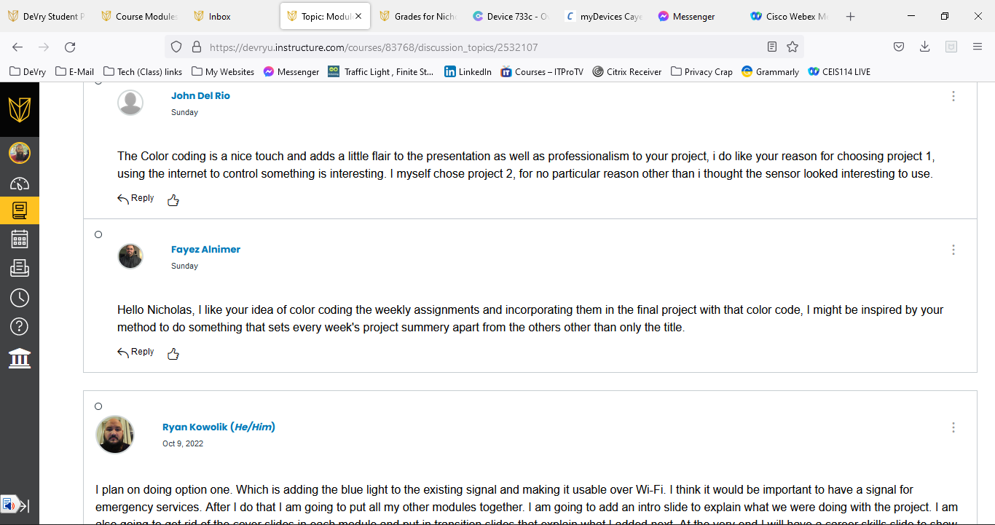
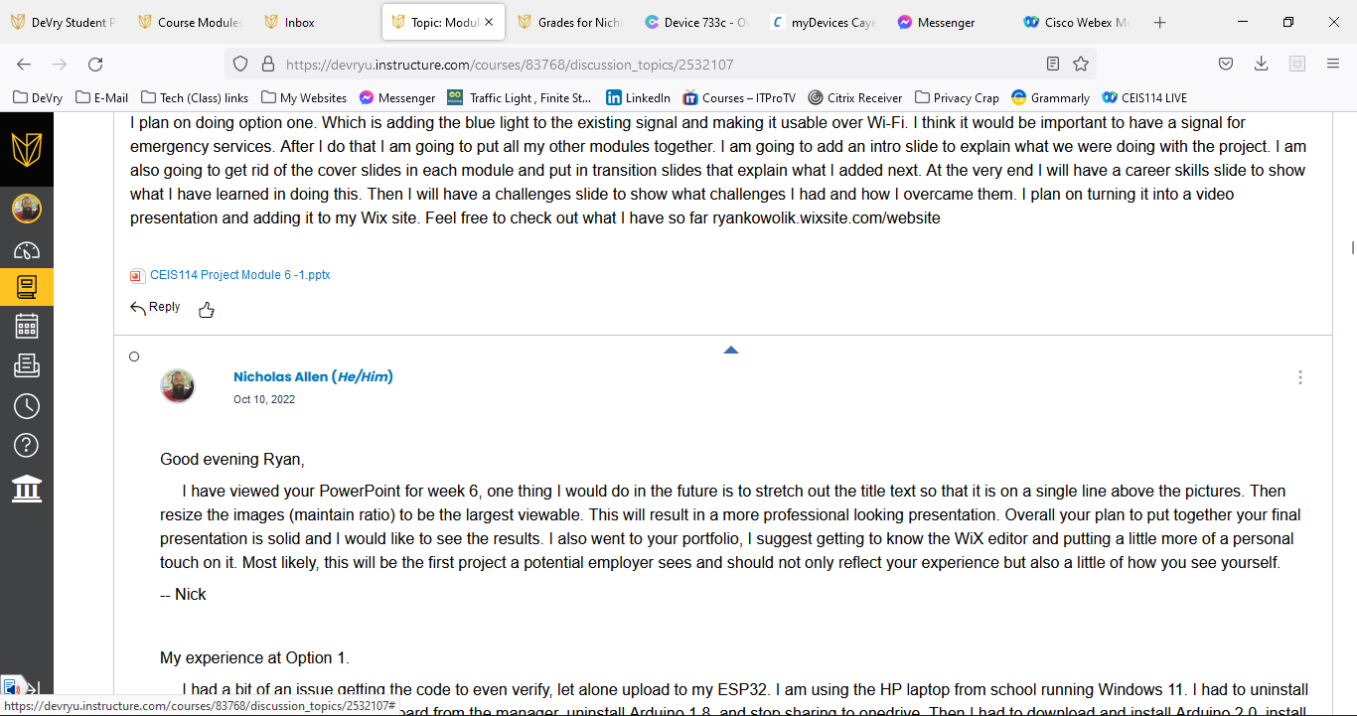
Feedback and Reflection

Slide 50
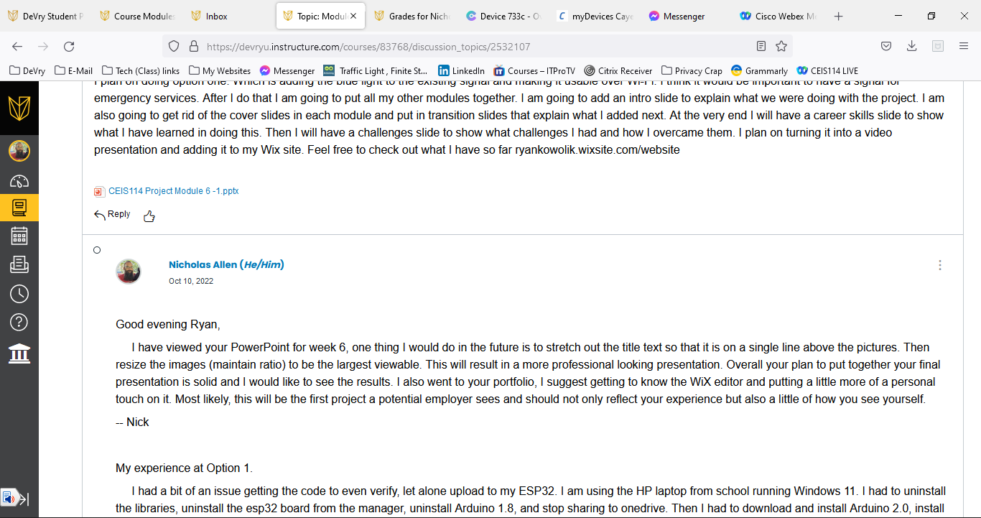
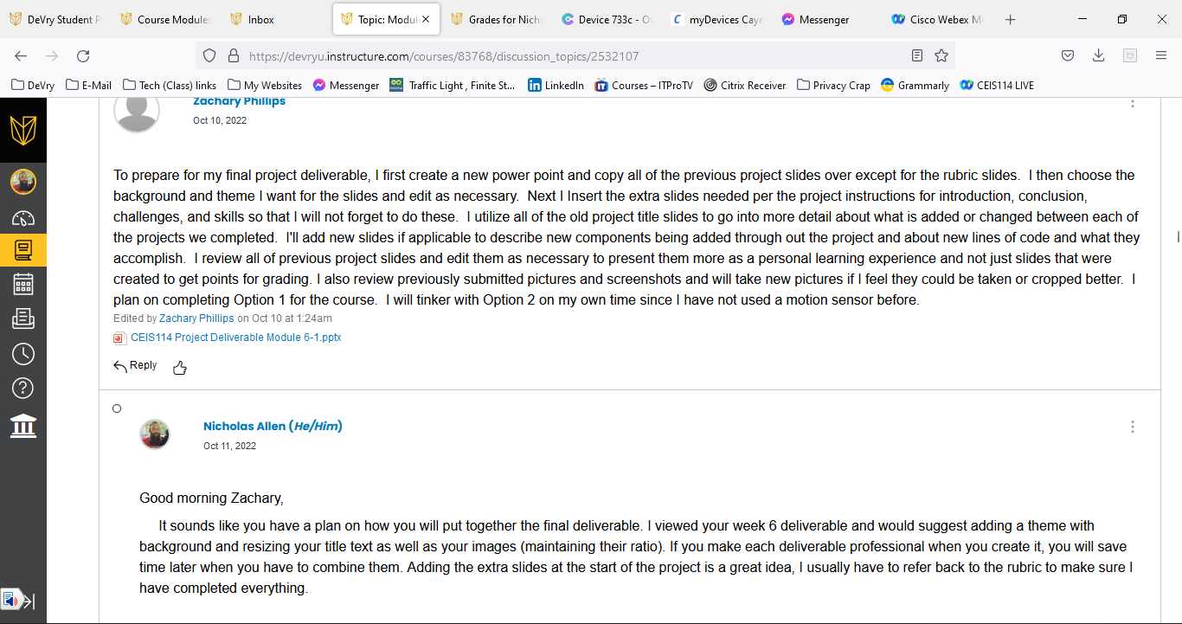
Feedback and Reflection

Slide 51
Challenges in the Project
The only challenges I encountered were with connections and wires except for trying to get the first rendition of the final project option 1 code. This was a pain to get going but I was successful. The new code seems to work a lot better and is way more responsive.

Slide 52
Career Skills I Developed During the Project
I learned how to connect a device to the internet and allow control.
I learned how to process through a project from planning to complete.
I learned about adding new features to a device in a series, small chucks are easier to debug and process.

Slide 53
Conclusion
I enjoyed this course. I learned quite a bit about adding features to a device, starting with the basic and adding each piece, one at a time. I think it would be cool to add a track to this with actual model cars to teach kids about traffic signals.

