Slide 1
Linux+ Certification Prep
CEIS106: Introduction to Operating Systems
JuLY – Aug 2022 Session
Prof. Rick Bird
Nicholas Allen
08/22/2022

Slide 2
Table Of Contents
Introduction To CEIS106
Week 1: Introduction to Linux
Week 2: Linux File System
Week 3: Linux Shell Scripts
Week 4: Linux Administration Tasks
Week 5: Networking
Week 6: Security, Troubleshooting, Performance
Weeks 7 & 8: Linux Careers and Course Finals
Challenges I Faced in This Course
How Linux can Advance My Career
Conclusion

Slide 3
Introduction to CEIS106
CEIS106 (Introduction to Operating Systems) is more Linux+ Certification training and prep for the COMPTia Linux+ Certification. I think this is fitting as most people use Windows on their home computers and may not have any experience in anything else. I have never used a Mac much, but I understand it’s UNIX derived. In this presentation we learn how to use the Linux operating system and prepare for the Linux+ Certification test from COMPTia.

Slide 4
Introduction to Linux
Week 1
In week 1 we learned about the different types of programs a computer executes, applications and operating systems, and focused down on the operating systems. We learned Linux history and the advantages of using Open-Source Software over closed source software as well as the install process for the Linux operating system.

Slide 5
LINUX Filesystem Hierarchy
Week 2
In week 2 we learned about the Linux Bash (Bourne Again SHell) shell and how to navigate the Linux file structure. We learned how to change directories, search for files or folders, and manipulate files and directories including their permissions.
Navigate the File Structure (Questions)
Create Directories and Files (Screen Shot)
Copy and Remove Directories and Files (Screen Shot)
Locate Directories and Files (Screen Shot)

Slide 6
Navigate the Linux filesystem tree
1. What is the pwd command an acronym for? What about the cd command?
Answer here:
pwd is an acronym for “Print Working Directory” and displays the directory you are currently in.
cd stands for “Change Directory” and is used with an argument to navigate the directory structure.
2. Explain the differences between a relative path and an absolute (full) path in Linux.
Answer here:
A relative path is linked to the directory you are currently in. A relative path can be either a “Parent” or a “Child” of the current directory. Parent directories are designated as a .. file, whereas Children always have names.
Absolute paths always start with the root, denoted as a / and can end with files or directories.
An example of an absolute path: /home/username/filename

Slide 7
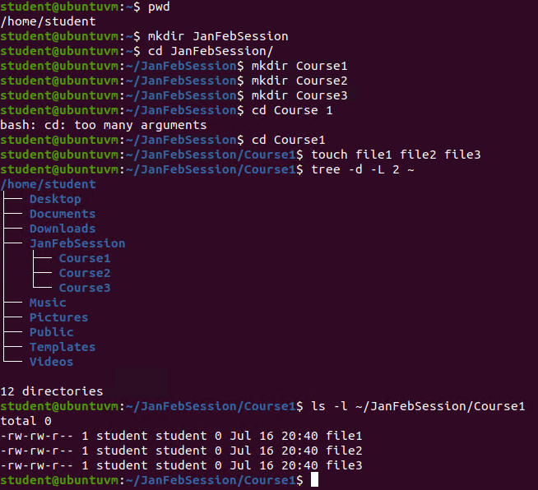
Create directories and Files

Slide 8
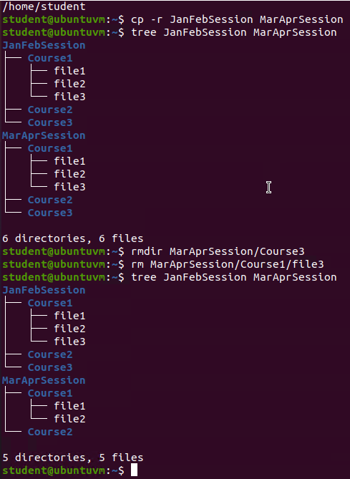
Copy and remove directories and files

Slide 9
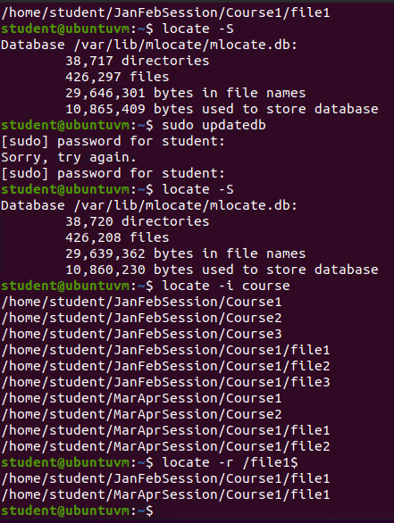
Locate Directories and Files

Slide 10
Linux Shell scripts
Week 3
In week 3 we learned about Linux shell scripts, what they are and how they function. We discussed at length the importance of knowing the “pipe” key and how it works to combine applications. We learned about other regular expressions and how we can use the “if else” “for” and “while” to create time saving scripts to increase production. We also learned the difference in programs waiting to run and processes currently running. And we learned about scheduling commands to run at future time and dates.
Create a Shell Script (Questions)
Change Script File Permissions (Screen Shot)
Set PATH Variable (Screen Shot)
Make PATH Variable Permanent (Screen Shot)

Slide 11
Create a shell script
1. What are the file permissions of the script?
Answer here: User has Read and Write permissions, Group as well as Other only has permissions to Read.
2. What’s the name of the user-defined variable in the script?
Answer here: The variable name is “text”
3. Which redirection meta-character is used in the script? What does it do?
Answer here: We use the >> redirection meta-character to append the file.
References:
1.No references needed

Slide 12
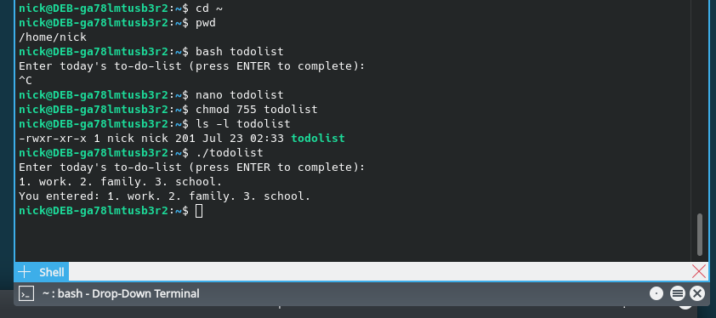
Change script file permissions

Slide 13
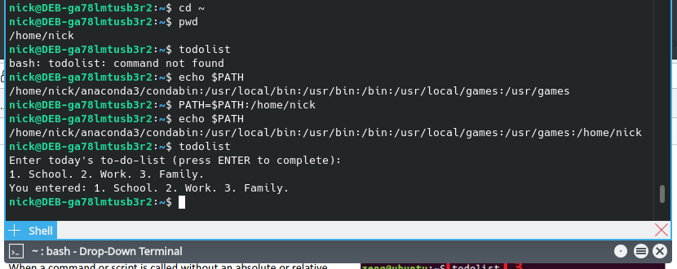
Set the PATH variable
I used my Debian setup instead of Azure Labs and do not have a user named student.
I used my home directory of /home/nick in place of /home/student.

Slide 14
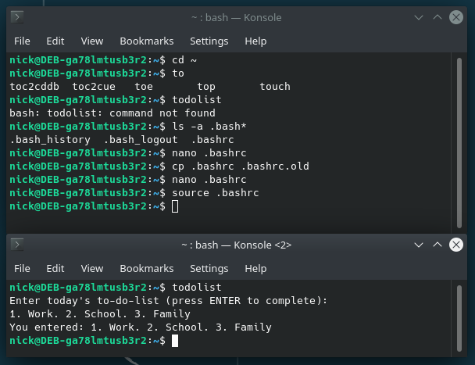
Make the PATH variable permanent
Run the todolist script before and after making the PATH variable permanent. Take a screenshot of both Terminal windows.

Slide 15
Linux Administration Tasks
Week 4
In week 4 we learned about setting up printers in Linux and the Common UNIX Printing System. We learned how to install software in Linux and discussed the common package managers (RPM, DPM, etc.). We learned about User and Group administration and how the Linux operating systems handles log files. We also learned about compression and archiving within Linux.
Add Users and Groups in CLI (Questions)
Test user and Group Settings (Screen Shot)
Add Users in GUI (Screen Shot)
Remove Users and Groups (Screen Shot)

Slide 16
Add users and groups in CLI
1. What does the –m option in the useradd command do?
Answer here: The -m is used to create the users home directory from the stored skeleton (/etc/skel).
2. What does the -3 option in the tail command do?
Answer here: Specifies that the tail command should only display the last 3 lines of the file.
3. Which line of the /etc/group file lists members of the “students” group? Copy it here.
Answer here: students:x:1004:nick,mary
References:
1. None needed

Slide 17
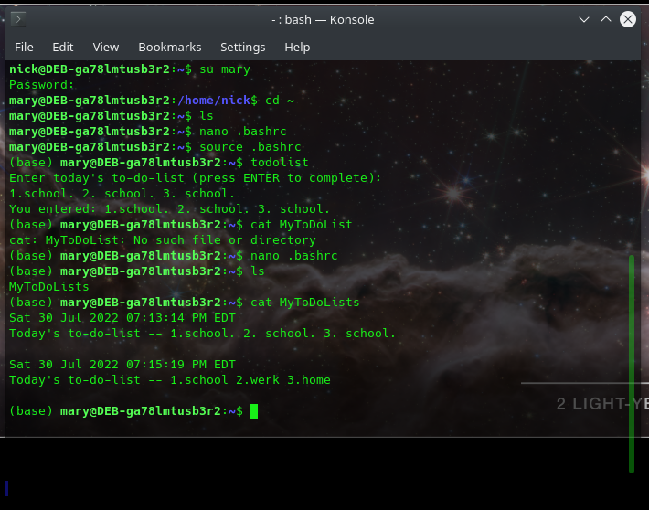
Test user and group settings

Slide 18
Add users in GUI

Slide 19
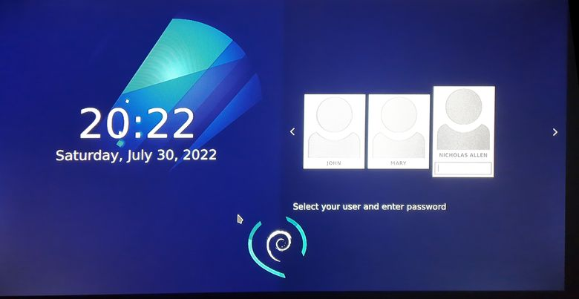
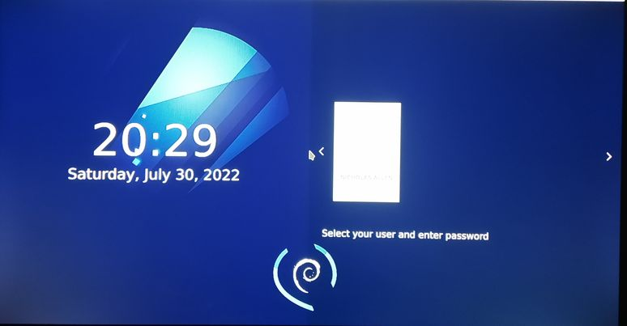
Remove users and groups
I used my Debian System; I could not get a screenshot of the Login Screen. These are images from my cell phone.

Slide 20
Networking
Week 5
Week 5 we learned about networking in the Linux operating system. This includes the pieces that make up networking like IP addresses, Gateway, etc. as well as the various settings and configuration files. We learned about Linux Network Services like DHCP, Email, HTTP, SSH, and others. We also discussed cloud and container technologies along with virtual machines.
Discover Host IP Configurations (Questions)
Discover Host IP Configurations (Screen Shot)
Manage Network Interfaces (Questions)
Use Network Utilities (Screen Shot)

Slide 21
Discover host IP configurations
1. What is the IP address of your Ubuntu machine?
Answer here: 192.168.1.104
2. What is the IP address of its default gateway?
Answer here: 192.168.1.1
3. What is the IP address of its DHCP server?
Answer here: 192.168.1.1
4. What is the IP address of its DNS server?
Answer here: 192.168.1.1

Slide 22
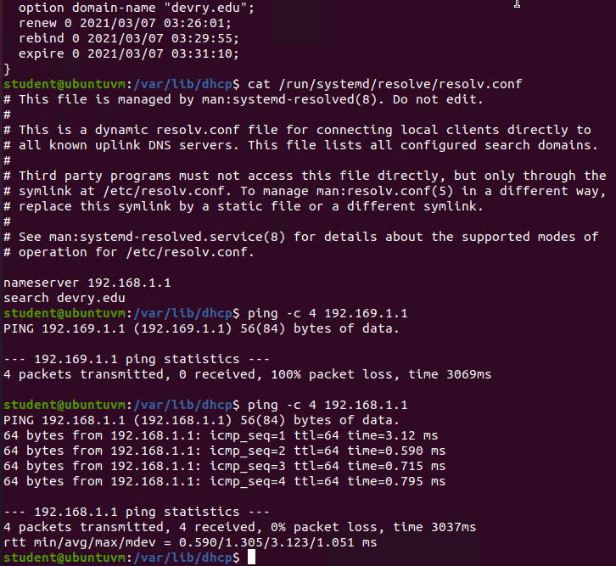
Discover host IP configurations

Slide 23
Manage network interfaces
1. Which DHCP message is shown in the output of the sudo dhclient –v –r eth0 command? [hint: the message name is in uppercase.]
DHCPRELEASE – Releasing the IP address back into the DHCP IPv4 pool
2. Which four DHCP messages are shown in the output of the sudo dhclient –v eth0 command? [hint: the message names are in uppercase.]
DHCPDISCOVER – Packet to see what DHCP servers are on the network
DHCPREQUEST – Requesting an IP address from the DHCP server
DHCPOFFER – Receiving an IP address offer
DHCPACK – Acknowledge the offer and accept the IP address for immediate use.

Slide 24
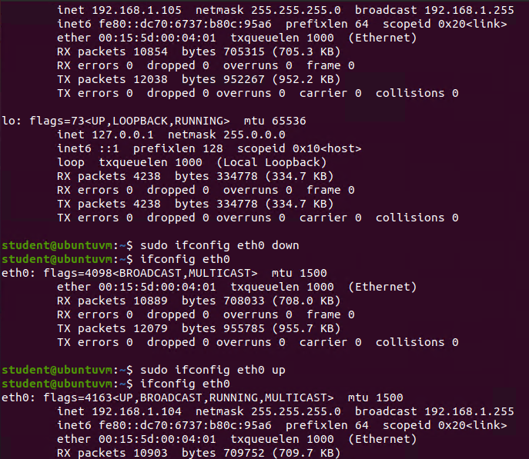
Use network utilities

Slide 25
Security, Troubleshooting, Performance
Week 6
In week 6 we learned how to keep a Linux server secure by limiting physical access and well as technological access. A few ways are monitoring physical access, keeping ports closed until needed, and reminding users to keep their passwords safe. We also learned about monitoring the system performance and system health.
Monitor Linux System Processes (Questions)
Monitor User Activities (Questions)
Monitor Network Bandwidth Usage (Screen Shot)

Slide 26
Monitor Linux system processes
1. What is the default action of the 15 SIGTERM kill signal?
Answer here: Kills the selected process.
2. In the System Monitor window, click on % CPU to sort the processes by CPU load. Which process shows the highest percentage of CPU usage?
Answer here: gnome-shell

Slide 27
Monitor user activities
Issue the sudo accton on command to turn on GNC accounting. Run the sudo updatedb command. Enter lastcomm updatedb to check if the updatedb command was executed before. Remember to turn off GNC accounting (sudo accton off) after answering the questions.
1. What flag value is displayed in the output?
Answer here: S for Super User
2. Why is the name of the user who ran the processes shown as root, not student?
Answer here: Because it was run as the Super User (assumed root for the single command)

Slide 28
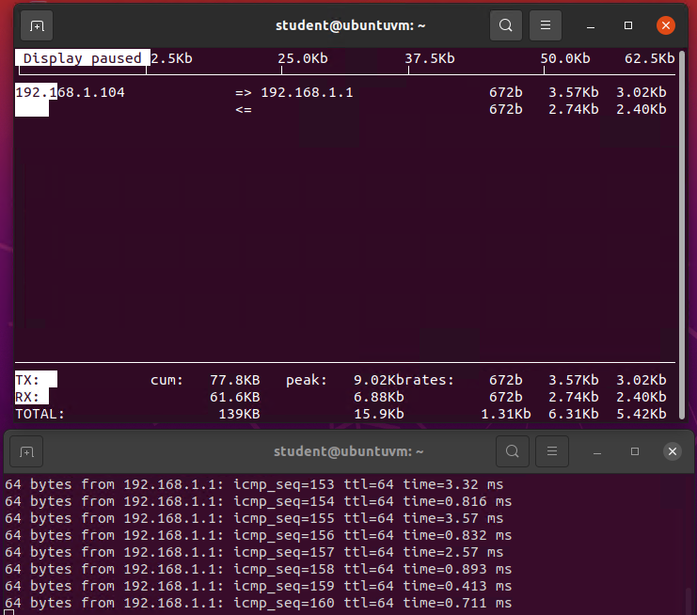
Monitor network bandwidth usage

Slide 29
Linux Careers and Course Finals
Week 7
In week 7 we discussed how the knowledge gained through this course and how the COMPTia Linux+ Certification will help in finding, maintaining and advancing in our selected careers. We watched ITProTV videos on Linux+ Certification and took a practice Linux+ Certification exam.
In week 8 we prepared this presentation, uploaded it to our portfolio, and continued to watch the ITProTV videos.
Week 8

Slide 30
Challenges I Faced In This Course
The only challenges I faced were because of being out of practice or difference in Linux “Flavor”. I am a fan of Debian and it’s offspring, nano over vi, KDE never gnome. I realize my preference might not be what my potential employer uses and therefore I need to know how and what the major distributions handle differently.

Slide 31
How Linux Can Advance My Career
Having the COMPTia Linux+ Certification listed on my resume will push my resume up the list. This opens many opportunities for success and helps get my “foot in the door.”
A few job titles are:
Linux Systems Administrator
Penetration Tester
Computer Forensics Specialist

Slide 32
Conclusion
I have used Linux off and on for many years now, however I still learned things in the class that I didn’t know. There were many things that I already knew as well. I feel this was a great refresh course for me as I had recently installed Linux on an older laptop just to play around with and drug out some older computers that needed updating. Passing the certification will be the confirmation to myself that I know what I am doing.
Thank you for checking out my project, I hope you enjoyed it.
-- Nicholas Allen

