Slide 1
CEIS101 Smart Home Security System
Created By Nicholas Allen
Arduino Mega 2560, Active Buzzer, LEDs, Photoresistor, Sonic Distance Sensor, Water Level Sensor, Digital Humidity and Temperature Sensor

Slide 2
Contents
Project Summary (Introduction) ---- Page 3
Module 2 (TinkerCAD Simulation) ---- Page 4
Module 3 (Inventory Of Parts) ---- Page 7
Module 4 (Door Sensor) ---- Page 12
Module 5 (Distance Sensor) ---- Page 17
Module 6 (Automated Light) ---- Page 23
Module 6 Challenge ---- Page 28
Follow Up---- Page 32

Slide 3
Project Summary (Introduction)
In this project we created a smart home system that could be used as an active security system. We learn to use the TinkerCAD website as well as the Arduino IDE and code.
We use the Arduino Mega 2560 along with other sensors to collect and use data, such as distance from the device using the ultrasonic sensor. If the sensor detects an object close enough it sounds the active buzzer and flashes the red LED. If the object blocks the light on the photosensor, the blue LED will turn on.
A list of components:
Arduino Mega 2560, Active Buzzer, several LEDs, Photoresistor, Sonic Distance Sensor, Water Level Sensor, Digital Humidity and Temperature Sensor (DHT-11), 10k resistor, some wires, full rail breadboard (the red + & blue - lines go full length and do not have a gap in the middle).

Slide 4
Module 2
TinkerCAD Project Simulation
Project Summary ---- Page 3
TinkerCAD Circuit Simulation (Screenshot) ---- Page 5
Project Code for TinkerCAD Simulation ---- Page 6
Module 3 ---- Page 7

Slide 5
TinkerCAD Simulation (Screenshot)

Slide 6
Code (screenshot)

Slide 7
Module 3
Inventory of Parts, Circuit Building, and Displaying Messages
Module 2 ---- Page 4
IOT Kit Inventory ---- Page 8
Project Component Inventory ---- Page 9
Circuit With Red LED On ---- Page 10
Screenshot of Serial Monitor ---- Page 11
Module 4 ---- Page 12

Slide 8
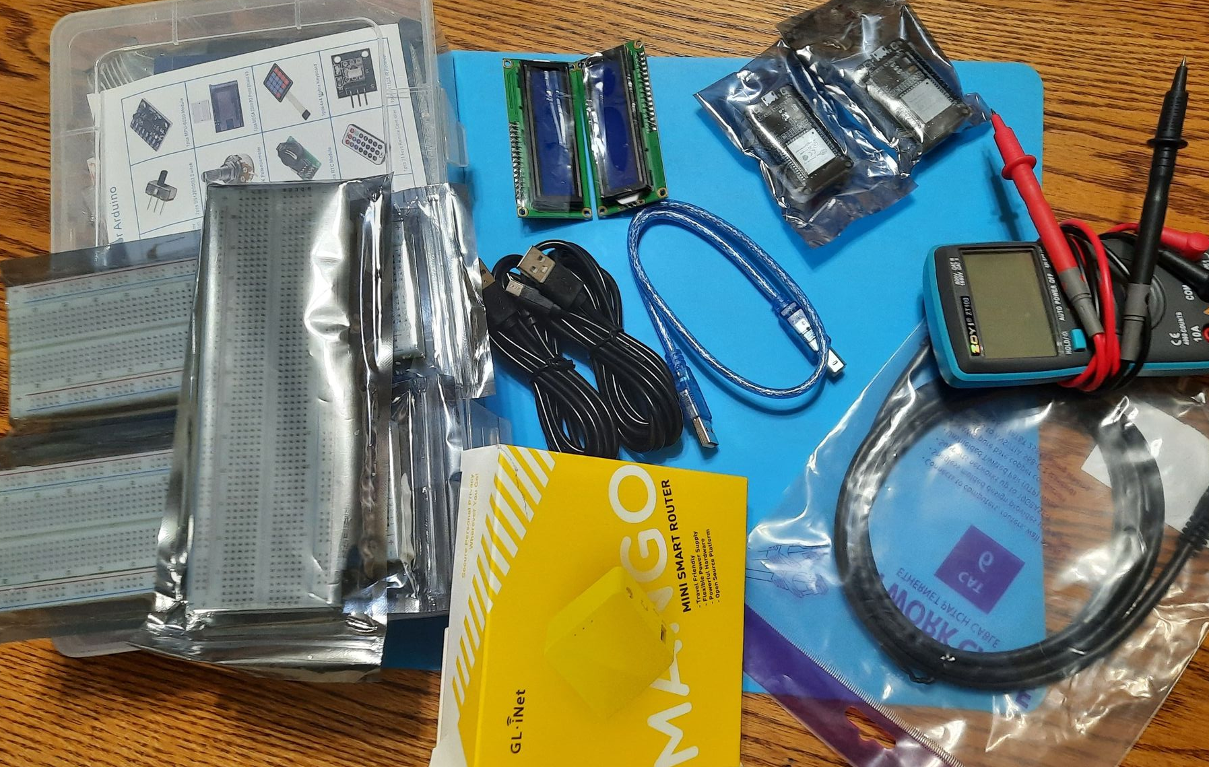
Inventory of IoT Kit (picture)
UCTRONICS Kit
ESP32 (2)
LCD Modules (2)
Breadboards (3)
Mini Router
Patch Cable
Digital Multi Meter
USB to Micro USB (2)

Slide 9
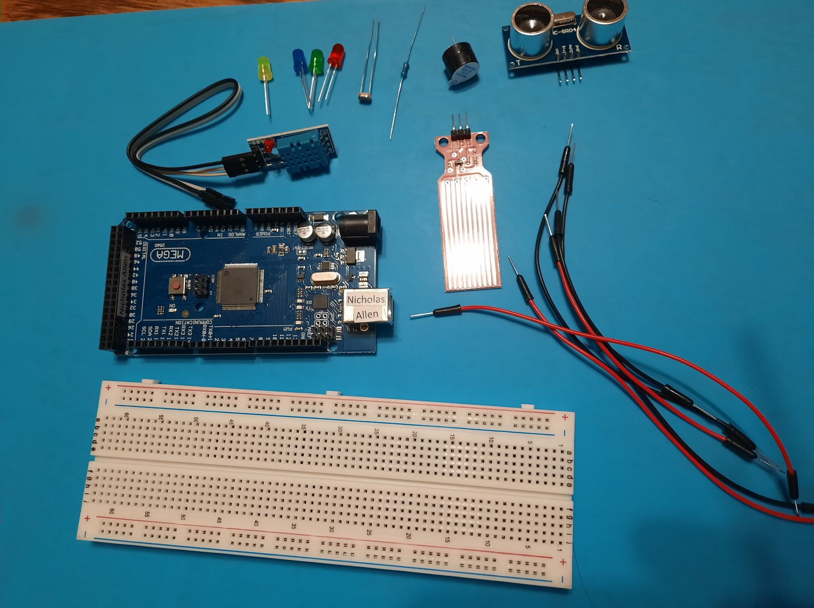
Organization of Project Components (picture)
Arduino Mega 2560
Breadboard
Resistor 10kΩ
LEDs
Ultrasonic Sensor
Active Buzzer
Photoresistor
Wires
USB Type B cable

Slide 10
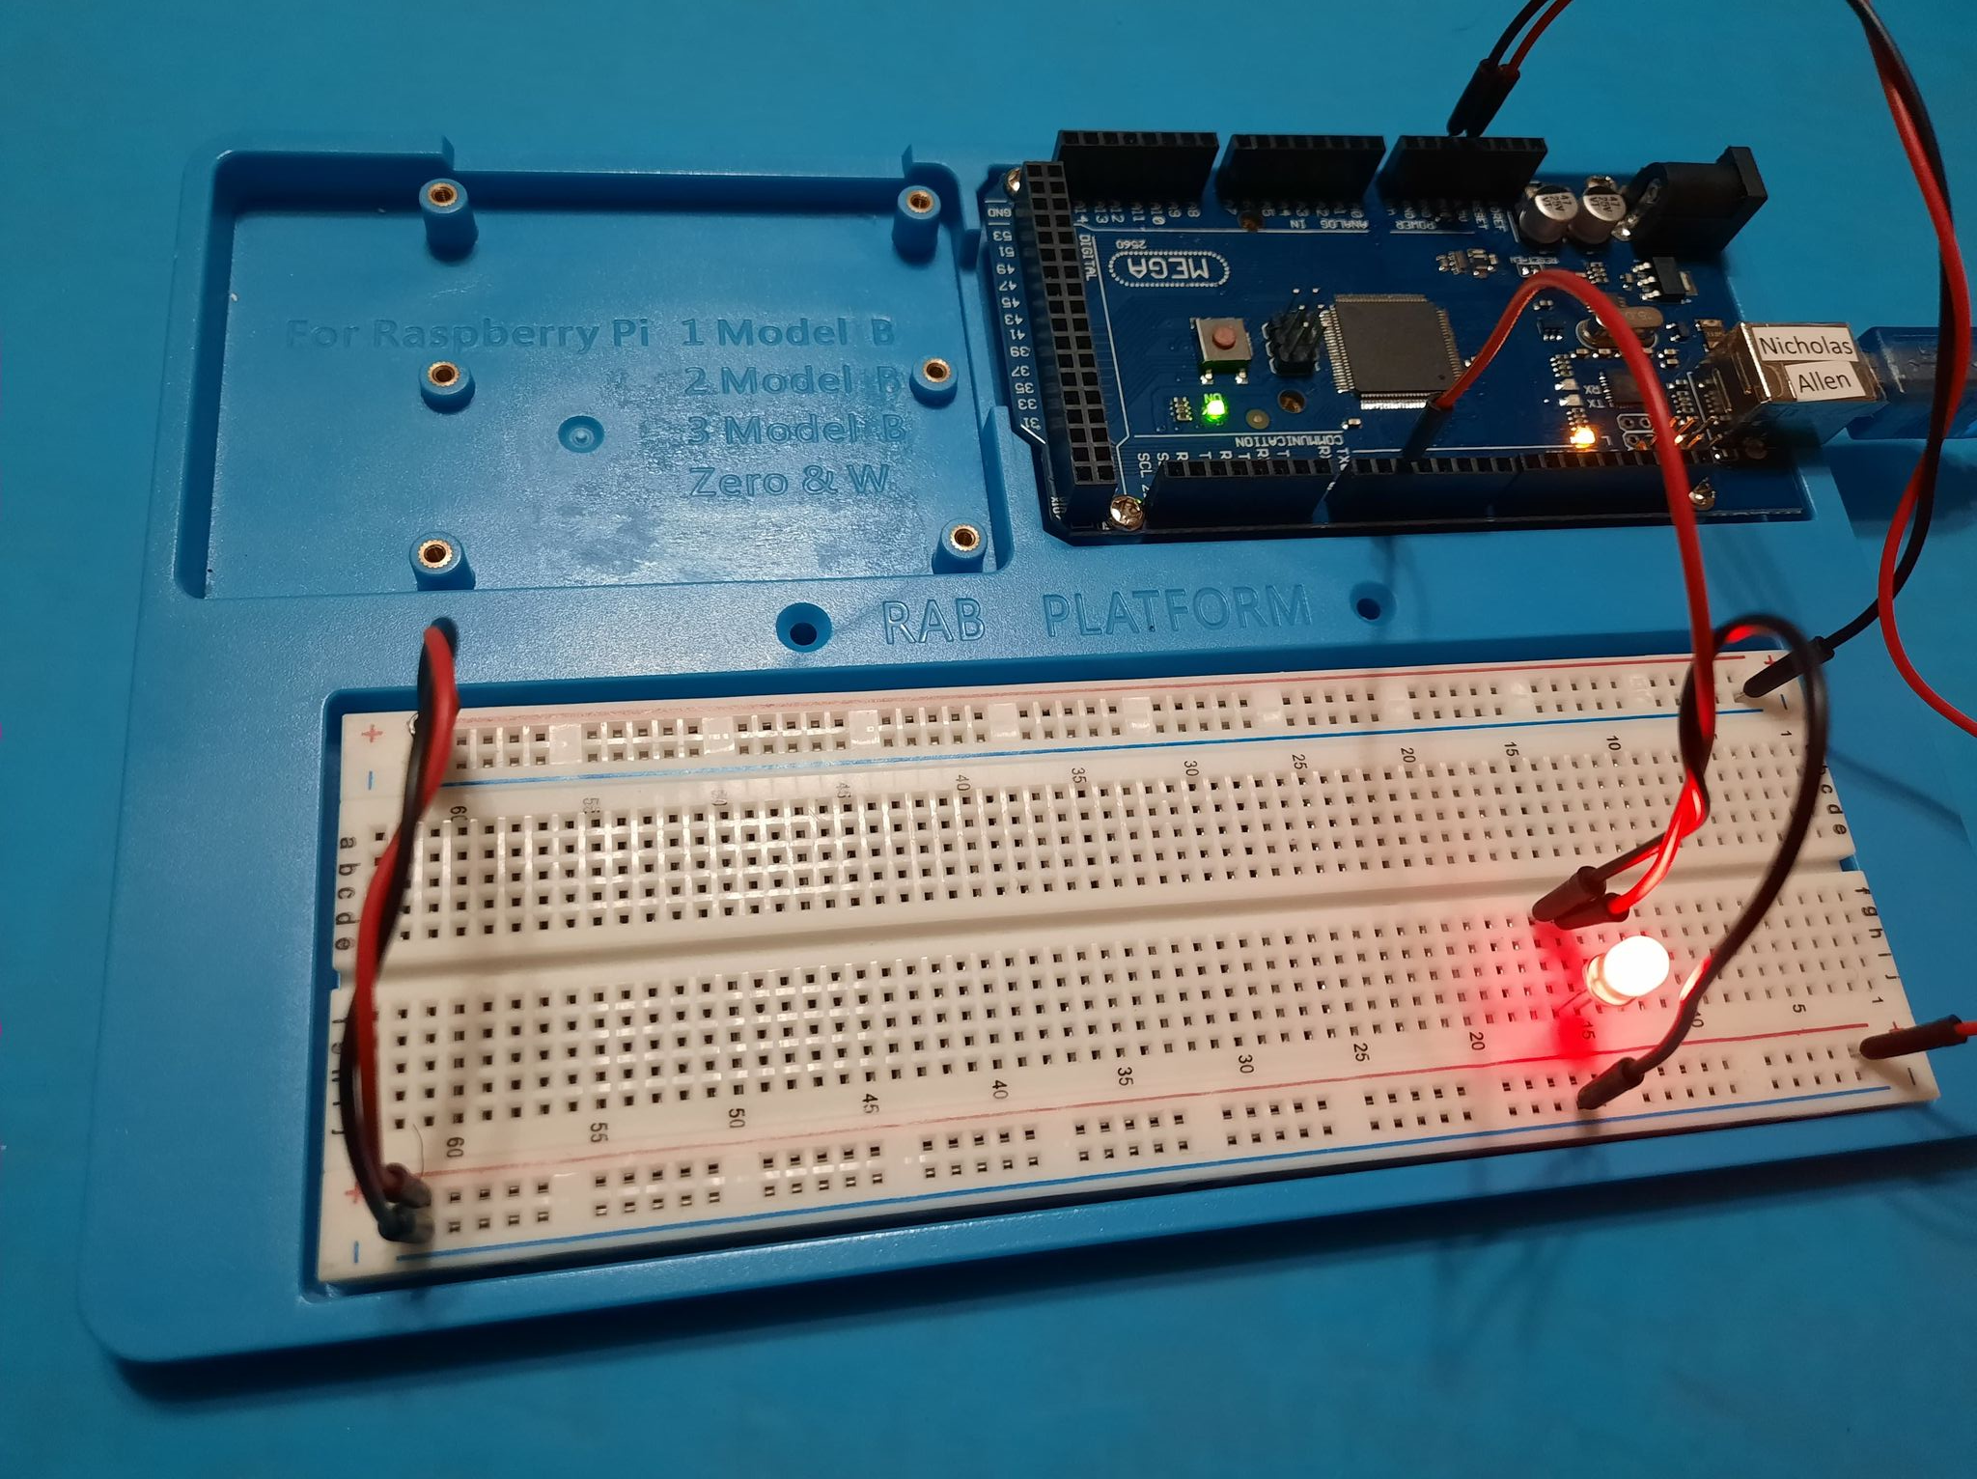
Circuit with red LED on (picture)

Slide 11
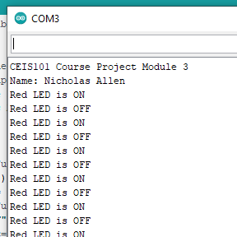
Serial Monitor (screenshot)

Slide 12
Module 4
Adding Door Sensor to Smart Home System
Module 3 ---- Page 7
Circuit w/ Simulated Door Closed w/ Green LED On ---- Page 13
Circuit w/ Simulated Door Open w/ Green LED Off ---- Page 14
Arduino Source Code (Screenshot) ---- Page 15
Serial Monitor (Screenshot) ---- Page 16
Module 5 ---- Page 17

Slide 13
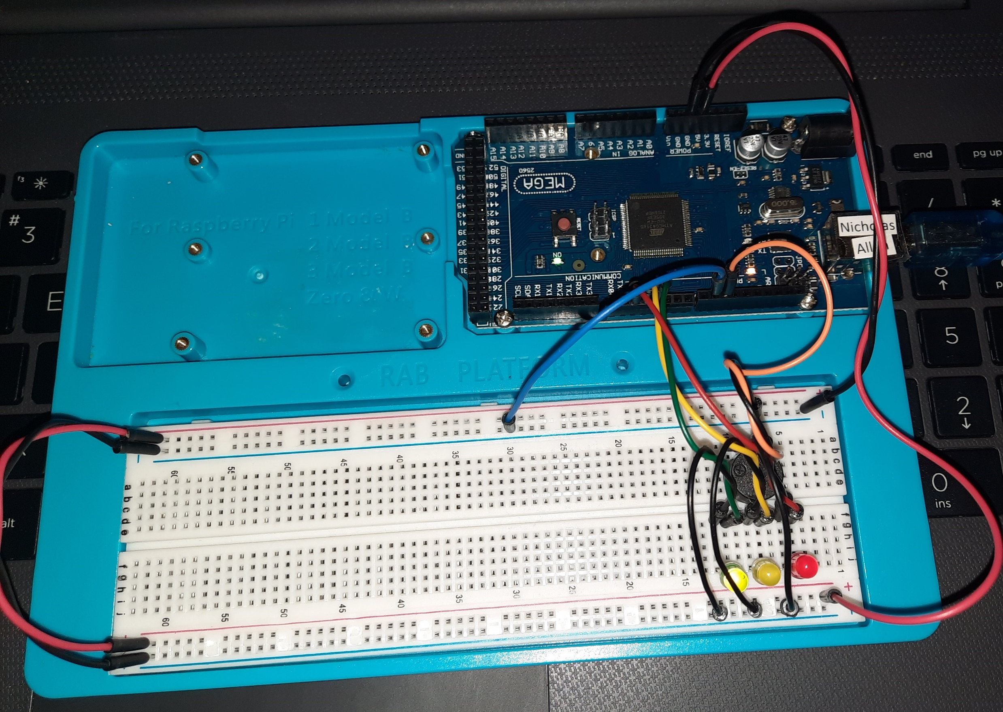
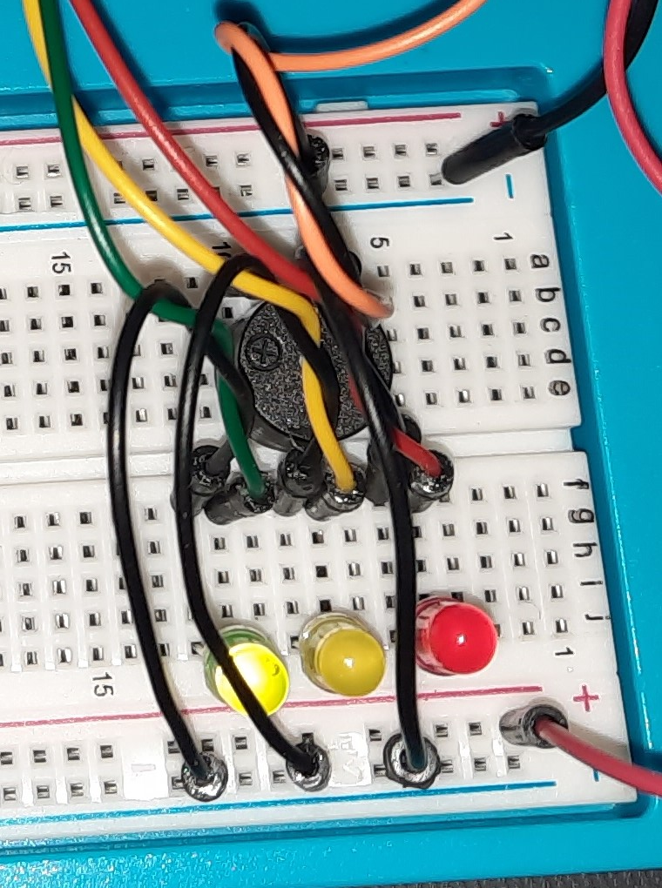
Circuit of door closed with Green LED ON (picture)

Slide 14
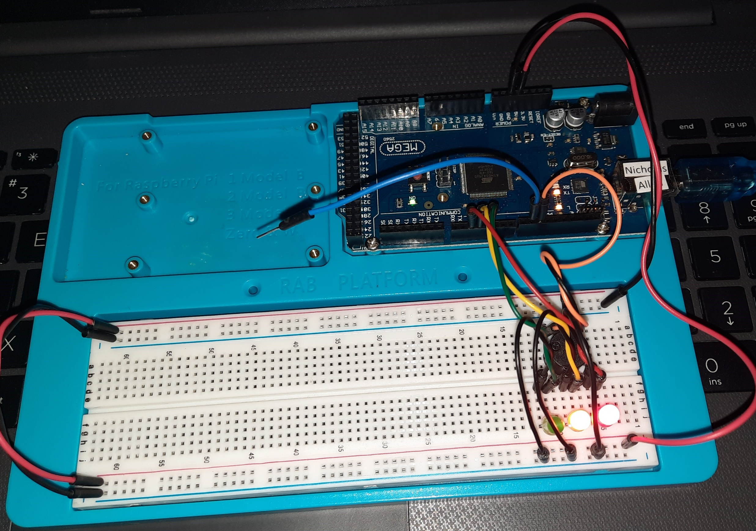
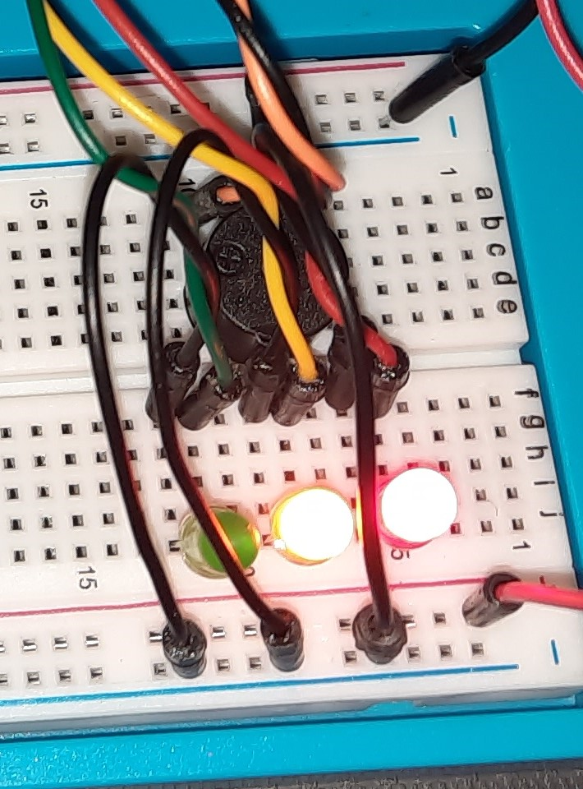
Circuit of door open with Green LED OFF (picture)

Slide 15
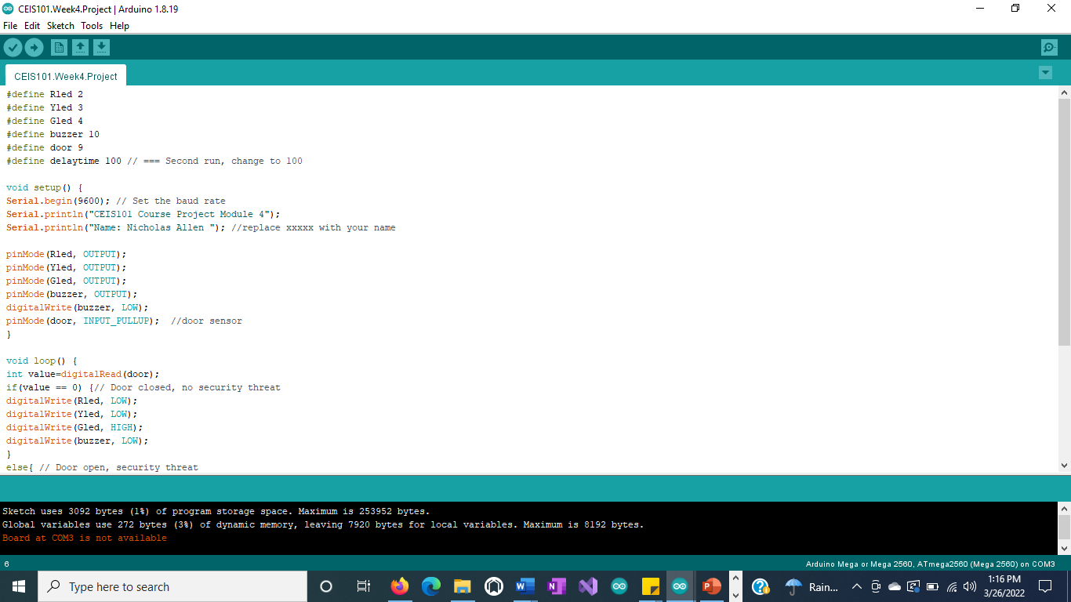
Arduino Code (screenshot)

Slide 16
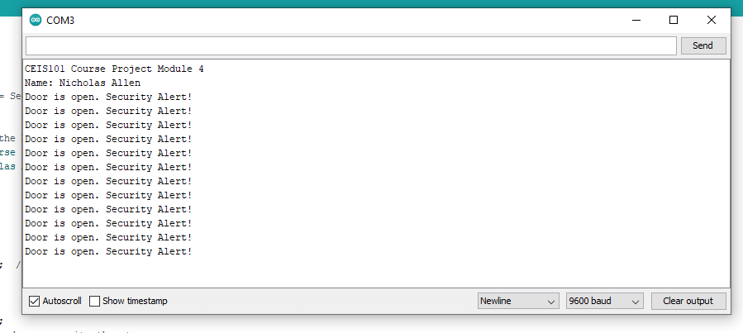
Serial Monitor (screenshot)

Slide 17
Module 5
Adding Distance Sensor to Smart Home System and Conducting Data Analysis
Module 4 ---- Page 12
Circuit w/ Green LED On ---- Page 18
Circuit w/ Yellow LED On ---- Page 19
Circuit w/ Red LED On ---- Page 20
Arduino Source Code (Screenshot) ---- Page 21
Data Analysis (Graph of Sensor Data) ---- Page 22
Module 6 ---- Page 23

Slide 18
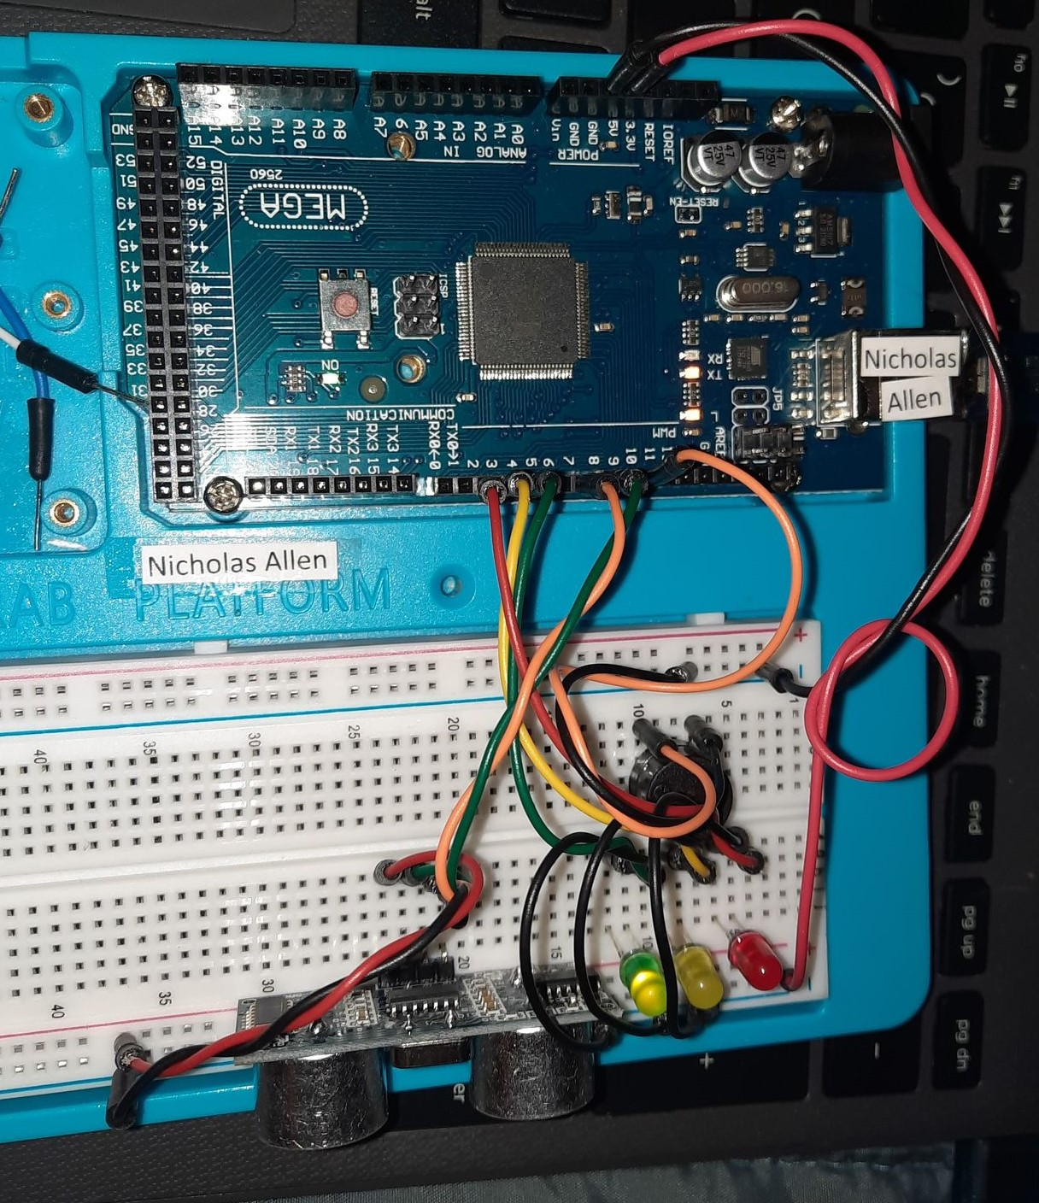
Circuit with green LED on (picture)

Slide 19
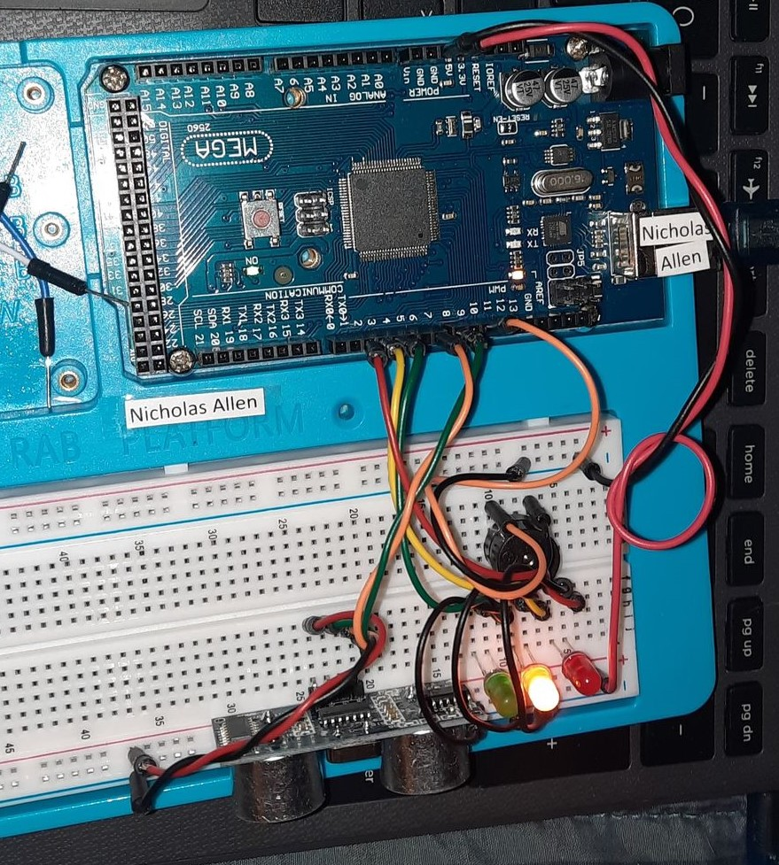
Circuit with yellow LED on (picture)

Slide 20
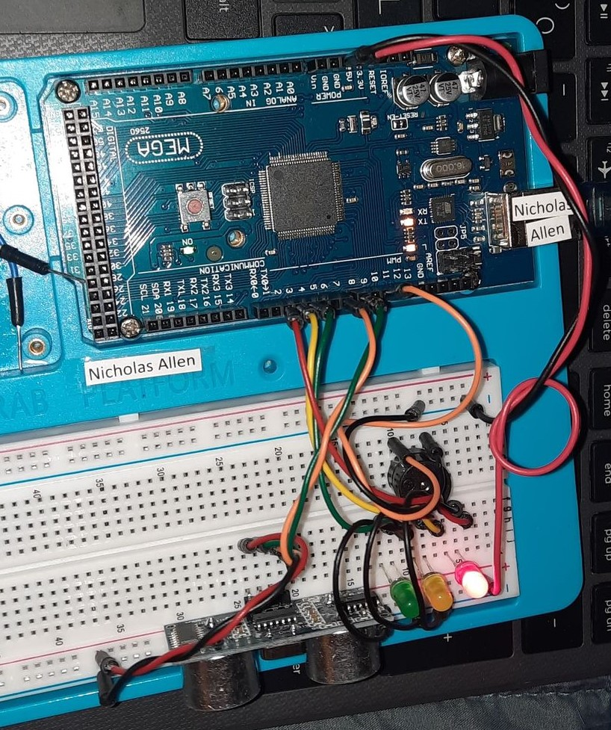
Circuit with red LED on (picture)

Slide 21
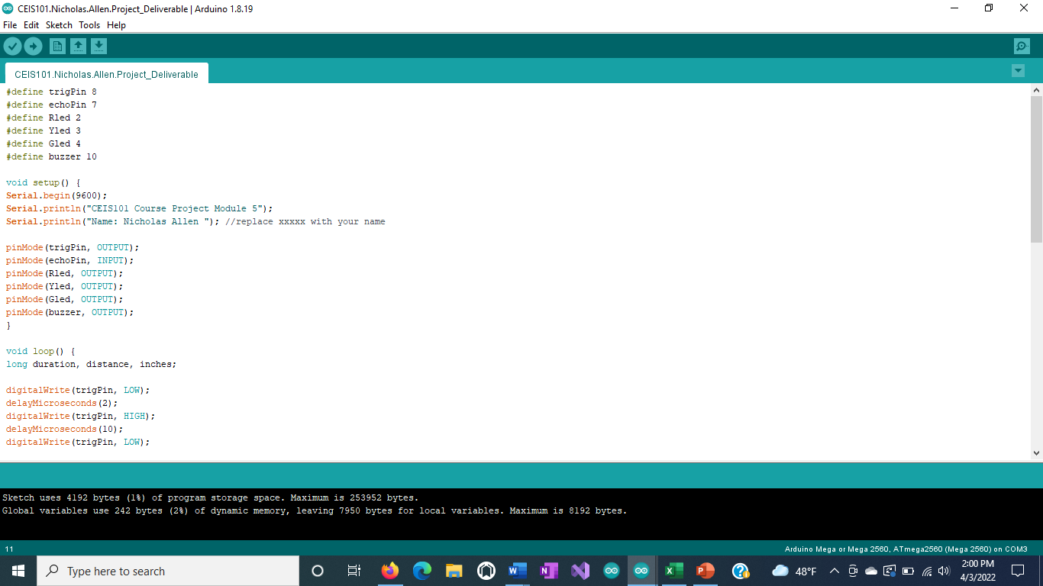
Arduino Code (screenshot)

Slide 22
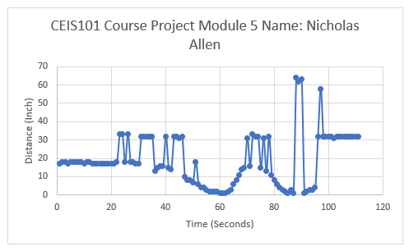
Plot of data (graph from Excel)

Slide 23
Module 6
Adding Automated Light to Smart Home System
Module 5 ---- Page 17
Circuit w/ Automated Blue LED Off ---- Page 24
Circuit w/ Automated Blue LED On ---- Page 25
Arduino Source Code (Screenshot) ---- Page 26
Serial Monitor (Screenshot) ---- Page 27
Module 6 Challenge ---- Page 28

Slide 24
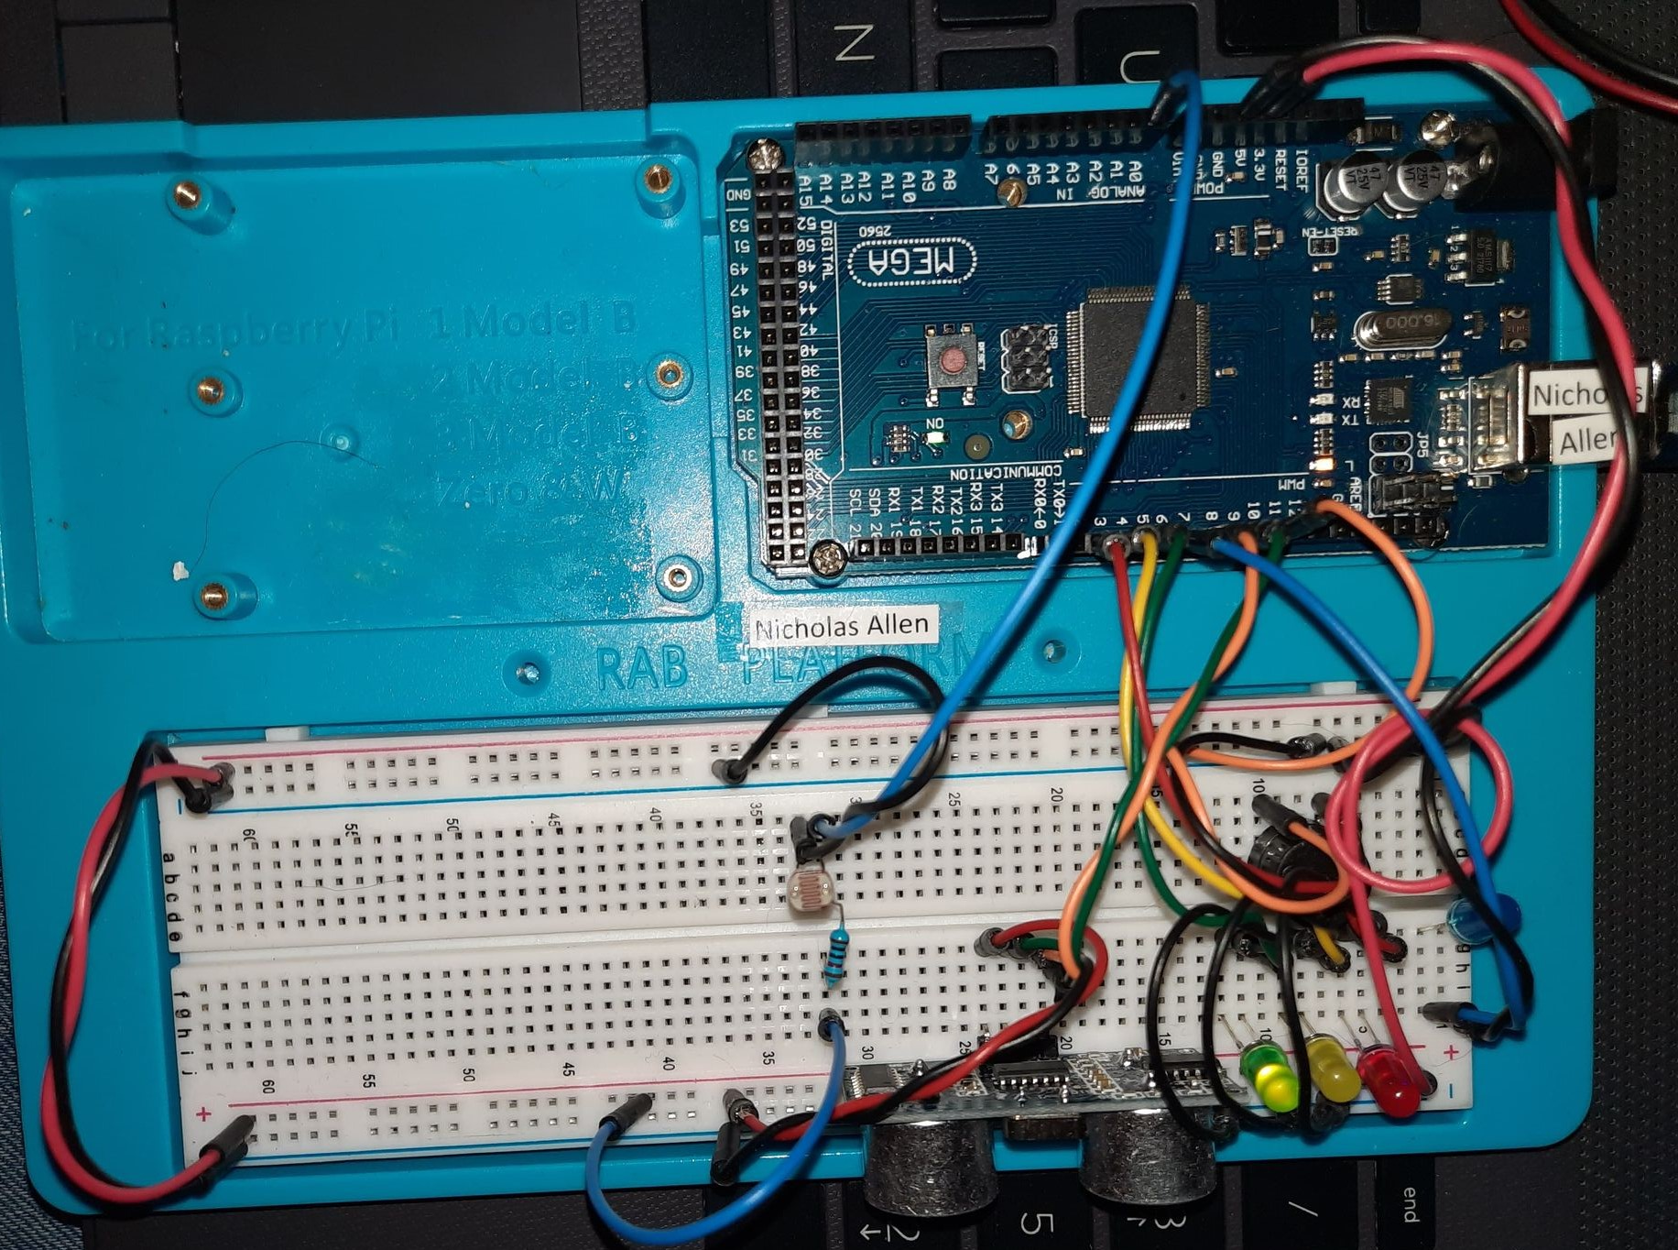
Circuit with automated LED off (picture)

Slide 25
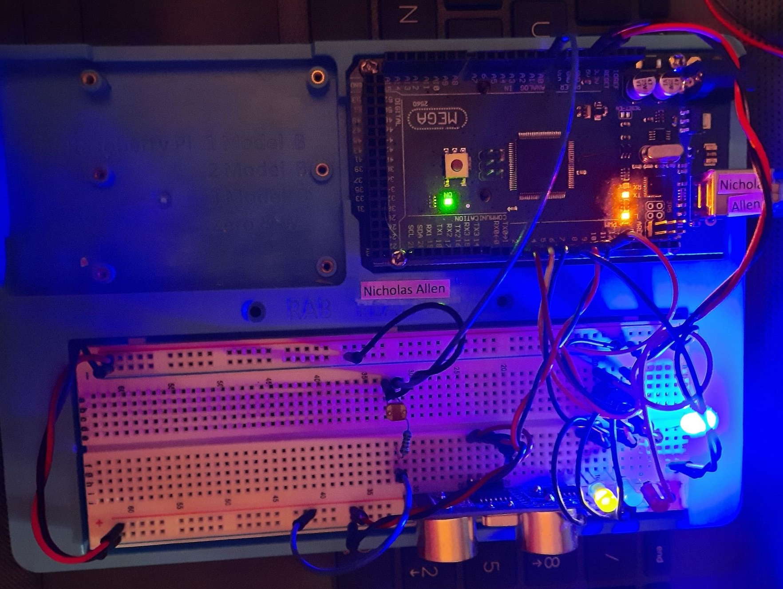
Circuit with automated LED on (picture)

Slide 26
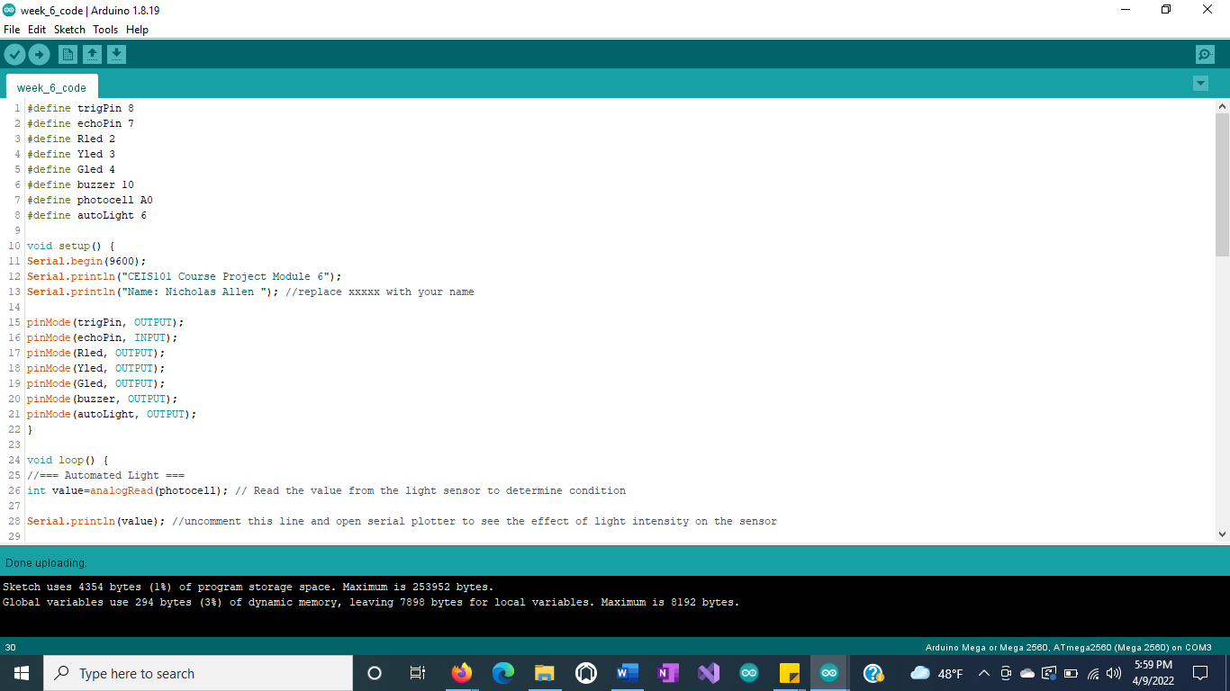
Arduino Code (screenshot)

Slide 27
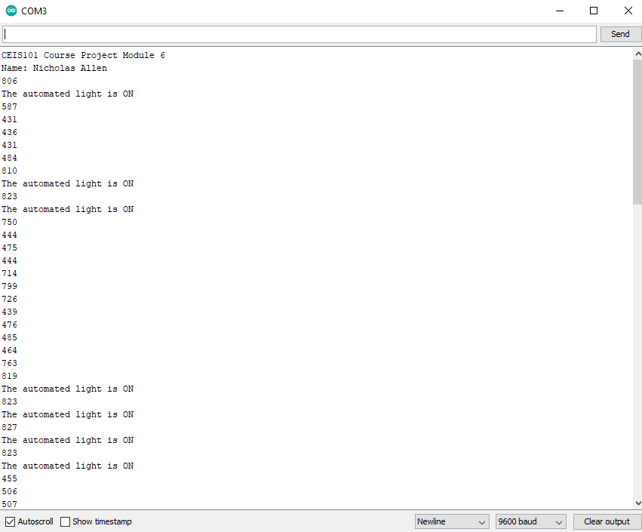
Serial Monitor (screenshot)

Slide 28
Module 6 Challenge
Adding DHT-11 and Water Level Sensor
Module 6 ---- Page 23
Circuit w/ Water Sensor & DHT-11 Sensor ---- Page 29
Arduino Code (Screenshot) ---- Page 30
Serial Monitor(Screenshot) ---- Page 31
Follow Up ---- Page 32

Slide 29
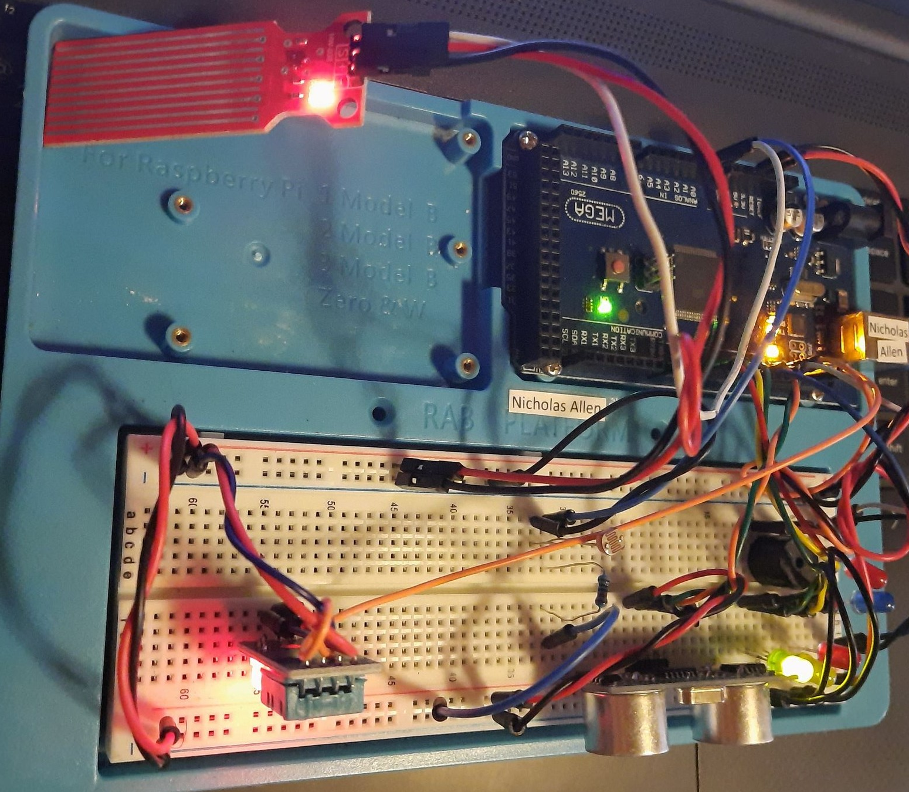
Circuit with Water Sensor and DHT-11 (picture)

Slide 30
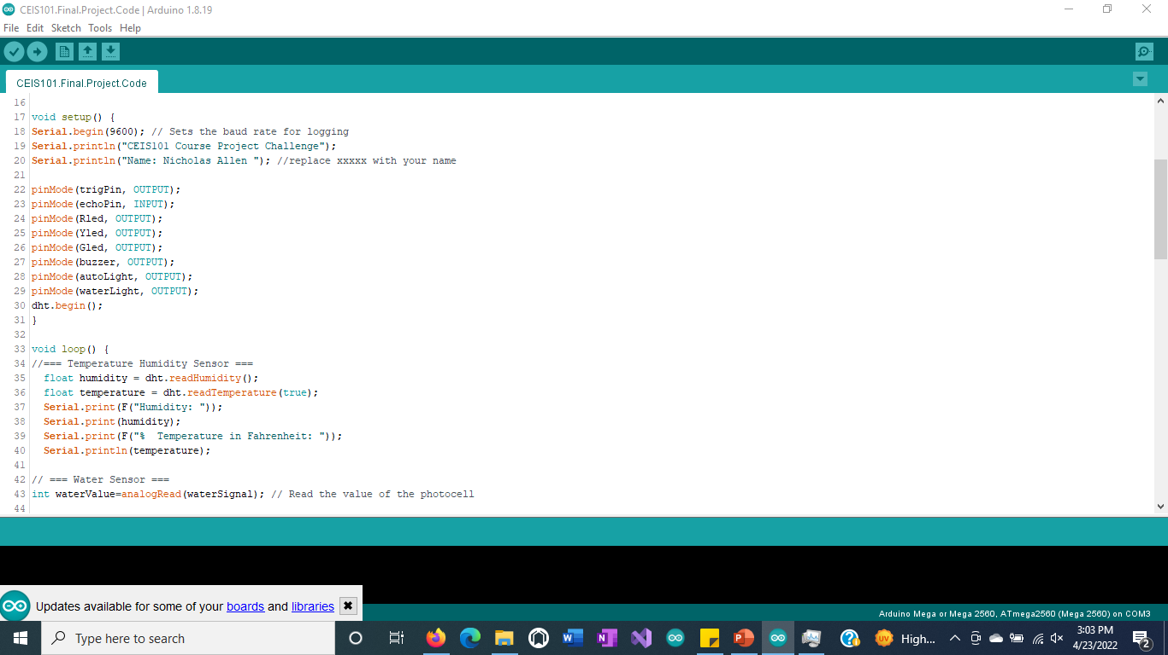
Arduino Code (screenshot)

Slide 31
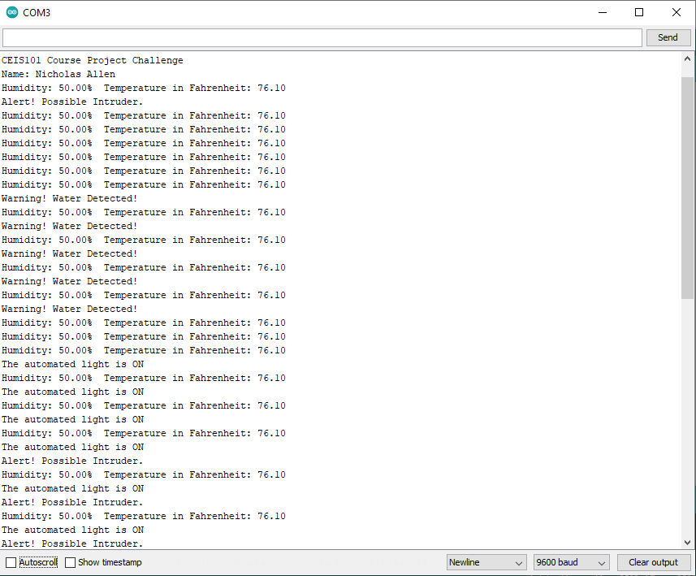
Serial Monitor (screenshot)

Slide 32
Follow up
Module 6 Challenge ---- Page 28
Project Challenges ---- Page 33
Skills ---- Page 34
Conclusion ---- Page 35

Slide 33
Project Challenges
I challenged myself to make my project as comprehensible as I could. Keep all my wires together in sets and my footprint small.
I was able to complete my project, as well as the end of class challenge, with no issues of errors.
The only technical issue I ran into during this project was the photoresistor sensitivity. Once I figured out how to adjust it’s sensitivity, I was able to correct the setting and make the project function as designed.

Slide 34
Skills
Skills that I believe I gained from this project are
Confidence in my abilities to create prototypes with Arduino.
Understanding of prototypes and IOT devices and their applications.
Basic programming skills.
IOT Device Design.

Slide 35
Conclusion
Thank you for looking at my project.
This is my first Arduino project but not the last.
I learned how to use a lot of sensors as well as programming the Arduino Mega 2560 through the Arduino IDE.
I think including a LED screen to display the humidity and temperature, as well as other data, to be used in conjunction with the current project would be an awesome addition.

